Slide 1
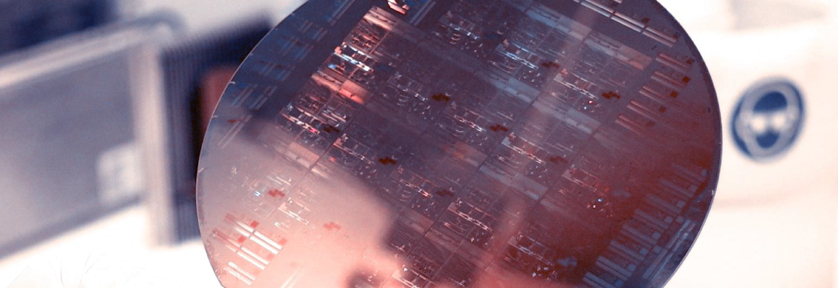
Lab Book 1. Waveguides
Student:

Slide 2
Instructions General
SOFTWARE
Python notebook supplied by instructors
SCRIPTS
From poliformat → download the 010_MODESOLVER_v2025_Student.ipynb
Either run locally or at Google Collaboratory
We are going to work with different Cross-Sections. In general, we will need: Materials definitions and the Geometrical parameters of each Cross-section.
W (width)
W (width)
Core
Core
h_core
h
(height)
Cladding
Cladding
Slab
XY Cross-section
h_slab
deep waveguide
shallow waveguide

Slide 3
Learning outcome #1 – Effective index of a waveguide
INSTRUCTOR:
Present Python and GDSFactory: materials, output, results.
Explain how to run a simulation for a particular cross-section.
Showcase how to change between shallow and deep waveguide.
Describe how to change the wavelength and width for the waveguide analysis.
Describe the outputs.
ALL EXAMPLE #1: waveguide width 1.2 µm, deep wvg, wavelength start and end same 1.55 µm → all ”Run”
ALL: Follow instructor, that will show how to 1) plot mode, 2) explore the results (neff …)
Document all your results (neff, plot fields of different modes, comparison between different polarizations…)

Slide 4
Learning outcome #2 – Wavelength behavior Wavelength 1.5-1.6 µm (step 0.02 µm) – width 1.2 µm
shallow waveguide
Paste plot here
deep waveguide
Paste plot here
slab = 150nm
Comment results (neff changes this way with wavelength, comparison between different waveguide cross-sections …)

Slide 5
Learning outcome #3 – Width dependence Width 0.6 - 1.6 µm (step 0.1 µm) – Wavelength 1.55 µm
deep waveguide
Paste plot here
Comment results (neff changes this way with wavelength, comparison between different waveguide cross-sections …)

Slide 6
Learning outcome #4 – Waveguide compact model Let’s model the waveguide using a second order polynomial: $$n_{eff}\left(λ\right)=n_{1}+n_{2}\left(λ−λ_{0}\right)+n_{3}{\left(λ−λ_{0}\right)}^{2}$$
deep waveguide
neff_TE0 vs $λ$ with the second-degree polynomial fit
& neff_TM0 vs $λ$ with the second-degree polynomial fit
shallow waveguide
neff_TE0 vs $λ$ with the second-degree polynomial fit
& neff_TM0 vs $λ$ with the second-degree polynomial fit
slab: 150nm
Find the second-degree polynomial coefficients and relate them with the group index and the dispersion parameter. $\left\{\begin{aligned}n_{eff}=n_{1} \\ n_{g}=n_{1}−n_{2}λ_{0} \\ D=−\frac{2λ_{0}n_{3}}{c}\left[\frac{s^{2}}{m}\right]\end{aligned}\right.$
Comment on the results found for the TE0 and TM0 for both deep and shallow waveguides.

Slide 7
Learning outcome #5 – Bend waveguide radius vs. loss – deep Find neff_TE0 for wvl 1.55 µm, width 1.0 µm for R=25,50,75,100, 125,150 µm
deep waveguide
Paste dB/90º neff_TE0 & neff_TM0 vs R
$α\left[\frac{dB}{90°}\right]=$ $R\frac{π}{2}α\left[\frac{dB}{µm}\right]$
Comment results, which is the safe radius, consider safe means less than 0.1 dB/90º.
What if you perform the same analysis for shallow waveguides?

Slide 8

Thank you

