Slide 1
SMS Spam Classifier
using Machine Learning
Submitted By:
Hiba Faiq [24k-0781]
Ruba Jamshed[24k-0950]
Atta Ur Rehman[24k-0969]
Course: AI lab
Instructor: Atif Luqman

Slide 2
Problem Statement
Mobile users receive many unwanted SMS messages
These include:
Advertisements
Fraud / phishing messages
Manual filtering is:
Time-consuming
Inefficient
👉 Problem: Automatically detect spam messages

Slide 3
Proposed Solution
Build an AI-based SMS Spam Classifier
Input: SMS message
Output:
Spam ⚠️
Not Spam ✅
👉 Uses Machine Learning + NLP

Slide 4
Algorithm Used
Multinomial Naive Bayes
Why this algorithm?
Works well for text classification
Fast and efficient
Handles word frequencies
Basic Idea:
Calculates probability of message being spam
Based on words in the message

Slide 5
System Workflow
Data Processing
What happens here:
You load the dataset using Pandas
You convert labels into numbers:
Spam = 1
Ham = 0
Why needed:
Machine learning models don’t understand text labels, only numbers.
Flow:
SMS → Preprocessing → Vectorization → Model → Prediction

Slide 6
Feature Extraction
Example:
Message: “Win money now”
Becomes something like: [win=1, money=1, now=1]
Why important:
👉 This is how text becomes usable for ML
Key concept: CountVectorizer (Bag of Words)
What it does:
Converts text into numbers
Counts how many times each word appears

Slide 7
Model Training
What happens:
Data is split:
80% training
20% testing
Model learns from training data
Why important:
👉 Model learns patterns like:
“free”, “win”, “prize” → spam

Slide 8
Confusion Matrix
 | Predicted Ham | Predicted Spam
Actual Ham | TN | FP
Actual Spam | FN | TP
Meaning:
TP (True Positive): Spam correctly detected
TN (True Negative): Ham correctly detected
FP (False Positive): Ham wrongly marked spam
FN (False Negative): Spam missed
“Confusion matrix helps us understand how well the model is performing by showing correct and incorrect predictions.”

Slide 9
Performance Metrics
✅ 1. Accuracy
Overall correctness
Formula: (TP + TN) / Total
👉 “Out of all messages, how many were correct?”
✅ 2. Precision
How many predicted spam are actually spam
Formula: TP / (TP + FP)
👉 Important when you want fewer false alarms

Slide 10
✅ 3. Recall
How many actual spam were detected
Formula: TP / (TP + FN)
👉 Important when you want to catch all spam
✅ 4. F1 Score
Balance between precision and recall
Formula: 2 × (Precision × Recall) / (Precision + Recall)
“These metrics help evaluate model performance. Precision focuses on accuracy of spam predictions, recall focuses on catching all spam, and F1 score balances both.”

Slide 11
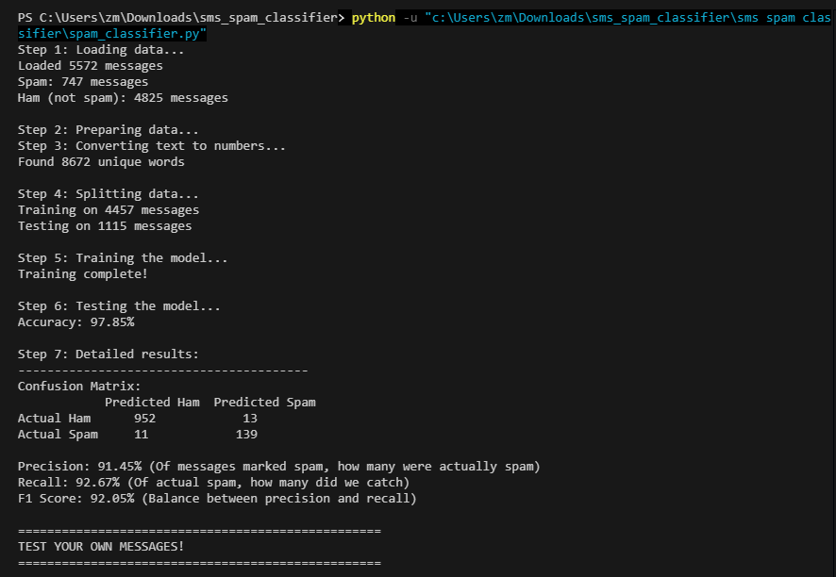
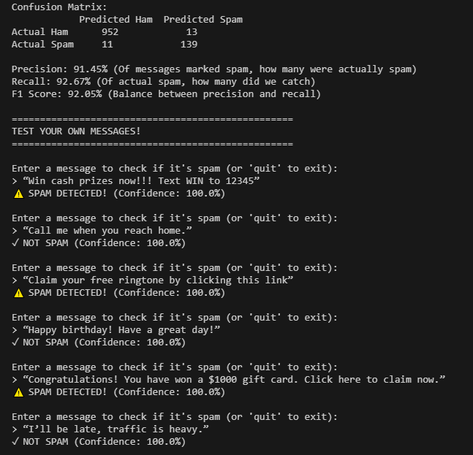
Example Output

Slide 12
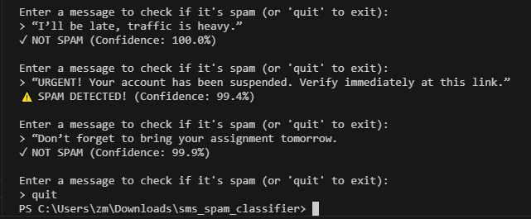
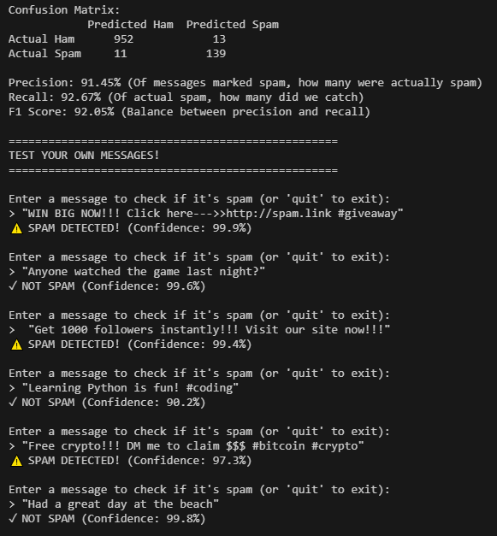
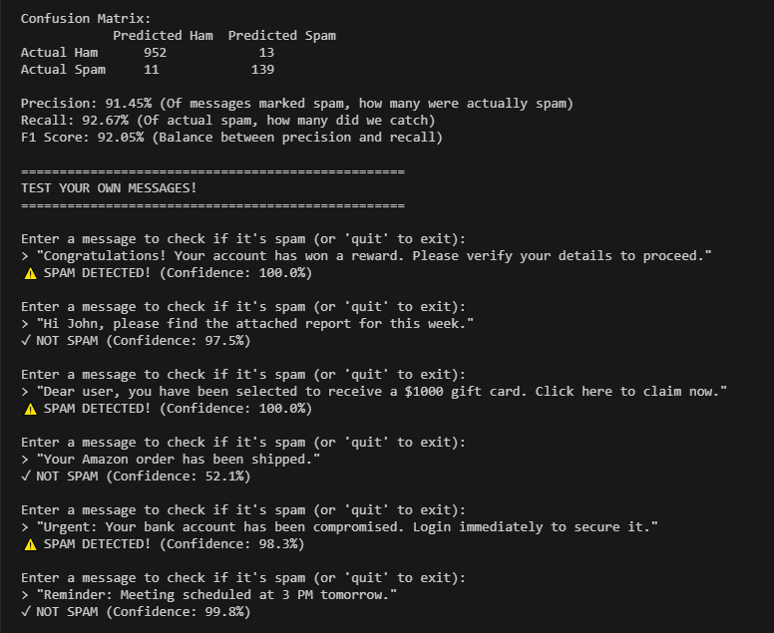

Slide 13
Strengths
Fast and simple
Good accuracy
Real-time prediction
Limitations
Cannot fully understand context
May misclassify tricky messages
Depends on training data
Future Improvements
Use TF-IDF
Deep learning models
Deploy as app

