Slide 1
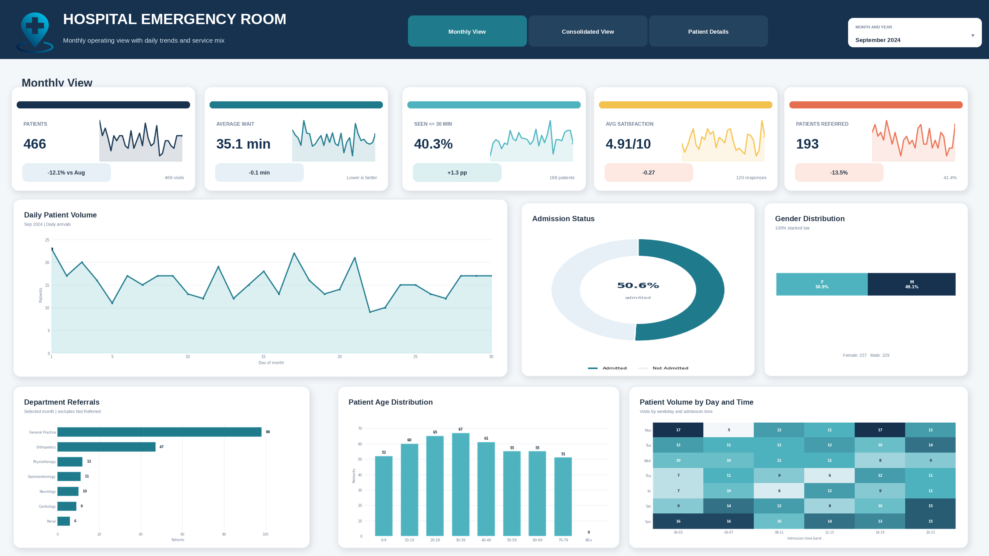
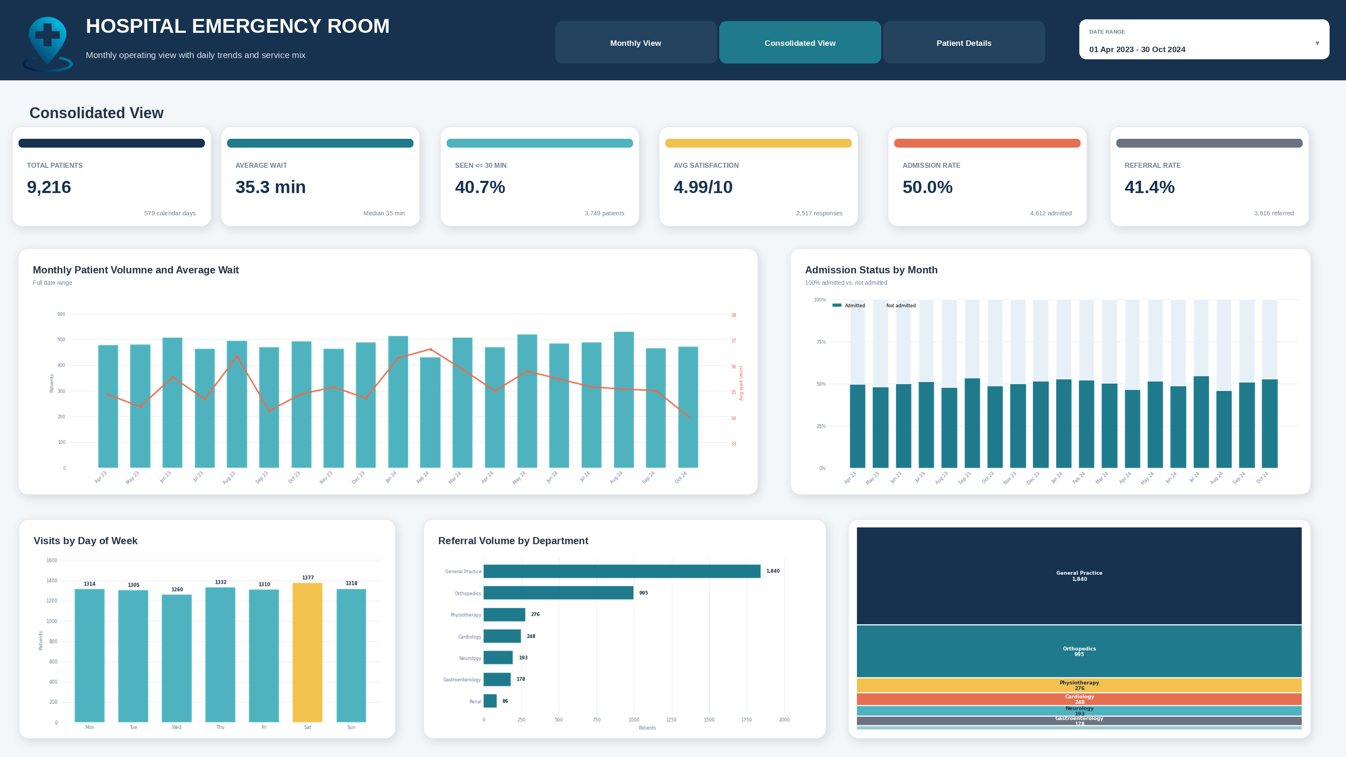
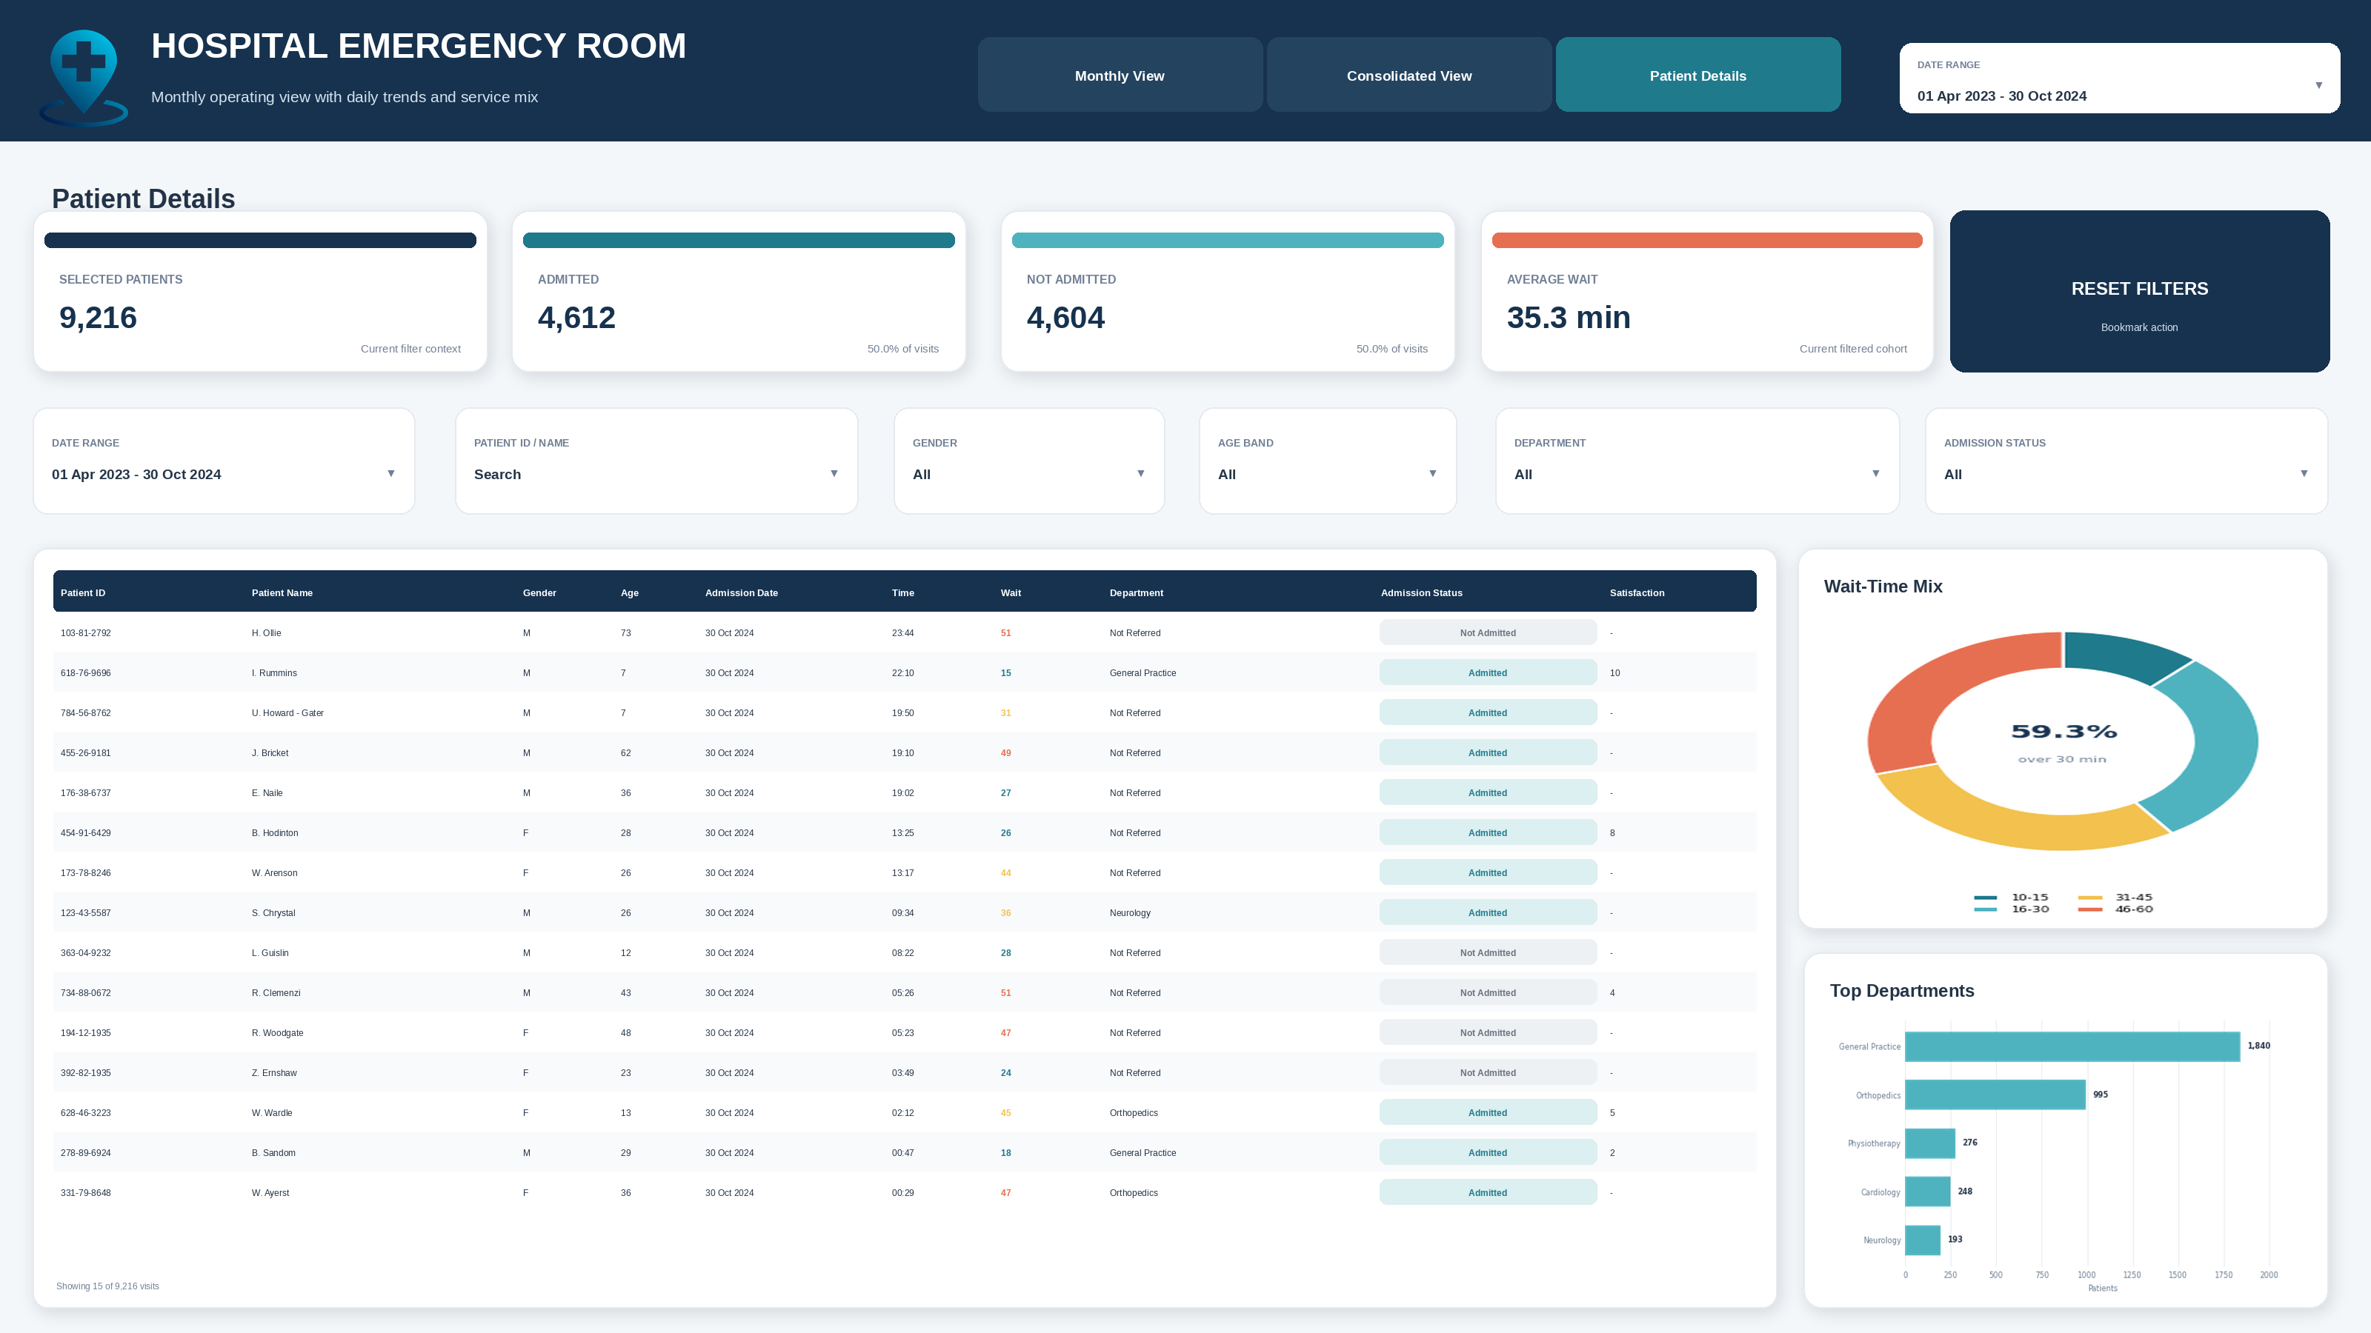
HOSPITAL
EMERGENCY ROOM
DASHBOARD
Power BI portfolio presentation
Business requirements, analytical pages, charts, KPIs and project findings
POWER BI
POWER QUERY
DAX
3 REPORT PAGES
9,216 visits | Apr 2023 - Oct 2024

Slide 2
Business Requirements
Requirement-to-report mapping
Requirement area
Expected outcome
Current status
Core KPIs
Total patients, average wait, seen within 30 minutes, satisfaction, admissions and referrals.
Implemented
Monthly View
Single-month KPIs, daily volume, admission, gender, referrals, age and day/time analysis.
Consolidated View
Date-range KPIs, monthly volume/wait, admission mix, weekday volume and referral analysis.
Patient Details
Patient-level table, filtering, wait-time mix, admission status and department analysis.
Not in current PBI

Slide 3
Dataset and Analytical Model
The report turns one ER visit table into operational KPIs, trends, distributions and patient-level detail.
ER VISITS
DATE RANGE
AVERAGE WAIT
TIMELY CARE
ADMISSION
REFERRAL
9,216
579 days
35.3 min
40.7%
50.0%
41.4%
One row per visit
01 Apr 2023 - 30 Oct 2024
Median: 35 min
Seen within 30 minutes
4,612 admitted
3,816 referred
Data flow
CSV source
Power Query
Semantic model
Report pages
Decision support
12 supplied columns
9,216 records
Types, dates, categories
and derived fields
Date context and
explicit measures
Monthly, consolidated
and patient detail
Operational trends
and investigation
Core analytical calculations
Demand
Service
Flow
Experience
Distinct patient/visit count, daily and monthly trends.
Average wait, wait-time bands and <=30-minute performance.
Admission rate, referral rate and department ranking.
Average satisfaction and response coverage.

Slide 4
Current PBIX Visual Inventory
The report uses native Power BI visuals across three implemented pages.
Monthly View
Consolidated View
Patient Details
5 KPI cards with sparklines
Area chart - daily volume
Donut - admission status
100% stacked bar - gender
Bar chart - department referrals
Column chart - age bands
Matrix heatmap - day and time
6 KPI cards
Line + clustered column combo
100% stacked monthly columns
Weekday column chart
Department referral bar chart
Treemap - referral mix
Between-date slicer
4 KPI cards and reset button
6 report slicers
Patient-level table
Donut - wait-time mix
Bar chart - top departments
Conditional status formatting
Date-range slicer
MONTH FILTER
DATE RANGE
MULTI-FILTER

Slide 5
Page 1 - Monthly View
Single-month operational monitoring with KPI trends and patient-flow analysis.

Slide 6
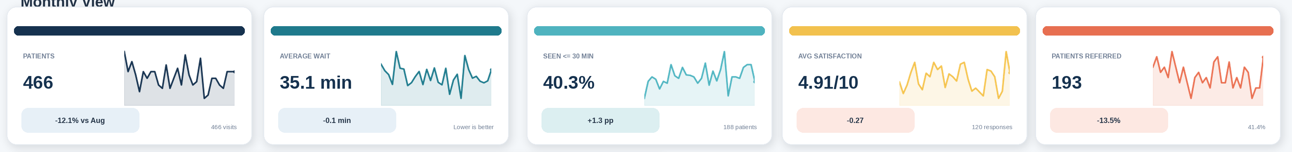
Monthly View - KPI Visuals
Five KPI groups combine the current value, month-over-month comparison and a daily sparkline.
September 2024 KPI interpretation
PATIENTS
AVERAGE WAIT
SEEN <=30 MIN
SATISFACTION
REFERRED
466
35.1 min
40.3%
4.91/10
193
-12.1% vs. August
-0.1 min
+1.3 pp
-0.27
-13.5%
Design value
The compact KPI cards provide both the level and the direction of change without requiring the user to open a separate trend page.

Slide 7
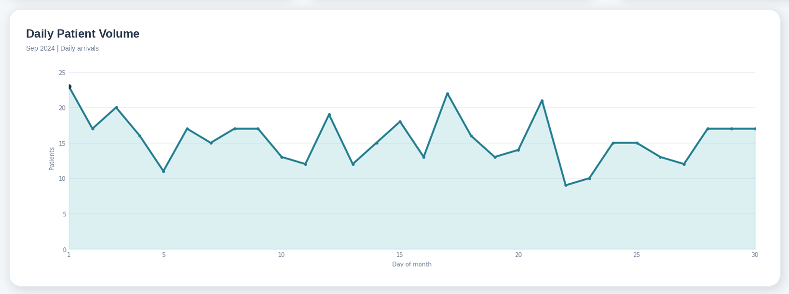
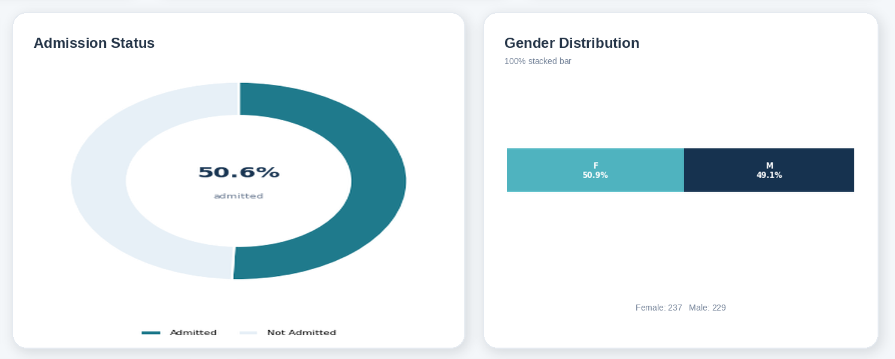
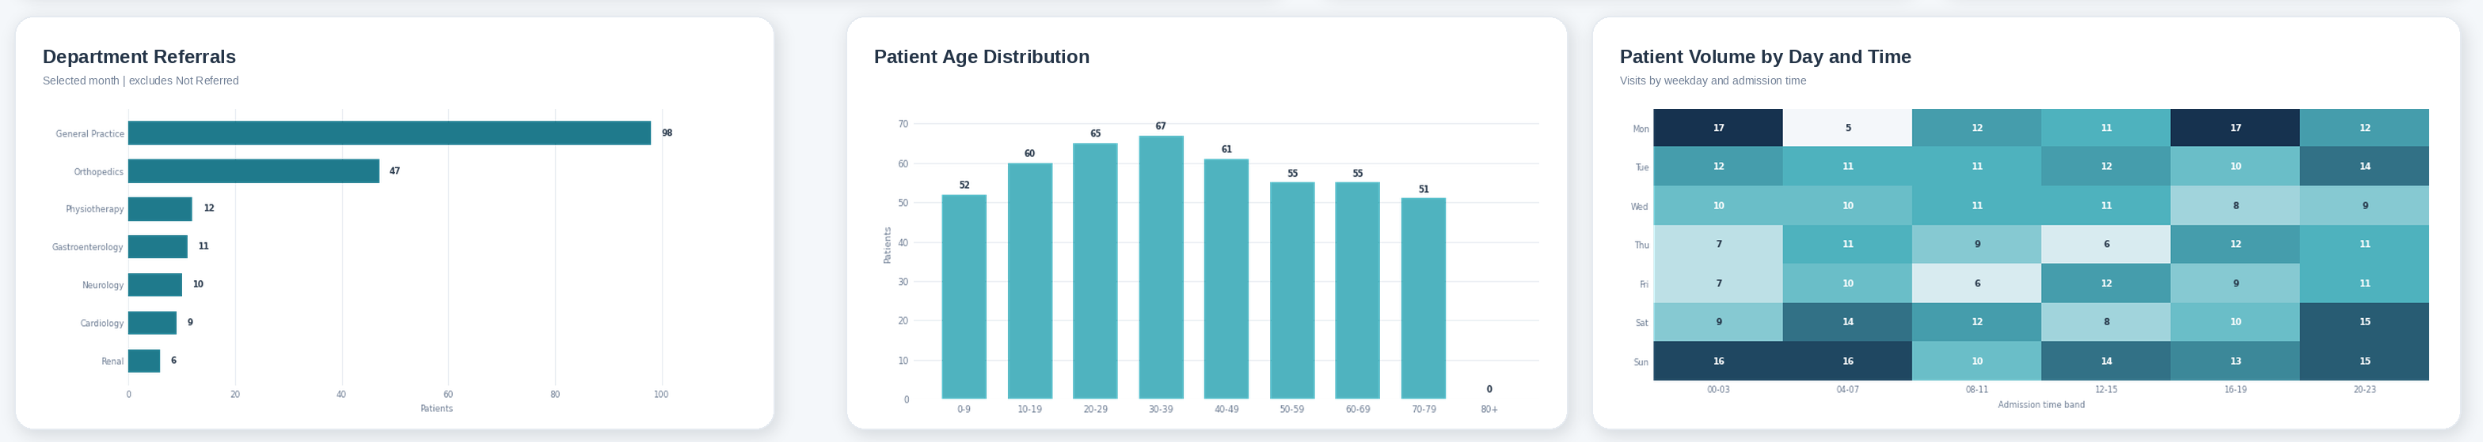
Monthly View - Analytical Charts
All chart visuals from the current Monthly View are presented below.
AREA CHART
DONUT + CARD
100% STACKED BAR
CLUSTERED BAR
CLUSTERED COLUMN
MATRIX HEATMAP

Slide 8
Page 2 - Consolidated View
Full-range performance summary for demand, service quality, admissions and referral patterns.

Slide 9
Consolidated View - KPI Visuals
Six KPI cards summarize the selected date range.
Full-range results
9,216
35.3 min
40.7%
4.99/10
50.0%
41.4%
TOTAL VISITS
AVERAGE WAIT
SEEN <=30 MIN
SATISFACTION
ADMISSION RATE
REFERRAL RATE
Interpretation caution
The 4.99/10 satisfaction result is based on 2,517 responses, representing 27.3% of all visits. The response rate should be shown with the score to avoid over-interpreting the average.

Slide 10
Page 3 - Patient Details
A filterable investigation page combining cohort KPIs, patient records and summary charts.

Slide 11
Patient Details - KPIs and Filter Controls
The page supports date, patient, gender, age, department and admission-status filtering.
Interaction design
Cohort KPIs
Search and filtering
Reset action
Selected patients, admitted, not admitted and average wait update with slicers.
Patient name/ID search plus five categorical controls and a date range.
A bookmark-backed button restores the default filter state.

Slide 12
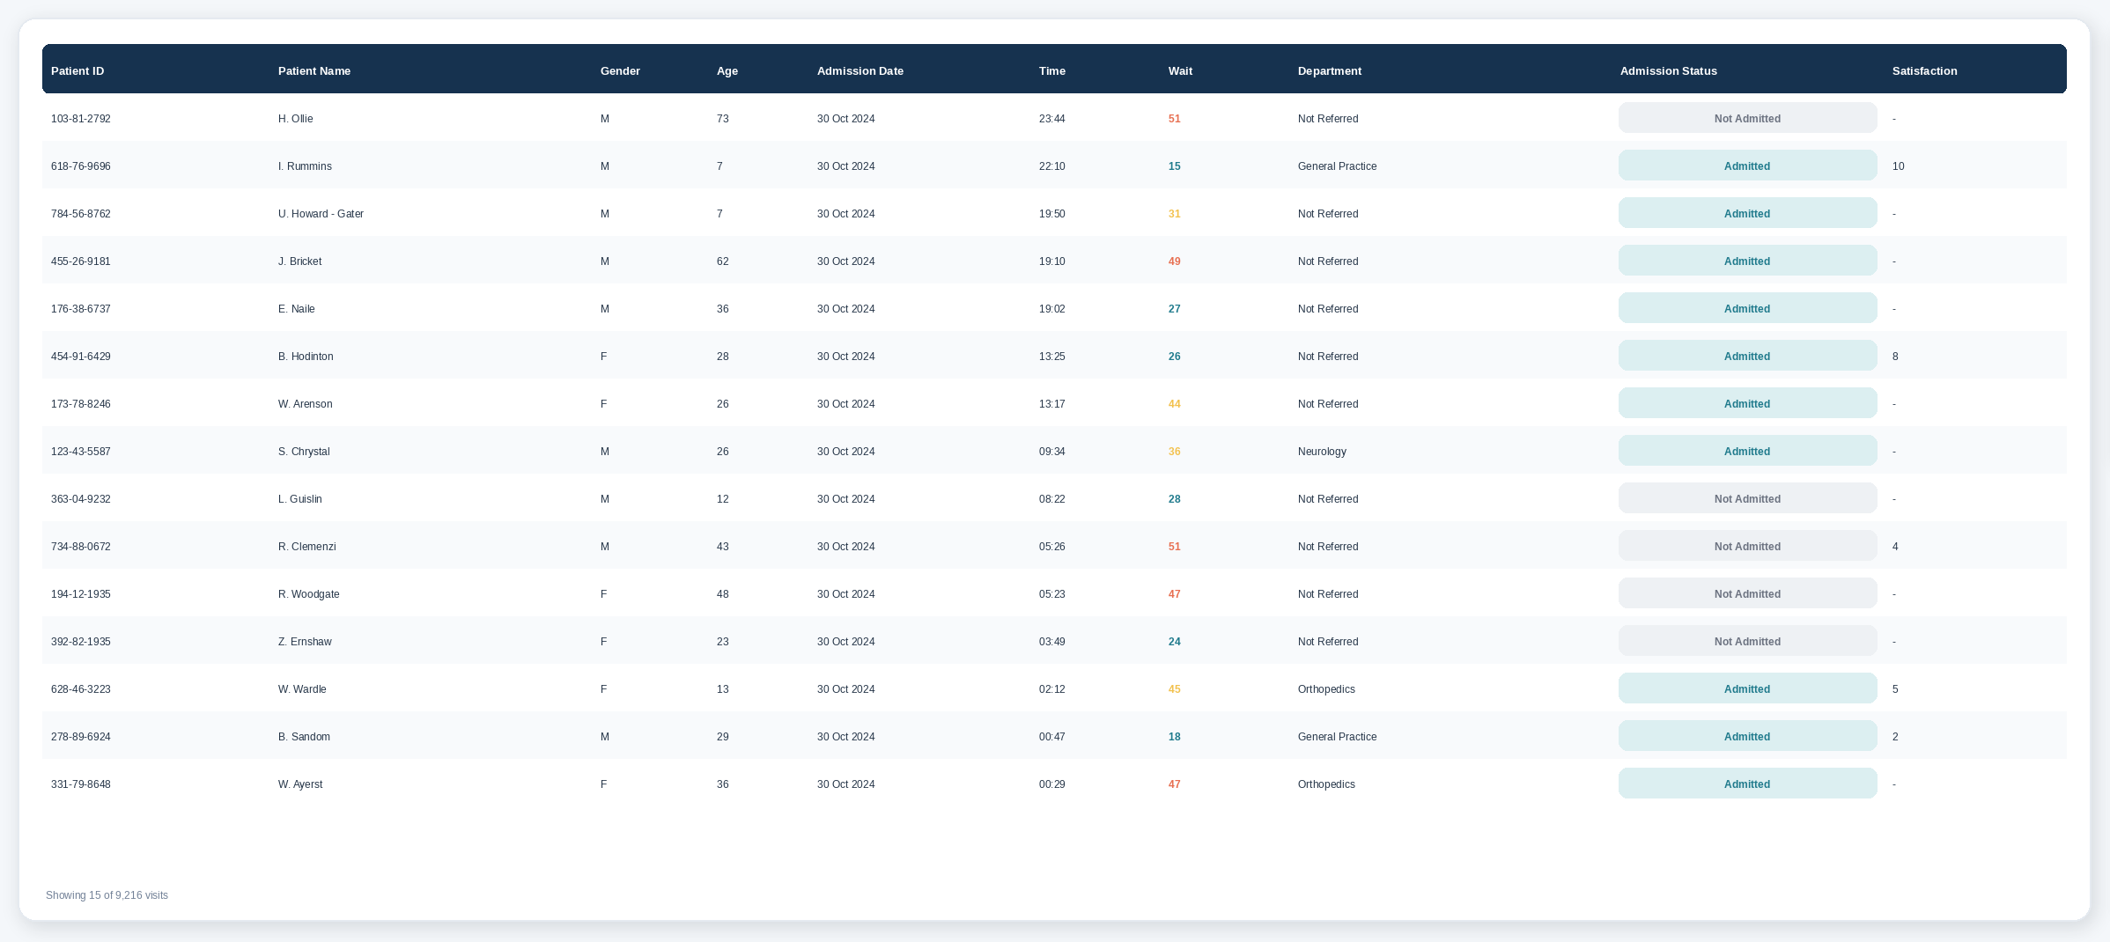
Patient Details - Record-Level Table
The main table provides row-level context for investigation, sorting and filtered review.

Slide 13
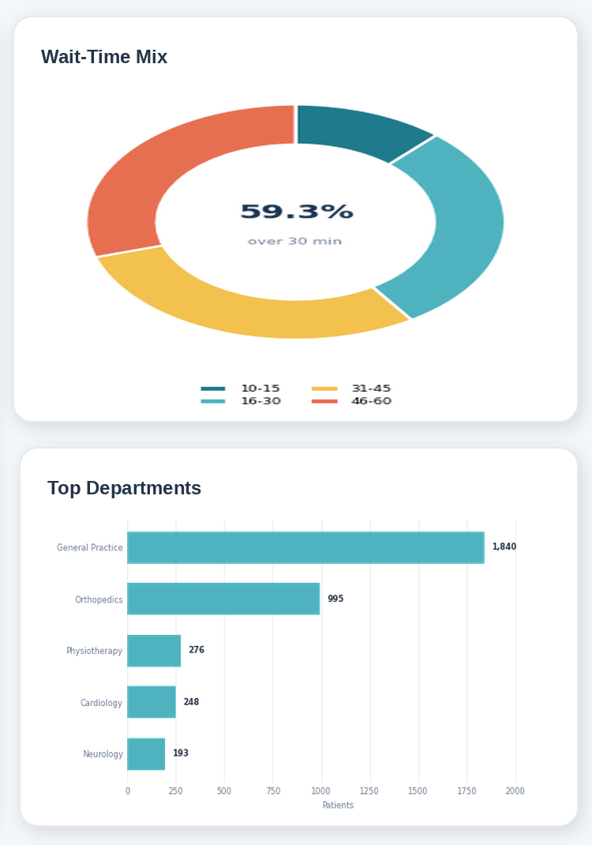
Patient Details - Summary Visuals
The right-side visuals summarize wait-time distribution and the leading referral departments.
Wait-time mix
OVER 30 MINUTES
31-45 MINUTES
46-60 MINUTES
59.3%
29.5%
29.8%
5,467 of 9,216 visits
2,717 visits
2,750 visits
Referral concentration
General Practice
1,840
Orthopedics
995
Physiotherapy
276
Cardiology
248
Neurology
193
General Practice and Orthopedics account for 74.3% of referred visits.

Slide 14
Key Findings and Recommended Actions
The current report highlights service-timeliness pressure, demand patterns and referral concentration.
59.3% waited over 30 minutes
Saturday is the busiest weekday
The largest opportunity is improving the timeliness threshold.
1,377 visits occurred on Saturdays across the full period.
Referral demand is concentrated
Feedback coverage is limited
General Practice and Orthopedics dominate referred volume.
Only 27.3% of visits include a satisfaction response.
Recommended action plan
Align triage and staffing to high-volume days and time bands.
Review referral handoffs, especially for the highest-volume departments.
Increase satisfaction-response coverage and monitor response bias.
P1
P2
P3
P4
Seen <=30 min %
Department wait / volume
Response rate

