Slide 1
Advance Database Management System ER Diagram Tutorial

Slide 2
Learning Objectives
To know about:
E-R Diagram
Entity Sets
Attributes
Relationship Sets
Mapping Cardinalities
ER Diagram
ER Diagram From Given Scenario
Alternative ER Notation
Roles
Total and Partial Participation
Keys
Weak Entity Set
Generalization
Specialization
Aggregation
Summary of Symbols

Slide 3
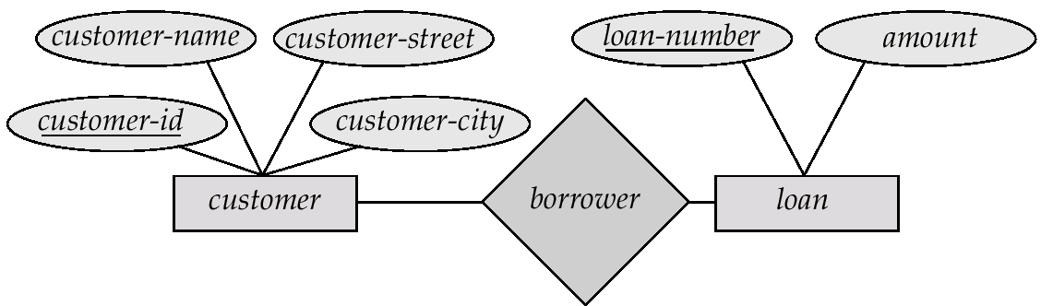
E-R Diagrams
Rectangles represent entity sets.
Diamonds represent relationship sets.
Lines link attributes to entity sets and entity sets to relationship sets.
Ellipses represent attributes
Double ellipses represent multivalued attributes.
Dashed ellipses denote derived attributes.
Underline indicates primary key attributes (will study later)

Slide 4
Entity Sets
A database can be modeled as a collection of entities or relationship among entities.
An entity is an object that exists and is distinguishable from other objects.
Example: specific person, company, event etc.
Entities have attributes
Example: people have names and addresses
An entity set is a set of entities of the same type that share the same properties.
Example: set of all persons, companies, trees, holidays

Slide 5
Attributes
An entity is represented by a set of attributes, that is descriptive properties possessed by all members of an entity set.
Domain is the set of permitted values for each attribute
Entity | Attributes
customer | customer-id, customer-name, customer-street, customer-city
loan | loan-number, amount

Slide 6
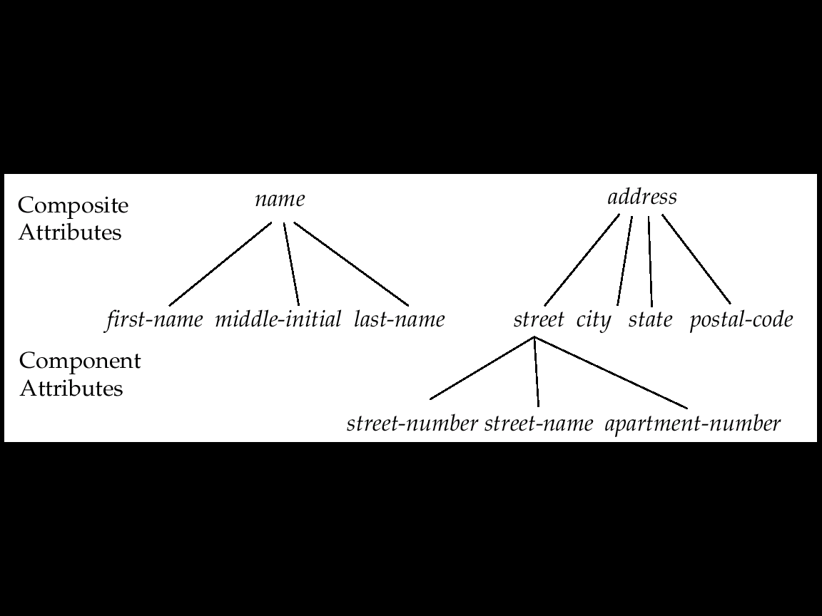
Attributes Types
Simple and composite attributes.
Single-valued and multi-valued attributes
E.g. multi-valued attribute: phone-numbers
Derived attributes can be computed from other attributes
E.g. age, given date of birth

Slide 7
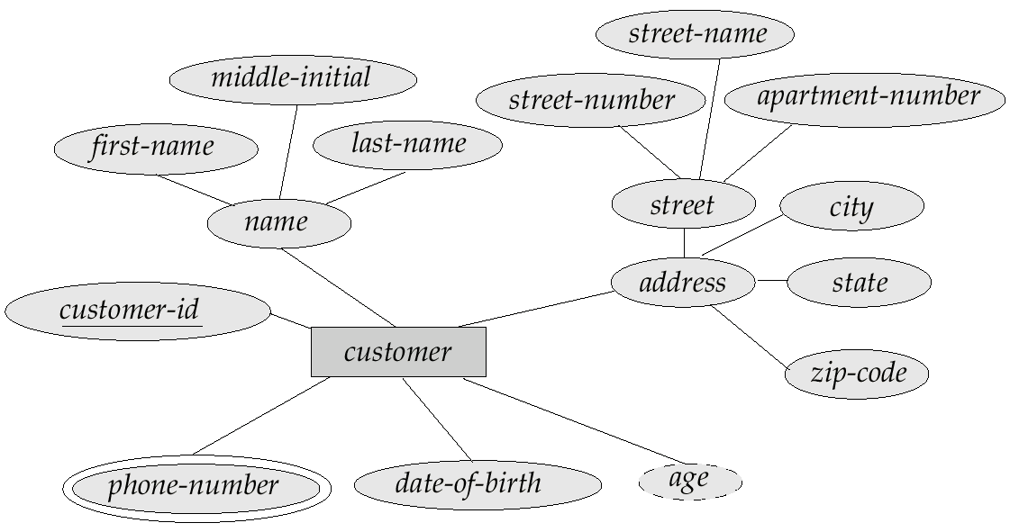
Composite, Multivalued &Derived Attributes

Slide 8
Relationship Sets
A relationship is an association among several entities
Example:
A relationship set is a mathematical relation among n ≥ 2 entities
An attribute can also be property of a relationship set.
Entity | Relationship | Entity
Sam | Deposit | A_102

Slide 9
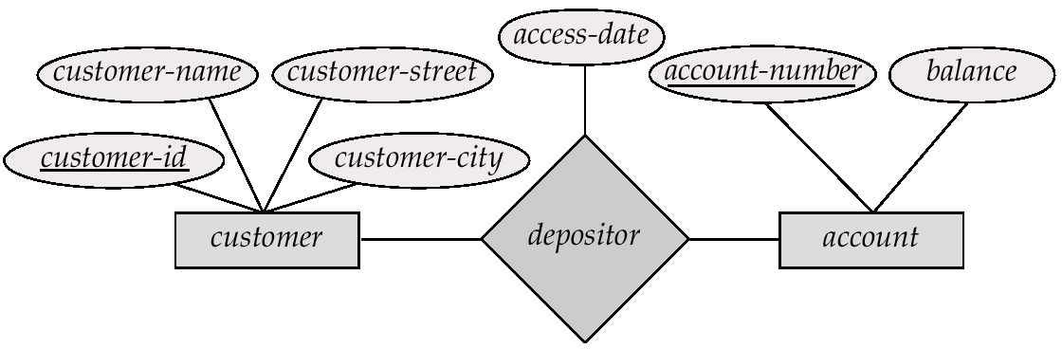
Relationship Sets with Attributes

Slide 10
Degree of a Relationship Set
Refers to number of entity sets that participate in a relationship set.
Relationship sets that involve two entity sets are binary (or degree two). Generally, most relationship sets in a database system are binary.
Relationship sets may involve more than two entity sets.
Relationships between more than two entity sets are rare. Most relationships are binary.

Slide 11
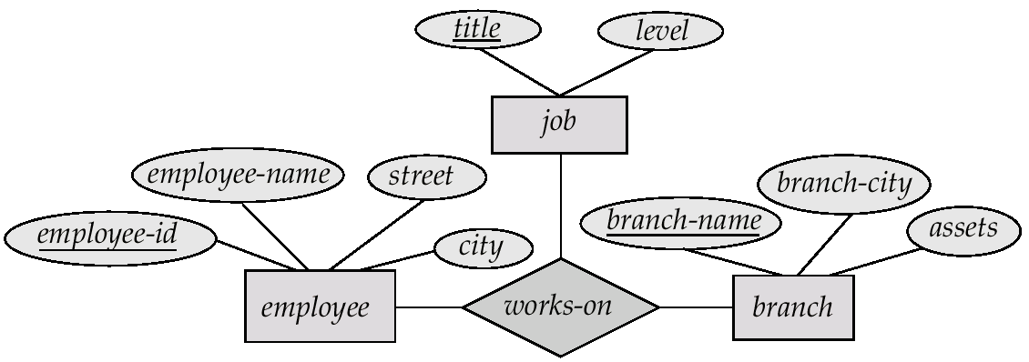
E-R Diagram with a Ternary Relationship

Slide 12
Mapping Cardinalities
Express the number of entities to which another entity can be associated via a relationship set.
Most useful in describing binary relationship sets.
Mapping Cardinalities affect ER Design
We express cardinality constraints by drawing either a directed line (→), signifying “one,” or an undirected line (—), signifying “many,” between the relationship set and the entity set.

Slide 13
Cardinality Type
For a binary relationship set the mapping cardinality must be one of the following types:
One to one
One to many
Many to one
Many to many

Slide 14
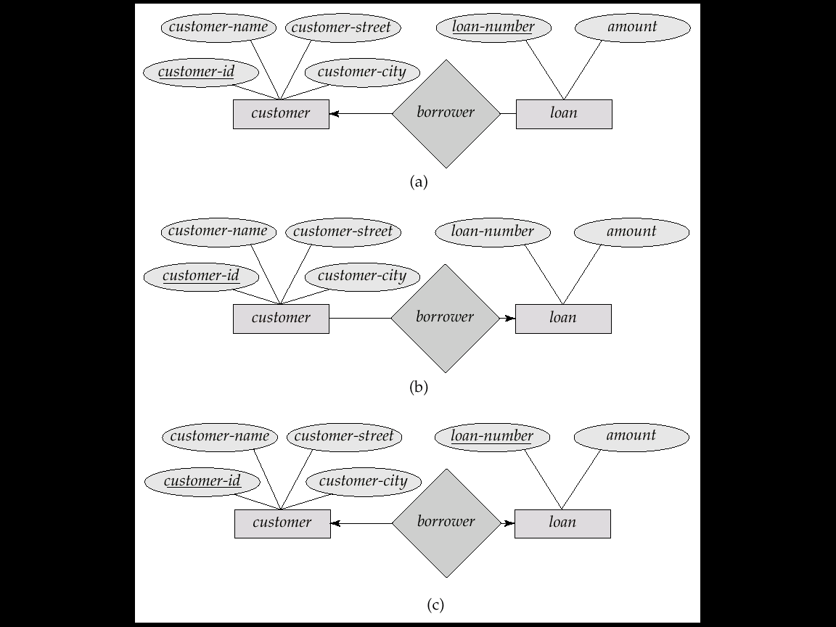
One-to-One relationship:
We express cardinality constraints by drawing either a directed line (→), signifying “one,” or an undirected line (—), signifying “many,” between the relationship set and the entity set.
E.g.: One-to-one relationship:
A customer is associated with at most one loan via the relationship borrower
A loan is associated with at most one customer via borrower

Slide 15
One-To-Many Relationship
In the one-to-many relationship a loan is associated with at most one customer via borrower, a customer is associated with several (including 0) loans via borrower

Slide 16
Many-To-One Relationships
In a many-to-one relationship a loan is associated with several (including 0) customers via borrower, a customer is associated with at most one loan via borrower

Slide 17
Many-To-Many Relationship
A customer is associated with several (possibly 0) loans via borrower
A loan is associated with several (possibly 0) customers via borrower

Slide 18
Draw ER Diagram From The Provided Scenario
In a library management system a member may rent many books. One
book may be rented by exactly one member. A member is identified by a
member number. The system also stores member name and address. A
member address is composed of house number, street name and city. A
book is identified by book ID. Book name, ISBN Number and edition of
a book are also stored. There may be multiple edition of a book. While
borrowing, the date of the borrowing and copy number of the book is
stored. A member may also reserve many books. A book may be
reserved by many members. To find the priority of the reservation the
date of making the reservation is also stored. A book is written by at
least one author. An author may write many books but the system
stores information of those authors of who has written at least one book stored
in the library. To identify an author the system stores author ID along with
author name. A book belongs to exactly one category and for a category there
must be at least one book. Each category has a name and the unique property of
each category is a category number.

Slide 19
Try yourself!!!
Please try to solve by yourself first. After that you can check the solution given in next slide….
(Remove the given blue box to see the solution)

Slide 20
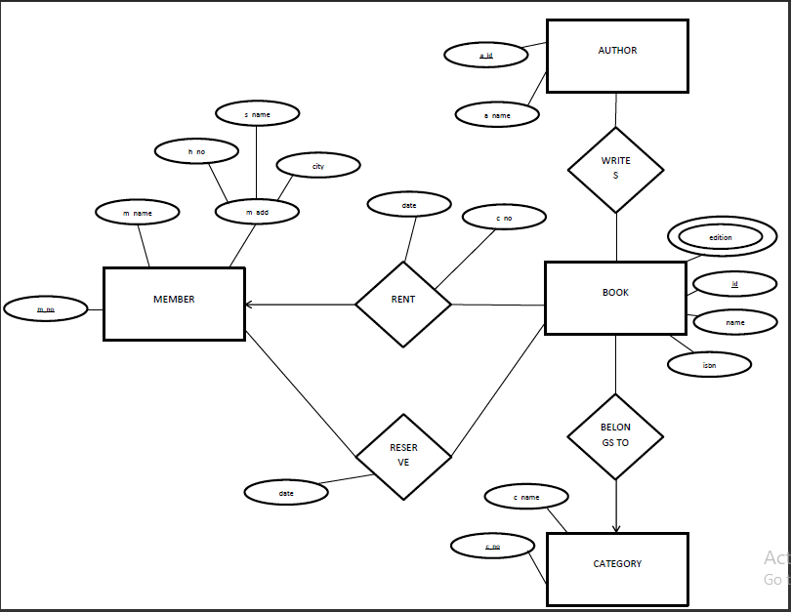
Solution

Slide 21
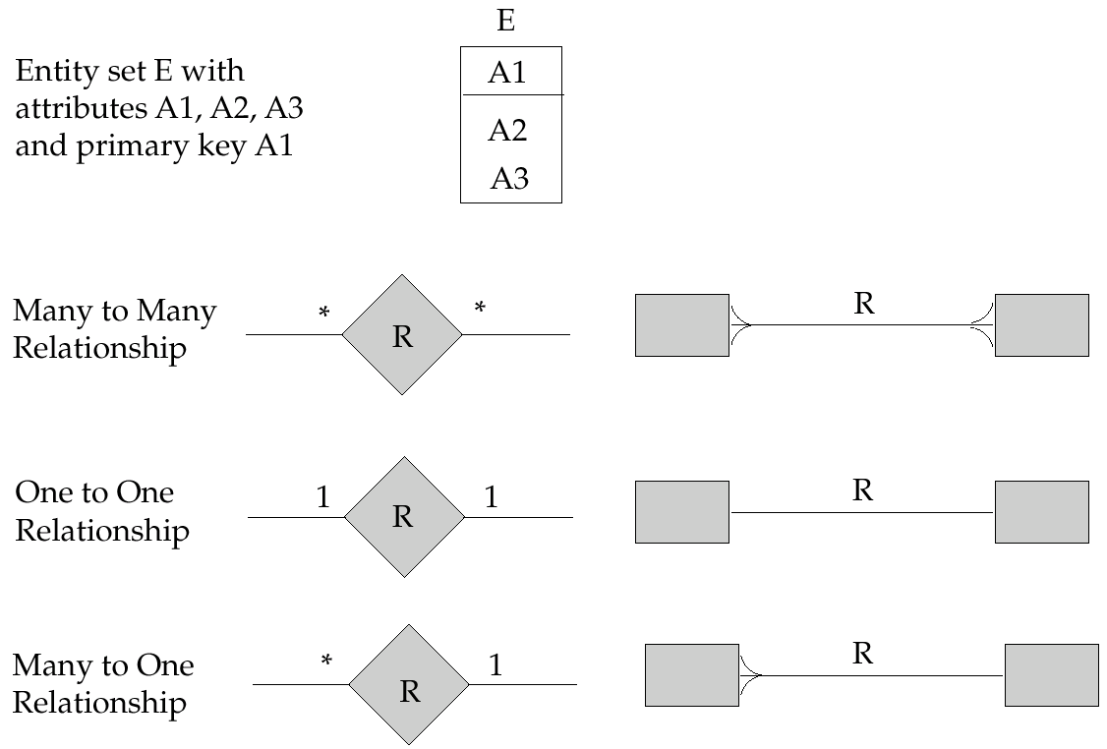
Alternative E-R Notations

Slide 22
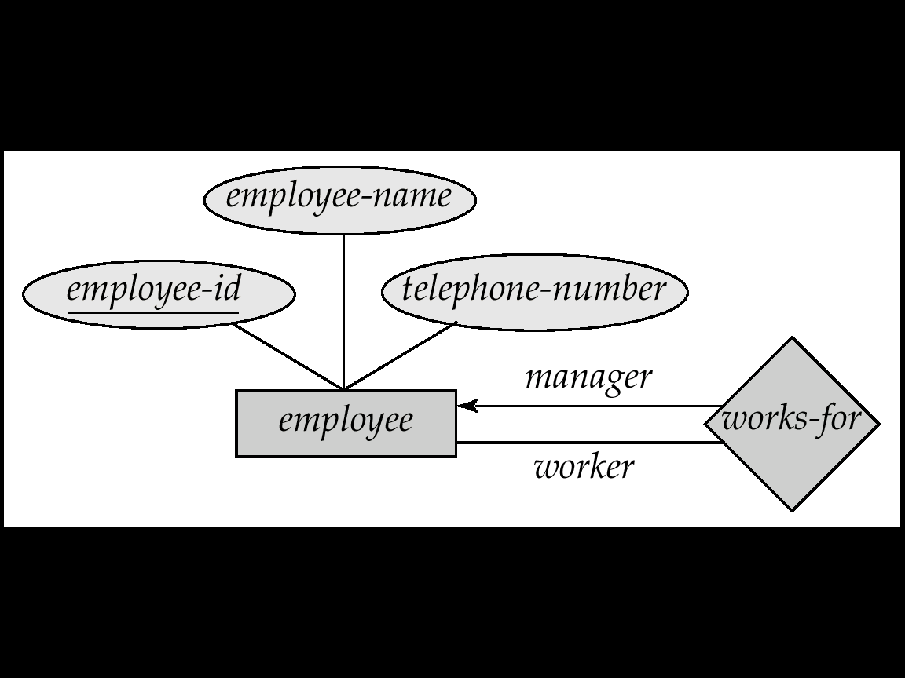
Roles
Entity sets of a relationship need not be distinct
The labels “manager” and “worker” are called roles; they specify how employee entities interact via the works-for relationship set.
Roles are indicated in E-R diagrams by labeling the lines that connect diamonds to rectangles.
Role labels are optional, and are used to clarify semantics of the relationship

Slide 23
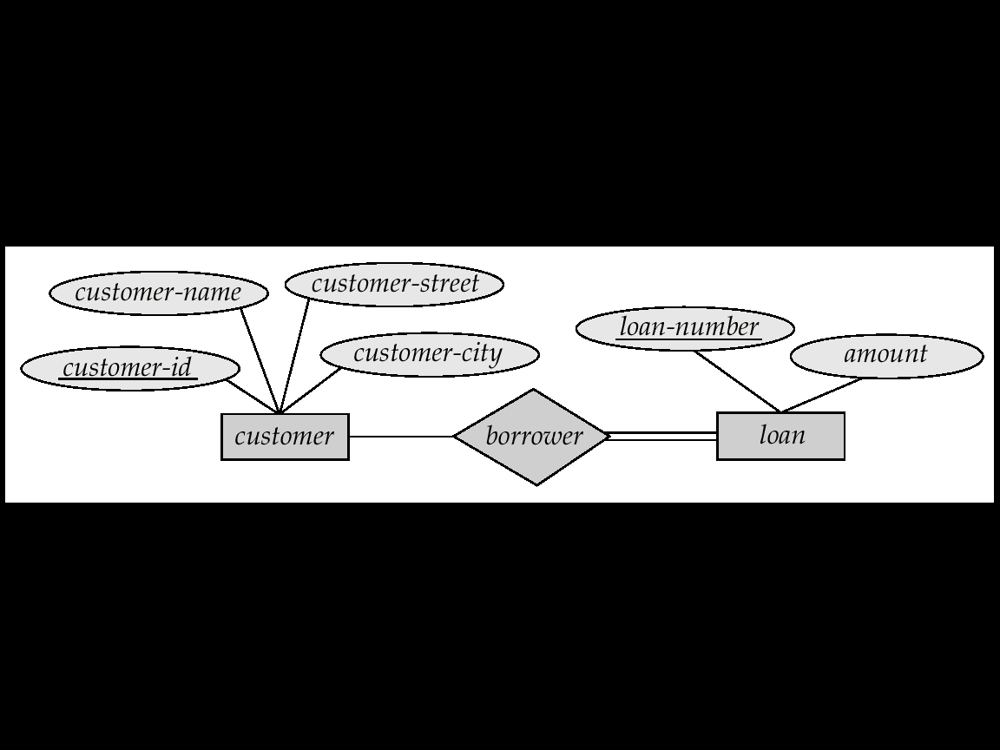
Participation of an Entity Set in a Relationship Set
Total participation (indicated by double line): every entity in the entity set participates in at least one relationship in the relationship set
E.g. participation of loan in borrower is total
every loan must have a customer associated to it via borrower
Partial participation: some entities may not participate in any relationship in the relationship set
E.g. participation of customer in borrower is partial

Slide 24
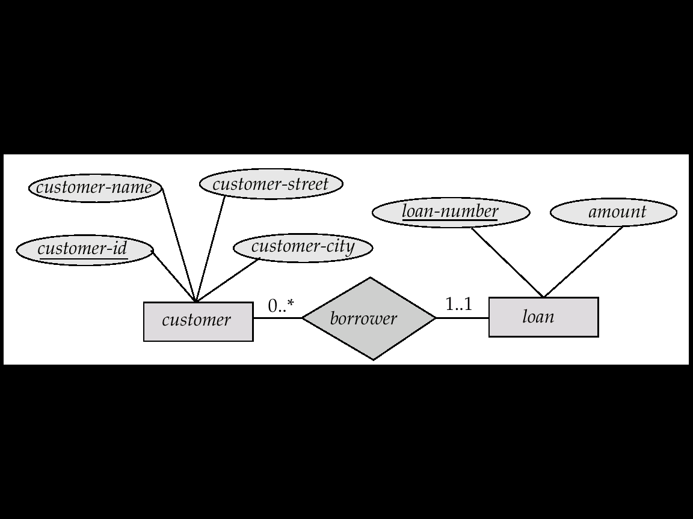
Alternative Notation for Cardinality Limits
Cardinality limits can also express participation constraints

Slide 25
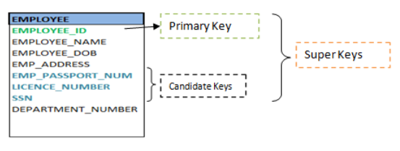
Keys
A super key of an entity set is a set of one or more attributes whose values uniquely determine each entity.
A candidate key of an entity set is a minimal super key
Although several candidate keys may exist, one of the candidate keys is selected to be the primary key.
Every candidate key is a super key but, every super key may or may not be a candidate key.

Slide 26
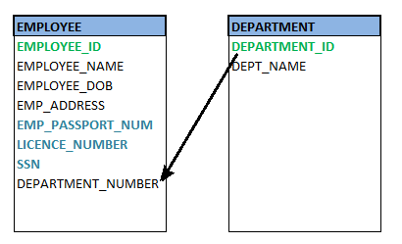
Foreign Keys
Foreign Key of the entity attribute is the entity which is the primary key of the related entity. Foreign key helps to establish the mapping between two or more entities.

Slide 27
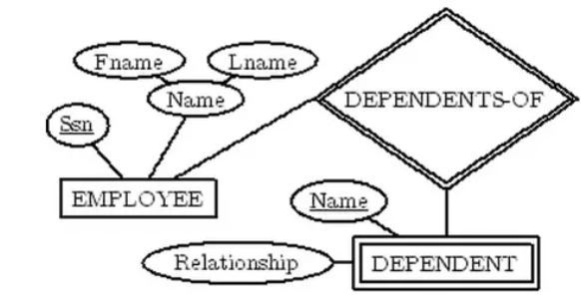
Weak Entity Sets
An entity set that does not have a primary key is referred to as a weak entity set.
The existence of a weak entity set depends on the existence of a identifying entity set
The discriminator (or partial key) of a weak entity set is the set of attributes that distinguishes among all the entities of a weak entity set.
We depict a weak entity set by double rectangles.

Slide 28
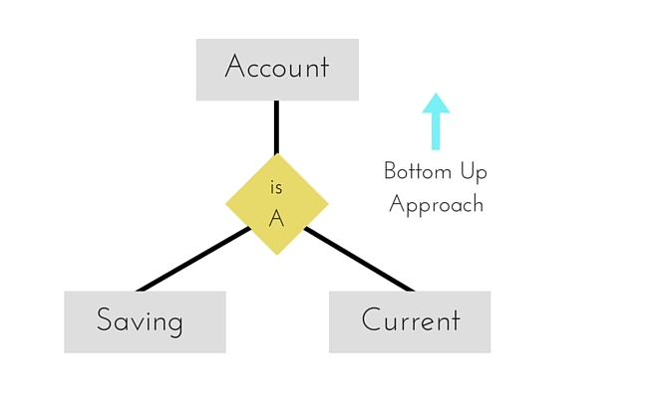
Generalization
Generalization is a bottom-up approach in which two lower level entities combine to form a higher level entity. In generalization, the higher level entity can also combine with other lower level entity to make further higher level entity.

Slide 29
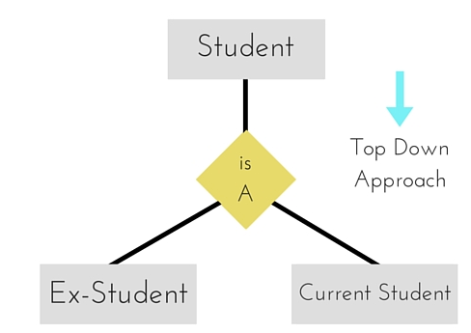
Specialization
Specialization is
opposite to Generalization.
It is a top-down approach
in which one higher level
entity can be broken down
into two lower level entity.
In specialization, some
higher level entities may
not have lower-level entity
sets at all.

Slide 30
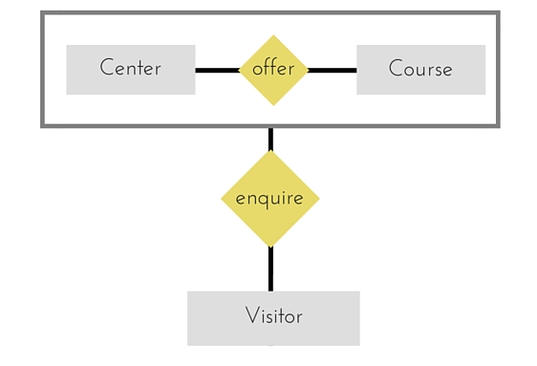
Aggregation
Aggregation is a process when relation between two entity is treated as a single entity. Here the relation between Center and Course, is acting as an Entity in relation with Visitor.

Slide 31
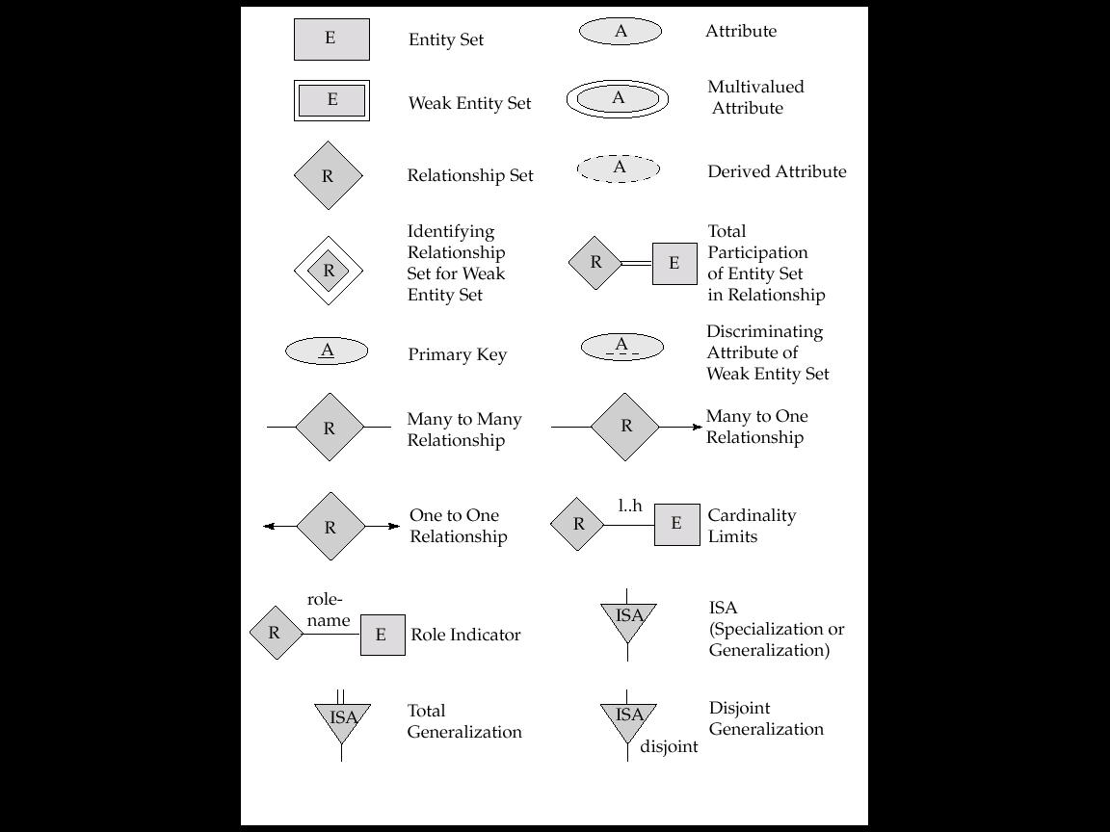
Summary of Symbols Used in E-R Notation

Slide 32
Draw ER Diagram From The Provided Scenario
In a University Management System, a student can attend class. Every class must have a student associated with it via attendance. Every student does not have to be associated with class via attendance. Class has sections. The existence of section is totally dependent on class. Class is taken by teacher. Lecturer and Professor can be generalized as teacher. Student can register for course. Course is made of lectures. Lectures contain assignment. Assignment can be specialized into homework, exam and project. Guardians can come and enquire about course and lecture. Now draw an ER diagram according to the mentioned scenario.

Slide 33
Try yourself!!!
Please try to solve by yourself first. After that you can check the solution given in next slide….
(Remove the given blue box to see the solution)

Slide 34
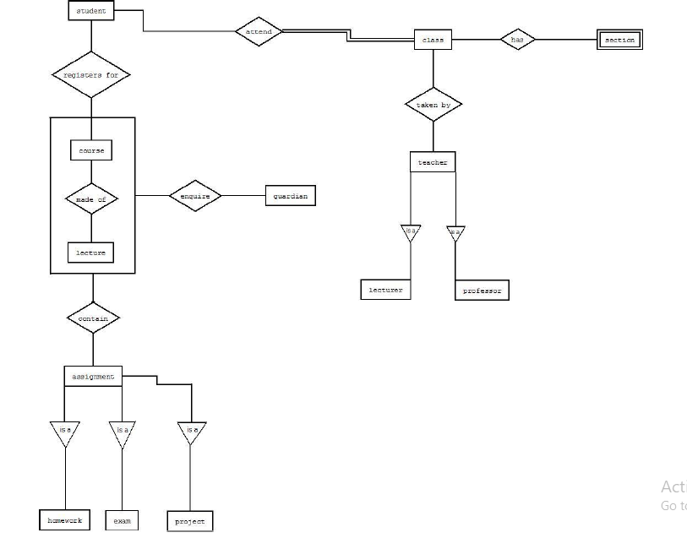
Solution

Slide 35
THANK YOU

