Slide 1

ADVENTIST UNIVERSITY OF CENTRAL AFRICA
Big Data-Driven Road Safety Intelligence
A Prototype Rwanda Road Safety Intelligence System
(RRSIS)
Big Data Essentials — Midterm Group Project
Rubagumya Brave — 101392
Group 15 | MSc Big Data Analytics | September 2026
Uwizeye Christelle — 101465
Rwagasana Felicien — 101364
Lecturer: Dr. Kundan Kumar | Big Data Essentials
Notes:
Introduce the project, the group and the technology stack.

Slide 2
RRSIS — GROUP 15
02 / 16
The Problem — Rwanda Road Safety Crisis
9,995
Road accidents in Rwanda — 2023
Three Critical Gaps
Data Volume — manual cross-tabulation of thousands of records is not feasible
78%
Pattern Identification — high-risk times and locations remain unidentified
Increase in accidents since 2018
Evidence Gap — interventions lack numerical justification
761
Fatal accidents in 2023
Source: NISR Statistical Yearbook 2024, Table 14.2.6
Notes:
Frame the Rwandan road safety crisis and the three gaps RRSIS addresses.

Slide 3
RRSIS — GROUP 15
03 / 16
RRSIS Solution — System Architecture
→
→
→
→
→
→
Raw Data
HDFS Storage
Spark Load
Cleaning
Analytics
Risk Model
Decisions
HDFS Layer
Apache Spark 3.4.4
Stores dataset at /Group_15/midterm_dataset/
Reads from HDFS in parallel partitions
Distributed, replicated, fault-tolerant
Processes 307,955 records efficiently
Raw CSV never modified — full audit trail
df_cleaned cached in memory after Task 2
72.2 MB — Road_Accident_Data.csv
Tasks 3–9 all read from memory
HDFS Path: hdfs://localhost:9000/Group_15/midterm_dataset/Road_Accident_Data.csv
Notes:
Walk the pipeline left to right, then explain the HDFS and Spark layers.

Slide 4
RRSIS — GROUP 15
04 / 16
Dataset — Kaggle Road Accident Dataset (Surrogate)
307,973
23
72.2 MB
Raw Records
Columns
File Size
Why This Dataset?
Severity Distribution
Large enough to justify distributed architecture
Attribute-rich for multi-factor analysis
Slight — 263,264 accidents — 85.49%
Openly licensed — UK accidents 2021–2022
Serious — 40,738 accidents — 13.23%
307,973 records across 23 columns
Fatal — 3,953 accidents — 1.28%
4 Insights That Transfer to Rwanda
Night-time severity pattern
Source: Xavierberge (2023), Kaggle Road Accident Dataset
Single carriageway road risk
Mechanisms not magnitudes — findings transfer as universal road safety dynamics
Evening peak concentration
Driver behaviour over weather conditions
Notes:
Justify the surrogate dataset and read the severity distribution.

Slide 5
RRSIS — GROUP 15
05 / 16
Task 2 — Data Quality Engineering
ISSUE
TREATMENT
RECORDS
Cleaning Result
307,973
1 Accident Date stored as String
to_date()
All 307,973
Records before
2 Time has fake date (2026-09-02)
date_format()
All 307,973
↓
3 Weather_Conditions missing
Fill "Unknown"
6,057
307,955
4 Road_Type missing
Fill "Unknown"
1,534
Records after
5 Road_Surface_Conditions missing
Fill "Unknown"
317
99.994% retention
6 Carriageway_Hazards missing
Fill "None"
3
Framework
7 Time missing entirely
Drop rows
17
Rahm and Do (2000)
8 Duplicate record
dropDuplicates()
1
5-Phase Cleaning Process
2×2 Taxonomy Classification
Exceeds minimum 5 issues required
Notes:
Eight quality issues, the treatment applied to each, and the retention rate.

Slide 6
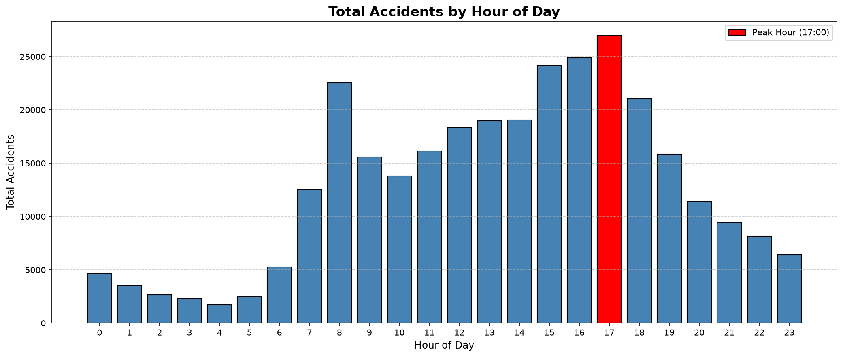
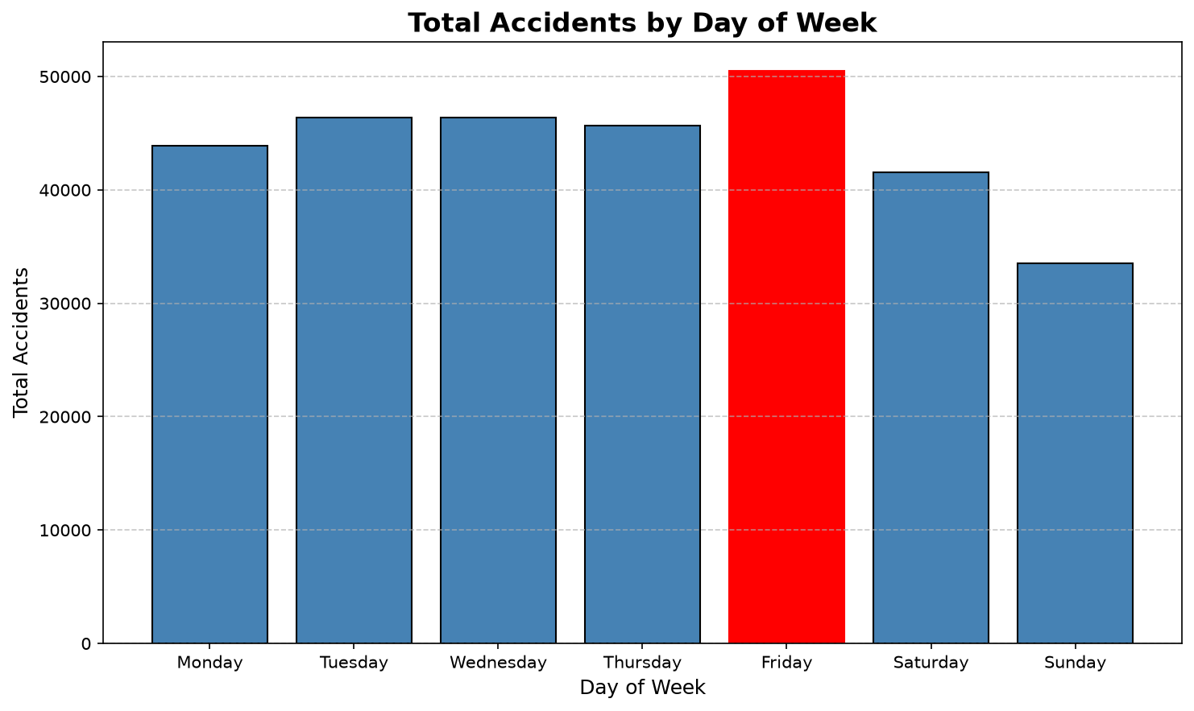
RRSIS — GROUP 15
06 / 16
Task 3 — Temporal Analysis: Frequency
17:00
Friday
November
Evening
Peak Hour — 26,964 accidents
Highest Day — 50,529 accidents
Peak Month — 29,094 accidents
Peak Period — 88,780 accidents
Figure 1: Accidents by Hour — peak at 17:00
Figure 2: Accidents by Day — Friday highest
Weekdays: 232,848 (75.6%) | Weekends: 75,107 (24.4%) | Top 10 combinations = 36.4% of dataset
Notes:
Where accidents cluster in time: hour, day, month and period.

Slide 7
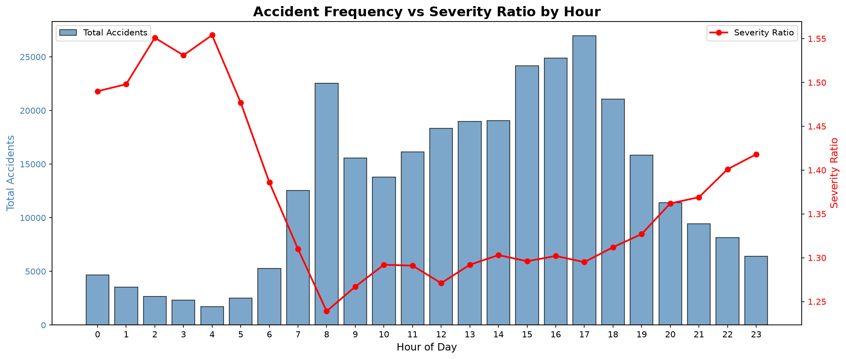
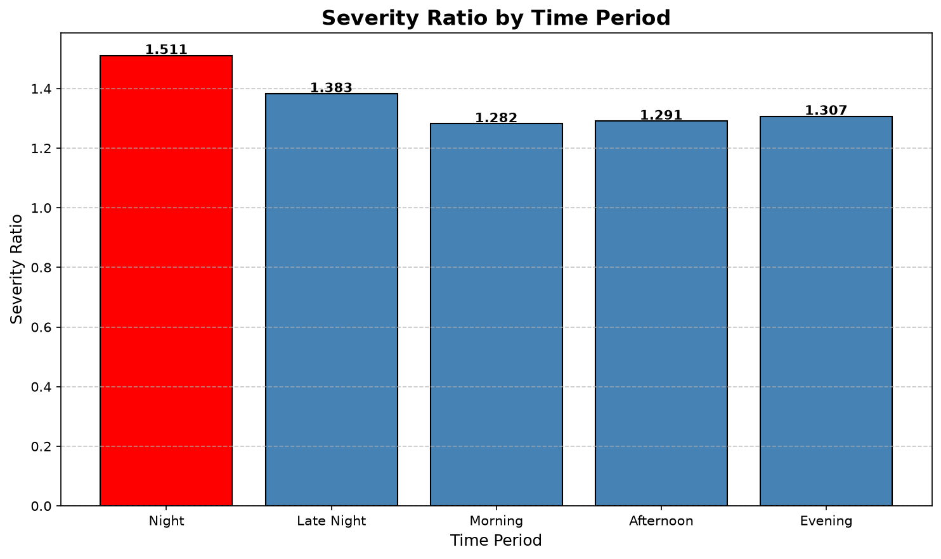
RRSIS — GROUP 15
07 / 16
Task 3 — The Severity Ratio Reversal
The Key Reversal
Night has the FEWEST accidents
but the HIGHEST severity ratio
Hour 04:00 = 1.554 — deadliest single hour
Figure 3: Frequency vs Severity Ratio by Hour — night hours deadliest
Supported by Abdelwahab (2001), Mujalli (2011), Delen (2006)
Figure 4: Severity Ratio by Time Period
Notes:
The central finding: fewest accidents at night, highest severity ratio.

Slide 8
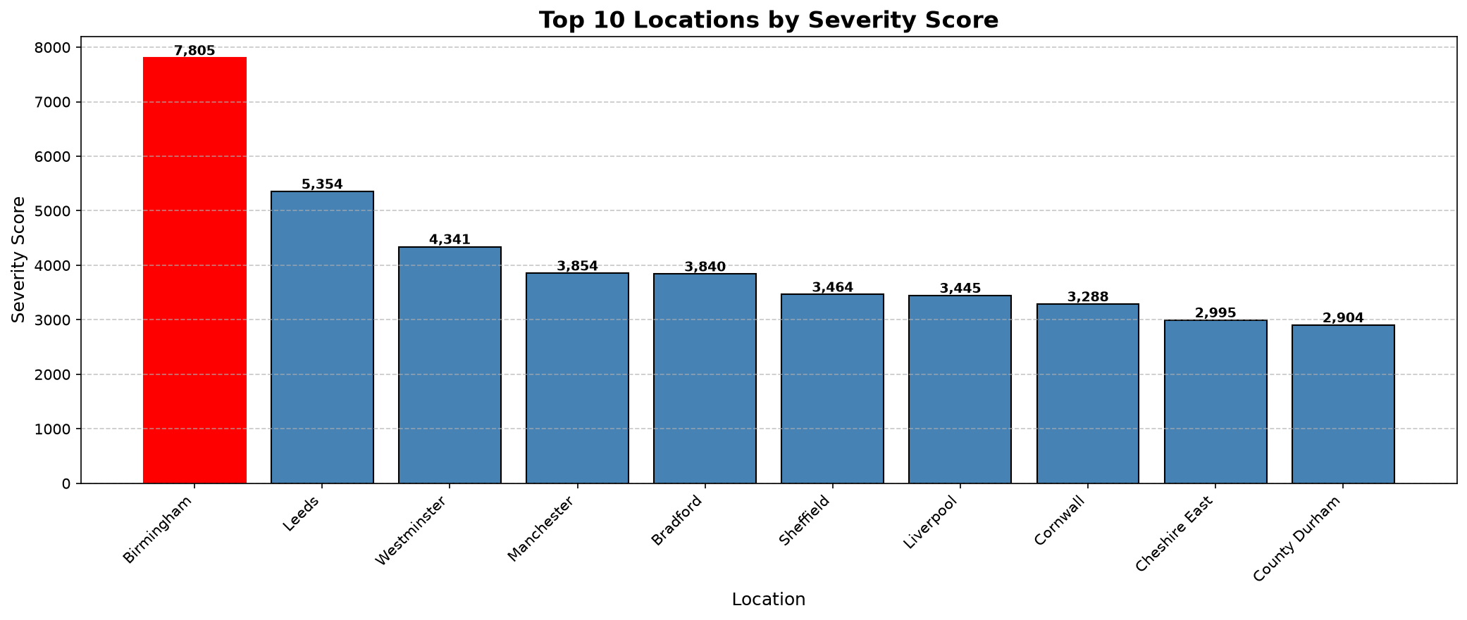
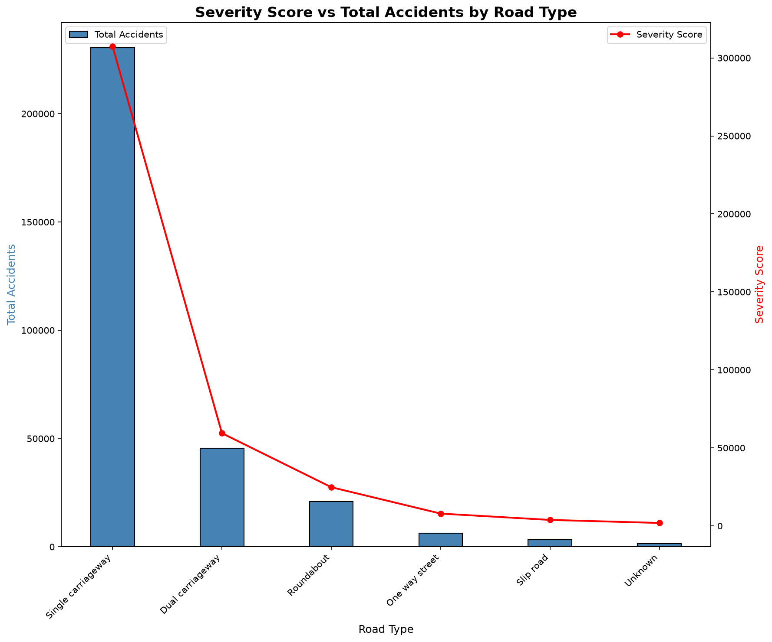
RRSIS — GROUP 15
08 / 16
Task 4 — Accident Severity Index
Slight = 1
Serious = 3
Fatal = 5
263,264 accidents — 85.49%
40,738 accidents — 13.23%
3,953 accidents — 1.28%
Weights justified by: Ordinality (Savolainen 2011) | Class Imbalance (Delen 2006) | Reporting Bias (Savolainen 2011)
Figure 5: Top 10 Locations by Severity Score — Birmingham 7,805
Birmingham 6,165 accidents · 57 fatalities · ratio 1.266
Westminster 2,811 accidents · 189 fatalities · ratio 1.544
Less than half the accidents — more than 3× the fatalities. Frequency ≠ Severity.
Figure 6: Single carriageway dominates
Notes:
Explain the 1/3/5 weighting, then contrast Birmingham with Westminster.

Slide 9
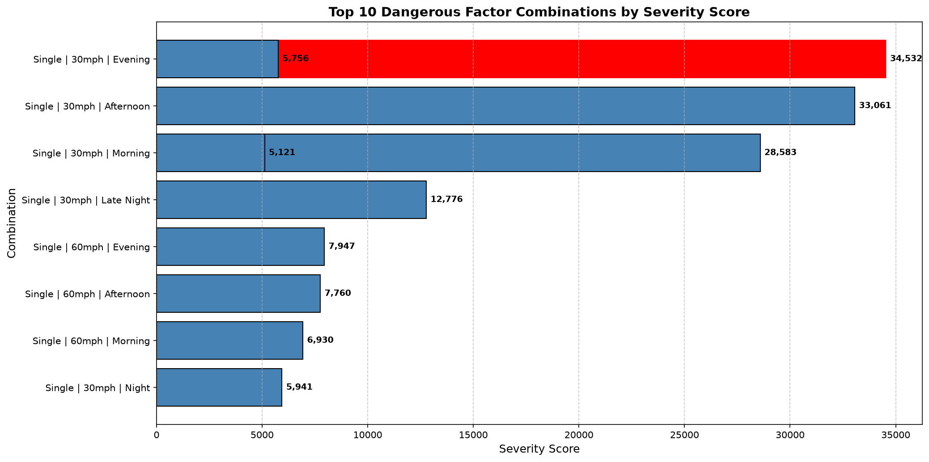
RRSIS — GROUP 15
09 / 16
Task 5 — Dangerous Factor Combination Analysis
Counter-Intuitive Finding
8 of top 10 combinations occur in
FINE WEATHER + DRY ROADS
Not rain. Not ice. Ordinary conditions.
Speed Matters More
60 mph severity ratio 1.610
30 mph severity ratio 1.285
20–26% more harmful per accident
Scale
Top 10 combinations = 36.4% of the entire dataset — a small set of conditions causes more than a third of all accidents
Figure 7: Top 10 Combinations — Single carriageway + Car dominates
6 Factors Analysed Simultaneously:
Road Type | Speed | Weather | Surface | Time Period | Vehicle
Consistent with Abdelwahab (p=0.556), Mujalli (0.4653 vs 0.3124), Delen (excluded weather)
Notes:
The counter-intuitive weather finding and the speed comparison.

Slide 10
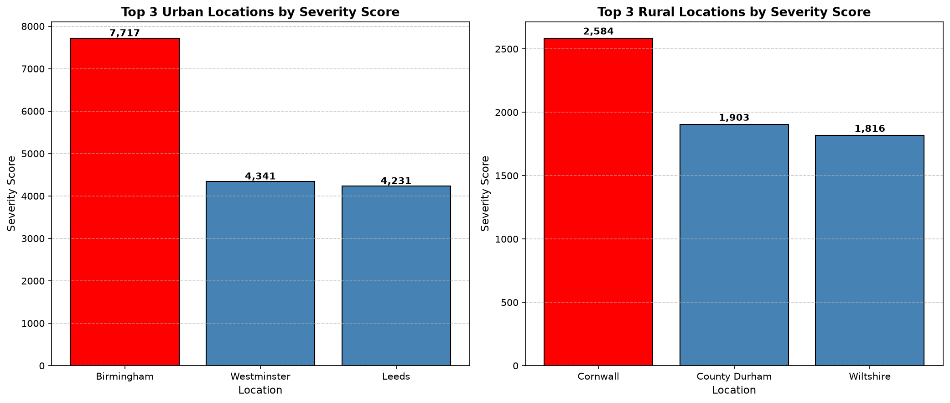
RRSIS — GROUP 15
10 / 16
Task 6 — Window Function Location Ranking
Urban Top 3
1. Birmingham — Severity 7,717 — Ratio 1.265
2. Westminster — Severity 4,341 — Ratio 1.544
3. Leeds — Severity 4,231 — Ratio 1.271
Rural Top 3
1. Cornwall — Severity 2,584 — Ratio 1.297
2. County Durham — Severity 1,903 — Ratio 1.339
3. Wiltshire — Severity 1,816 — Ratio 1.568
Figure 8: Top 3 Locations per Urban/Rural Category using dense_rank()
Wiltshire: only 1,158 accidents
Ratio 1.568 — 2nd highest in entire table
Why dense_rank() not rank() or row_number()?
Would NEVER appear in a national ranking
row_number() — breaks ties randomly — inconsistent results
Window function makes rural danger VISIBLE
rank() — skips numbers after ties — filter ≤3 may return only 2
dense_rank() — handles ties, never skips — always returns top 3 ✓
Rwanda equivalent: Kigali vs provincial roads — separate ranking ensures both receive attention
Notes:
Why dense_rank, and what the rural ranking exposes.

Slide 11
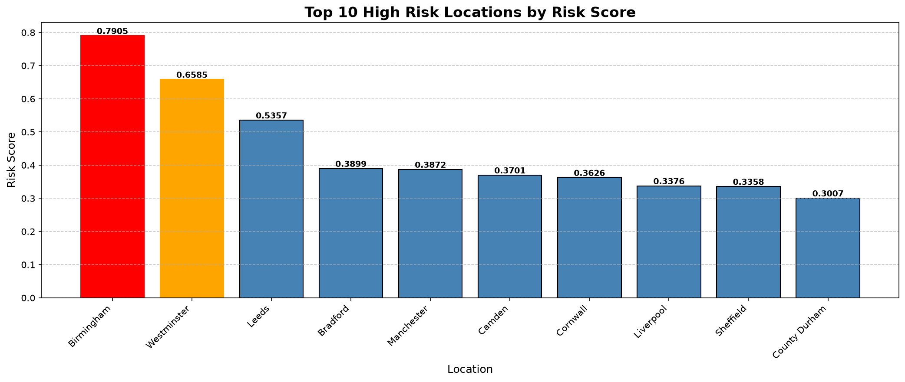
RRSIS — GROUP 15
11 / 16
Task 7 — Road Safety Risk Score
Risk Score = (0.3 × Norm_Frequency) + (0.4 × Norm_Severity) + (0.3 × Norm_Fatal)
Min-Max Normalisation: v′ = (v − min) / (max − min) | Source: Delen et al. (2006) Eq. 1
Frequency 0.3
Severity 0.4
Fatal 0.3
Systemic risk — consistent volume
Highest weight — measures actual harm
Separate — rare events not overwhelmed
Risk Score Reveals Hidden Danger
Westminster ranks 5th by accident count but jumps to 2nd by Risk Score — 189 fatalities, highest of any location. The fatal component (0.3) reveals what a raw count hides.
Figure 9: Top 10 High Risk Locations by Composite Risk Score
Notes:
The composite risk formula and what it surfaces that counts hide.

Slide 12
RRSIS — GROUP 15
12 / 16
Task 8 — Spark Execution and Performance
cache() — Why It Matters
4 Execution Plans — df.explain(True)
WITHOUT cache():
Parsed Plan
Task 3 → re-read HDFS + re-clean → analyse
What the analyst wrote
Task 4 → re-read HDFS + re-clean → analyse
Task 5 → re-read HDFS + re-clean → analyse
Analyzed Plan
… repeated 7 times — very slow
Columns and types validated
WITH cache():
Optimized Plan
First use → read HDFS + clean → store in memory
Catalyst optimizer improves the query
Task 3 → read from memory ✓ fast
Task 4 → read from memory ✓ fast
Task 5 → read from memory ✓ fast
Physical Plan
Exact execution steps on the cluster
307,955 records cached successfully
df_cleaned.cache() + df_cleaned.count() triggers storage
3 Shuffle Operations Identified
All Tasks 3–9 read from memory
Notes:
Four plans, three shuffles, and why cache changes the runtime.

Slide 13
RRSIS — GROUP 15
13 / 16
Task 9 — Five Management Priorities
PRIORITY 1
PRIORITY 2
Evening Rush Hour
Single Carriageway
72,929 accidents (23.7%)
230,595 accidents (74.9%)
in the 16:00–18:00 window
Severity 307,409 — 5× dual carriageway
Deploy traffic management
Improve markings and lighting
PRIORITY 3
PRIORITY 4
PRIORITY 5
High Risk Locations
Friday and Weekend
Night Time
Birmingham 0.7905
Fatal rate 1.78% weekend
Severity ratio 1.511
Westminster 0.6585
vs 1.12% weekday
Fatal rate 3.43%
Concentrate resources
Launch awareness campaigns
Night patrols and lighting
All priorities backed by Spark analysis of 307,955 records — evidence-based, ranked, actionable
Notes:
The five ranked management priorities and the action for each.

Slide 14
RRSIS — GROUP 15
14 / 16
Literature Review — Five Papers, Three Cross-Paper Findings
Five Papers Used
Three Cross-Paper Findings
Abdelwahab & Abdel-Aty (2001)
Temporal Variables
Weather insignificant p=0.556 — time of day a weak predictor
Weak severity predictors — all three papers agree. RRSIS frames them as frequency/exposure analysis.
Mujalli & de Oña (2011)
Good weather P(KSI)=0.4653 > rain 0.3124 — severity combinations
Adverse Weather
Does NOT increase severity — 8 of the top 10 combinations occur in fine weather.
Delen, Sharda & Bessonov (2006)
Min-max formula Eq. 1 — no single factor determines severity
Combinations Drive Severity
Savolainen et al. (2011)
No single factor determines outcome. RRSIS Task 5 confirms this on 307,955 records.
Severity is ordinal — slight injuries undercounted 50–75%
Rahm & Do (2000)
RRSIS 307,955 records vs literature max 30,358 = 10× more data
Garbage in, garbage out — 5-phase cleaning + 2×2 taxonomy
Notes:
Five papers and the three findings that recur across them.

Slide 15
RRSIS — GROUP 15
15 / 16
Limitations and Future Recommendations
Six Acknowledged Limitations
Future Recommendations
Surrogate Dataset
Apply to Rwanda National Police Data
UK data — not actual Rwanda accidents
Substitute HDFS path and column mapping only
No Model Validation
Add Validation Split
Descriptive tool — no accuracy figure
Train on 2021, test on 2022 — check ranking stability
Fixed Weights
Derive Weights Empirically
0.3/0.4/0.3 assigned by judgement, not data
Sensitivity analysis instead of fixed judgement
Temporal Variables Reframed
Add Exposure Denominator
Time is exposure, not severity explanation
Traffic volume per location — rate, not burden
Spatial Correlation
Real-Time Processing
Adjacent locations share unobserved effects
Spark Structured Streaming for live detection
Underreporting Bias
Rwanda GIS Integration
Slight injuries undercounted 50–75%
Corridor-level spatial analysis — addresses L5
Notes:
Six limitations acknowledged, six recommendations that answer them.

Slide 16
RRSIS — GROUP 15
16 / 16
Conclusion
307,955 Records
99.994% Retention
Processed on HDFS + PySpark
After cleaning 8 quality issues
vs max 30,358 in any reviewed paper
vs 9.5–53% losses in the literature
5 Ranked Priorities
Ready for Rwanda
With full numerical evidence
Substitute the HDFS path only
Evidence-based, actionable, transparent
Apply to RNP data when access is granted
RRSIS — Turning accident records into ranked management priorities
Rubagumya Brave | Uwizeye Christelle | Rwagasana Felicien
Group 15 — Big Data Essentials — AUCA — September 2026 | Lecturer: Dr. Kundan Kumar
Thank You — Open for Questions
Notes:
Close on the four headline outcomes and invite questions.

