Slide 1






AI-Based Occlusion Handling in AR Using Monocular Depth and Segmentation Models
Paper ID:30
Author’s details:
Rubalpreet Kaur and Surbhi Sharma
Department of Electronics and Communication Engineering
Thapar Institute of Engineering and Technology
rkaur2_be23@thapar.edu

Slide 2
Outlines
Introduction to Problem [2 slides]
Existing Research Overview [2 slides]
Research Gaps and Objectives [2 slides]
Research Approach and Methodology [2 slides]
Proposed work [1 slide]
Results and Analysis [2 slides] (if you want to give, but not compulsory)
Conclusion and Future Work [1 slide]
References [1 slide]
Click a section to jump →
Introduction
Existing Research
Gaps & Objectives
Methodology
Proposed Work
Results
Conclusion
References

Slide 3
Introduction to Problem
← Outline
Why Occlusion Matters in AR/VR
Immersive AR/VR experiences depend on accurate spatial interaction between virtual and real-world objects.
When a virtual object fails to hide behind a real one, the illusion of depth collapses and the scene feels visually inconsistent.
Occlusion reasoning — deciding which object should be visible at each pixel — is therefore a core requirement for believable mixed reality.
The Core Question
“Should a virtual object be hidden behind a real-world object in the current frame?”
Answering this reliably in real time requires per-pixel depth and a clean foreground mask of the real scene.
4/16/2026
3

Slide 4
Introduction to Problem
← Outline
Current Industry Approach and Its Limitations
Hardware-Dependent Sensors
Commercial AR/VR systems rely on LiDAR, Time-of-Flight, and structured-light depth sensors to capture scene geometry.
Cost and Power Overhead
Dedicated depth hardware increases device price, battery drain, and overall system complexity for headsets and phones.
Limited Accessibility
Most low-cost devices and standard webcams lack these sensors, leaving a large class of hardware unable to support occlusion-aware AR.
Motivation: Can accurate occlusion be achieved using only a standard RGB camera, removing the dependency on specialised depth hardware?
4/16/2026
4

Slide 5
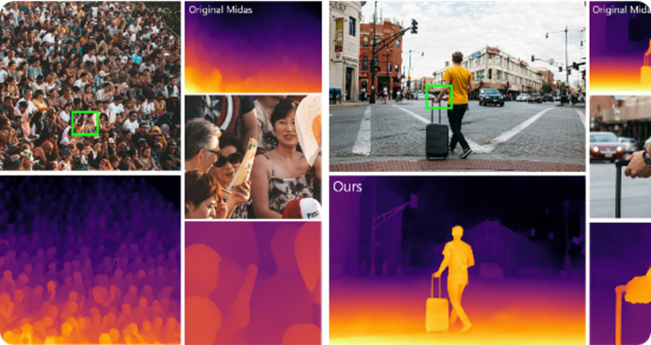
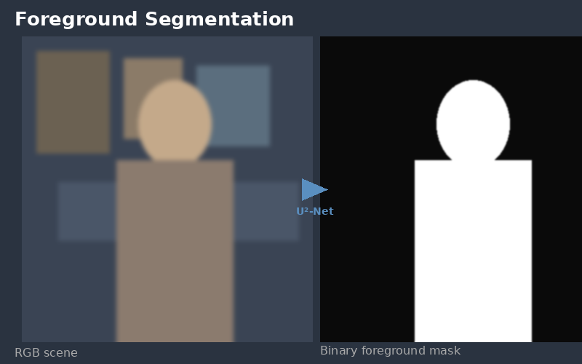
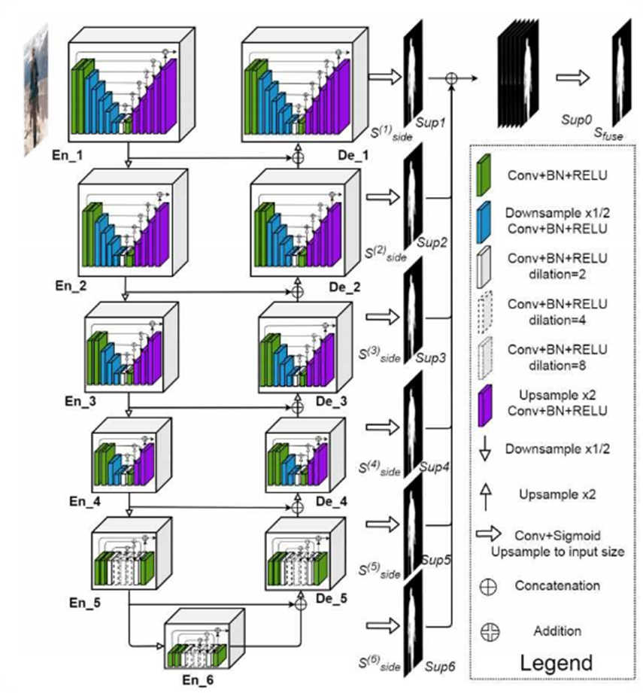
Existing Research Overview
← Outline
Two Foundational Directions in the Literature
Monocular Depth Estimation
MiDaS (Ranftl et al., 2020) demonstrated robust zero-shot depth estimation by mixing multiple datasets.
Enables per-pixel relative depth from a single RGB frame, with no stereo or LiDAR.
Forms the depth backbone used in this work through an ONNX deployment.
Semantic / Salient Segmentation
U₂-Net (Qin et al., 2020) introduced a nested U-structure for strong salient object detection at low cost.
Produces clean binary foreground masks that isolate real-world objects from the background.
Used here to identify real pixels whose depth must be compared against the virtual object.
Fig. Example MiDaS depth output (plasma colormap)
Fig. RGB scene → U²-Net binary foreground mask
4/16/2026
5

Slide 6
Existing Research Overview
← Outline
Commercial AR Platforms
Google ARCore Depth API
Google’s ARCore exposes a Depth API for object occlusion in AR, but relies on supported devices and motion-based depth, limiting static single-frame and webcam-only use.
What the Literature Tells Us
Strong monocular depth models now exist and are accessible.
Robust, lightweight segmentation models are readily available.
Commercial AR occlusion remains tied to motion cues or hardware sensors.
A purely monocular, sensor-free occlusion pipeline that combines both models is not widely demonstrated.
Apple ARKit with LiDAR
On recent iPhones and iPads, ARKit uses the built-in LiDAR scanner to produce dense depth maps, achieving high-quality occlusion at the cost of premium, sensor-equipped hardware.
4/16/2026
6

Slide 7
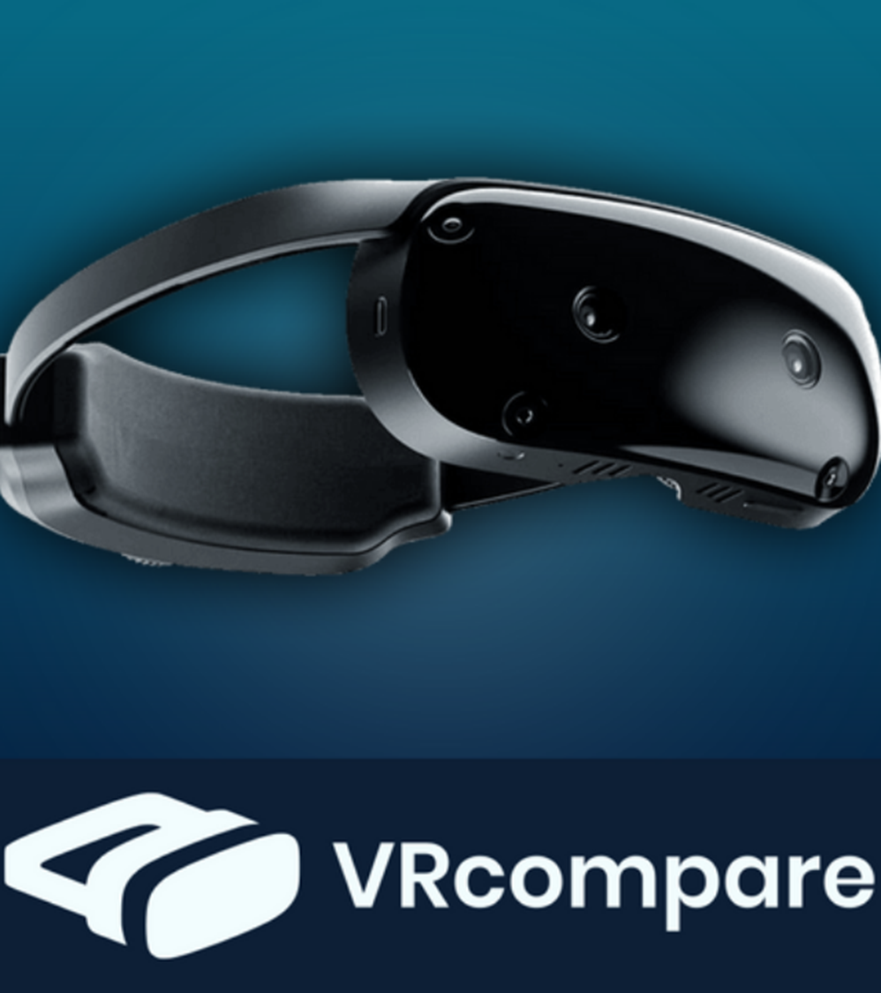
Research Gaps and Objectives
← Outline
Identified Research Gaps
1
Hardware Dependency
2
Fragmented Use of Models
3
Limited XR Headset Validation
Most working occlusion pipelines assume a depth sensor, excluding standard laptops, webcams, and low-cost headsets.
Monocular depth and segmentation are widely studied in isolation, but rarely combined into a single occlusion reasoning pipeline.
Few works demonstrate the feasibility of a purely software-based occlusion pipeline on standalone XR headsets.
4/16/2026
7

Slide 8
Research Gaps and Objectives
← Outline
Research Objectives
Design a Hardware-Free Framework
Build an occlusion-handling pipeline that runs on monocular RGB input alone, with no dedicated depth sensor.
Integrate Depth + Segmentation
Combine a MiDaS-based depth model with a U²-Net-based segmentation model inside a single reasoning module.
Implement a Working Prototype
Deploy the pipeline in Python using OpenCV and ONNX models, validated on a standard laptop webcam.
Demonstrate XR Readiness
Evaluate feasibility for deployment on standalone AR/VR headsets, with planned integration on the AJNAXR headset.
4/16/2026
8

Slide 9
Research Approach and Methodology
← Outline
System Overview — Three-Stage Pipeline
RGB Frame
Monocular Depth
(MiDaS, ONNX)
Semantic Segmentation
(U₂-Net, ONNX)
Occlusion Reasoning
Composited Output
Standard webcam input
Per-pixel depth map
Foreground object mask
Per-pixel depth compare
Virtual object correctly occluded
1. Monocular Depth Estimation — a MiDaS-based ONNX model estimates pixel-level depth from each RGB frame.
2. Semantic Segmentation — a U₂-Net-based ONNX model produces a binary foreground mask to isolate real-world objects.
3. Occlusion Reasoning Module — compares the real-world object’s depth against the assigned depth of the virtual object; if the real pixel is closer, the virtual pixel is hidden.
4/16/2026
9

Slide 10
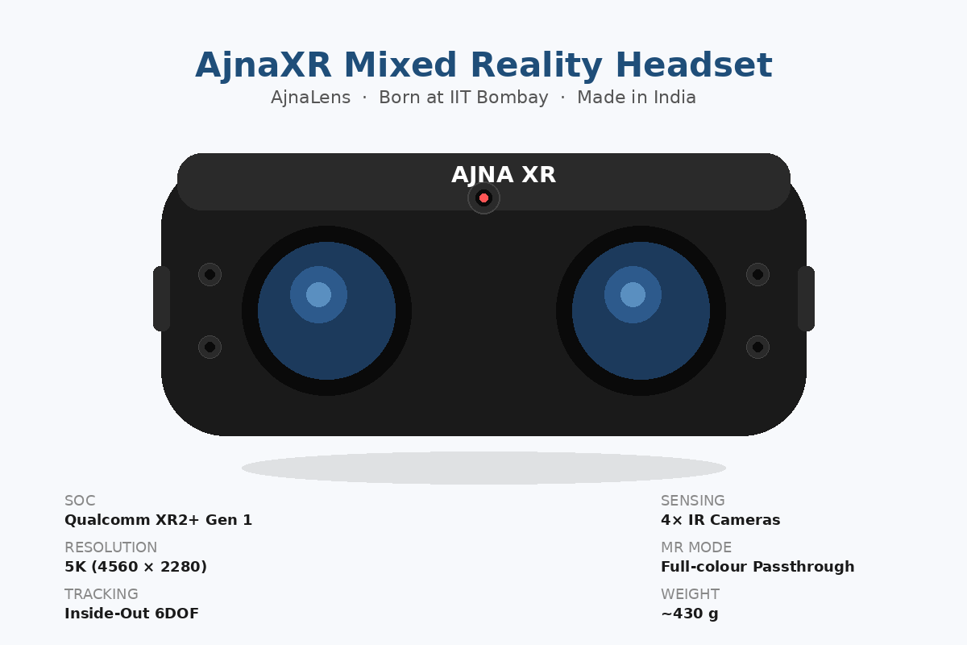
Research Approach and Methodology
← Outline
Occlusion Decision — Per-Pixel Depth Comparison
Implementation Details
Language: Python
Vision / IO: OpenCV
Inference: ONNX Runtime (MiDaS + U₂-Net)
Input: Standard laptop webcam (RGB only)
Processing: CPU-only, no GPU or depth sensor required
Output: Composited frame with occluded virtual object
Target deployment: Standalone AR/VR headsets (AJNAXR planned)
Governing Rule
O(x, y) = I(x, y) if D(x, y) < D_{v}
V(x, y) otherwise
Where:
I(x, y) — real-world image pixel at (x, y).
V(x, y) — virtual object pixel at (x, y).
D(x, y) — estimated depth of the real scene.
D_{v} — assigned depth of the virtual object.
Target deployment device:
4/16/2026
10

Slide 11
Proposed Work
← Outline
A Hardware-Free Occlusion Reasoning Framework
Core Contribution
A monocular, AI-driven occlusion pipeline that replaces LiDAR and Time-of-Flight sensors with standard RGB input.
Unified module that fuses per-pixel depth and foreground segmentation into a single occlusion decision per frame.
Full Python + OpenCV + ONNX implementation validated on a standard laptop webcam with no auxiliary hardware.
Designed from the outset for deployment on standalone AR/VR headsets, with planned integration on the AJNAXR headset.
Why It Matters
Cost-effective: removes the need for dedicated depth hardware.
Scalable: runs on commodity laptops and potentially on XR headsets without specialised sensors.
Adaptable: modular pipeline where individual models can be swapped for lighter or more accurate alternatives.
Accessible: opens occlusion-aware AR to a much wider class of devices.
4/16/2026
11

Slide 12
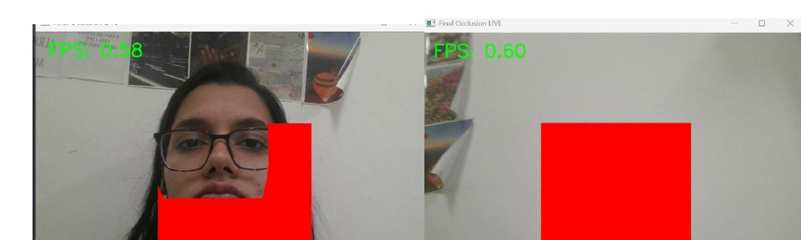
Results and Analysis
← Outline
Experimental Demonstration
Key Observations
Correct Occlusion Behaviour
Virtual object is properly hidden when the real subject is closer to the camera.
Runtime Performance
0.5–1 FPS on a CPU-only setup using a standard laptop webcam.
Hardware-Free Operation
No LiDAR, ToF, or depth sensor required — only an RGB camera.
Fig. 1. Left: virtual object correctly hidden behind the foreground subject. Right: virtual object fully rendered in the absence of foreground objects.
0.5 – 1
FPS on CPU-only laptop
0 sensors
Runs on standard RGB webcam
4/16/2026
12

Slide 13
Conclusion and Future Work
← Outline
Conclusion
Hardware-independent occlusion handling is feasible using only monocular vision-based AI models.
The prototype reproduces realistic occlusion effects without any dedicated depth hardware.
Results validate the effectiveness of AI-based models for efficient per-pixel depth reasoning.
Though throughput is currently limited by model size and CPU-only inference, the framework is efficient enough to support XR devices.
Future Work
1
Real-Time Performance
Optimise inference pipeline to raise frame rate beyond 1 FPS.
2
Lightweight Model Assessment
Evaluate compressed and distilled variants of MiDaS and U²-Net.
3
XR Headset Integration
Deploy and validate on the AJNAXR standalone headset.
4
Robustness Evaluation
Test across varied lighting, backgrounds, and scene complexity.
4/16/2026
13

Slide 14
References
← Outline
[1] R. Ranftl, K. Lasinger, D. Hafner, K. Schindler, and V. Koltun,
“Towards Robust Monocular Depth Estimation: Mixing Datasets for Zero-Shot Cross-Dataset Transfer,”
IEEE Transactions on Pattern Analysis and Machine Intelligence, 2020.
[2] X. Qin, Z. Zhang, C. Huang, M. Dehghan, O. Zaiane, and M. Jagersand,
“U²-Net: Going Deeper with Nested U-Structure for Salient Object Detection,”
Pattern Recognition, 2020.
[3] Google,
“ARCore Depth API for Object Occlusion in Augmented Reality,”
Available: https://developers.google.com/ar
4/16/2026
14

