Slide 1
Movie Classifier
Shravan Venketraman CSE 3rd Year

Slide 2
Concepts implemented
Tried to implement NLP (Natural Language Processing) by extracting data and text from Wikipedia pages of several movies and checking them for specific male centric keywords
Tried to implement Machine Learning models like DecisionTreeClassifier that helps in taking input and output value columns from a csv file in order to build a model
The ML model helped in determining whether a given film was male centric or not by checking whether the average centrality of the character was above 10

Slide 3
Libraries imported
Wikipedia/WikipediaAPI (For using Wikipedia’s web scraping modules)
Pandas (For creating dataframes in python from csv files)
Requests and bs4 (Also for web scraping Wikipedia pages and reading them into a text file)
Sklearn, Sklearn.tree and Sklearn.model_selection (For importing DecisionTreeClassifiers and other modules to assign training and testing data – train_test_split)

Slide 4
Datasets used
Male_mentions_centrality.csv (For creating the DecisionTreeClassifier)
Male_adjverb.csv (For crosschecking with Wikipedia pages for keywords)

Slide 5
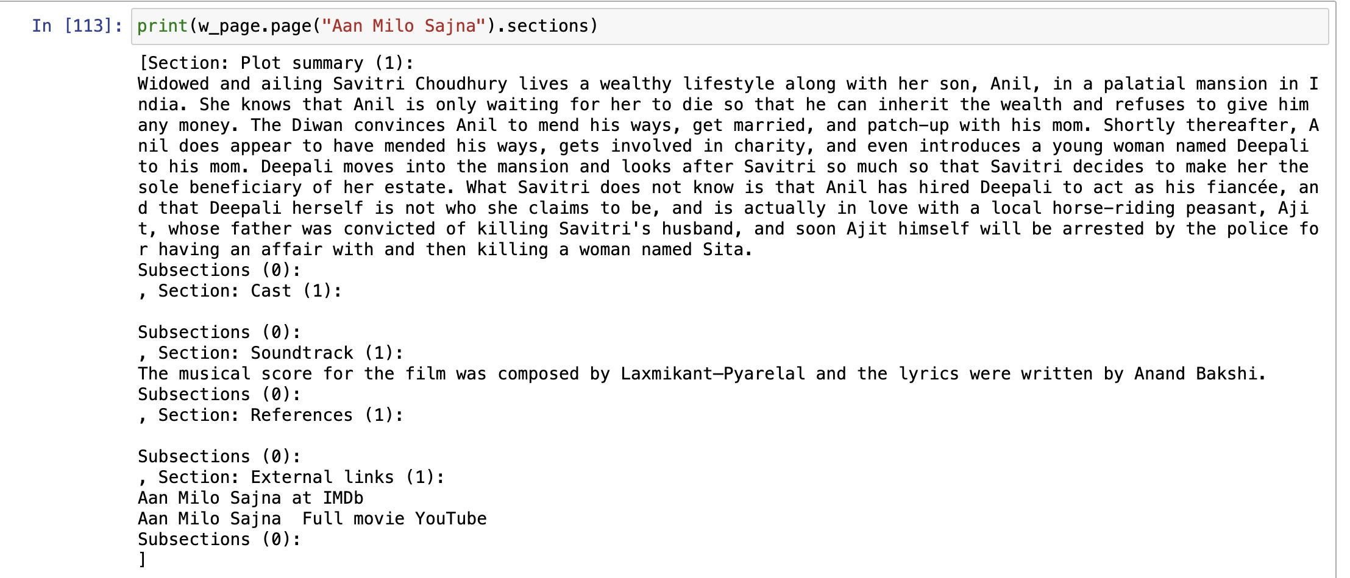
Web scraping from wikipedia

Slide 6
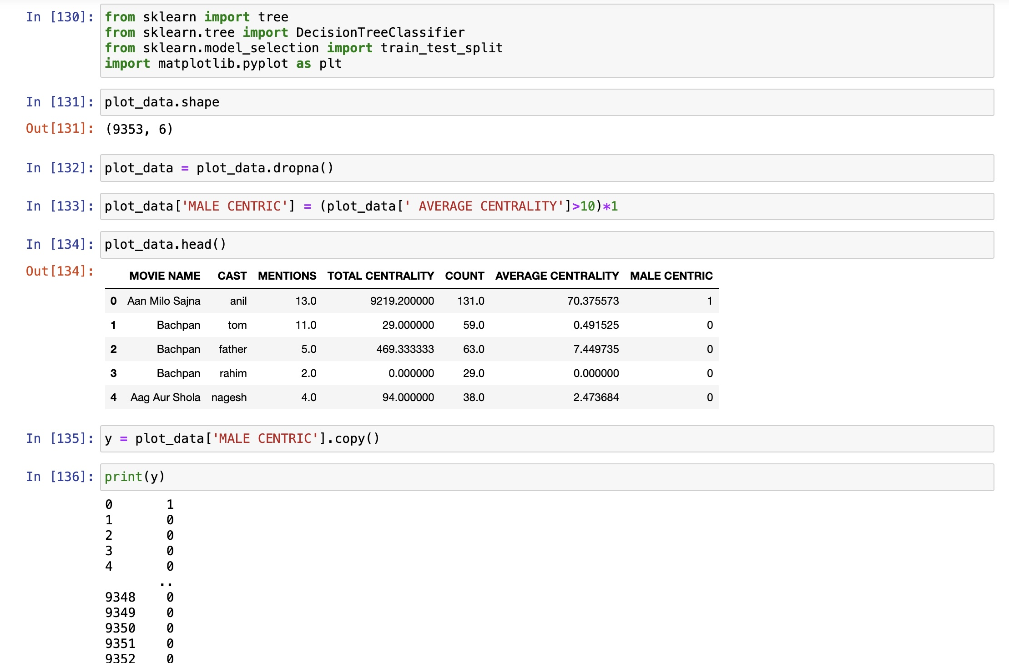
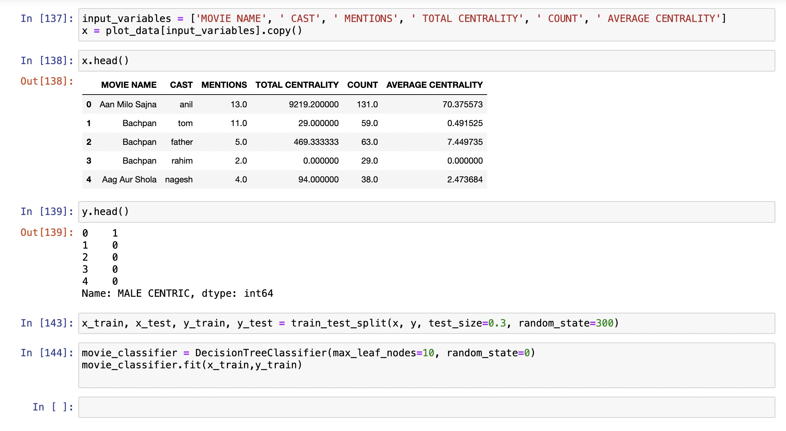
DecisionTreeClassifier

Slide 7
THANK YOU

