Slide 1
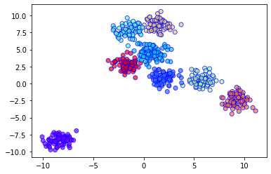
Balanced Iterative Reducing and Clustering using Hierarchies (BIRCH) is a clustering algorithm that can cluster large datasets by first generating a small and compact summary of the large dataset that retains as much information as possible. This smaller summary is then clustered instead of clustering the larger dataset. BIRCH is often used to complement other clustering algorithms by creating a summary of the dataset that the other clustering algorithm can now use.

Slide 2
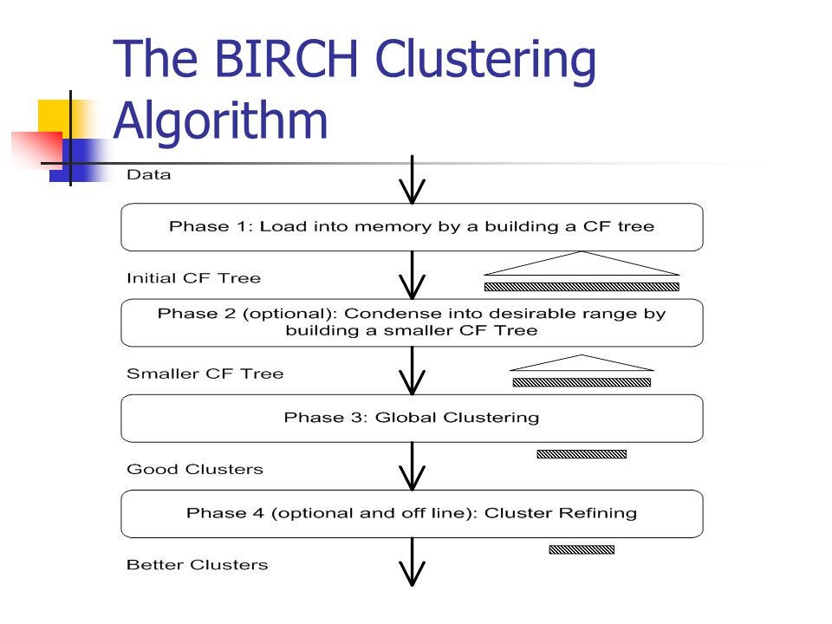

Slide 3
