Slide 1
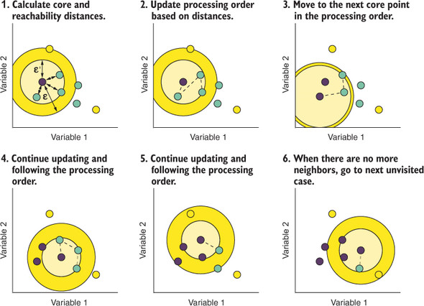
OPTICS (Ordering Points To Identify the Clustering Structure) is a density-based clustering algorithm, similar to DBSCAN (Density-Based Spatial Clustering of Applications with Noise), but it can extract clusters of varying densities and shapes. It is useful for identifying clusters of different densities in large, high-dimensional datasets.

Slide 2
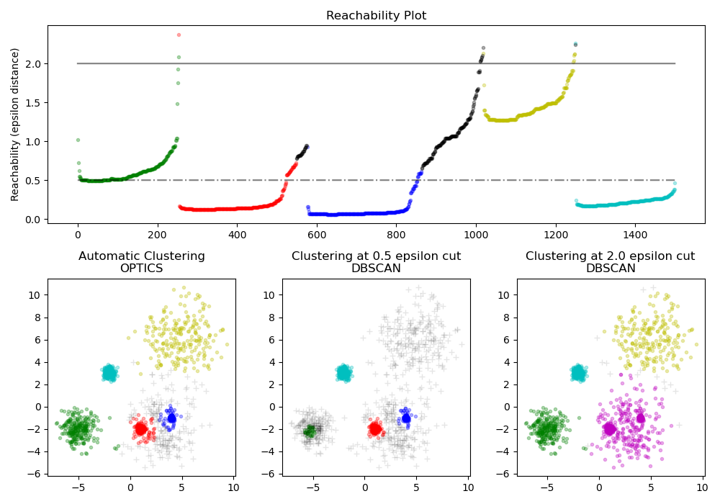
Illustration of how works

Slide 3
