Slide 1
11.10.2021 (Ex.no.10)
18.10.2021 (Ex.no.10)
25.10.2021 (Ex.no.10)

Slide 2
Ex.no.10
Entity Relationship Diagram

Slide 3
Database
A database is an organized collection of structured information, or data, typically stored electronically in a computer system.

Slide 4
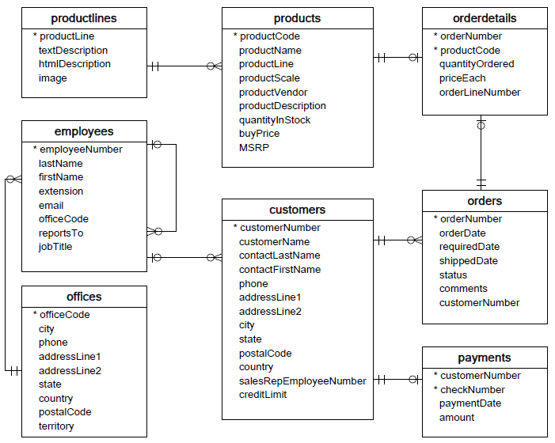
Database Example

Slide 5
Entity components
Entity
Attributes
Keys
Cardinality

Slide 6
Entity Relationship
A primary key is used to ensure data in the specific column is unique. It is a column cannot have NULL values. It is either an existing table column or a column that is specifically generated by the database according to a defined sequence.
A foreign key is a column or group of columns in a relational database table that provides a link between data in two tables. It is a column (or columns) that references a column (most often the primary key) of another table.

Slide 7
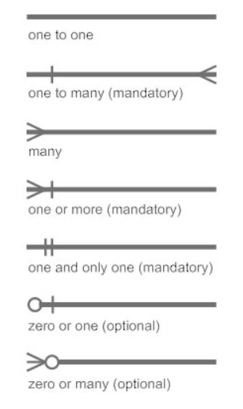
Cardinality
Cardinality specifies how many instances of an entity relate to one instance of another entity.

Slide 8
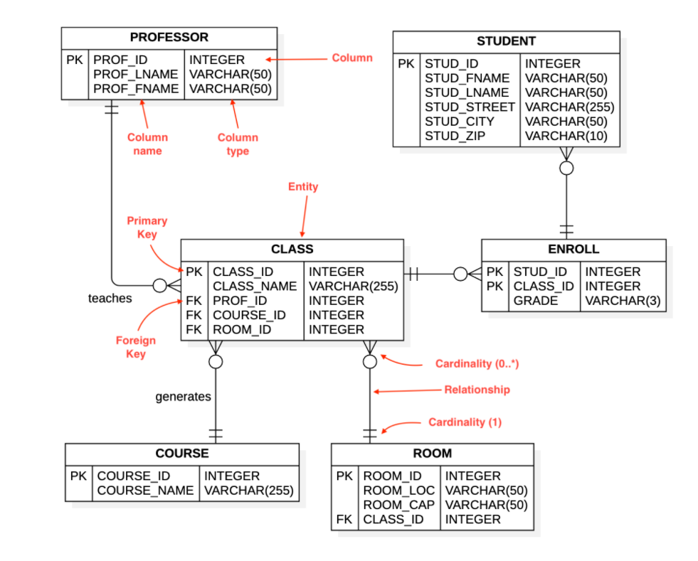
An example

Slide 9
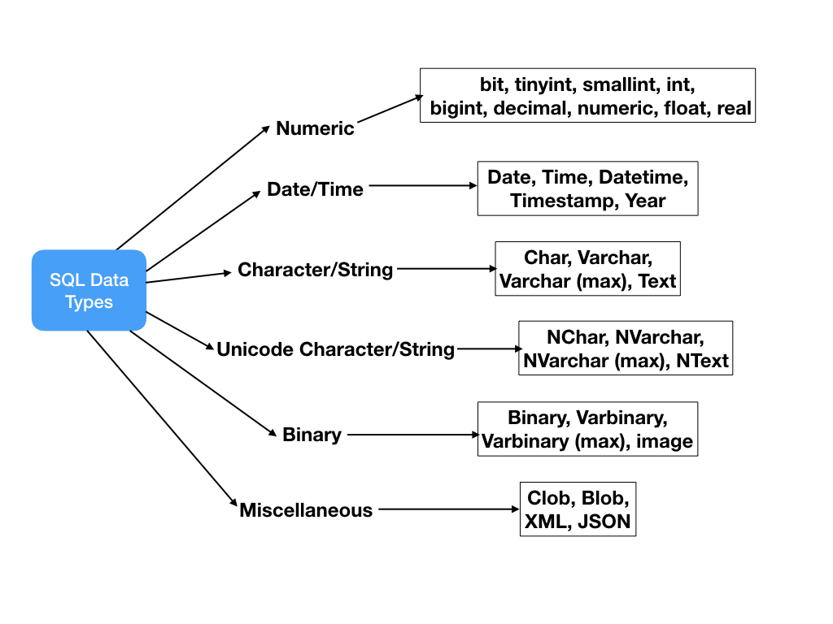
Database datatype

