Slide 1
MM811 Presentation
Topic: Coach MO: Question Generation
-Mottiv
Team #6
Raju Bhattarai, Rajapriya, Ruban Gino Singh

Slide 2
Coach Mo : Problem Statement & Challenges
Problem Statement
Athletes and fitness enthusiasts ask detailed, specific questions about workout plans.
They expect instant, personalized answers that align with their fitness goals.
Current System Limitation:
Relies on a pre-built database for responding to queries.
Provides generic responses if an answer is unavailable, causing user dissatisfaction.
Challenges
Incomplete Database:Limited scope of responses leads to delays and reduced user engagement.
Scalability Issues:As the user base grows, updating and maintaining the database becomes increasingly difficult.
Personalization Gap:Generic responses fail to meet user expectations for tailored coaching.
User Retention Risk:Frustration with delays or generic answers may lead users to switch to alternative platforms.

Slide 3
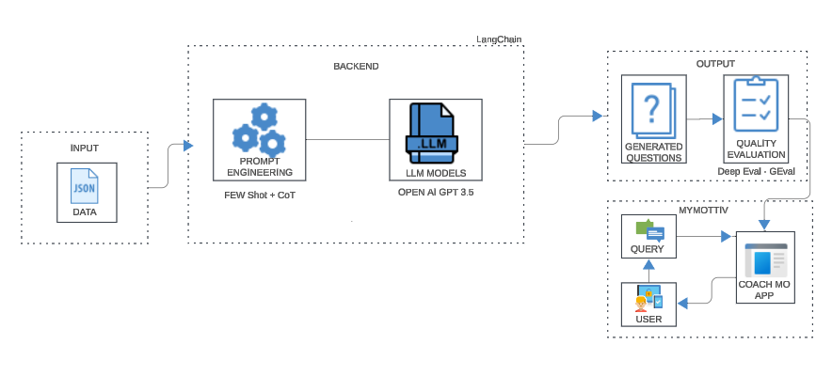
Implementation

Slide 4
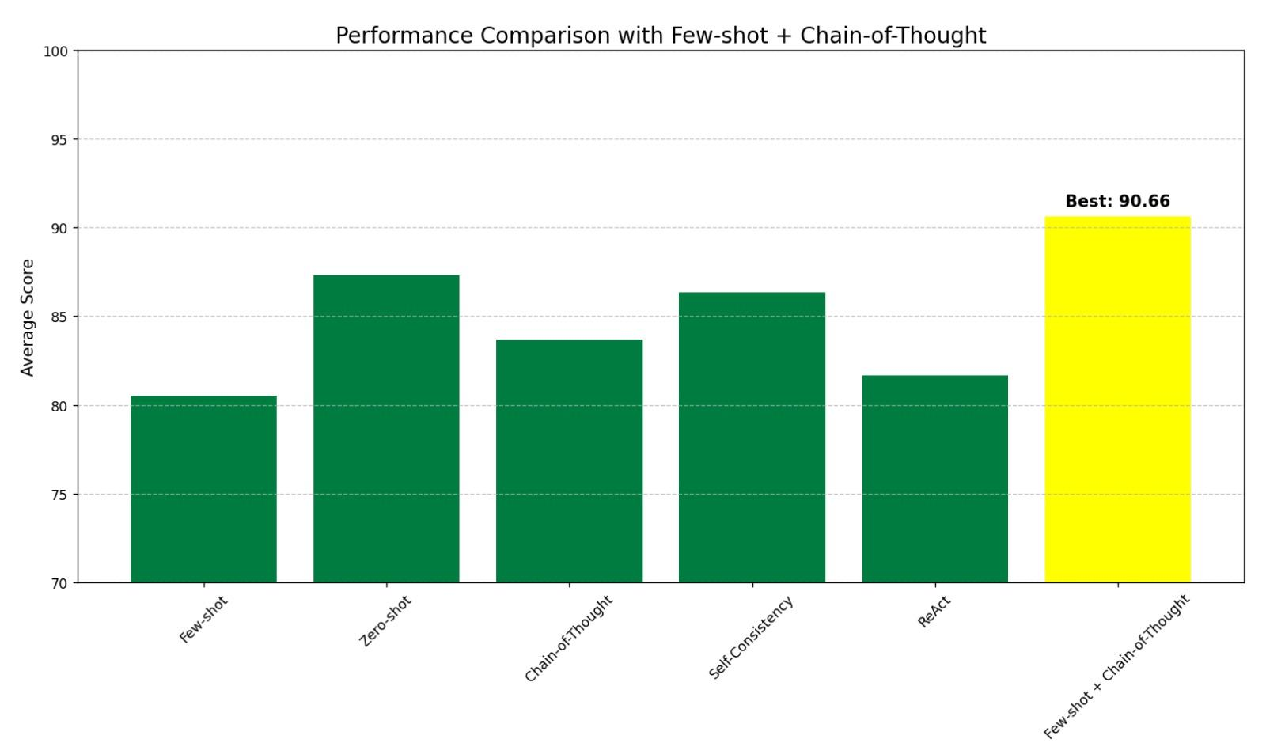
Evaluation of Prompting Techniques
Prompting Techniques Overview
Zero-shot Prompting:
Simple task description; generated questions were generic and lacked depth.
Few-shot Prompting:
Examples improved relevance but lacked reasoning depth.
Chain-of-Thought Prompting:
Enhanced logical structure; occasionally verbose or redundant.
ReAct (Reasoning + Acting):
Combined reasoning with action; promising but computationally expensive.
Selected Approach: Few-shot + Chain-of-Thought Combination
Tailored questions align with workout context.
Effectively addresses user-specific goals.
The Hybrid Prompting Technique provides the best balance for high-quality, contextual question generation, making it the most effective methodology for Coach Mo.

Slide 5
Introduction to G-Eval Metrics by DeepEval Framework
What is DeepEval?
To evaluate large language models (LLMs) and generative AI systems.
Includes a set of metrics designed to measure the performance of these systems
Focus on G-Eval Metrics:
Core components of DeepEval.
In-depth assessment of model-generated content.
Focuses on natural language understanding, coherence, relevance, and factuality.
Uses of G-Eval?
Provides robust evaluation for AI and LLMs.
Identifying strengths and weaknesses of the generated content.
Ensures alignment with real-world use cases.

Slide 6
Key Features of G-Eval Metrics
Quality of Generated Content:
Assesses the fluency, grammar, and readability of the output.
Relevance & Coherence:
Measures how relevant and contextually appropriate the responses are to the given input.
Evaluates logical flow and consistency within the generated text.
Factual Accuracy:
Assesses the factuality of the model's response.
Compares the output against reliable data sources.
Diversity & Creativity:
Measures the level of diversity in the output to avoid repetitive and predictable responses.
Encourages creativity without sacrificing relevance.

Slide 7
Why Use G-Eval for This Evaluation?
Comprehensive Evaluation:
Multi-dimensional approach to assessing the accuracy and quality of generated questions.
Evaluates not just grammar and syntax but also factual correctness, relevance, and alignment.
Customization for Specific Use Cases:
Evaluate specific metrics like correctness and relevance tailored to a particular use case.
Improving Model Performance:
Helps in pinpointing areas of improvement for the AI system.
Objective and Automated Evaluation:
Offers an automated way to evaluate AI-generated questions without requiring manual input, providing a more consistent and scalable approach to evaluation.
Scoring mechanism in the code allows for consistent grading of generated content.

Slide 8
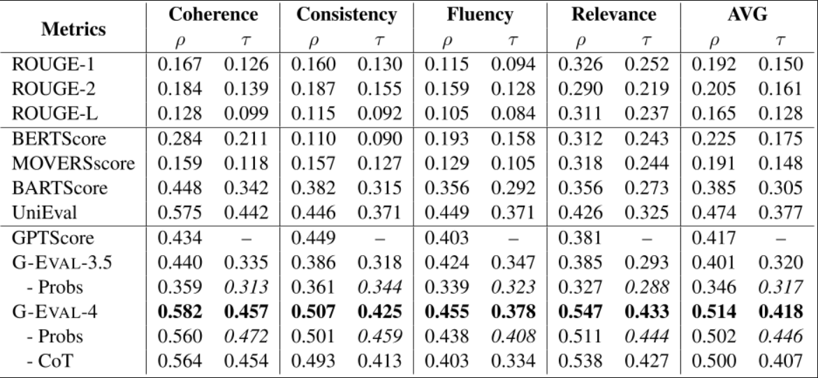
G-Eval Compared to other Metrices
Yang Liu, Dan Iter, Yichong Xu, Shuohang Wang, Ruochen Xu, & Chenguang Zhu. (2023). G-Eval: NLG Evaluation using GPT-4 with Better Human Alignment.

Slide 9
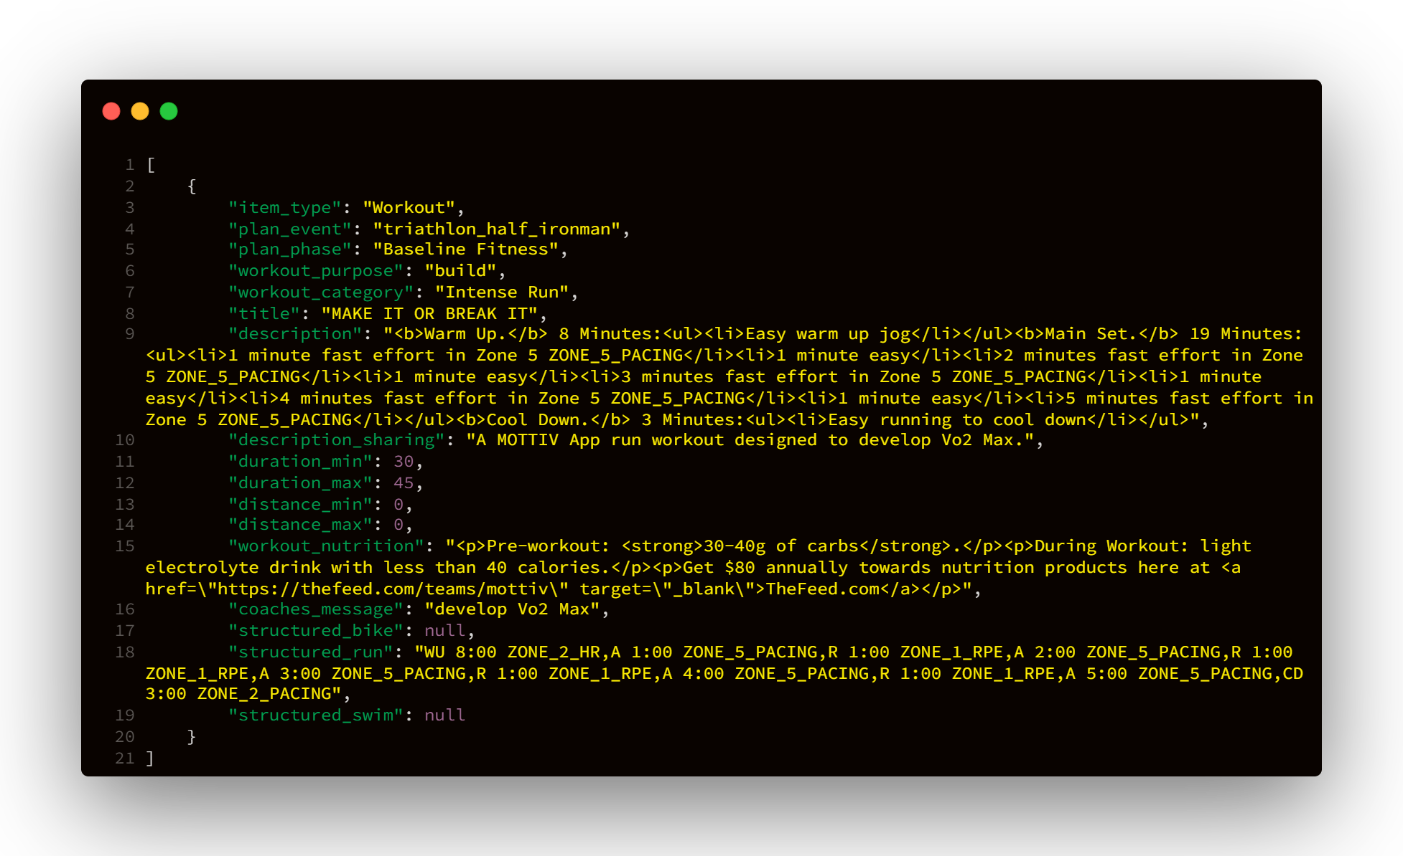
Workout Data

Slide 10
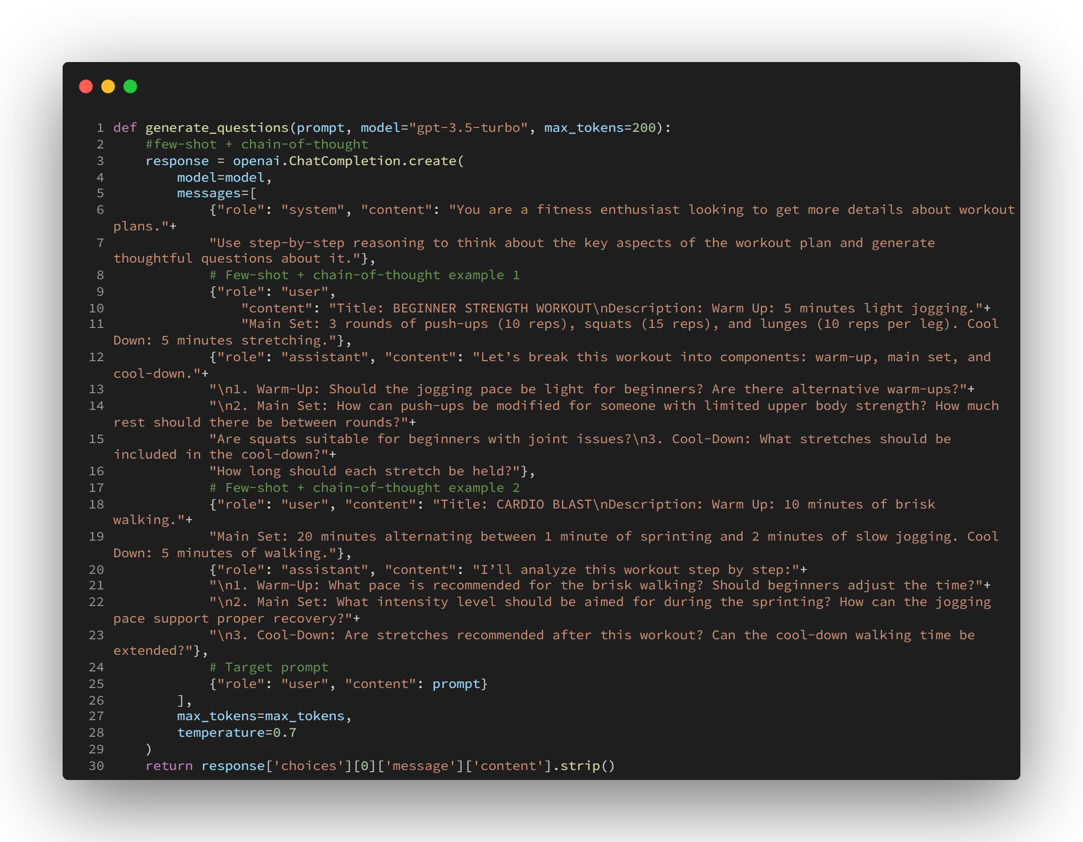
Code Implementation

Slide 11
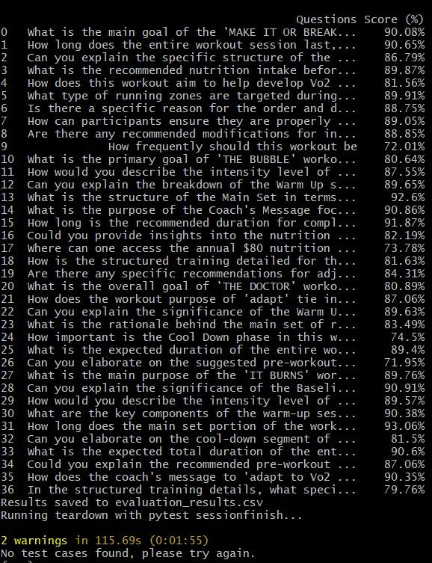
Results

Slide 12
Novelty
Mottiv Vs Our System
Metric | Mottiv | Our System
Question Generation | Manual | Few Shot + Chain-Of-Thought
Quality Accuracy | 75% | 85%
Evaluation Type | Batch-Based | Per-Question
Attributes Used | Description | All Attributes

Slide 13
Discussion
Key Contributions:
Few-shot + Chain-of-Thought prompting: Enhances reasoning and quality.
85% Quality Benchmark: Sets a new standard.
Per-question evaluation: Ensures accuracy and reliability.
Impact of our project:
Higher accuracy, relevant and diverse questions.
Enriched question database
Cost savings
Reduced waiting time

Slide 14
Thank You

