Slide 1

Student Details
Name : Ruban christan pais
Skill Build email ID : rubanpais99@gmail.com
College name : ST Joseph engineering college
College state : karnataka
Internship domain : artificial Intelligence
Start date - end date : 12/06/2023 – 24/07/2023

Slide 2
PROJECT TITLE : Mental fitness tracker Problem Statement
Mental illness is a health problem that undoubtedly impacts emotions, reasoning, and social interaction of a person.These issues have shown that mental illness gives serious consequences across societies and demands new strategies for prevention and intervention. To accomplish these strategies, early detection of mental health is an essential procedure.The increase of mental health problems and the need for effective medical health care have led to an investigation of machine learning that can be applied in mental health problems.
Machine learning is a technique that aims to construct systems that can improve through experience by usingadvanced statistical and probabilistic techniques. It is believed to be a signiﬁcantly useful tool to help in predictingmental health. It is allowing many researchers to acquire important information from the data, provide personalized experiences, and develop automated intelligent systems.

Slide 3

AGENDA
The agenda for building a mental fitness tracker involves creating and user-centered approach to mental well-being. The mental fitness tracker plays an important role in creating fostering a positive and empathetic environment.
The user-friendly interface will allow easy data input and view mental health status. These days due to pandemics and other crisis the people are lacking from mental fitness the main aim of the tracker is to help the people.

Slide 4
PROJECT OVERVIEW
Mental Fitness Tracker with ML Models: A data-driven application called the Mental Fitness Tracker was created to evaluate and enhance the mental health of people throughout the world. The project predicts a person's mental fitness using two different datasets consists of different disorders about people in different nations throughout the world.The heatmaps and pie map are used for visualization of the data available.It consist of many process like data load and processing,data cleaning,training model etc.
Using machine learning models including RandomForest, XGBoost, and SVR regressors.The model evaluation of the model Is also done at the end inorder to give the most accurate and suitable model to be preferred.The software supports users' journeys with their mental health by offering individualized insights, suggestions, and real-time monitoring that promote resilience and well-being.

Slide 5

WHO ARE THE END USERS of this project?
The Mental Fitness Tracker's intended users are people who want to keep track of and enhance their mental health. They may be individuals from a range of age groups, occupations, and backgrounds who wish to monitor their mental health, pinpoint areas that could use work, and get tailored advice on how to enhance their mental fitness. The application serves a wide range of users, including individuals with stress, anxiety, or other mental health issues as well as others who are interested in proactive mental health management.
The tracker allows users to access self-help resources, learn about their mental health patterns, and perhaps even seek professional support for their best mental health.

Slide 6
YOUR SOLUTION AND ITS VALUE PROPOSITION
Our Mental Fitness Tracker is a powerful tool that combines machine learning models, including RandomForest, XGBoost, and SVR regressors, to offer a comprehensive mental health management solution. Utilizing two datasets from different countries, the application delivers personalized mental fitness analyses, real-time monitoring, and evidence-based recommendations to empower individuals in understanding and improving their mental well-being. With user-friendly navigation, data privacy, and cross-country comparisons, the app encourages a proactive approach to mental health,by fostering resilience and personal growth, our solution enables users to take charge of their mental fitness, leading to a more balanced and fulfilling life.

Slide 7
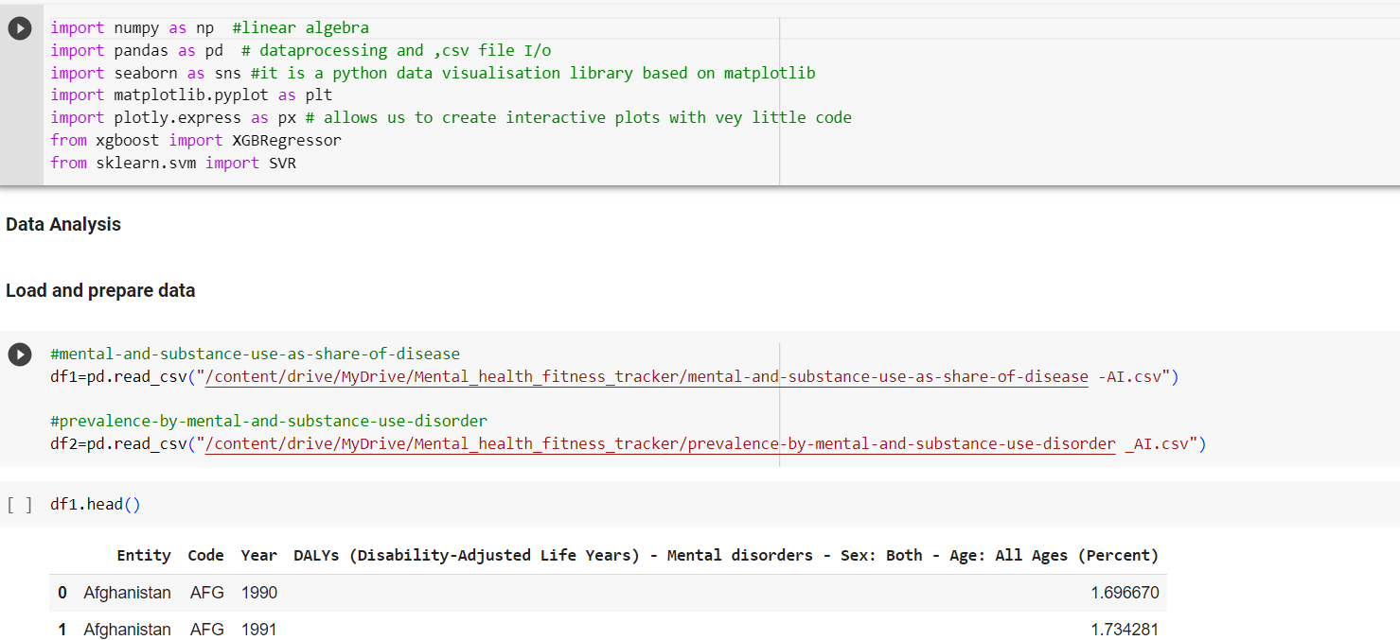
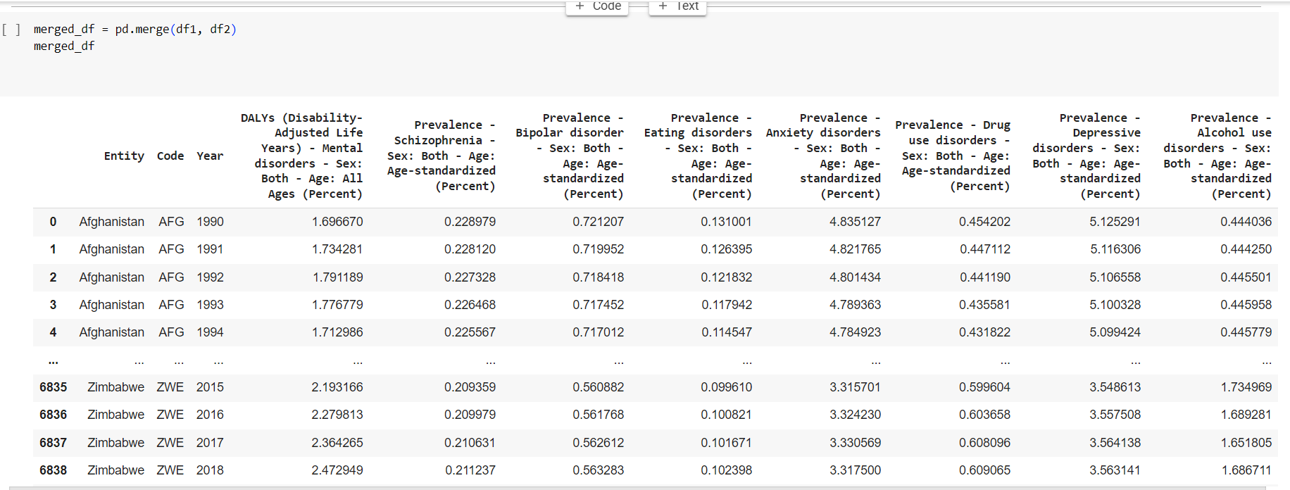
How did you customize the project and make it your own

Slide 8
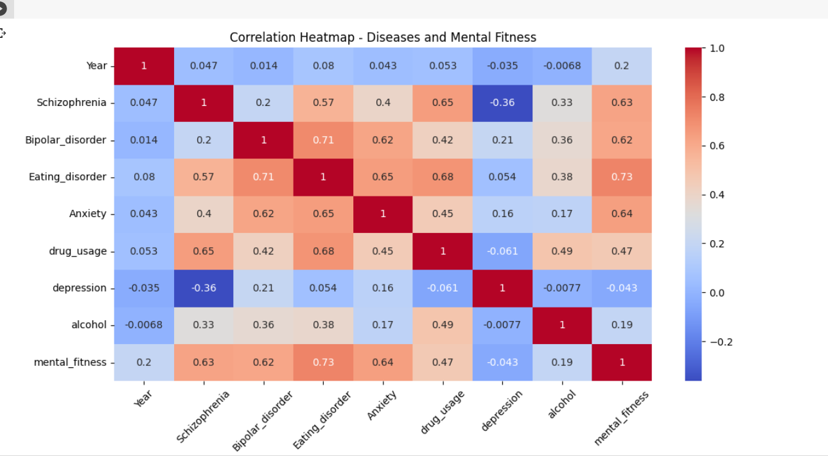
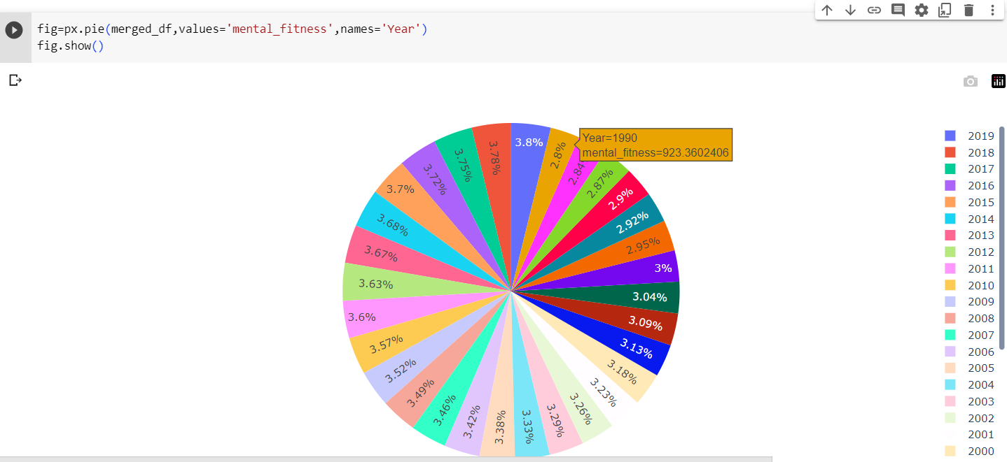
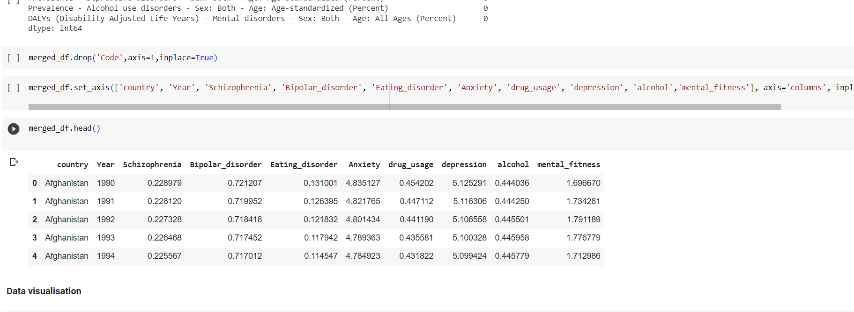

Slide 9
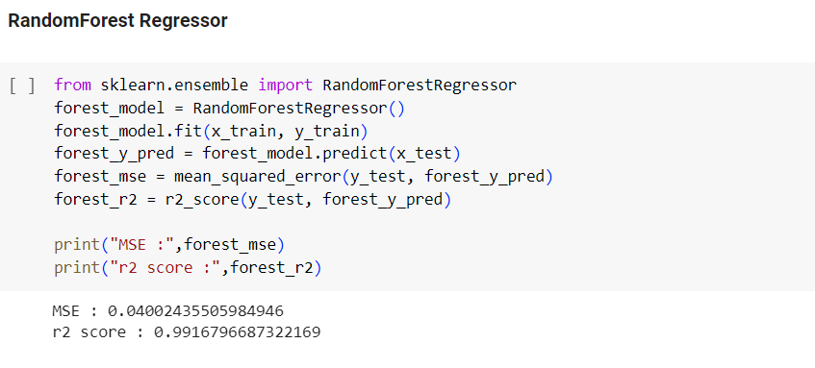
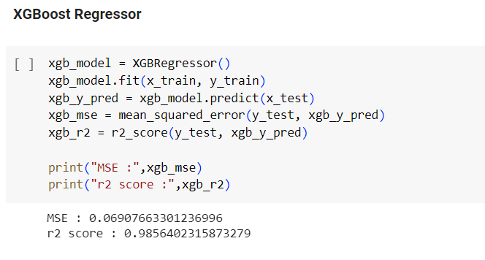
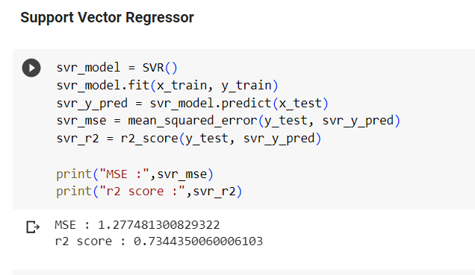
MODELLING

Slide 10
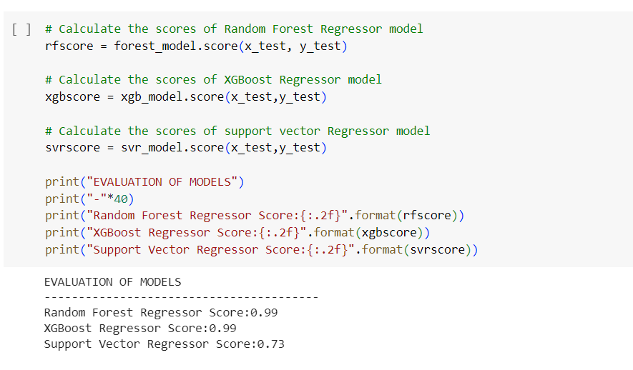
Results

Slide 11
links
Google collab link:
https://colab.research.google.com/drive/1n-Bz4GAnqbABOd8TyqrUe5oDABMTtZtJ#scrollTo=SGxHuGJsCug8
Github link:
https://github.com/Ruban7777/Mental_Fitness_Tracker

