Slide 1
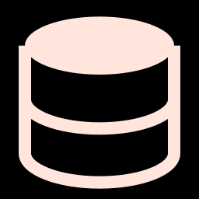



Real-Time Data Sync
MongoDB to Snowflake
Proof of Concept — Edge-to-Cloud Pipeline with High Availability
March 2026 | EXL POC

Slide 2


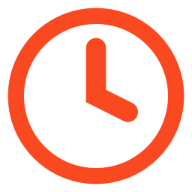

The Challenge
Edge/branch systems generate data that must reach the cloud warehouse in real time
Direct database-to-database replication is fragile — any network interruption loses data
Traditional batch ETL introduces hours of delay
Need a solution that is resilient, real-time, and cost-effective

Slide 3
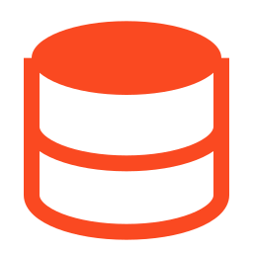



Our Approach: Event-Driven Streaming with Kafka
Use MongoDB Change Streams to capture every insert, update, and delete as it happens
Stream changes through Apache Kafka as a durable, fault-tolerant message bus
Kafka Snowflake Sink Connector delivers data to Snowflake via Snowpipe
If the cloud side goes down, Kafka queues all messages — zero data loss

Slide 4
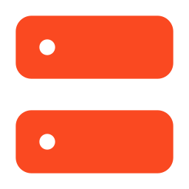
Architecture Overview
EDGE DEVICE
CENTRAL HUB
MongoDB
Kafka (KRaft)
Network ►
Sink Connector
►
Snowflake
(Cloud DW)
Kafka Source
Connector
Kafka UI

Slide 5

Technology Stack
EDGE
HUB
MongoDB 7.0
Apache Kafka 3.8.1 (KRaft mode)
Kafka Connect + MongoDB Source Connector 1.13.1
Kafka Connect + Snowflake
Sink Connector 2.4.0
Kafka UI
Docker & Docker Compose
Docker & Docker Compose

Slide 6
How Data Flows
1
Application inserts/updates a document in MongoDB
2
MongoDB Change Stream emits a change event
3
Kafka Source Connector captures the event and publishes to a Kafka topic
4
Kafka Sink Connector consumes from the topic and stages data to Snowflake
5
Snowpipe loads the staged data into the target table within ~60 seconds
Key Configuration Decisions
• Database-level watching: Source connector monitors ALL collections automatically
• Regex topic subscription: Sink connector auto-subscribes to new collections
• Single-broker Kafka with KRaft mode — no Zookeeper dependency

Slide 7
What Happens When the Cloud Goes Down?
1
2
3
4
Normal
Break
Recovery
Verified
►
►
►
MongoDB → Kafka →
Snowflake
Kafka + Snowflake
go offline
Kafka re-syncs ALL
queued data
All records in
Snowflake — 0 loss

Slide 8
Availability Test Results
Phase | Action | Result
Baseline | 3 seed orders in MongoDB → 3 rows in Snowflake | PASS
During Outage | Inserted 5 orders while Kafka was down → MongoDB accepted all 5 | PASS
Recovery | Restarted Kafka + Sink → All 8 records (3+5) in Snowflake | PASS
Latency | Time from recovery to full sync | < 90 sec

Slide 9
Why Zero Data Loss?
Resume Token
MongoDB Change Streams maintain a resume token — the source connector picks up exactly where it left off
Copy Existing
startup.mode=copy_existing re-copies all existing data on first connect or after offset loss
Durable Log
Kafka's durable log retains messages for 7 days by default
Exactly-Once
Snowpipe provides exactly-once delivery semantics

Slide 10
Resilience Across Failure Types
Failure | Data Lost? | Recovery
Kafka broker down | No | Source connector retries until Kafka returns
Snowflake unreachable | No | Sink connector retries; Kafka retains messages
Edge network drops | No | Source connector reconnects and resumes from last token
MongoDB restarts | No | Change stream resumes from stored resume token
Full power outage | No | copy_existing re-syncs all data on restart

Slide 11
Key Takeaways
Real-Time CDC Pipeline
MongoDB → Kafka → Snowflake in under 60 seconds
Zero Data Loss Proven
Data survives complete cloud-side outage
Zero Cost POC
Built entirely on open-source + free trial

Slide 12

Thank You
Questions?
March 2026 | EXL POC

