Slide 1


Sales Enablement Platform Designed to support scalable, multi-client health insurance sales operations
January 2026

Slide 2
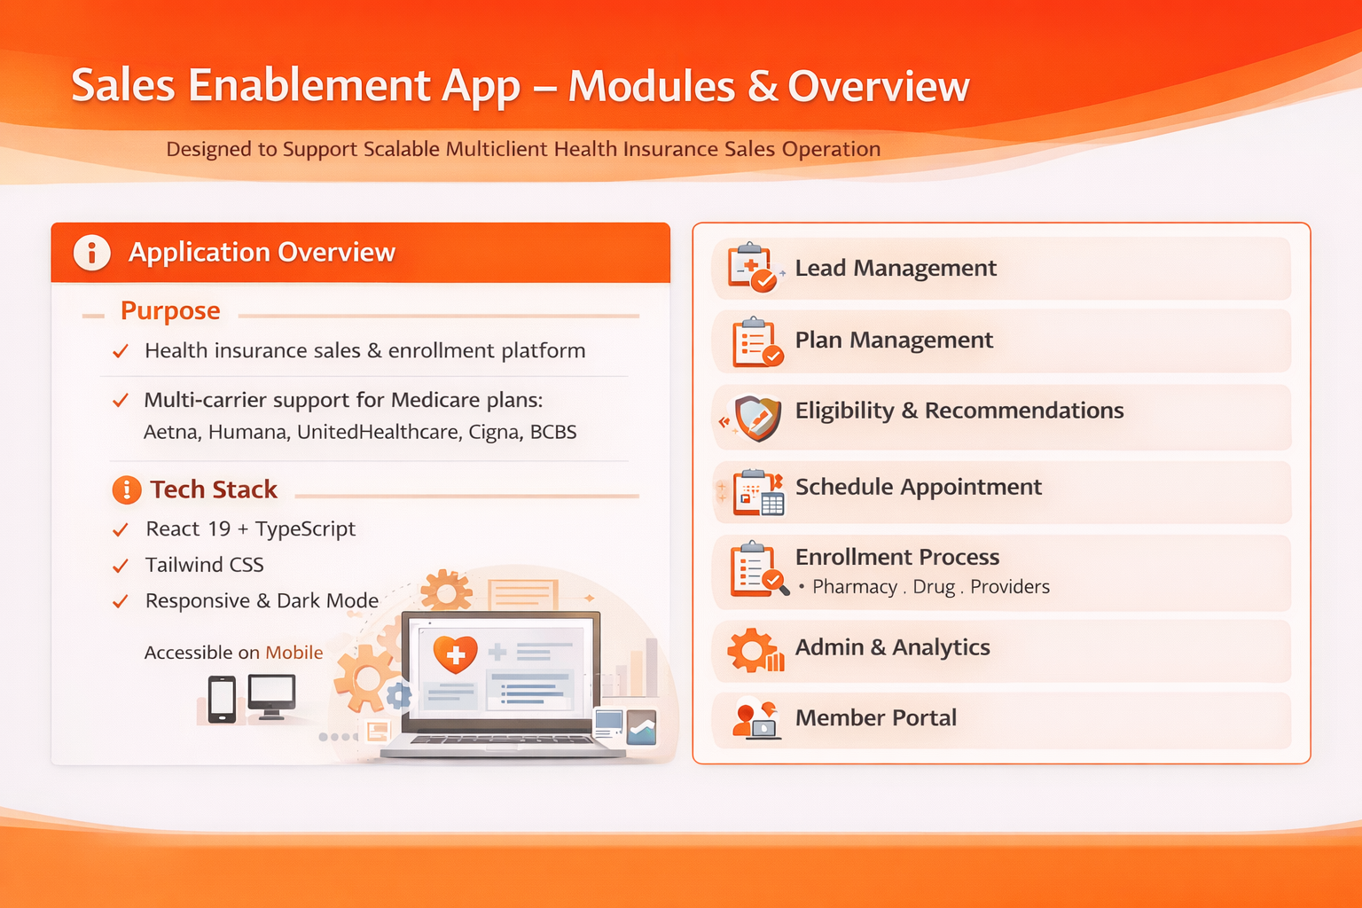

Slide 3






Sales Enablement Platform – Medicare Sales Solution
A reusable sales enablement platform to streamline Medicare lead management, plan selection, and enrollment in a scalable and efficient manner.
Background
Problem Outline:
Medicare sales involves multiple disconnected steps: lead creation, appointment scheduling, plan comparison, and enrollment
Agents rely on fragmented tools, resulting in inefficiencies and inconsistent member experiences
Limited real-time visibility into lead progression and conversion outcomes
Platforms are often built client-specific, limiting reuse and scalability
Objectives:
Build a scalable, reusable sales enablement platform for Medicare enrollment
Provide end-to-end lead-to-member visibility in a single system
Improve agent efficiency while maintaining compliance and accuracy
Targeted Users:
Telesales and field sales agents
Sales managers and operations teams
Business leadership for performance insights
Technology Stack:
React + TypeScript
Responsive Web & Mobile Design
Solution summary
Outcomes
Reusability:
Easily configurable for new clients, carriers, and geographies
Agent Productivity:
Reduced manual effort through guided workflows
End-to-End Visibility
Unified view of lead status, conversions, and enrollments
Scalability:
Designed to support growth without platform redesign
Lead-to-Enroll Workflow
Leads → Appointments → Plan Selection → Eligibility Check → Enrollment → Member
How It Works
Agents manage leads through a structured lifecycle
Plans are filtered based on geography, eligibility, and member needs
Enrollment is guided through a multi-step workflow with validation
Data flows into real-time dashboards for monitoring and optimization
Platform Architecture
Web & Mobile Responsive Application
Modular components for leads, plans, enrollment, and analytics
Role-based access and configurable business rules
Opportunity Results
Better decision-making through real-time insights
Improved lead-to-member conversion tracking
Faster onboarding for new sales use cases

