Slide 1

Team : FIREFLIES

Slide 2
supply chain simulation

Slide 3
Presented By :
NAME ID NO
Shah Alam Titu 152-15-5513
Rabia Akter 152-15-5519
Lucky Sultana Ananna 152-15-5524
Jahid Hasan 152-15-5588
Tipu Sultan 152-15-5599
Mst. Rubaiya Rumi 152-15-6051

Slide 4
DATA STURCTURE
Link list
The reason behind using link list
Justify the reason

Slide 5
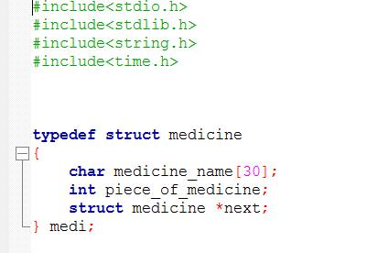
Data Type (3 attributes)

Slide 6
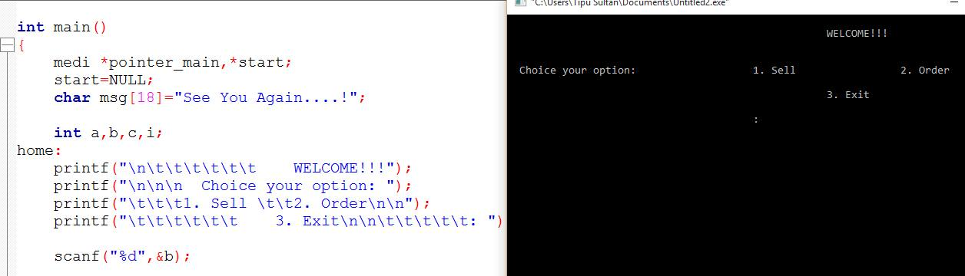
main function

Slide 7
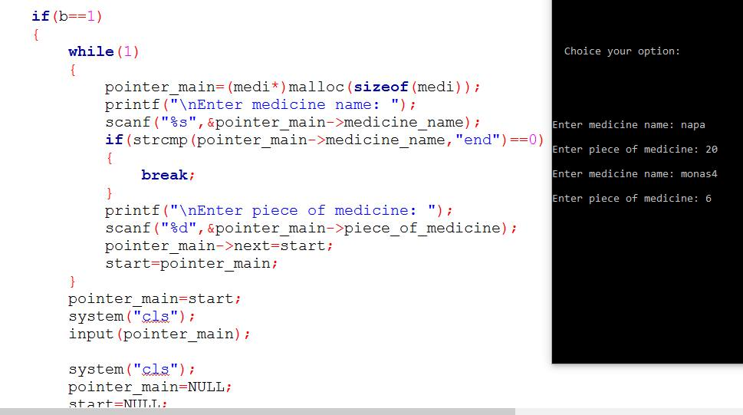
Input

Slide 8
NODE Pointer_main=(medi*)malloc(sizeof (medi));
Pointer_main next
Medicine_name piece_of_medicine

Slide 9
NODE
Start=NULL;
Pointer_main->next=start;
Pointer_main
next
Medicine_name piece_of_medicine
napa | 18

Slide 10
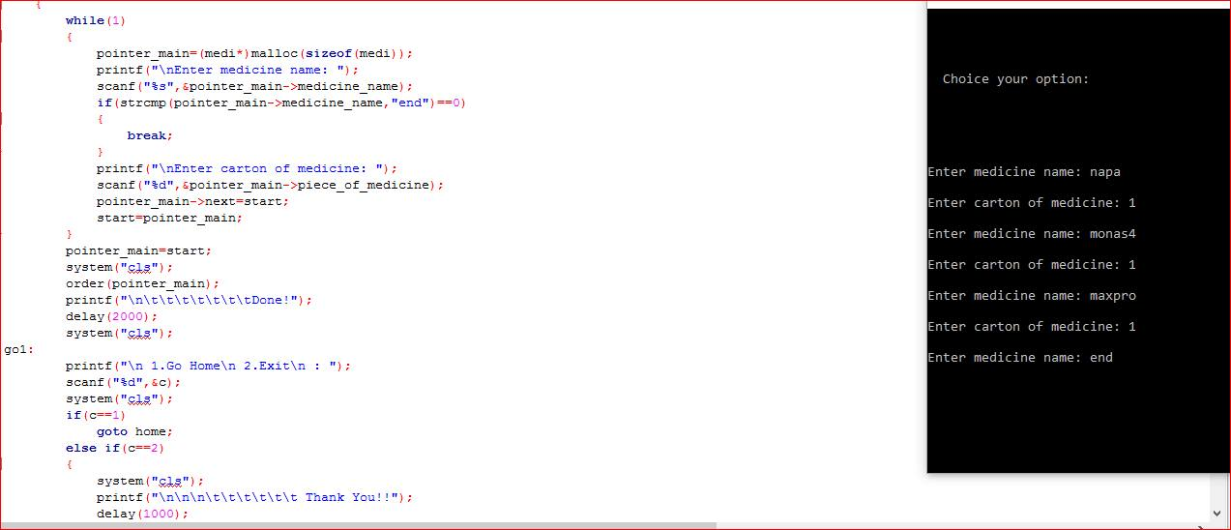
Input Function

Slide 11
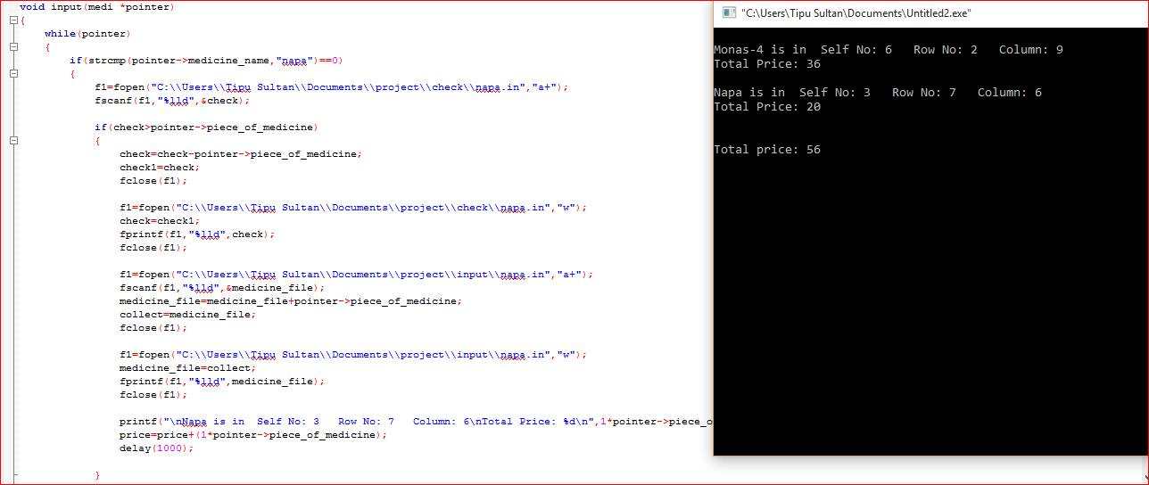
Input Function

Slide 12
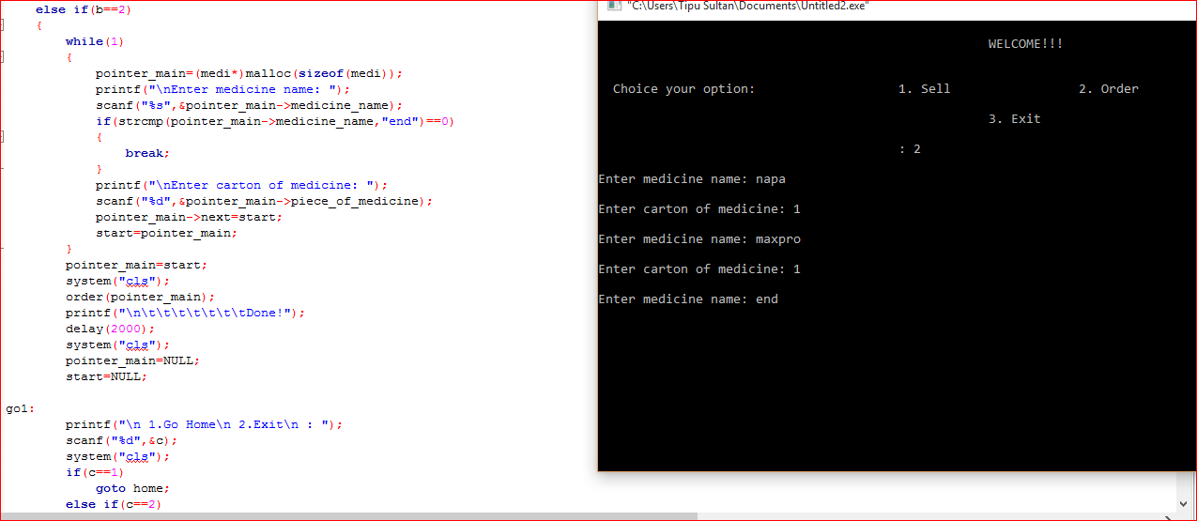
Order function

Slide 13
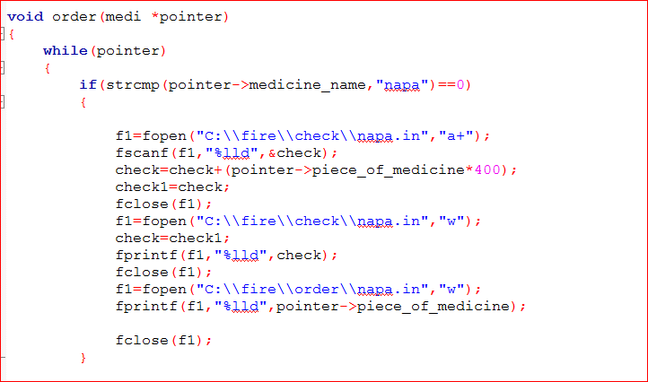
Order Function

Slide 14
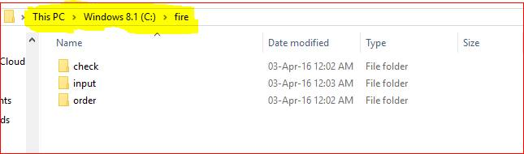
Saved Files in PC

Slide 15
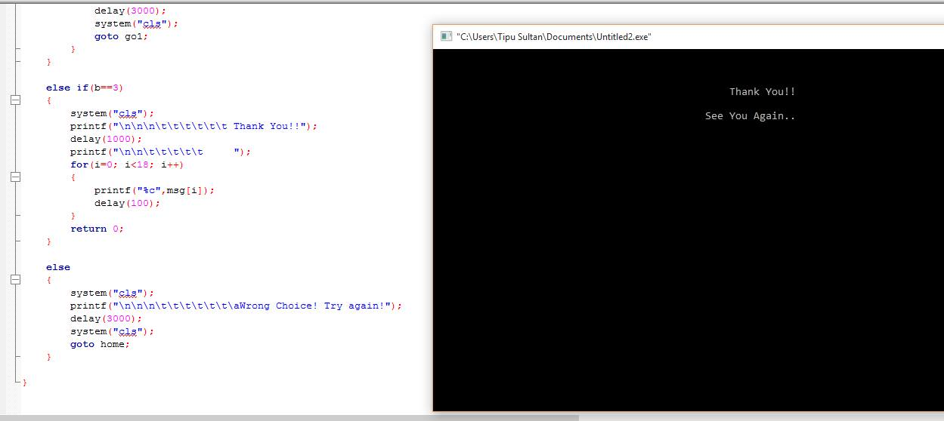
Last Display

Slide 16
Question Segment

Slide 17
Thank You

