Slide 1
Team : FIREFLIES

Slide 2
supply chain simulation

Slide 3
Presented By :
NAME ID NO
Shah Alam Titu 152-15-5513
Rabia Akter 152-15-5518
Lucky Sultana Ananna 152-15-5524
Jahid Hasan 152-15-5588
Tipu Sultan 152-15-5599
Mst. Rubaiya Rumi 152-15-6051

Slide 4
Table of Contents :
Definition
Importance of Supply Chain
Supply Chain Management
Bullwhip Effect
Plans For The Development
App in Supply Chain Management
Flow Chart
App’s Working Process
Advantages
Minimize Bullwhip Effect
Disadvantages
Conclusion
References
Working Progress

Slide 5
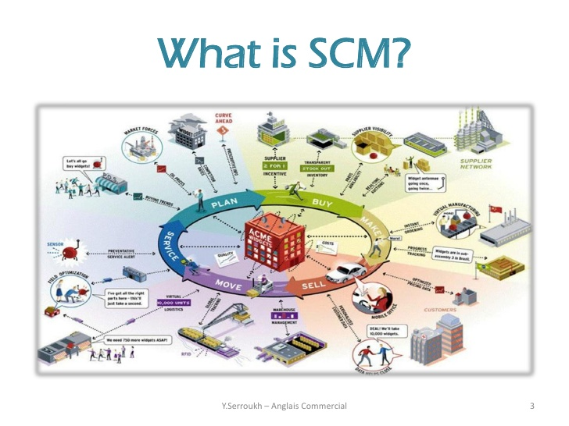
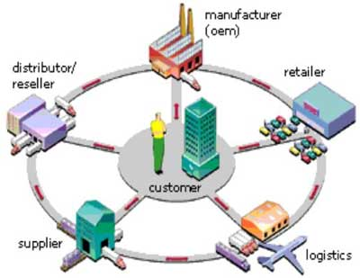
Definition :

Slide 6
Importance of Supply Chain
Public Demand
Existence of Every Company
for instance : Medicine Company
Leather Factory
Jute Mill
Tea/Coffee Factory
Packet Food etc.

Slide 7
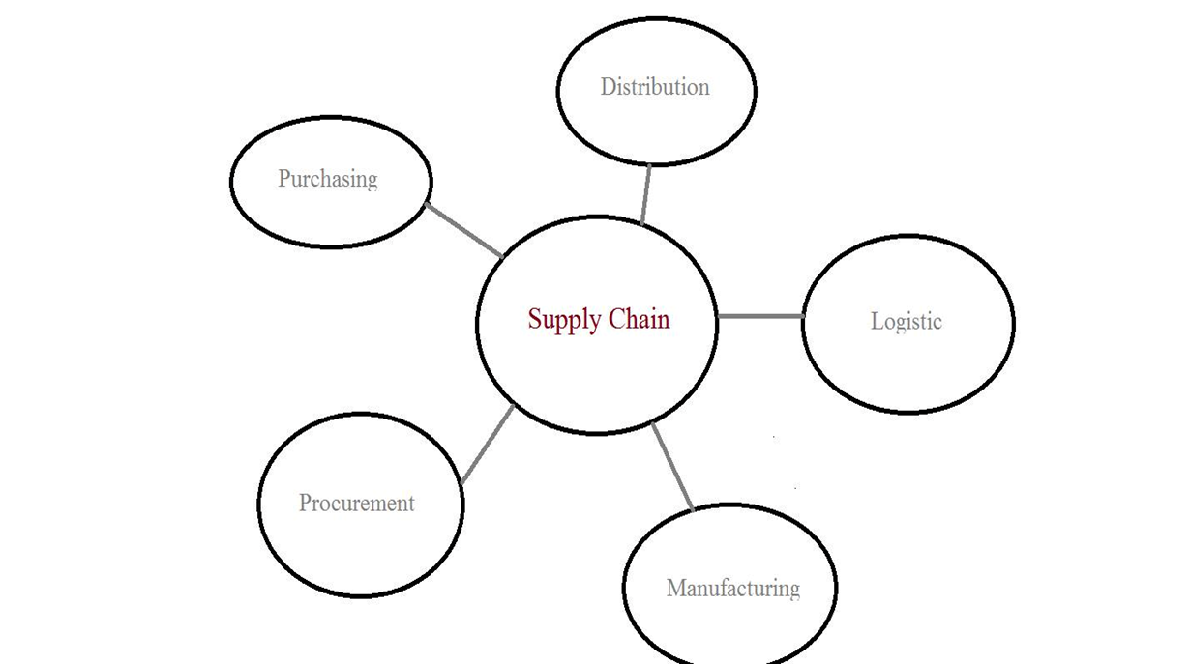
Supply Chain Managements

Slide 8
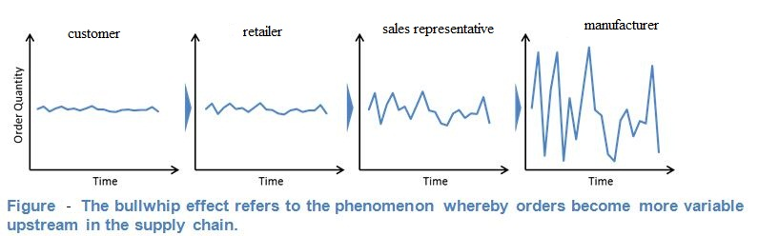
Bullwhip Effect
Definition
Disorganization
Lack of Communication
Price Variation
Demand Information

Slide 9
App in Supply Chain Management
Manual Process Becomes Digitalized
Able to Send Information Fast
For This App, Total Process Will be Specific & Organized

Slide 10
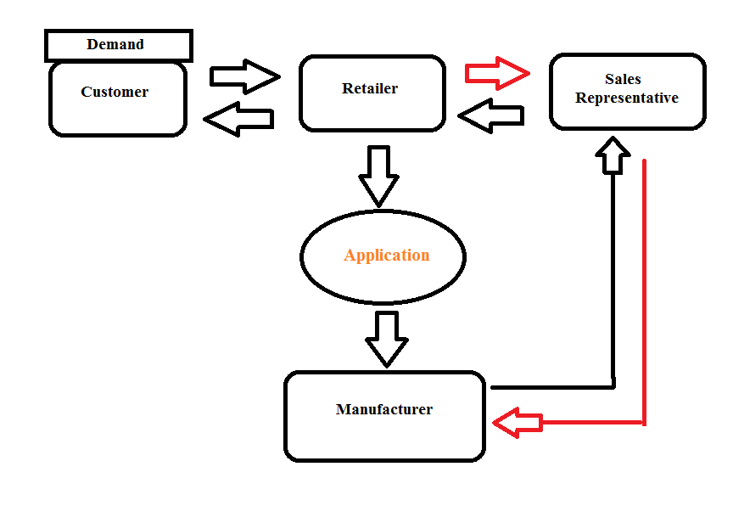
Flow Chart

Slide 11
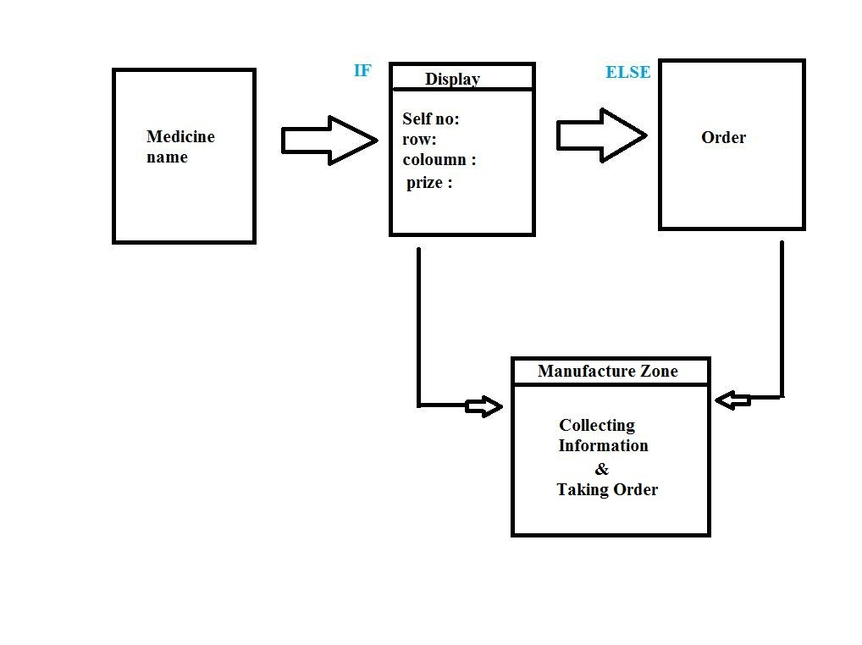
App’s Working Process

Slide 12
Advantages
Sending information in a Shortest Time
Can Order immediately
Retailer Can Know the Position of Medicine in Shop
Instant Information about Price
Able to Know about Percentage

Slide 13
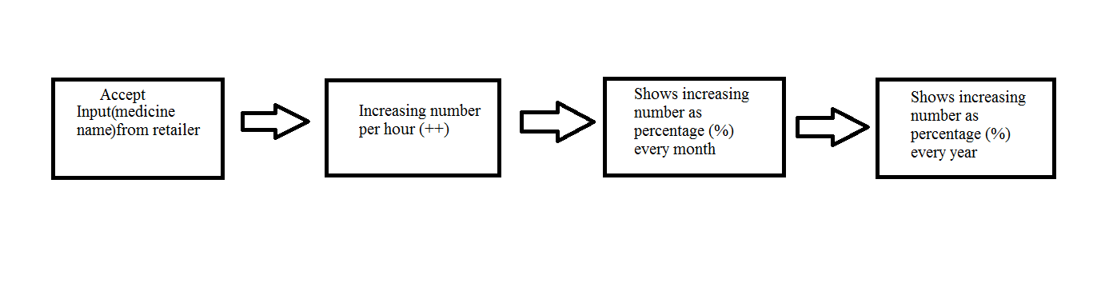
Minimize Bullwhip Effect
Display Board in Manufacture Zone

Slide 14
Limitations
Internet Cost
Can Not for PC
Row & Column no. will be Manually Inputted on display

Slide 15
Conclusion
Very smart app minimizing time
minimizing fact, bullwhip effect
New change in companies

Slide 16
References
Google
Wikipedia
Renata company

Slide 17
Working progress
How to Code
Uses of Data Structure
Stack
How to Organize

Slide 18
Question Segment

Slide 19
Thank you

