Slide 1
Title: Introduction to Computer Vision
Submitted to
Submitted to
Dr. Liton Jude Rozario
Professor
Department of Computer Science and Engineering
Jahangirnagar University
Submitted by
Rubayed All Islam
Class Roll: 370
Exam Roll:202182
Department of Computer Science and Engineering
Jahangirnagar University

Slide 2
Project Background:
Image Classification
Assigning labels to images based on content.
Applications: Object detection, medical imaging, autonomous vehicles.
Challenges: Feature extraction, high dimensionality, data variability.

Slide 3

01
Image Dataset Preparation
02
Feature Extraction using HOG
Object Detection Workflow
03
Model Training with Scikit-learn
04
Evaluation and Confusion Matrix
05
Performance Summary
06
Deploy and Apply Predictions

Slide 4
1
Introduction to Computer Vision
Computer Vision (CV): Science of perceiving and understanding the world through images/videos
Rapid advancements due to AI and Deep Learning (DL)
Enables applications like self-driving cars, face recognition, and smart devices
Goal: Build systems that interpret visual input like humans

Slide 5
1
Chapter Objectives
Understand components of vision systems
Explore applications of computer vision
Learn the computer vision pipeline
Discuss image preprocessing and feature extraction
Introduce classifier learning algorithms

Slide 6
1
Why Computer Vision Matters
CV transforms industries: automotive, healthcare, security
Neural networks enhance visual perception
Everyday applications: smartphone unlocking, smart locks
Future potential: Personalized smart devices (e.g., TVs, couches)

Slide 7
1
Visual Perception Defined
Visual Perception: Observing patterns/objects through sight
Example: Autonomous vehicles
Detect pedestrians, lanes, traffic signs
Understand environment for safe navigation
CV mimics human ability to interpret visual input

Slide 8
1
Vision Systems Overview
Two main components:
Sensing Device: Captures visual data (e.g., eye, camera)
Interpreting Device: Processes and understands data (e.g., brain, algorithm)
Human vs. Machine: Similar structure, different execution
Goal: Replicate human vision capabilities

Slide 9
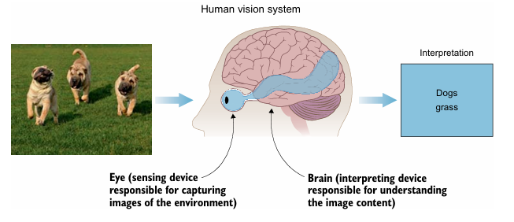
1
Human Vision System
Components: Eye (sensor) and brain (interpreter)
Example: Identifying dogs in an image
Natural for humans due to years of training
Brain classifies objects based on learned features

Slide 10
1
Learning Like Humans
Human learning process:
See examples (e.g., dog images)
Adjust understanding based on feedback (e.g., horse vs. dog)
Supervised learning analogy:
Labeled data trains brain to recognize objects
Trial and error refines classification
Humans learn faster than machines (fewer examples needed)

Slide 11
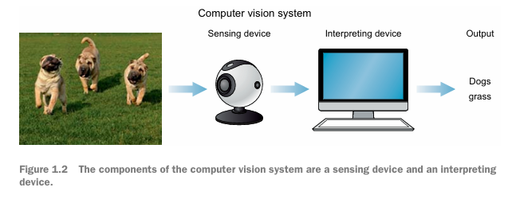
1
AI Vision Systems
Mimic human vision with:
Sensing Device: Camera, Lidar, etc.
Interpreting Device: Algorithms (e.g., neural networks)
Goal: Classify and interpret image content like humans
Inspired by biological vision systems

Slide 12
Sensing Devices in CV
Types of sensing devices:
Cameras: Detect signs, markings
Lidar: Creates 3D maps
Radar: Measures distance, velocity
X-rays/CT scans: Medical applications
Example: Autonomous vehicles use multiple sensors for 360° perception

Slide 13
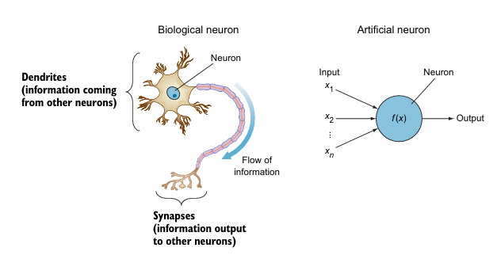
Interpreting Devices
Role: Process and classify image data
Artificial Neural Networks (ANNs):
Inspired by biological neurons
Process input signals to produce outputs
Deep Learning: Multi-layered neural networks

Slide 14
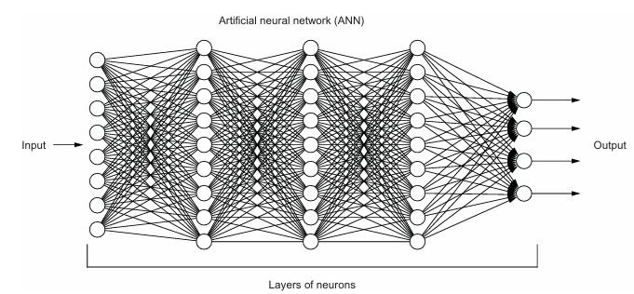
Deep Learning in CV
Deep Learning (DL) uses layered neural networks
Key architectures:
Artificial Neural Networks (ANNs)
Convolutional Neural Networks (CNNs)
Generative Adversarial Networks (GANs)
Applications extend beyond CV (e.g., NLP, VUIs)

Slide 15
Machine vs. Human Performance
Machines now surpass humans in some CV tasks
Example: Classifying 10,000 dog images
Neural networks achieve >95% accuracy in hours
Humans take longer with lower accuracy
Creative tasks: Machines generate art in seconds

Slide 16
Applications of Computer Vision
CV applications span industries:
Autonomous vehicles
Medical diagnostics
Security systems
Retail and robotics
Powered by DL algorithms like CNNs, GANs
Focus: Visual perception tasks

Slide 17
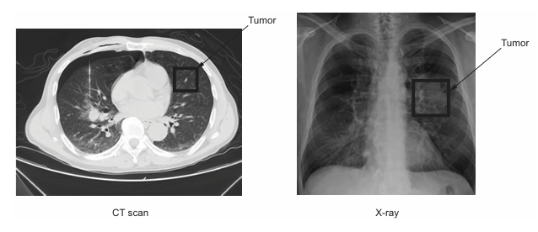
Image Classification
Task: Assign labels to images (e.g., cat, dog)
Uses Convolutional Neural Networks (CNNs)
Examples:
Lung cancer detection: Identify nodules in CT scans
Traffic sign recognition: Classify signs automatically

Slide 18
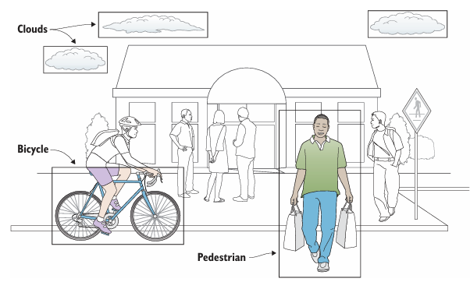
Object Detection and Localization
Task: Identify and locate multiple objects in an image
Algorithms: YOLO, SSD, Faster R-CNN
Applications:
Autonomous systems: Detect pedestrians, vehicles
Security: Identify objects in surveillance

Slide 19
Neural Style Transfer
Task: Apply artistic style to an image
Example: Transform a city photo into Van Gogh’s style
Process: Combine content image with style image
Creates art in seconds, unlike human painters

Slide 20
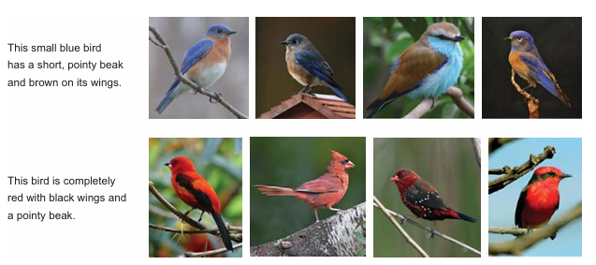
Generative Adversarial Networks (GANs)
Task: Create new, realistic images
How it works: Two networks (generator vs. discriminator)
Example: StackGAN generates images from text descriptions
Applications: Art, design, entertainment

Slide 21
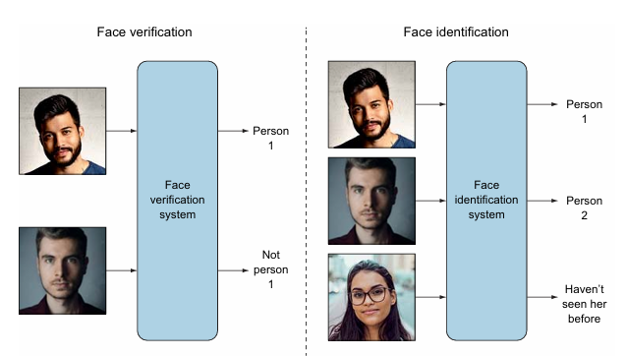
Face Recognition
Task: Identify or verify faces in images
Types:
Face Identification: One-to-many matching
Face Verification: One-to-one matching
Applications: Smartphone unlocking, security

Slide 22
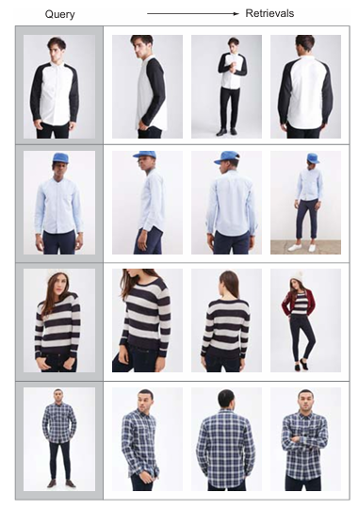
Image Recommendation Systems
Task: Find similar images based on a query
Example: Apparel search on shopping websites
Process: Match query image to similar products
Enhances user experience in e-commerce

Slide 23
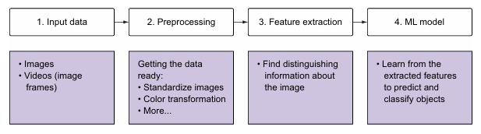
Computer Vision Pipeline
Four main steps:
Image Input: Capture visual data
Preprocessing: Standardize images
Feature Extraction: Identify key patterns
Classification: Predict labels
Example: Classify motorcycle vs. car vs. dog

Slide 24
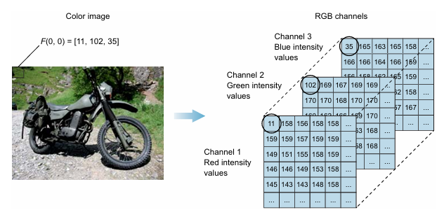
Image Input
Images as functions:
Grayscale: F(x,y) = intensity
Color (RGB): F(x,y) = [red, green, blue]
Computers see images as matrices:
Grayscale: 2D matrix
Color: 3D matrix (three channels)

Slide 25
Image Processing
Purpose: Standardize and clean data
Techniques:
Resize images to uniform dimensions
Convert color to grayscale (if color is not critical)
Data augmentation: Scaling, rotation
Example: Reduce complexity for simpler models

Slide 26
Feature Extraction
Features: Unique properties (e.g., shapes, colors)
Good features:
Identifiable, consistent, robust to noise
Traditional ML: Handcrafted features (e.g., HOG, SIFT)
Deep Learning: Automatic feature extraction by neural networks

Slide 27
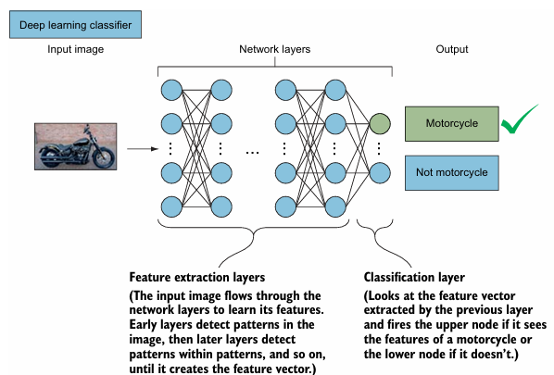
Classifier Learning Algorithm
Role: Predict class labels from features
Traditional ML: SVM, AdaBoost
Deep Learning: CNNs for complex tasks
Process: Neural networks learn features layer by layer
Output: Probability of each class (e.g., 85% motorcycle)

Slide 28
1
Introduction to Computer Vision
Image Processing
Resize and normalize images using `scikit-image` to ensure uniform input size and format.
Data Storage
Store processed data and corresponding labels with `joblib` for efficient training and testing workflows.

Slide 29
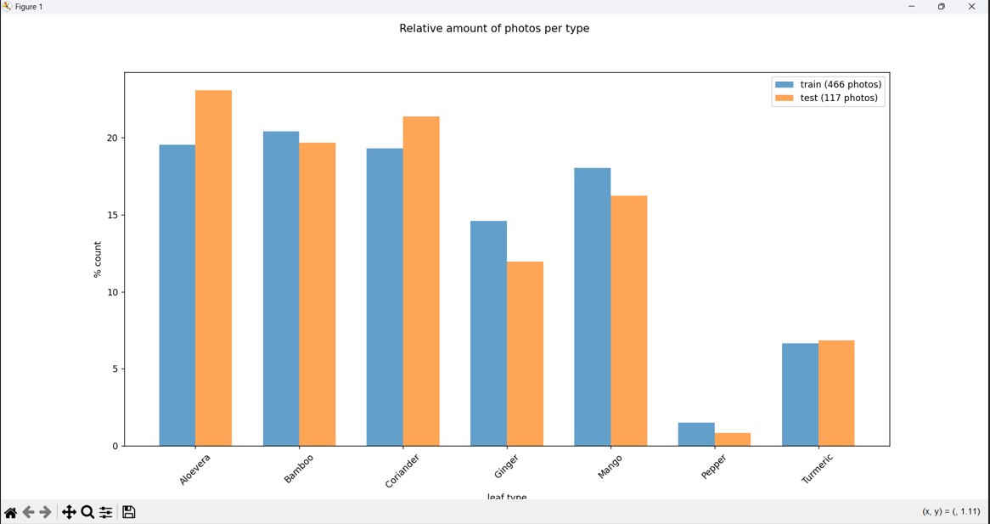
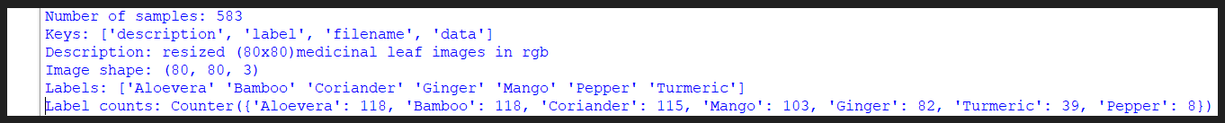
1
Image Dataset Preparation(Cont… )
Tested:
117 photos

Slide 30
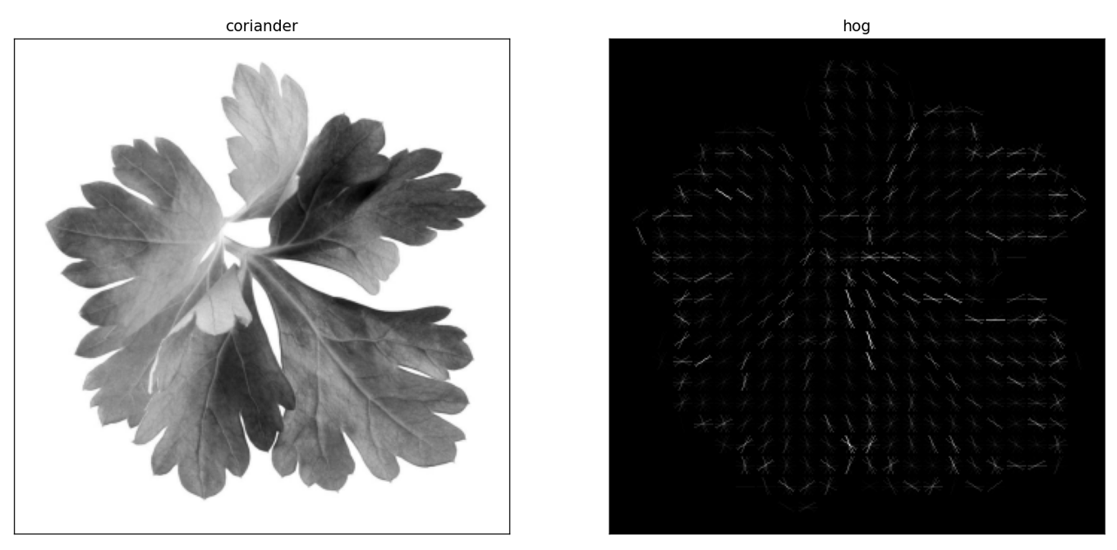
2
Feature Extraction using HOG
What is HOG?
Histogram of Oriented Gradients is a descriptor that captures edge directions and is useful for detecting object shapes and textures.
Using Scikit-Image
The `hog()` function from `skimage.feature` transforms images into feature vectors representing structural content.
Output Format
Each image is converted into a vector of numerical features, which are then fed to a machine learning model for classification.

Slide 31
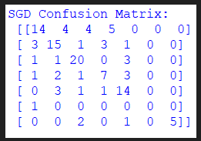
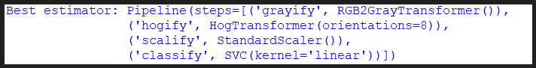
3
Model Training with Scikit-learn
Choosing a Classifier
Linear classifiers like `SGDClassifier` are chosen for their efficiency with large and sparse feature datasets.
Training the Model
The model is trained on HOG-transformed image data, associating image features with target labels.
Saving the Model
Trained models are serialized using `joblib.dump()` for future inference without retraining.

Slide 32
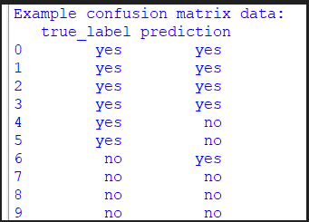
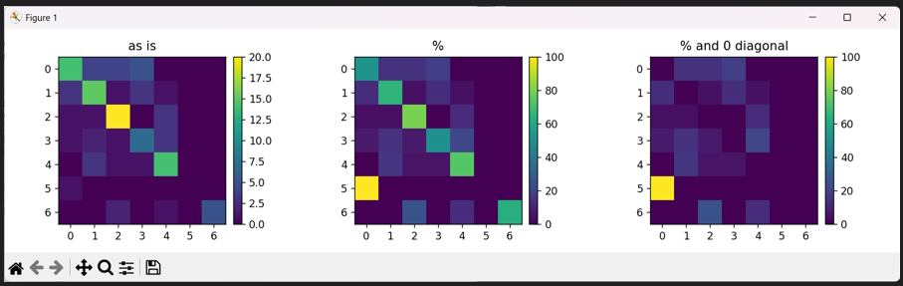
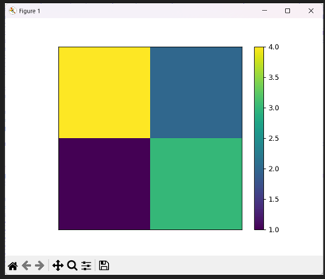
4
Model Evaluation and Confusion Matrix
Accuracy Assessment
Evaluate the model using test datasets to calculate accuracy, precision, and recall scores.
Confusion Matrix
Use Scikit-learn’s `confusion_matrix()` and `classification_report()` to detail model performance.
Insights and Adjustments
Analyze the confusion matrix to identify and address patterns in misclassifications.

Slide 33
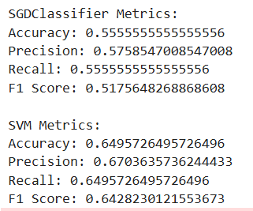
5
Performance Summary
Metric | Value | Note
Accuracy | 0.5555 | Species Variation
Precision | 0.5758 | Weighted Average
Recall | 0.5555 | Weighted Average
F1-Score | 0.5176 | Weighted Average
Table: Performance Summary for SGDClassifier
Metric | Value | Note
Accuracy | 0.6496 | Species Variation
Precision | 0.6704 | Weighted Average
Recall | 0.6596 | Weighted Average
F1-Score | 0.6428 | Weighted Average
Table: Performance Summary for SVM with Linear Kernel

Slide 34
6
Deploy and Apply Predictions
Using the Trained Model
Load the trained model using `joblib.load()` and use it to predict categories for new image inputs.
Testing New Images
Transform new images using the same HOG feature extraction method to maintain consistency.
Real-World Use Cases
Deploy models into applications like surveillance, quality control, and wildlife monitoring.

Slide 35


01
`scikit-learn` - for model building and evaluation
02
`scikit-image` - for image preprocessing and HOG extraction
Python Libraries Used
03
`joblib` - to save and load models and data
04
`matplotlib` - for visualizing data and results
05
`numpy`, `os`, `pprint` - utilities for data and file handling

Slide 36
How does the code flow work in the tutorial?
Key Highlights from the Kapernikov Example
Import necessary libraries (`sklearn`, `skimage`, `joblib`)
2. Load and preprocess image data
3. Extract features using `hog()`
4. Train `SGDClassifier` with extracted features
5. Evaluate using accuracy and confusion matrix
6. Save the trained model
Uses a simple directory structure for dataset
HOG feature vectors are directly passed into the classifier
- Avoids deep learning to show the power of classical ML + feature engineering

Slide 37
Python Library Functions Breakdown
scikit-image (skimage)
scikit-learn (sklearn)
joblib & others
`skimage.io.imread()` loads images; `skimage.transform.resize()` adjusts them to fixed size; `skimage.feature.hog()` extracts features.
`SGDClassifier()` is used for training; `confusion_matrix()`, `classification_report()` evaluate performance.
`joblib.dump()` and `load()` save and restore datasets and models; `os`, `numpy`, `pprint` help with file and data manipulation.

Slide 38

Sample Code Snippets from Tutorial
HOG Feature Extraction
from skimage.feature import hog
features = hog(image, orientations=9, pixels_per_cell=(8, 8),
cells_per_block=(2, 2), visualize=True)
Training the Classifier
from sklearn.linear_model import SGDClassifier
clf = SGDClassifier()
clf.fit(X_train, y_train)
Saving the Model
import joblib
joblib.dump(clf, 'model.pkl')

Slide 39

Directory & Dataset Structure
Folder Layout
The tutorial uses a folder layout where each class/category of images is stored in its own subfolder, forming a labeled dataset.
Automation with Python
Python's `os.walk()` is used to traverse the directory structure and collect image paths programmatically.
Sample Code
for dirname, _, filenames in os.walk(data_dir):
for f in filenames:
img_path = os.path.join(dirname, f)

Slide 40
Loading and Preprocessing Images
Reading Images
Images are read using `skimage.io.imread()` from the file path collected during directory traversal.
Resizing & Formatting
Images are resized using `skimage.transform.resize()` to a standard size such as (128, 128) for consistent input shape.
Label Encoding
Labels are generated based on folder names and stored for model training.

Slide 41

Model Testing and Prediction
Applying Trained Classifier
After training, the classifier is applied to unseen HOG-processed images to make predictions.
Visualizing Predictions
Using `matplotlib.pyplot`, sample predictions are displayed alongside true labels.
Code Example
predicted = clf.predict(test_features)
print(classification_report(y_test, predicted))

Slide 42
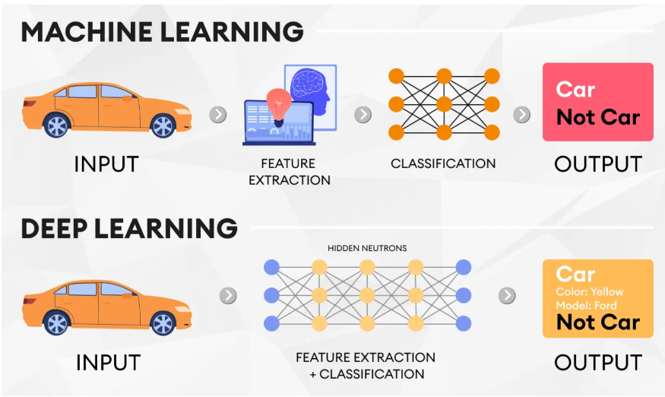
Deep Learning in Object Detection
Why Deep Learning?
Deep learning allows models to learn complex features from raw image pixels using architectures like CNNs, leading to improved detection accuracy.
Popular Architectures
Common object detection models include YOLO (You Only Look Once), SSD (Single Shot Detector), and Faster R-CNN.
Use Cases
These models are used in real-time applications such as autonomous vehicles, security surveillance, and robotics.

Slide 43

Using YOLO with OpenCV
YOLO Overview
YOLO divides images into grids and predicts bounding boxes and class probabilities for real-time object detection.
OpenCV Integration
OpenCV’s DNN module allows loading pre-trained YOLO models to perform detection on images and videos.
Code Implementation
Use `cv2.dnn.readNetFromDarknet()` with YOLO config and weights to detect objects in frames using Python.

Slide 44

Real-Time Object Detection
Challenges in Real-Time
Real-time detection requires balancing speed and accuracy, especially on resource-constrained devices.
Optimization Strategies
Use lightweight models (e.g., YOLOv4-Tiny), reduce input resolution, and apply inference optimizations.
Applications
Applied in surveillance, autonomous driving, and industrial robotics where fast decisions are crucial.

Slide 45

Performance Optimization Techniques
Hardware Acceleration
Use GPUs or TPUs for faster computation, especially for deep learning models.
Model Quantization
Convert models to lower-precision formats (e.g., INT8) to speed up inference with minimal accuracy loss.
Batching and Parallelism
Process multiple images in batches and leverage multiprocessing to improve throughput.

Slide 46
Thank You!

