Slide 1
Johnson Counter
Power consumption comparison between D and jk flip flop

Slide 2
What is Ring counter?
A ring counter is a type of counter composed of flip-flops connected into a shift register, with the output of the last flip-flop fed to the input of the first, making a "circular" or "ring" structure. The output of the 1 flip-flop acts as the input of the another flip-flop. There are two types of ring counters: a)A straight ring counter also known as a one-hot counter, connects the output of the last shift register to the first shift register input and circulates a single one (or zero) bit around the ring. B)A twisted ring counter, also called switch-tail ring counter, walking ring counter, Johnson counter, or Möbius counter, connects the complement of the output of the last shift register to the input of the first register and circulates a stream of ones followed by zeros around the ring.

Slide 3
Applications of Jonson Counter:
To divide the frequency of the clock signal by varying their feedback. Typically used alongside function generators.
Used as a synchronous decade counter or divider circuit.
“Quadrature” (sine/cosine) Oscillator or Generator can be used to produce four individual outputs that are each 90 degrees “out-of-phase” with respect to each other to produce a 4-phase timing signal. This is basically the working principle of a 2 phase stepper motor. So you can say the Johnson counter more or less helps driving stepper motor in least connections.
The 3 stage Johnson counter is used as a 3 phase square wave generator which produces 1200 phase shift. This is used in real time systems where timer ic’s are used.

Slide 4
Applications:
As object counters
Parallel to serial data conversion logic circuits
Analog to digital convertors.
Digital clocks
Digital triangular wave generator.
Generating staircase voltage
Frequency divider circuits of the clock signals. (Where the Input frequency divided by 2)
Synchronous decade counter or divider circuit
Timers and Rate measurement. (Time circuits, Washing machines, Alarm clock etc)
As a 3 phase square wave generator which produces 120 phase shift (3 stage Johnson counter)

Slide 5
Working of Johnson Counter
The default state of Johnson counter is 0000 thus before starting the clock input we need to clear the counter using clear input.
Whenever a clock edge hits the counter the output of each flip-flop will transfer to the next stage (flip-flop) but the inverted output of the last flip-flop will shift to the first stage making the state 1000.
Upon next clock cycle, another ‘1’ will stack in from the left side as the inverted output of the last stage will be shifted to the first stage.
On next clock cycle, another ‘1’ will add in from left until the state becomes 1111.
Now that the last flip-flop’s output is ‘1’, the next clock cycle will shift the invert of the last flip-flop which is ‘0’ into the first flip-flop. It will result in stacking ‘0’ from the left side. This stacking of the first 0 will make the state 1111 into 0111.
The next coming clock cycles will stack in 0’s from the left making the states 0011, 0001 & 0000 with each clock cycle. Eventually, it reaches its default state and it starts from the beginning again.

Slide 6
Ring Counter:
Advantages:
Disadvantages:
More outputs as compared to ring counter.
It has same number of flip flop but it can count twice the number of states the ring counter can count.
It count the data in a continuous loop
It only needs half the number of flip-flops compared to the standard ring counter for the same MOD
Only 8 of the 15 states are being used.
It doesn’t count in a binary sequence.

Slide 7
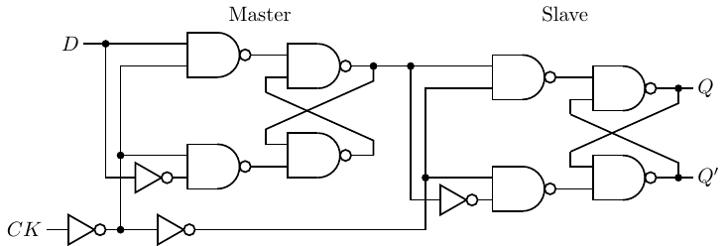
Working Principles of D flip-flops:
Although the terminology varies somewhat in the literature, it is generally agreed that:
A latch uses a level based clock signal.
A ﬂip-ﬂop is triggered by a clock signal edge.
At each “tick” of the clock, there are four possible actions that might be taken on a single bit — store 0, store 1, complement the bit (also called toggle), or leave it as is.
A D ﬂip-ﬂop is a common device for storing a single bit. We can turn the D latch into a D ﬂip-ﬂop by using two D latches connected in a master/slave conﬁguration as shown in Figure.
D ﬂip-ﬂop, positive-edge triggering

Slide 8
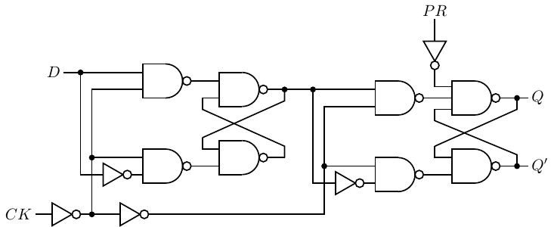
The bit to be stored, 0 or 1, is applied to the D input of the Master D latch. The clock signal is applied to the CK input. It is normally 0. When the clock signal makes a transition from 0 to 1, the Master D latch will either Reset or Set, following the D input of 0 or 1, respectively.
While the CK input is at the 1 level, the control signal to the Slave D latch is 1, which deactivates this latch. Meanwhile, the output of this ﬂip-ﬂop, the output of the Slave D latch, is probably connected to the input of another circuit, which is activated by the same CK. Since the state of the Slave does not change during this clock half-cycle, the second circuit has enough time to read the current state of the ﬂip-ﬂop connected to its input. Also during this clock half-cycle, the state of the Master D latch has ample time to settle.
When the CK input transitions back to the 0 level, the control signal to the Master D latch becomes 1, deactivating it. At the same time, the control input to the Slave D latch goes to 0, thus activating the Slave D latch to store the appropriate value, 0 or 1. The new input will be applied to the Slave D latch during the second clock half-cycle, after the circuit connected to its output has had suﬃcient time to read its previous state. Thus, signals travel along a path of logic circuits in lock step with a clock signal.
There are applications where a ﬂip-ﬂop must be set to a known value before the clocking begins. This figure shows a D ﬂip-ﬂop with an asynchronous preset input added to it.
D ﬂip-ﬂop, positive-edge triggering with asynchronous preset.

Slide 9
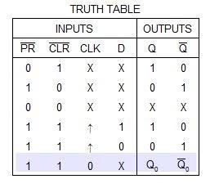
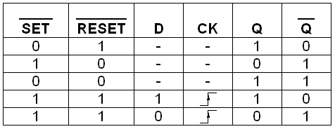
D Flip-flop Data Table:

Slide 10
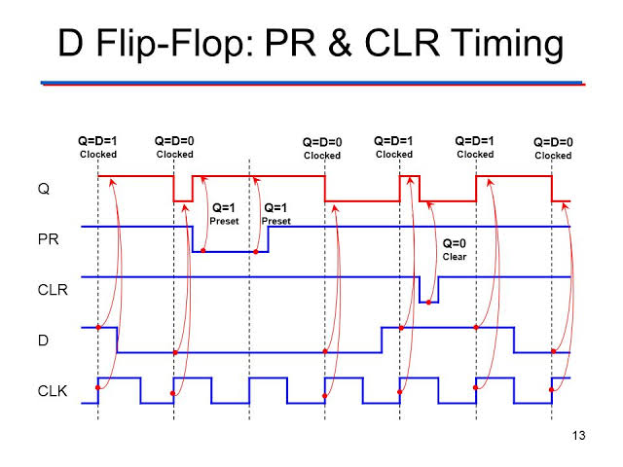
D flip-flop’s timing diagram:

Slide 11
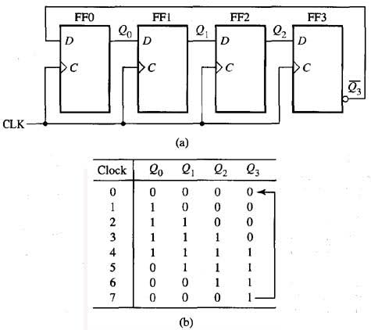
D flip-flop Data table with 8 states:

Slide 12
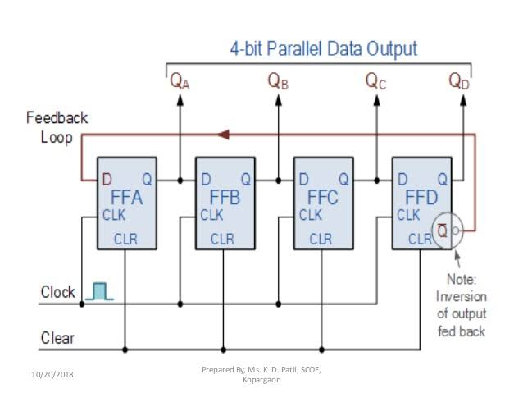
D flip-flop Schematic diagram:

Slide 13
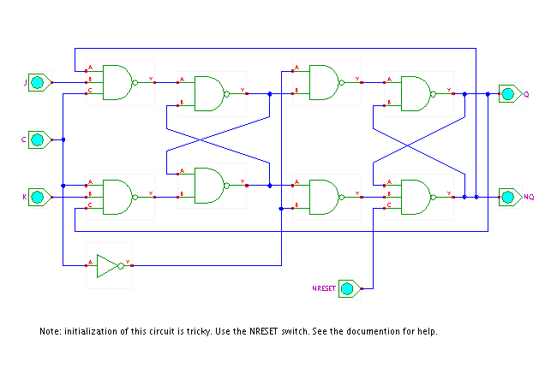
JK flip-flop Circuit diagram:

Slide 14
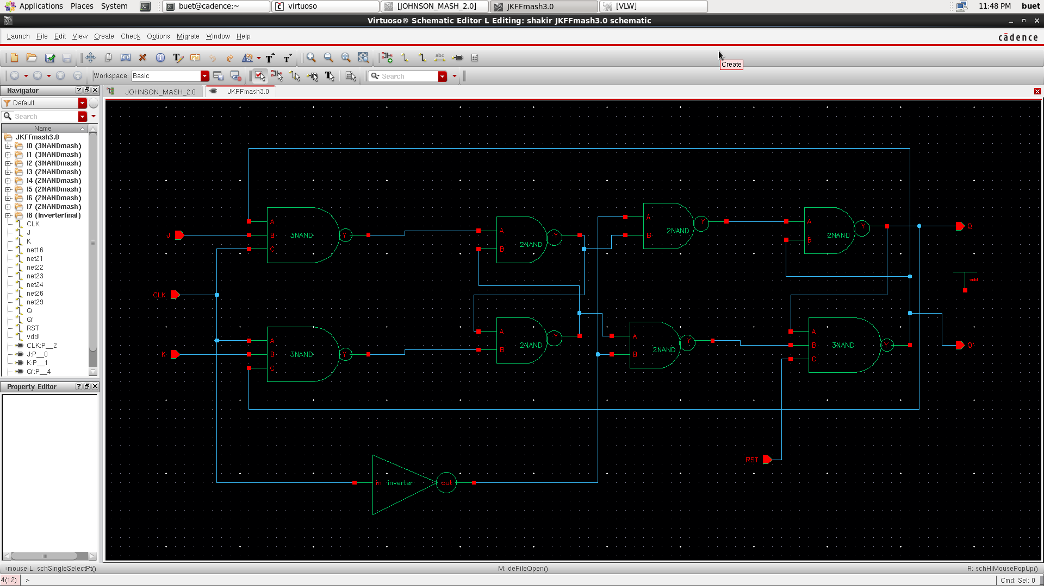
Schematic:

Slide 15
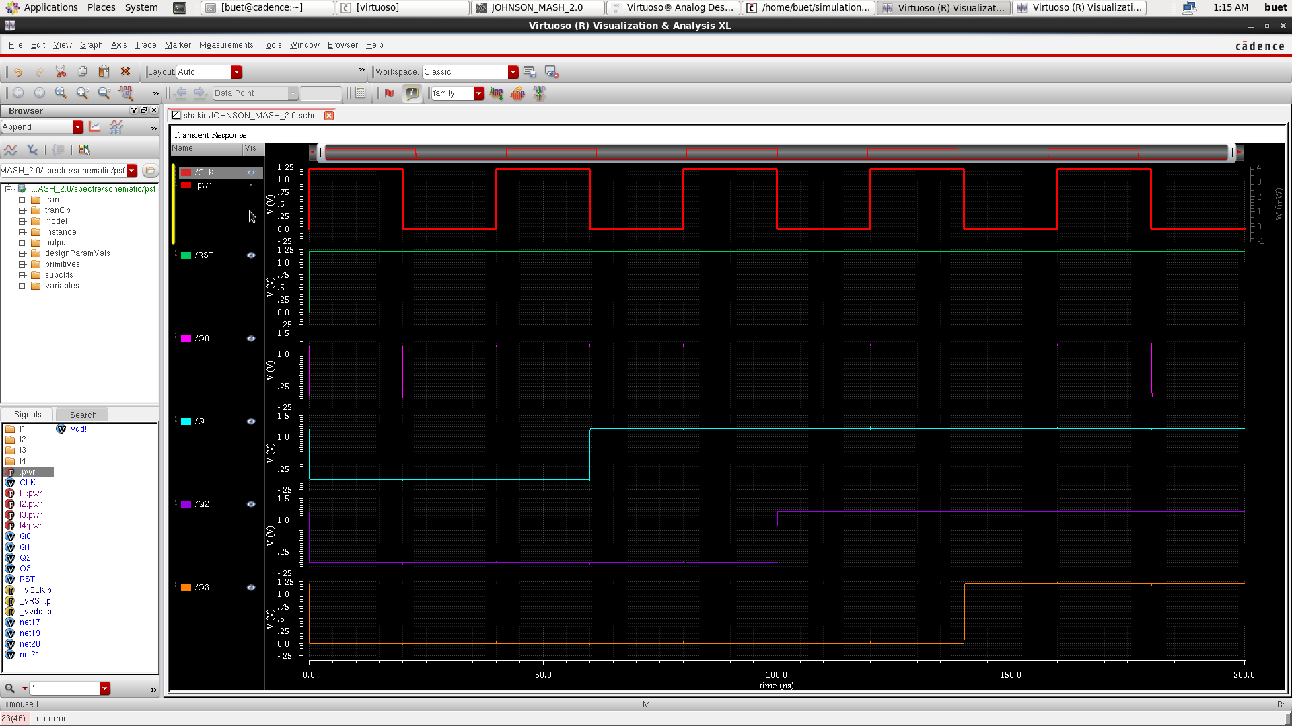
Johnson jk Output:

Slide 16
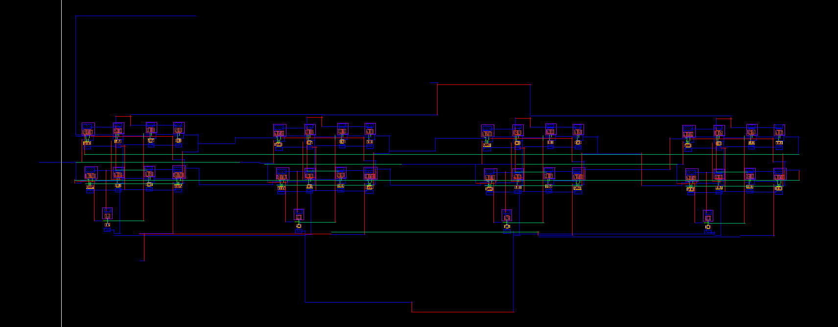
Johnson Jk flipflop Layout:

Slide 17
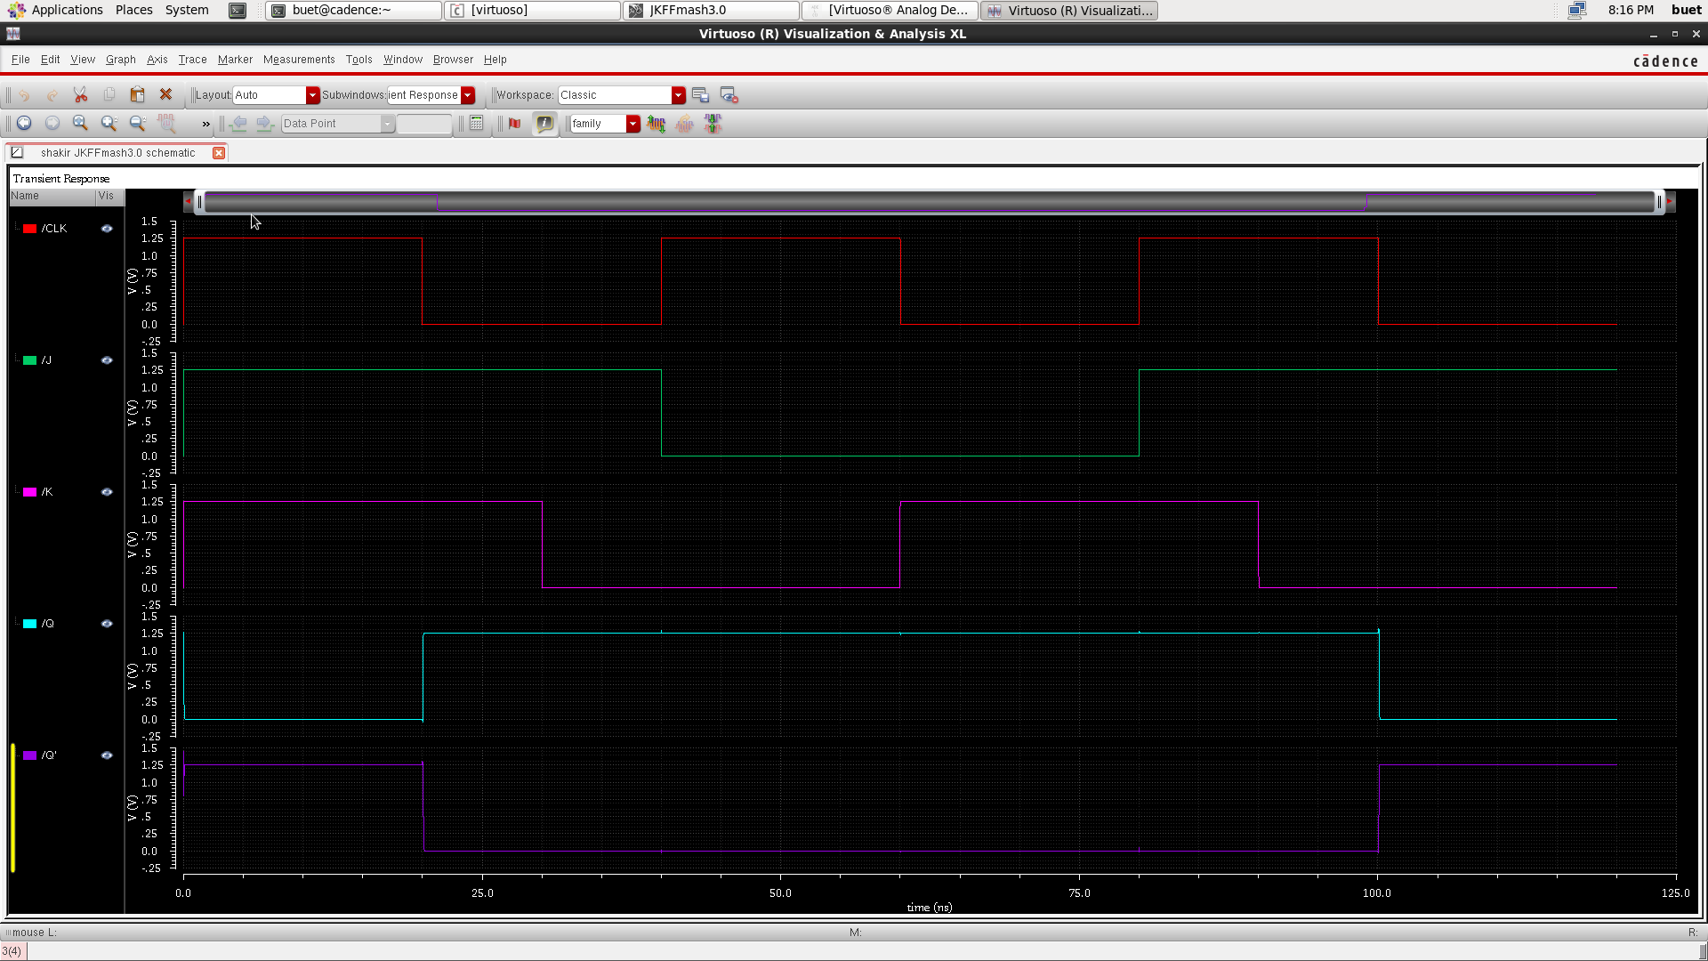
Johnson jkff output:

Slide 18
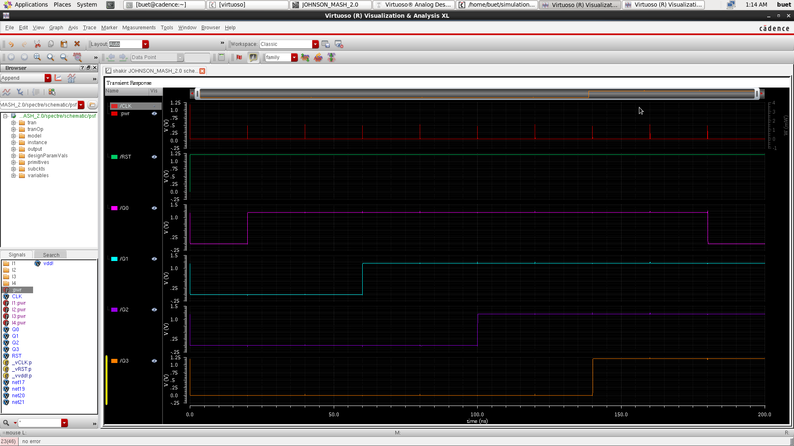
Johnson jk power graph:

Slide 19
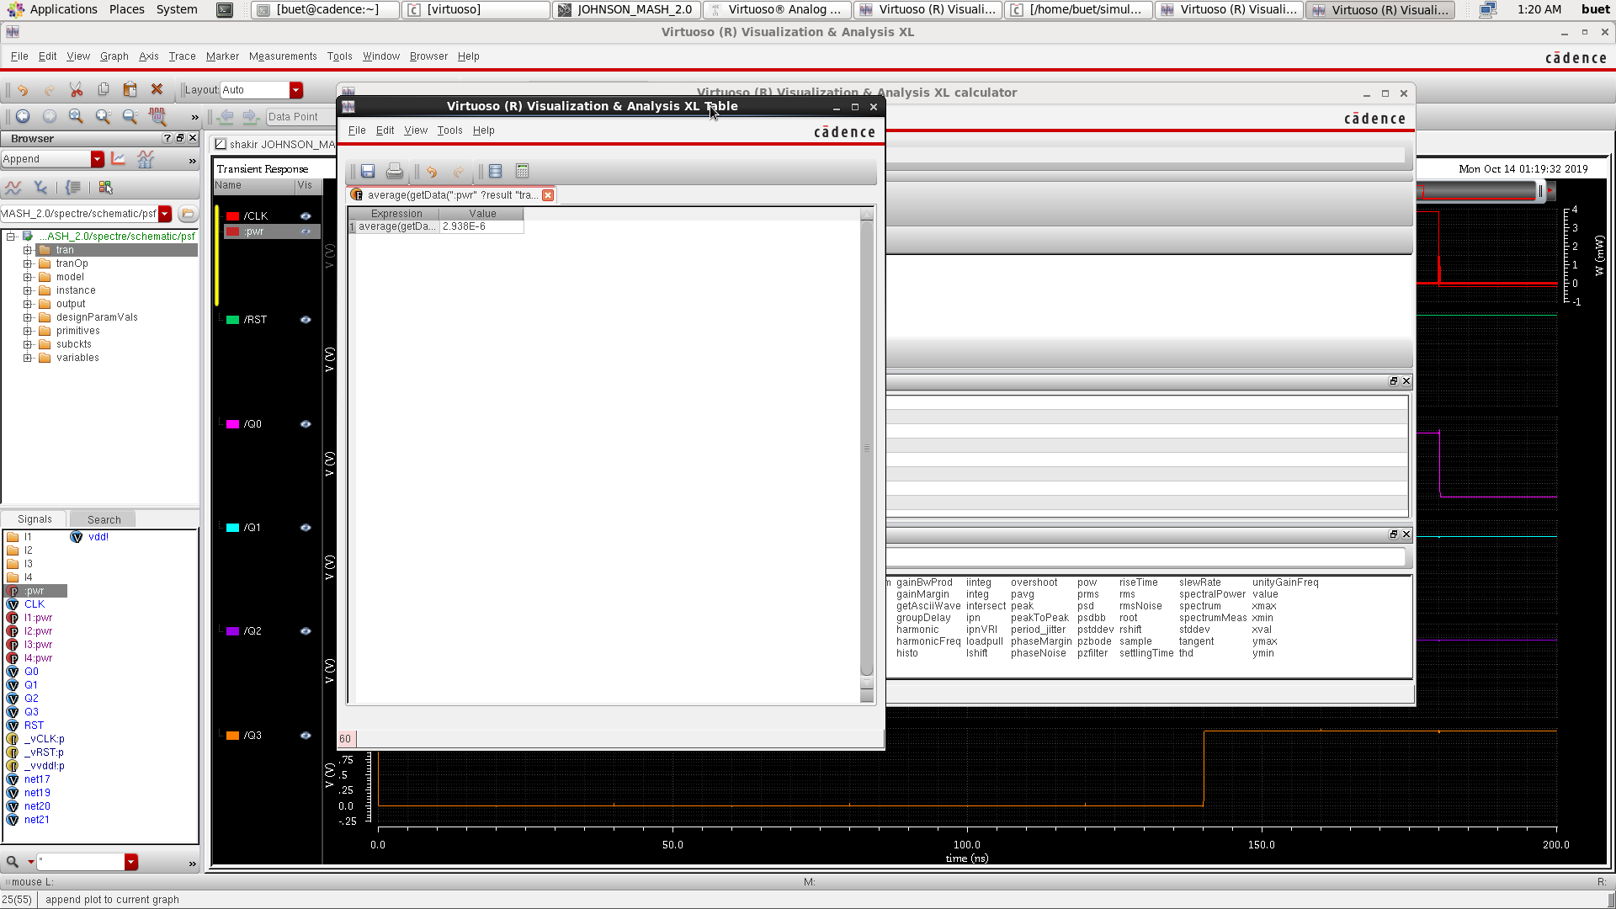
Power Johnson jk calculation:

Slide 20
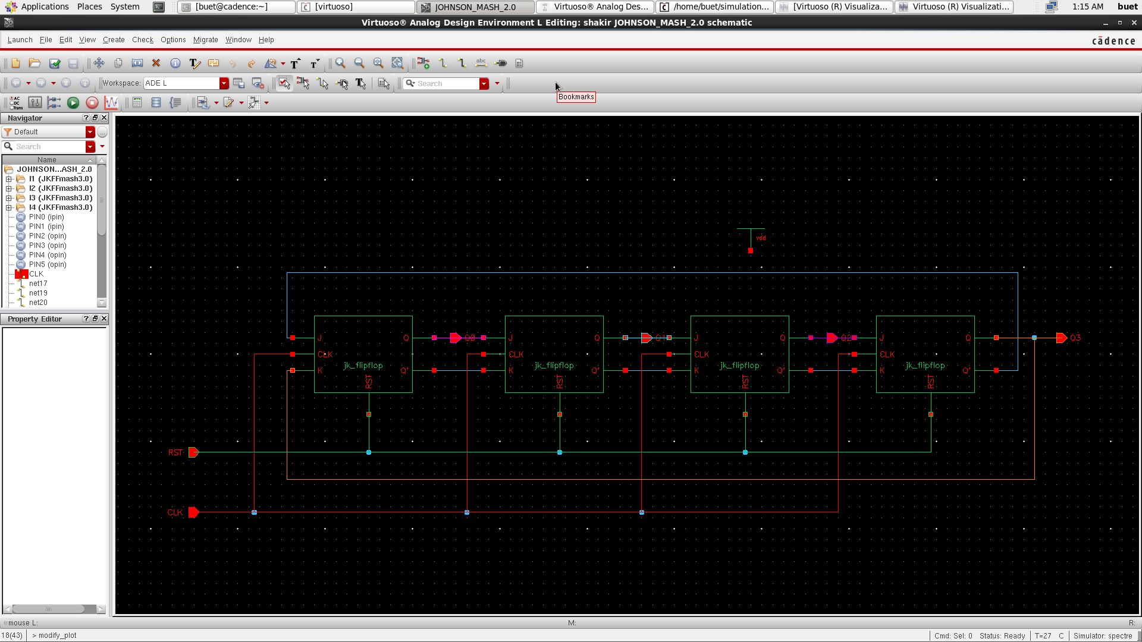
Johnson Schematic:

Slide 21
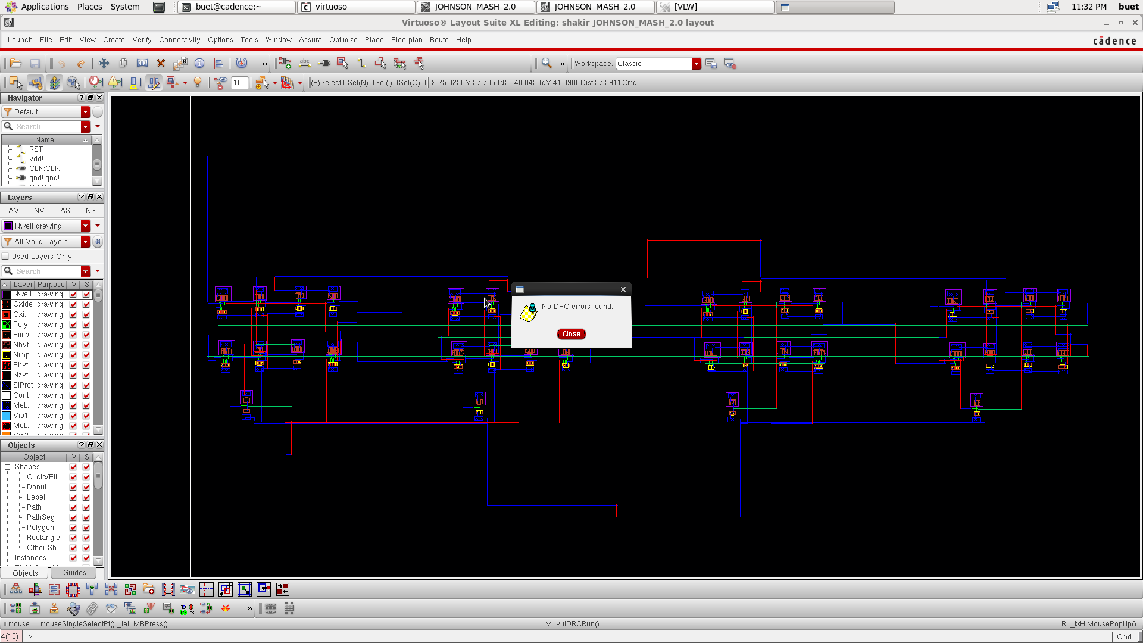
JK DRC:

Slide 22
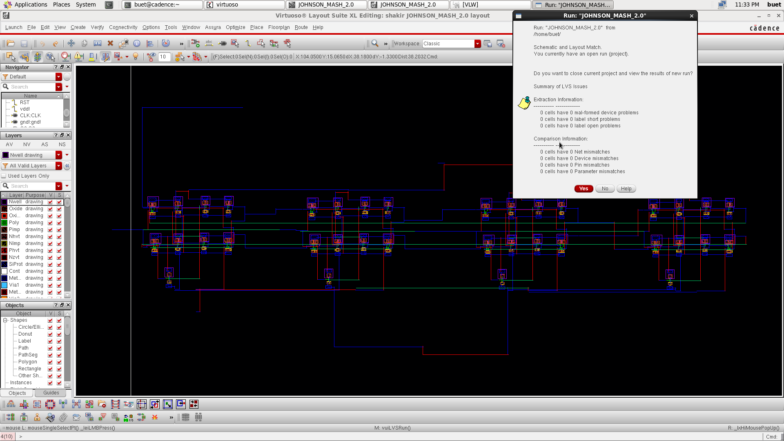
JK LVS:

