Slide 1
JHUB HACKATHON

Slide 2

THEME

Slide 3
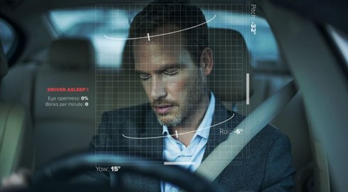
DRIVER DROWSINESS
DETECTION

Slide 4
PROBLEM
21 percent of all fatal accidents are due to drowsy driving.
60 percent of adult drivers or about 168 million people have driven a vehicle while feeling drowsy in year 2021.
Each year, drowsy driving accounts for about 100,000 crashes, 71,000 injuries, and 1,550 fatalities, according to the National Safety Council (NSC).

Slide 5
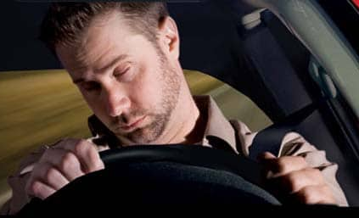
MAIN MOTIVE
To reduce the number of accidents caused due to drowsiness of driver.

Slide 6
IDEA
Buzzer sound produced while drowsiness is detected in driver
Snap of the drowsy driver is sent to the respective authority for further action
The location and time of driver is recorded

Slide 7

THANK YOU
TEAM OPTIMUS

