Slide 1



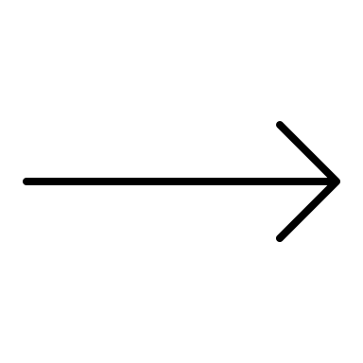

DV8 Integration: : CHEAT SHEET
About
Functions
Related Vignettes
The dv8_showcase.Rmd vignette introduces ArchDia's DV8 design structural matrices, architectural flaws, and decoupling level in Kaiaulu.
parse_gitlog(), filter_by_*(), gitlog_to_hdsmj()
See the following notebooks for related analyses:
Design Structure Matrix (DSM): A visual model for expressing dependencies.
Architectural Flaws: DV8 can detect 6 types of architectural flaws: Clique, Package Cycle, Improper Inheritance, Unstable Interface, Crossing, and Modularity Violation.
Decoupling Level: Measures how well a design is separated into modules based on the DRH clustering.
parse_gitlog() generates a table from a git project, which can be filtered via the filter functions, and then transformed into a history design structure matrix (hdsm.json) representation.
dv8_showcase.Rmd
gitlog_showcase.Rmd
depends_showcase.Rmd
social_smells_showcase.Rmd
.git
*-hdsm.
json
Project Config Setup
parse_ dependencies(), filter_by_*(), dependencies_to_sdsmj()
dv8_mdsmb_to_decoupling_level()
The first part of running any vignette is setting up your project configuration file (examples in kaiaulu/conf).
parse_dependencies() generates a table of dependencies from Depends, which can be filtered via the filter functions, and then transformed into a structural design structure matrix (sdsm.json) representation.
Takes as a parameter a *-merge.dv8-dsm binary file and returns the Decoupling Level metrics as a *.json file.
Required Fields
tool:
dv8:
folder_path: ../../analysis/dv8/apr
architectural_flaws:
- cliqueDepends:
- call
- use
- crossingCochange: 2
- crossingFanIn: 4
- crossingFanOut: 4
- mvCochange: 2
- uiCochange: 2
- uihDepends:
- call
- use
- uihInheritance:
- extend
- implement
- public
- private
- virtual
- uiHistoryImpact: 10
- uiStructImpact: 0.01
Indirect Fields
tool:
depends:
code_language: cpp
keep_dependencies_type:
- Cast
- Call
- Import
- Return
- Set
- Use
- Implement
- ImplLink
- Extend
- Create
- Throw
- Parameter
- Contain
*-merge.
dv8-dsm
*-dl
.json
src
*-sdsm.
json
dv8_mdsmb_to_hierclsxb()
dv8_dsmj_to_dsmb(), dv8_hdsmb_sdsmb_to_mdsmb()
Takes in a *-merge.dv8-dsm binary file and computes the design rule hierarchy as a *-merge.dv8-clsx binary file.
Converts dsm.json files into .dv8-dsm files (historical DSM and structural DSM). Merges these matrices into one new matrix in a *-merge.dv8-dsm file (merged DSM file).
*-merge.
dv8-dsm
*-clsx.
dv8-clsx
*-sdsm.
json
*-sdsm.
dv8-dsm
*-merge.
dv8-dsm
dv8_mdsmb_drhier_to_excel()
*-hdsm.
json
*-hdsm.
dv8-dsm
Takes as a parameter a *-merge.dv8-dsm binary file and optionally a *-clsx.dv8-clsx and exports it to an excel spreadsheet for further analysis.
dv8_mdsmb_to_flaws()
The file ”tools.yml” must also be configured. See README.md for more information on 3rd party software dependencies.
Detects architecture anti-patterns from a merged DSM binary file and returns an architectural flaws folder.
*-clsx.
dv8-clsx
Required Fields:
Perceval (version 0.12.24)
Depends (version 0.96a)
DV8 (version 4.0-20210630.025325+)
- clique
- modularity-violation
- package-cycle
- unhealthy-inheritance
*-merge.
xlsx
*-merge.
dv8-dsm
Architectural Flaws
Parser functions are also available on the Kaiaulu API for various DV8 json files.
*-merge.
dv8-dsm
Kaiāulu
CC BY SA Leilani Reich, Carlos Paradis • Learn more with the dv8_showcase.Rmd vignette • Kaiaulu package version 0.0.0.9600 (in development) • Updated: 2023-04
For DV8 downloads and license information see ArchDia.com.

