Slide 1
Multiplayer Racing Game
Developed By
Zahurul Islam Prince- 1207056
Rupayan Sarker- 1107031
Supervised By
Dr. Kazi Md. Rokibul Alam
Professor, Department of Computer Science and Engineering
Khulna University of Engineering & Technology (KUET)

Slide 2
Points To be Discussed
Introduction
Formal characteristics of a Game
Game Structure
Multiplayer Game
Types of Multiplayer Game
Tool
Main Ideas
The Game Window
Game Play

Slide 3
Points To be Discussed
Scripting
Control
Possible Improvements
Conclusion

Slide 4
Introduction
A game is a Closed, formal abstract system
Players involved in engaging structured conflict to achieve a goal
The illusion of control in controlled environment
Just like “Multiplayer Car Racing”
”

Slide 5
Basic characteristics of a Game
Objectives
Procedures
Rules
Resources
Boundaries
Conflict
Outcome

Slide 6
Game Structure
Start Up
Introductory Movie
Front End
Game Options
Sound Options
Video Options
Main Game
Introduction
Game Play(Game Modes)
End Game
Credit
Shut Down

Slide 7
Multiplayer Game

Slide 8
Types of Multiplayer Game
Online Multiplayer Game
Local/Offline Multiplayer Game

Slide 9
Online Multiplayer Game
which can be played via a game server over the internet, with other players around the world

Slide 10
Local/Offline Multiplayer Game
played by multiple people either on the same device, or through a local connection such as local Wi-Fi or Bluetooth

Slide 11
Tool: Unity
Unity is a multi-platform, integrated IDE for scripting games, and working with 3D virtual worlds Including:
Game engine
3D objects / lighting / physics / animation / scripting
Accompanying script editor
MonoDevelop (win/mac)
Can also use Visual Studio (Windows)
3D terrain editor
3D object animation manager
Executable exporter many platforms: iPhone / Android / Windows

Slide 12
Main Ideas(Continued)
Graphical Interface
To develop a Car Racing Track with Cars
Surroundings like our country side

Slide 13
Main Ideas(Continued)
Interaction between users
Wi-Fi
Bluetooth

Slide 14
Main Ideas(Continued)
Evaluation & Measurement
Time Stamp
Position
Lap Completion

Slide 15
Main Ideas
Audio
For the home screen
Another for game playing
Last one for ending

Slide 16
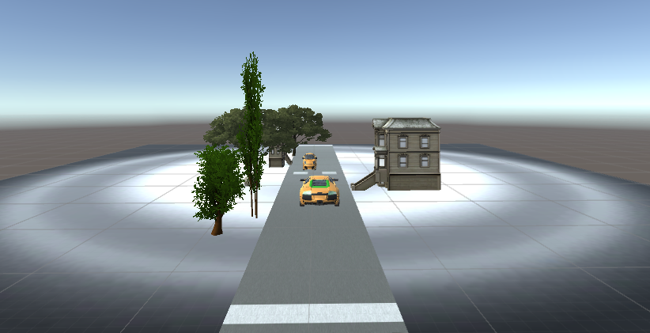
The Game Window(Continued)
The Game window shows what players will see. When Play button is pressed, the results will be displayed out in this window.

Slide 17
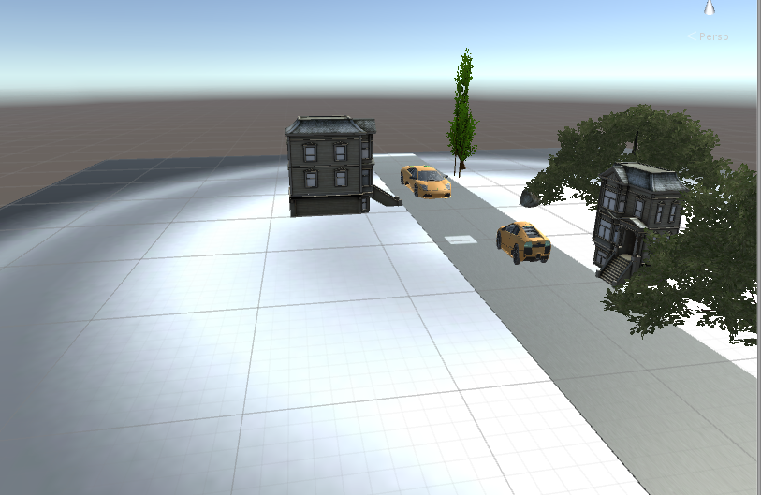
The Game Window

Slide 18
Game Play
Perspective
First person
Third person
Top down
Isometric
Modes
Single player
Multiplayer
Mechanics

Slide 19
Controls
Accelerometer
Button For home page navigation

Slide 20
Scripting
Unity implements a MONO compiler
Scripts can be written in
JavaScript
Most introductory tutorials are written in JavaScript
C#
Very similar to Java, Unity can be integrated with the Microsoft Visual Studio editor, to get full benefits of code completion, source version control etc.
We Like to prefer c#

Slide 21
Possible Improvements
Characters can be added with
Name
Appearance
Physics
Rigid Body Dynamics
Collision Detection
Particles & Effects
AI
Network

Slide 22
Conclusion
Design accounts for ¾ of entire production timeline of a game
In this term we have designed the layout along with idea
In the upcoming days all the other properties would be implemented

Slide 23


