Slide 1

Critical Design Review
Voltron Autonomous Go Kart V3
Ben Hall, Crockett Hensley, Brighton Swales, Ruben Murillo
Department of Robotics & Mechatronics Engineering

Slide 2
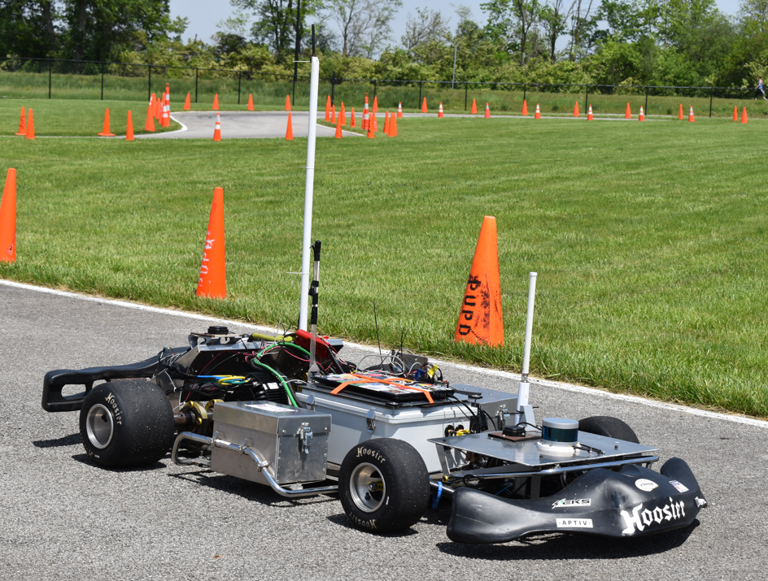
System Overview
The Voltron renovation project aims to improve reliability, speed, and ease of use of KSU EVT's autonomous racing go-kart.
The project will enhance a particular subset of systems, including electro-mechanical steering mechanism, mount for LiDAR and Camera hardware, and adding an odometry sensor system.
The overhaul of the gearbox used to steer Voltron is central to the system upgrades.
Upgrades were made to the vision system by improving the LiDAR hardware and placement accompanied by a 3D camera.
Development and implementation of a wheel odometry system that assists in the state estimation of Voltron.

Slide 3
Voltron Subsystems Design Block Diagram
Drive Motor
Wheel Speed Sensors
Odom Teensy
VectorNav
EStop
LiDAR Unit
Onboard PC
VCU
Status Light
ODrive
RGB-D Camera
P2P Connection
Receiver
Brake
Base Station PC
Remote Controls

Slide 4
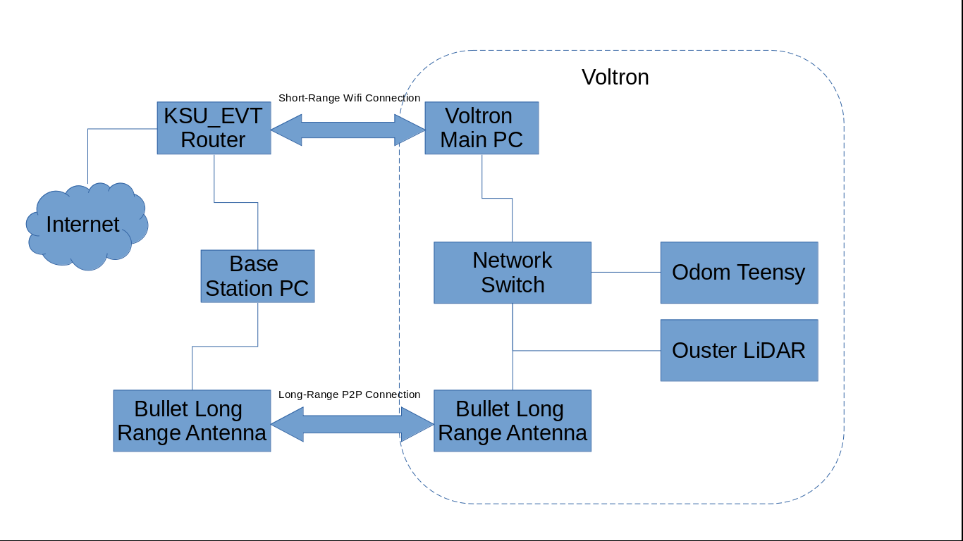
Voltron Network Block Diagram

Slide 5
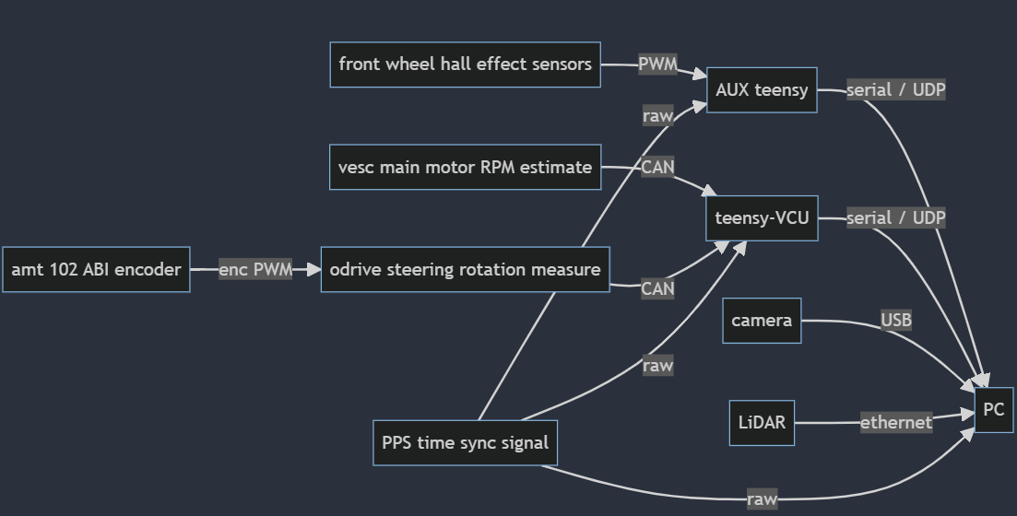
Flowchart for Software

Slide 6
Major Parts
Parts | Model
Absolute encoder | CUI AMT 102 encoder
Sensor | Littelfuse M12 Gear tooth Speed Sensor (x2)
Sensor | Ouster Os-0 64 channel LiDAR
Camera | Oak-D Pro
Circuit Board | PCB for VCU/SCU manufactured by JLC
Motor Controller | Odrive Robotics D6374 -150kV
Microcontroller | Teesny 4.1 Microcontroller
Steering Motor | DUAL SHAFT MOTOR - D6374 150kV

Slide 7
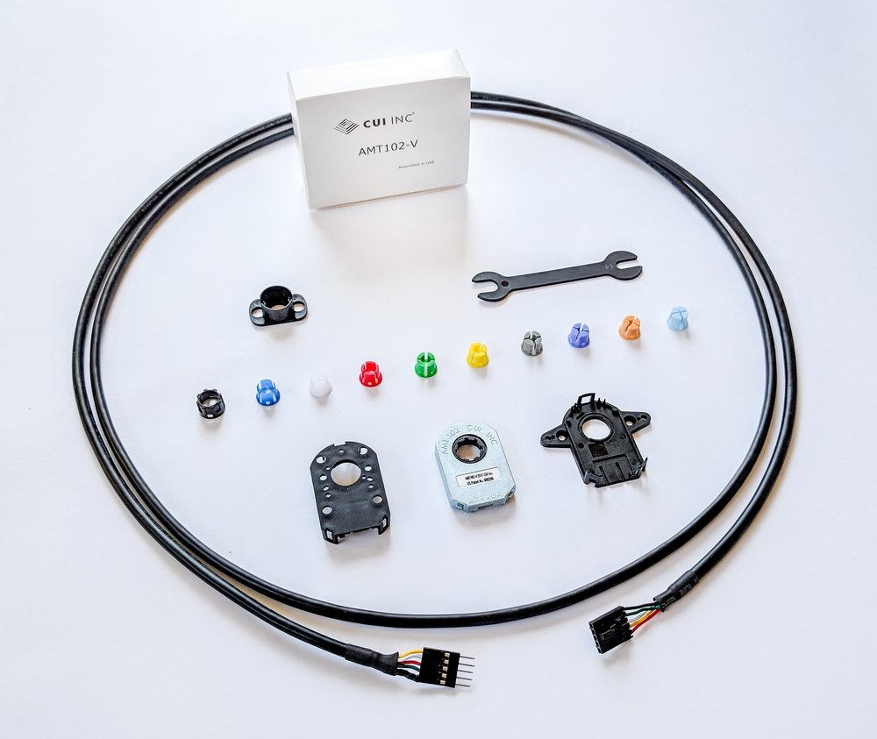
CUI AMT 102 encoder
Patented capacitive ASIC technology
Low power consumption
CMOS outputs
16 DIP switch selectable resolutions
Index pulse
modular package design
straight (radial) and right-angle (axial) versions
9 mounting hole options for radial version
8 mounting hole options for axial version
-40~100°C operating temperature

Slide 8
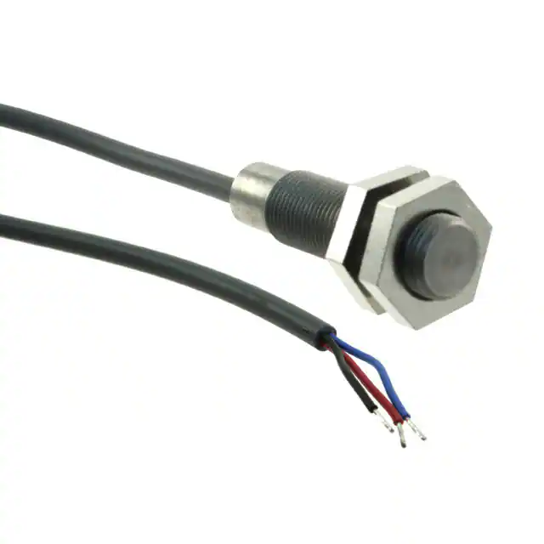
Littelfuse M12 Geartooth Speed Sensor
Ferrous target gear tooth speed sensor
Stainless steel M12 threaded barrel
Electronic protection against severe and automotive environments
Self adjusting magnetic range
Three-wire (voltage output)
EMC Protection (Consult Littelfuse)
Short circuit/reverse voltage protection

Slide 9
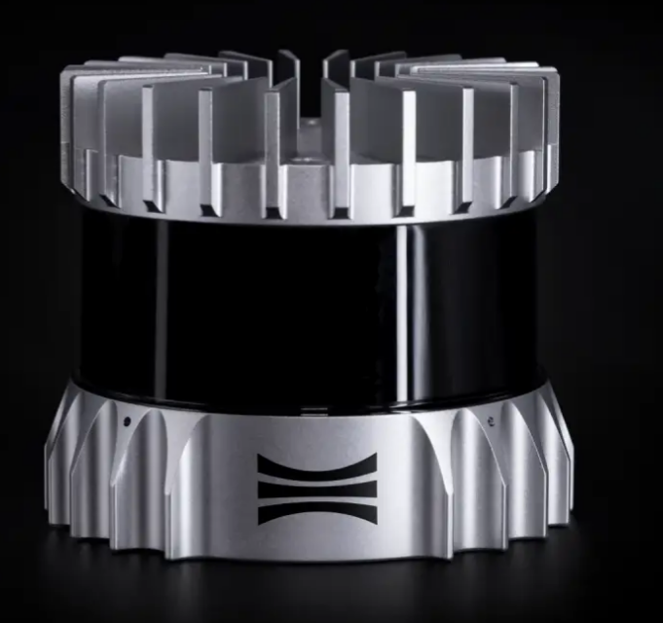
Ouster Os-0 64 channel LiDAR
35m Range at 10% reflectivity
100 m Max range
90º Vertical field of view
64 Channels of resolution
5.2M Max points per second
10x Photon sensitivity

Slide 10
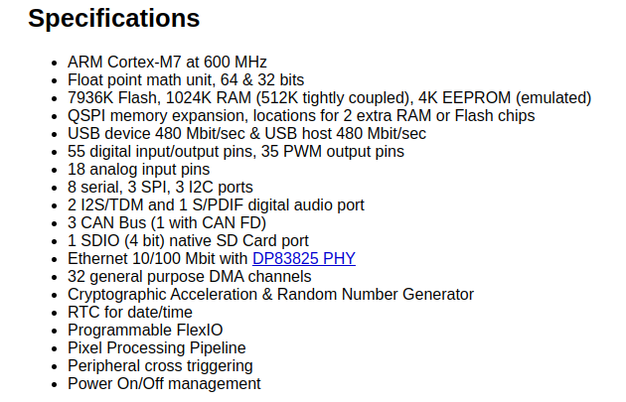
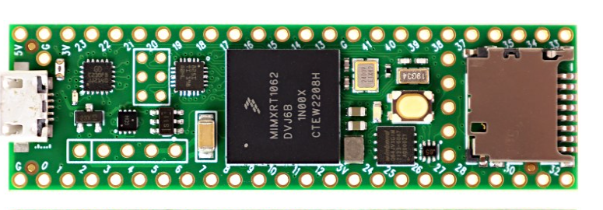
Teensy 4.1

Slide 11
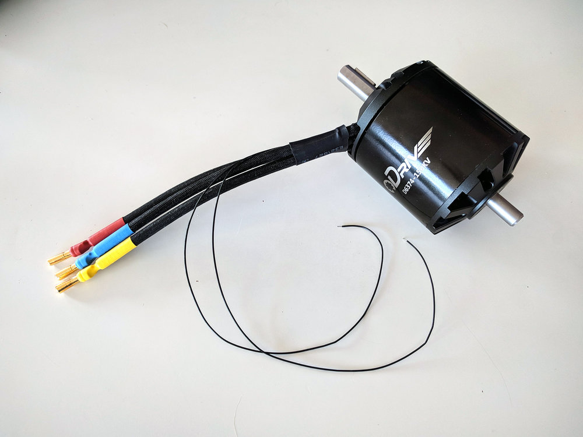
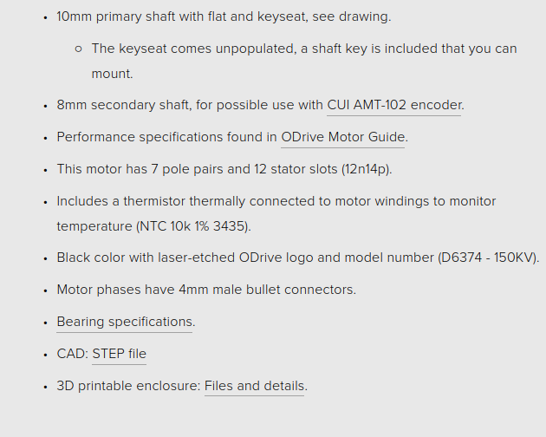
DUAL SHAFT MOTOR - D6374 150kV

Slide 12
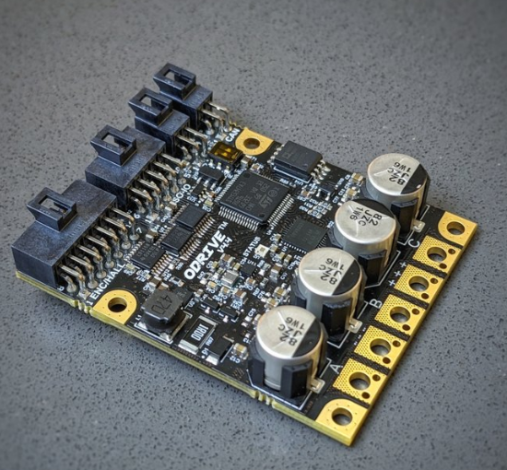
Odrive Robotics D6374 -150kV
Precise control and drive of brushless motors
15-58V DC voltage range
120A peak motor current, 70A continuous with cooling.
Encoder feedback for precise servo motion
  On-board absolute on-axis magnetic encoder
  Absolute encoder over RS485, incremental encoder, Hall sensors
Regenerative braking power back to DC power.
Semi-isolated or fully isolated CAN-FD transceiver
Motor thermistor temperature feedback
12V fan output

Slide 13
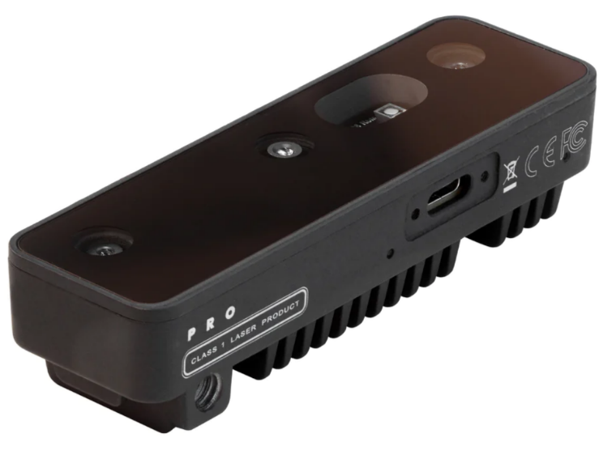
Oak-D Pro
USB-C connector for both power and communication, supporting USB2 and USB3 protocols (5Gbps / 10Gbps)
IR illumination LED: allows perceiving low-light and no-light environments
IR laser dot projector (active stereo): improves depth perception, especially for low-visual-interest surfaces (little or no surface texture)
4 TOPS of processing power (1.4 TOPS for AI)
Run any AI model, even custom architectured/built ones
Encoding: H.264, H.265, MJPEG - 4K/30FPS, 1080P/60FPS
Computer vision: warp/dewarp, resize, crop, edge detection, feature tracking
Stereo depth perception at 120 FPS with filtering
Object tracking: 2D and 3D tracking
Dimension: 97x29.5x22.9 mm
Weight: 91g

Slide 14
Defining Our Minimum Success Criteria
Constraints: Economics, Accuracy, and Reliability
Accurate and timely odometry system with a publication rate of 100hz:
Built with cost-effective parts that provide a high cost-benefit ratio
Must maintain reliability and accuracy
20% improvement in grounded stationary steering settling time:
Current settling time is 1.1867 seconds while stationary, grounded, and fully charged
Desired settling time must be 0.949 seconds or less

Slide 15
Defining Our Minimum Success Criteria cont.
Constraints: Economics, Accuracy, and Reliability
Rigid and robust mounting system for LiDAR and camera:
Must be easily removable for independent testing
Must be manufacturable with on-campus resources
Must protect the camera and LiDAR from on-track dangers such as impacting cones and barriers
Must be able to sustain a 10 lb lateral load on upper platform with no permanent deformation
Redesigned steering gearbox to reduce backlash and improve accuracy:
Goal is to achieve a 20% reduction in wheel backlash
Redesigned gearbox should provide a more precise steering response and better handling
Cost-benefit ratio of the parts used must be considered.

Slide 16
Major Works
Mechanical design tasks (35% of project):
Mechanical design work was deemed the most effective means of improving steering performance. To reduce steering play and improve accuracy. A redesign of the gearbox was the most economical course of action to pursue.
Implemented and improved the accuracy of the system steering system through tighter tolerance of the steering gearbox
Created a gearbox that reduces unwanted wheel movement while improving steering speeds through increased power and lower gear ratios.
Electrical design tasks (10% of project):
To reduce settling time, a more powerful steering drive motor was determined to be an effective means of accomplishment.
Wired motor controllers, DC brushless motor, encoder and CAN
Required knowledge of motor physics and control theory
Performed required power wiring, networking and the time sync signal for the Ouster Lidar
Integrated the wheel speed hall effect sensors with a Teensy 4.1

Slide 17
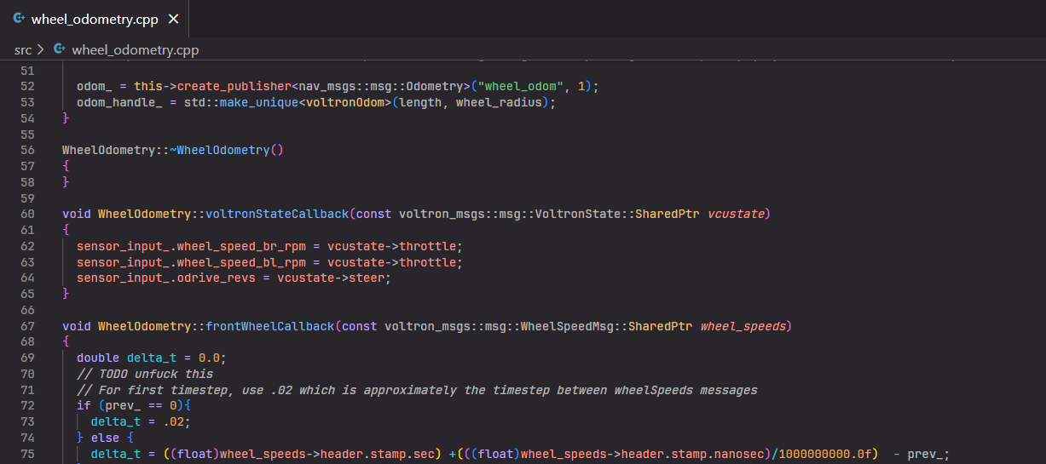
Major Works
Embedded programming tasks (55% of project):
Requirements for formulating engineering problems for embedded programming include real-time sensor data control, ROS2 for wheel odometry, and Python testing for parameters such as steering motor settling time, which require knowledge of robotics, data analysis, testing, and debugging.
Read sensor data from a microcontroller and used it in real-time control and decision-making processes
Utilized ROS2 to develop a wheel odometry system which required knowledge of robotic operating systems
Used Python to test and collect data on parameters like the steering motor's settling time requires understanding of data analysis, testing, and debugging methods

Slide 18
Design Requirements & Specifications
Functions
Enhance kart functionality for better steering accuracy and spatial estimation
Incorporate several upgrades into the existing system
Install a higher-resolution LiDAR sensor to provide more detailed and precise data on surrounding objects
Install a new 3D camera to provide real-time visual data for improved spatial estimation
Upgrade the steering motor and install a new belt-driven gearbox to reduce settling time and increase accuracy and response time
Upgrade the odometry system with Hall-effect sensors for real-time wheel speed data and better path estimation
Result in a kart with greater precision, accuracy, and efficiency on the track.

Slide 19
Verification Approach/Plan
Systems | Analysis | Simulation | Testing
Steering System | ✓ |  | ✓
Odometry System | ✓ | ✓ | ✓
Lidar and Camera System |  |  | ✓

Slide 20
Analysis of Odometry System
Wheel Speed Odometry estimate evaluation:
In order to evaluate our odometry estimate created by our wheel speed and angle sensors, we can use our existing on-board inertial navigation system (INS) that currently provides an estimate.
We compared time-synced direct measurements of body frame velocity and GPS-based position to attempt to identify error and noise in the system.
  Significant noise in the wheel speed readings was detected, and this was addressed using kalman filtering and eliminating high-frequency readings (debouncing)
  A speed decay equation was implemented such that if the odometer’s speed is integrated into position, there will be little to no drift.
We designed and implemented a kinematic model of the kart to estimate its position based on the odometers.
The output of our kinematic model was compared to hand calculated results to ensure its accuracy.

Slide 21
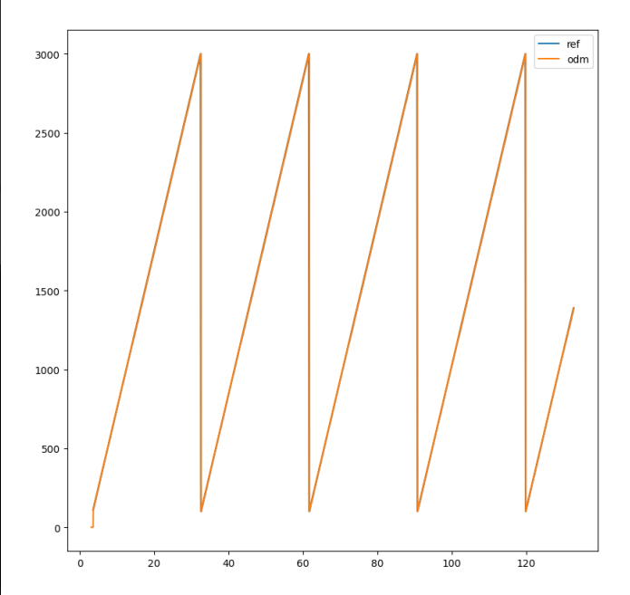
Simulation of Wheel Speed Sensor
Wheel Speed Piecewise Verification
Our wheel speed sensor uses a digital signal created by a hall effect sensor and a known tooth count of a wheel speed disk to estimate the angular velocity or RPM of our go-kart wheel.
This data was simulated by using another microcontroller to create this PWM like signal at a specific frequency as calculated by an expected RPM, verifying the integrity of the speed estimate.

Slide 22
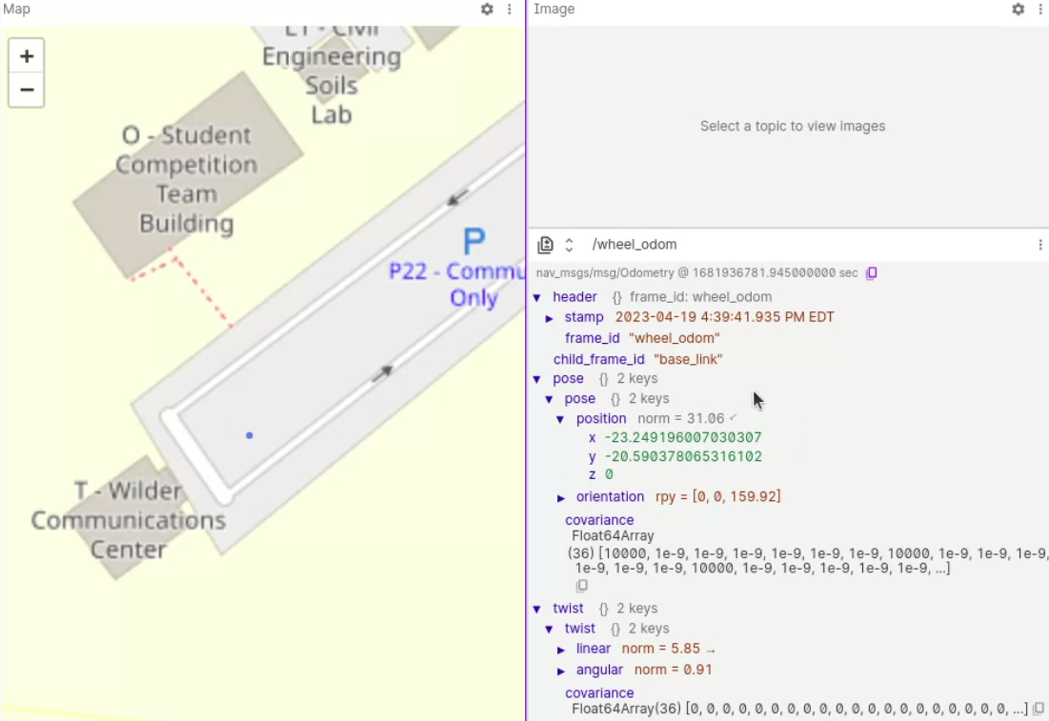

Test results of Odometry System
Wheel Speed Odometry Integration Test
Debugged ROS 2 code deployment within Voltron’s system environment
Verified using actual data recorded from the installed odometers on one of Voltron’s road tests that the odometry system is able to deliver usable results with reasonable accuracy over a short time horizon, with a publication rate of 100Hz

Slide 23
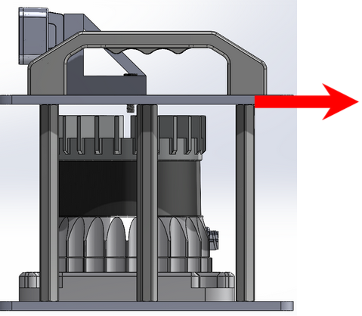
Test of Lidar and Camera Cage
To ensure structural integrity of cage, we will conduct lateral load testing on the upper level of the cage while holding the lower level stationary and measure the amount of deflection at 10 lbs of force.

Slide 24
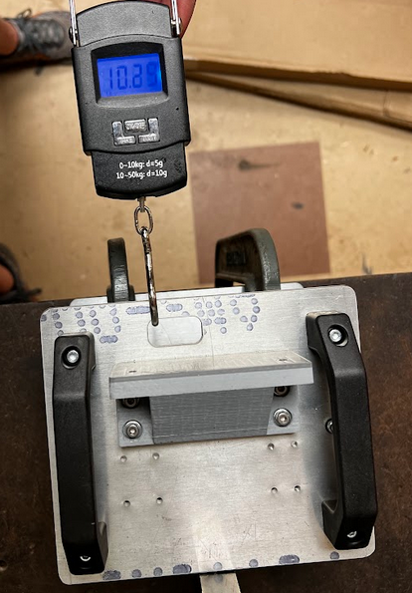
Test Results of Lidar and Camera Cage
With the base secured to a test bench, a lateral load was applied to the upper plate. The force was measured using a force meter and the deflection was measured by having a straight-edged tool against the upper plate and seeing the difference in spacing after the force was applied. Deflection was approximately 2 mm during testing and no permanent deformation was present after testing.
https://drive.google.com/file/d/1p4MHw2Wgh1e1pCxiqEvOhBFeNPz0Vj2E/view?usp=sharing

Slide 25
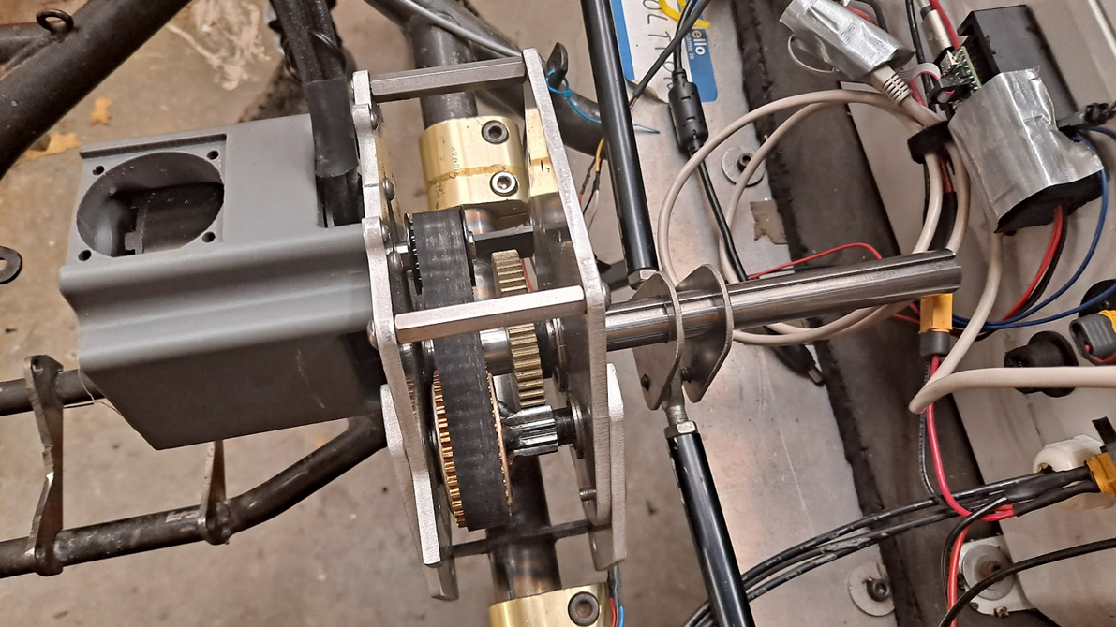
Analysis and Construction of Steering System
Determined requirements
Identified motor with highest low-speed power
Created a design that focused on reliability and repairability
Selected the gear ratio which would approximately keep the motor at the peak power output assuming a 200ms actuation time

Slide 26
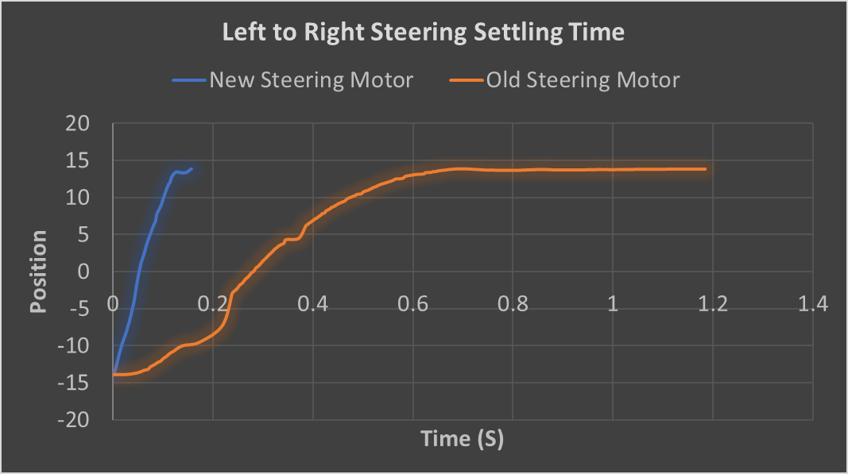
Test results of Steering System
Settling time of steering system via python Script
Settling time of original steering system: 1.1867s, determined via python script.
New steering system needed to achieve settling time of 0.949s or faster for 20% improvement.
Same testing conditions used for new system tests, performed multiple times for accuracy and repeatability.
New system achieved average settling time of 0.16575s, exceeding the 20% improvement goal with over 85% improvement.

Slide 27
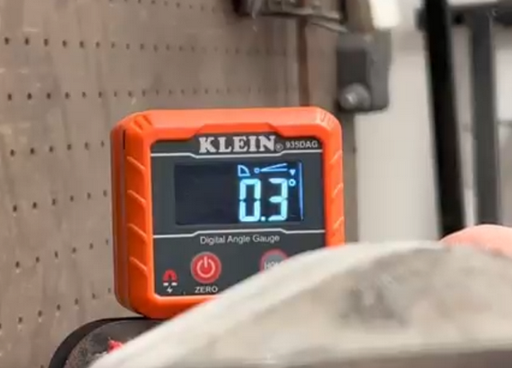
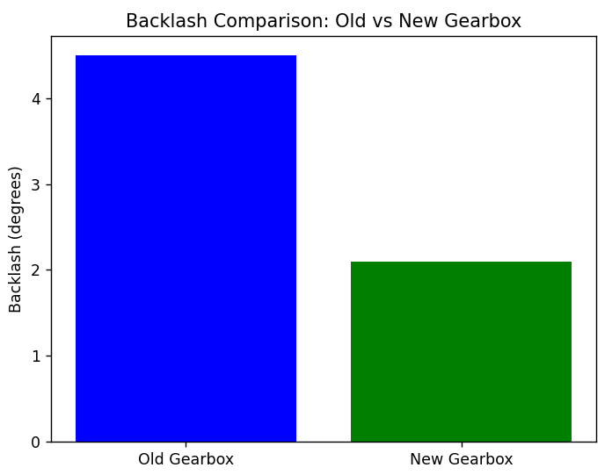
Test results of Steering System Cont.
The original gearbox had an initial starting position of .3 degrees above horizontal and was able to be rotated to 4.8 degrees above horizontal. This indicated 4.5 degrees of uncontrolled displacement in the gearbox.
The new gearbox had a starting position of .7 degrees above horizontal and was able to be rotated to 2.8 degrees before stopping. This results in 2.1 degrees of unwanted displacement.
Testing showed a 53.6% reduction in movement of the new locked output shaft.
https://drive.google.com/file/d/1RiRdRGRTWo4sEsLlVIs6GEMBHdwWpKj1/view?usp=sharing

Slide 28
Trade Study- Steering motor
Motor Characteristics | Odrive DUAL SHAFT MOTOR - D6374 150KV | NEO Brushless Motor V1.1
Rated Voltage | 8-50 VDC | 6-12S LiPo
Rated Power | 3600 W | 1900 W
Maximum Torque | 5 Nm | 2.6 Nm
Maximum Speed | 10000 RPM | 10000 RPM
Price | $119.00 | $48.00

Slide 29
Trade Study-Microcontroller
Microcontroller Characteristics | Arduino Nano | Raspberry Pico | Teensy 4.1
Microcontroller Model | ATmega328P | RP2040 | MK64FX512
Clock Speed | 16 MHz | 133 MHz | 600 MHz
RAM | 2 KB | 264 KB | 1 MB
Flash Memory | 32 KB | 2 MB | 8 MB
GPIO Pins | 22 | 26 | 37
Price | $16.00 | $7.00 | $31.50

Slide 30
Trade Study-Wheel Speed Sensors
Wheel Sensor Characteristics | Littelfuse M12 Gear Tooth Speed Sensor | Cherry Electrical Sensors CRG Series | Sensata Technologies KAV
Type | Gear tooth sensor | Magnetic sensor | Gear tooth sensor
Operating Voltage Range | 4.5V to 24V | 4.5V to 24V | 4.5V to 24V
Output Signal | Digital | Digital | Digital
Maximum Speed Detection | Up to 20,000 RPM | Up to 20,000 RPM | Up to 30,000 RPM
Supply Current | 5mA to 20mA | 5mA to 15mA | 5mA to 20mA
Price | $42.80 | $34.50 | $37.85

Slide 31
Trade Study-Motor Controllers
Motor Controller | ODrive Pro | Roboteq | Phidgets
Motor Types | BLDC, PMSM, DC | DC, BLDC, Stepper | DC, Stepper, Servo
Maximum Voltage | 58V | 60V | 24V
Maximum Current | 120A | 150A | 20A
Advanced Features | Closed-loop control, Regenerative braking, Sensorless control | Regenerative braking, Analog and Digital I/Os, CANopen support | PID control, Closed-loop control, Position control
Price | $229.00 | $345.00 | $75.00

Slide 32
Trade Study-Lidar Sensors
Characteristic | Ouster OS-0 64 | Velodyne VLP-16
Price | $4,500 | $8,000-$10,000
Vertical Resolution | 64 channels | 16 channels
Range | Up to 120 m | Up to 100 m
Accuracy | <1 cm | <3 cm
Size (L x W x H) | 98 x 98 x 87 mm | 100 x 100 x 97 mm

Slide 33
Trade Study-Absolute Encoders
Characteristic | CUI AMT 102 | Dynapar HS35 | BEI Sensors MAE3
Resolution | 12 bits | Up to 17 bits | Up to 14 bits
Maximum Speed | 10,000 RPM | 6,000 RPM | 6,000 RPM
Operating Voltage | 5V or 9-30V | 5-26V | 5-30V
Output Options | SPI, ABI | SSI, CANopen | SSI, CANopen
Price | $39 | ~$300 | ~$200

Slide 34
Trade Study-Cameras
Camera Model | Price | Sensor Type | Field of View | Depth Sensing | Max Range | Max Frame Rate | Interface
Oak-D Pro | $349 | RGB + Depth | 68° H, 41° V | Yes | 7 meters | 60 fps | USB 3.0
Intel RealSense D435 | $199 - $349 | RGB + Depth | 85.2° H, 58° V | Yes | 3 meters | 90 fps | USB 3.0

Slide 35
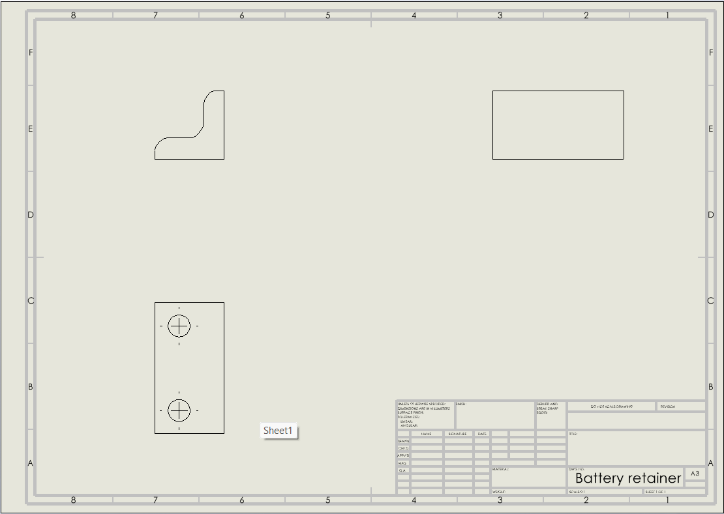
Standard Compliance
ASME Y14.1
ASME Y14.1 establishes requirements for engineering drawings and related documentation
SolidWorks is a CAD software that helps create drawings that meet ASME Y14.1 compliance
SolidWorks allows customization of drawing sheet format, including size, orientation, title block, and grid spacing
Custom text styles and templates can be created in SolidWorks to conform to ASME Y14.1 requirements for text and labeling
Multiple views of a part or assembly can be created in SolidWorks, with dimensions, notes, and other information, in accordance with ASME Y14.1
SolidWorks features help organize drawings according to ASME Y14.1 requirements, including automatic view alignment and spacing

Slide 36
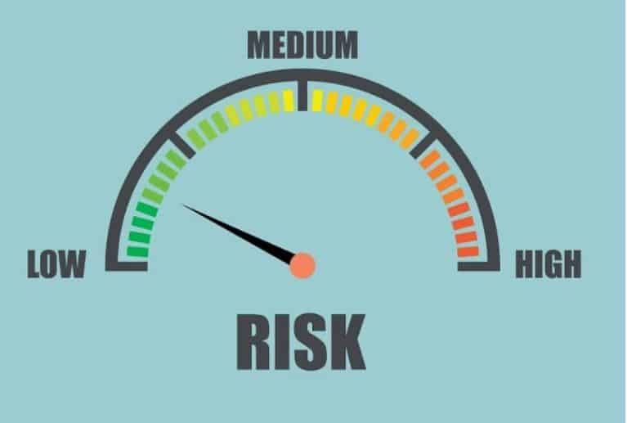
Standard Compliance Cont.
ISO 12100 standard for risk assessment and risk reduction
Potential risks associated with upgrading and overhauling of subsystems on the go-kart have been identified
Additive manufacturing techniques are being used to fabricate the mounting hardware for the LiDAR sensor and RGB-D camera system to reduce the risk of injury and accidents associated with traditional machining methods
A Text User Interface (TUI) is being implemented for control and monitoring of the go-kart to reduce the risk of accidents due to poor control and monitoring of the system
Measures are being taken to reduce the risk of damage to the system during the testing and integration phase, such as conducting field tests and tuning and filtering the software for the wheel odometry system
Adherence to the ISO 12100 standard ensures the prototype is safe, reliable, and can be tested and integrated with confidence.

Slide 37
CAD Diagrams
Battery Retainer

Slide 38
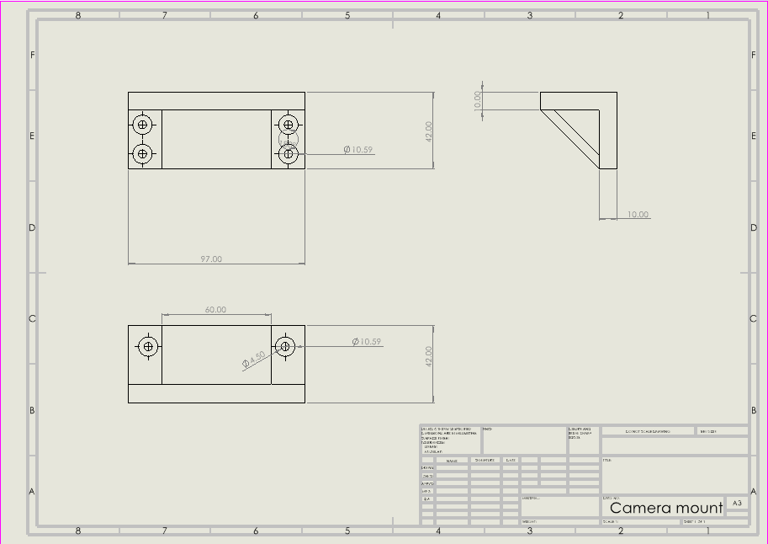
CAD Diagrams
The 3d printed camera mount provides needed stability and placement for the updated LiDAR cage

Slide 39
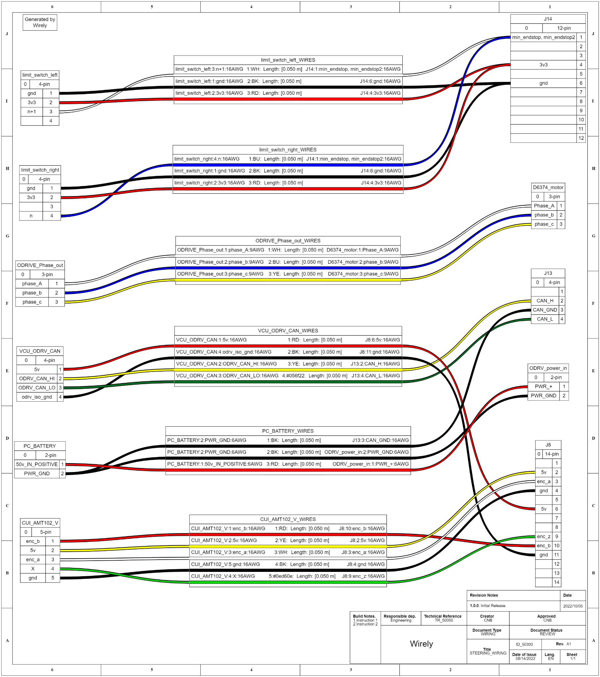
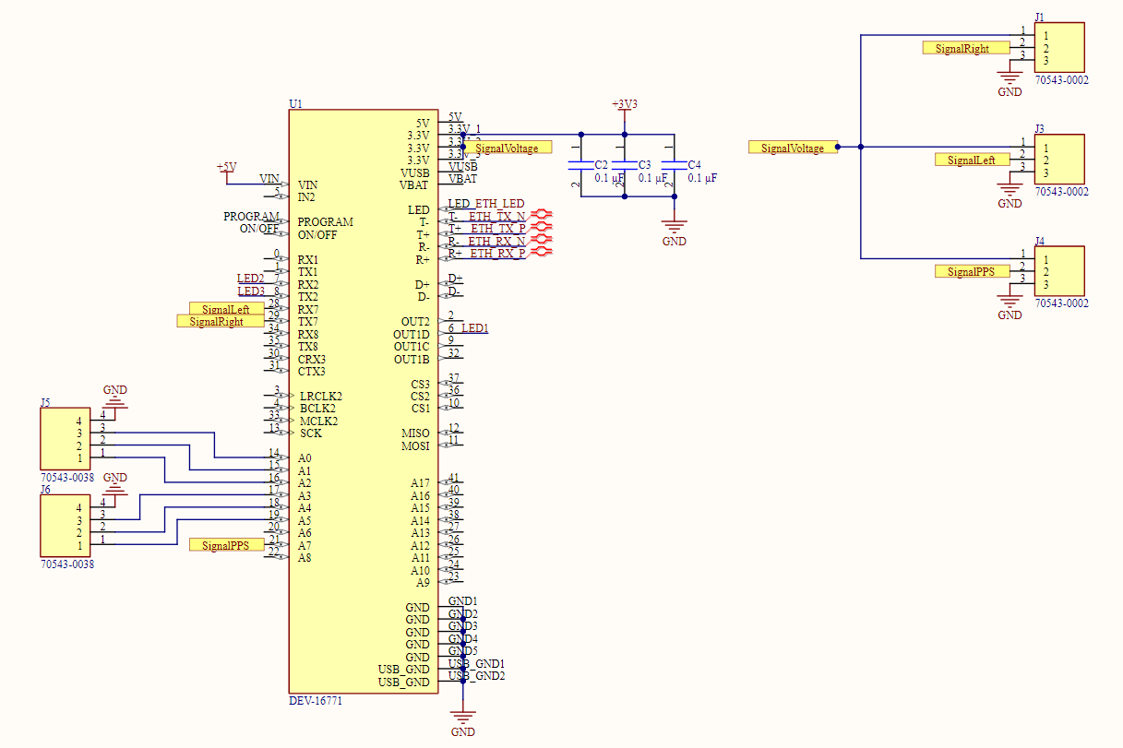
Electrical Schematics

Slide 40

Team chart & major responsibilities of each member
Ben leads the Autonomous Go-Kart project, handling planning and scheduling while also using SolidWorks for designing the steering gearbox. Ben also works on odometry development using ROS2 and C++. Ben also worked on integration of the systems onto the go-kart. Ben’s responsibilities also included project architecting and communication between the larger EVT organization and our senior design team.
Brighton designs and 3D prints the Lidar and Camera cage using SolidWorks, while also being responsible for HMI development and designing the graphical user interface (GUI) for the go-kart. Brighton also assisted in manufacturing for the LiDAR-Camera mount and integration onto the kart.
Ruben ensures the go-kart's systems are working as intended by conducting software experimentation for testing development. They also work on HMI development, designing the GUI appearance and functionality using Python, and odometry development by programming with C++ and ROS2 to calculate wheel odometry mathematics.
Crockett is responsible for embedded development, using micro-ros with hall effect sensors and teensy microcontrollers for wheel speed readings. They also program systemd processes for the go-kart and are involved in steering motor development by installing and configuring the O-Drive pro motor.

Slide 41
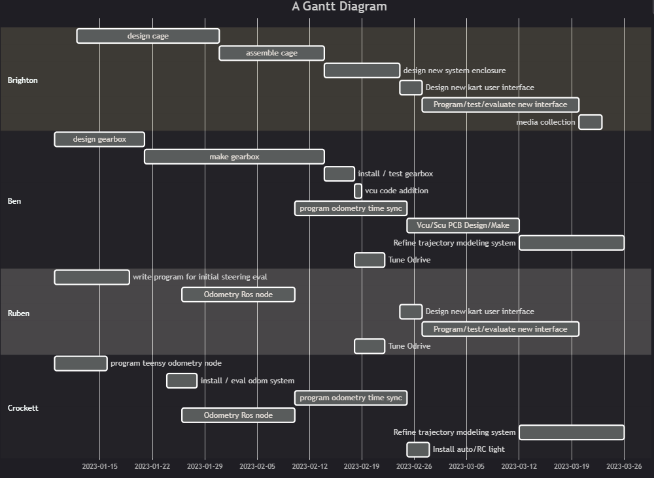
Schedule - Gantt chart

Slide 42
Budget
Items | Price ($)
CUI AMT 102 encoder | $39.00
Littelfuse M12 Gear tooth Speed Sensor (x2) | $85.60
Ouster Os-0 64 channel LiDAR | $4500.00
Oak-D pro | $349.00
PCB for VCU/SCU | $300.00
Odrive Robotics D6374 -150kV | $229.00
Teesny 4.1 Microcontroller | $31.50
DUAL SHAFT MOTOR - D6374 150KV | $119.00
Misc. Parts/Materials | $3000.00
Total Cost | $8,653.10

Slide 43
Source of Materials and Resources
Software:
ROS2_WIKI
Wheel_Odometry ROS code
Odrive_WIKI
SolidWorks
Altium
MatLab
Ubuntu 22.04
Gitlab
Discord
Autorally project
Hardware:
McMaster-Carr
Luxonis
Ouster
OdriveRobotics
Digikey
PJRC
Mentors:
Cameron McKinney
Timothy Gallion
Dr. David Guerra-Zubiaga
Dr. Matt Marshall
Sahan Reddy
Walker Burns
KSU Formula SAE Team
Facility:
Mechatronics Lab Q-118
Wilder Communications Center/EVT Workshop
Media Collection
Stray Dog Pictures

Slide 44
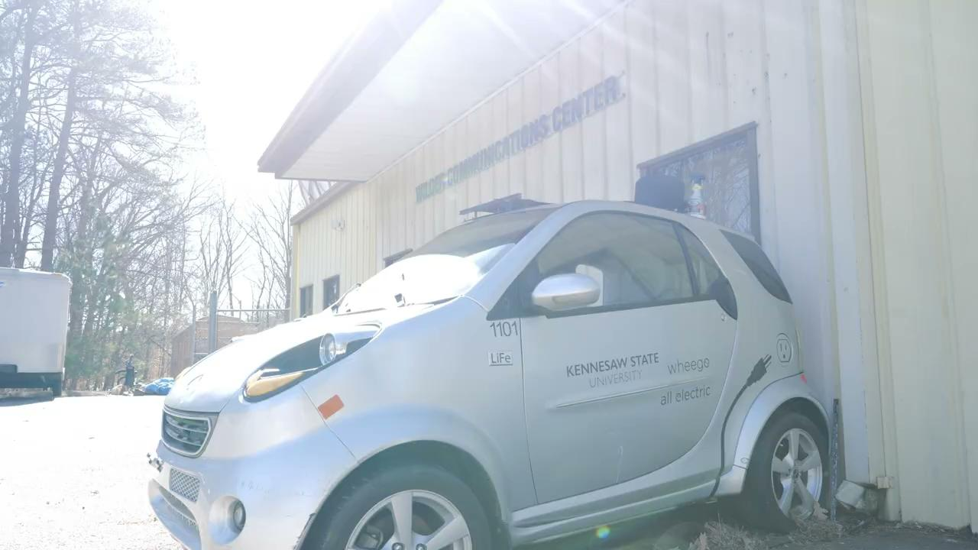
Demonstration Video

Slide 45
Lessons Learned
We gained proficiency in ROS2, which is a popular and powerful framework for building robotics systems, opening up a range of opportunities for future projects and applications.
We gained proficiency in platformio, a build platform for many micro-controllers such as the Arduino and Teensy.
We honed our skills in C++ and Cmake which are fundamental skills for any software development project, leading to more successful and impactful projects.
Learned about various software platforms such as textualize, foxglove studio, and the new ODrive PRO motor controller configuration features
We became adept at finding, reading, and using documentation, which is crucial for navigating and using devices and code effectively, saving time and effort and reducing errors and bugs in the project.

Slide 46
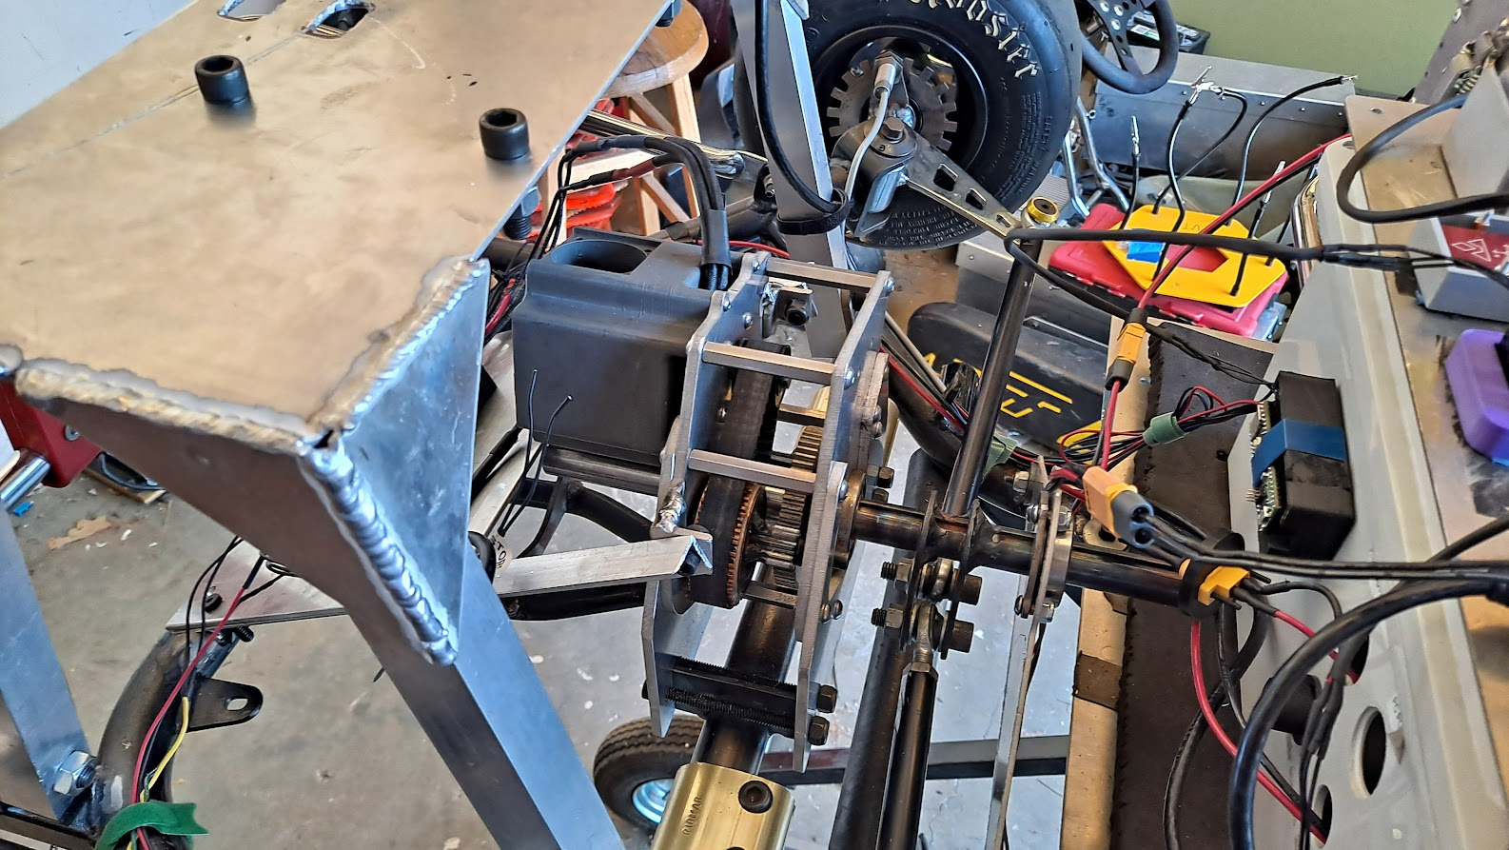
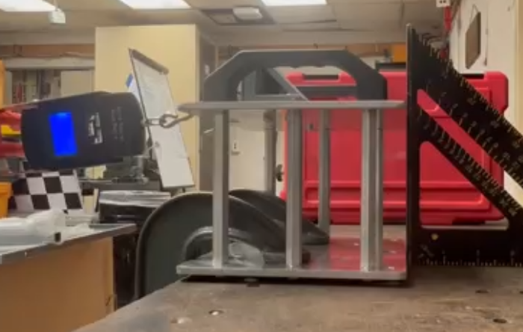
Achievements
Settling time for the steering system was reduced by 85% (0.167s vs 1.18s).
The new LiDAR cage offers necessary protection for vital systems.

Slide 47
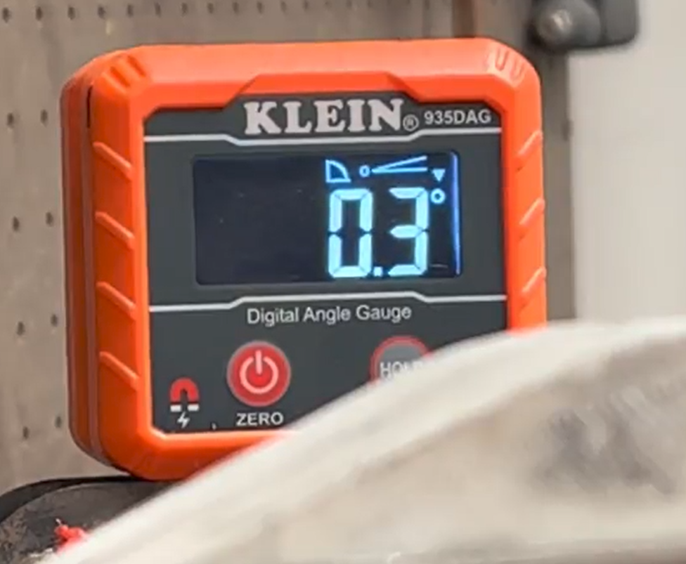
Achievements Cont.
Steering backlash was reduced by 53.6%.
A newly designed and installed odometry system gives an accurate position of the kart over a short time horizon with a publishing rate of 100hz.

Slide 48
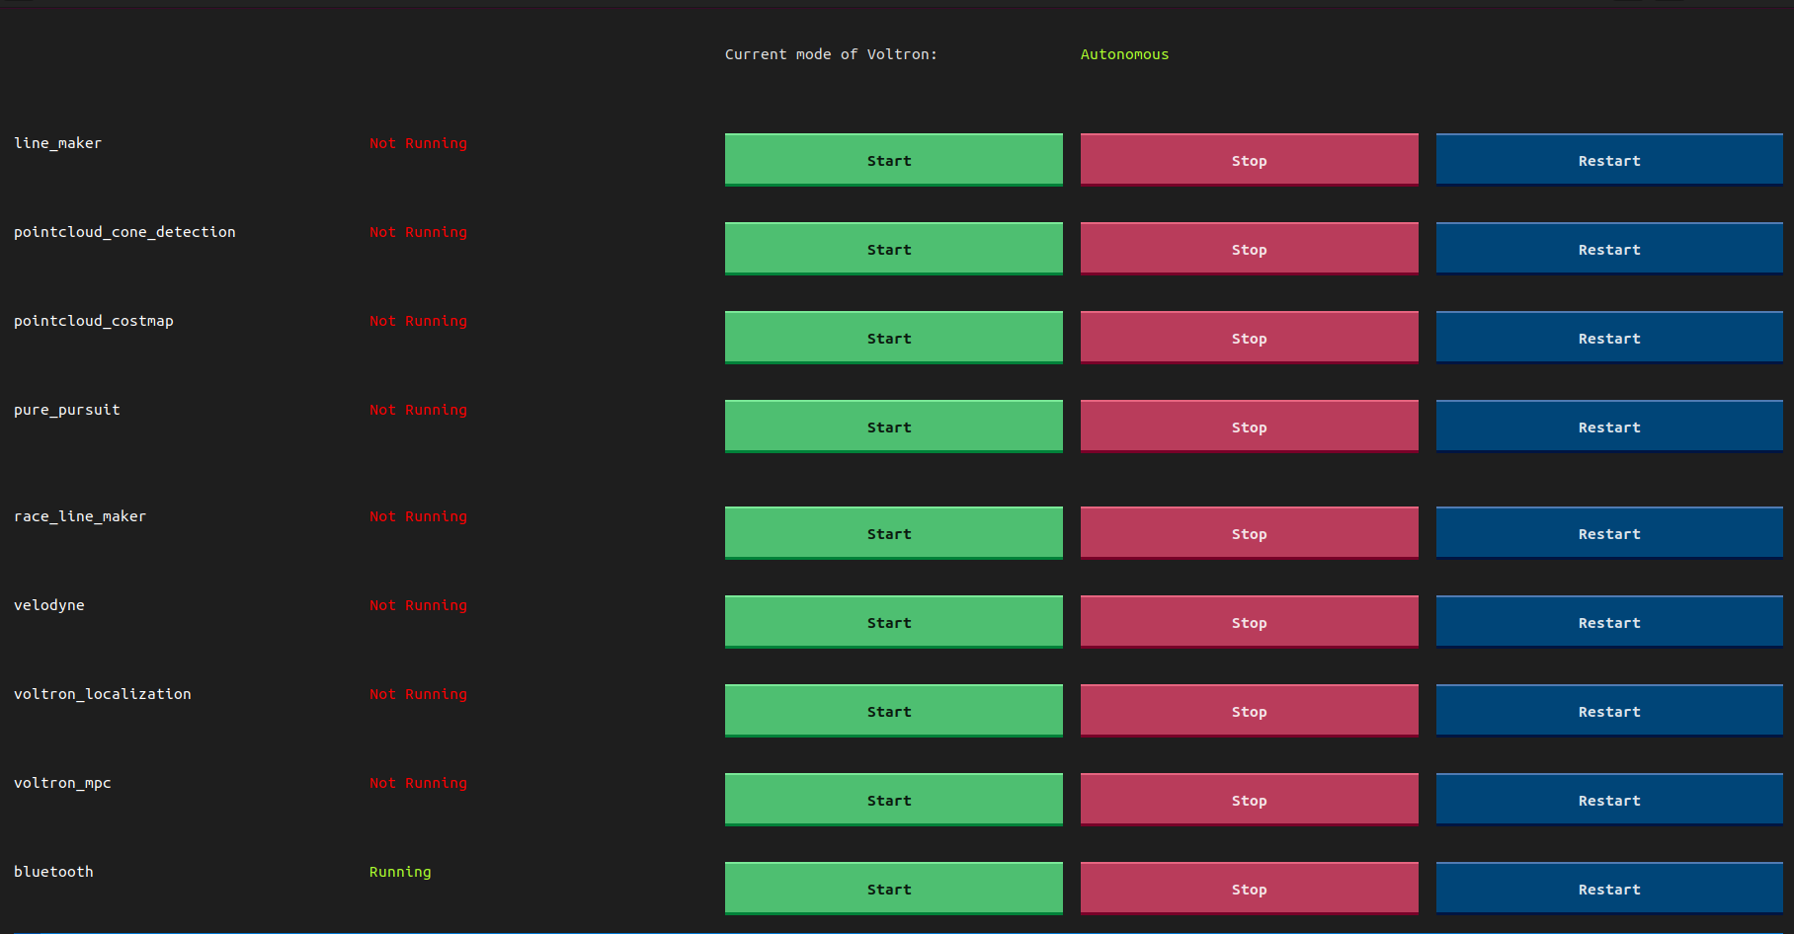
Future works & possible optimizations
TUI for the System processes of the Voltron Go-kart:
Improved human interactivity:
Allows users to see active/inactive system processes
Enables users to start, stop, and restart system processes of their choice
Shows the current status of the kart: Autonomous/ Manual/ Idle
Status of TUI: The TUI is completed and awaiting implementation on Voltron's computer. However, it still requires an option for remote operation via SSH connection while the kart is moving. Additionally, integration with Voltron is necessary to enable the TUI to determine the Kart's mode.

Slide 49
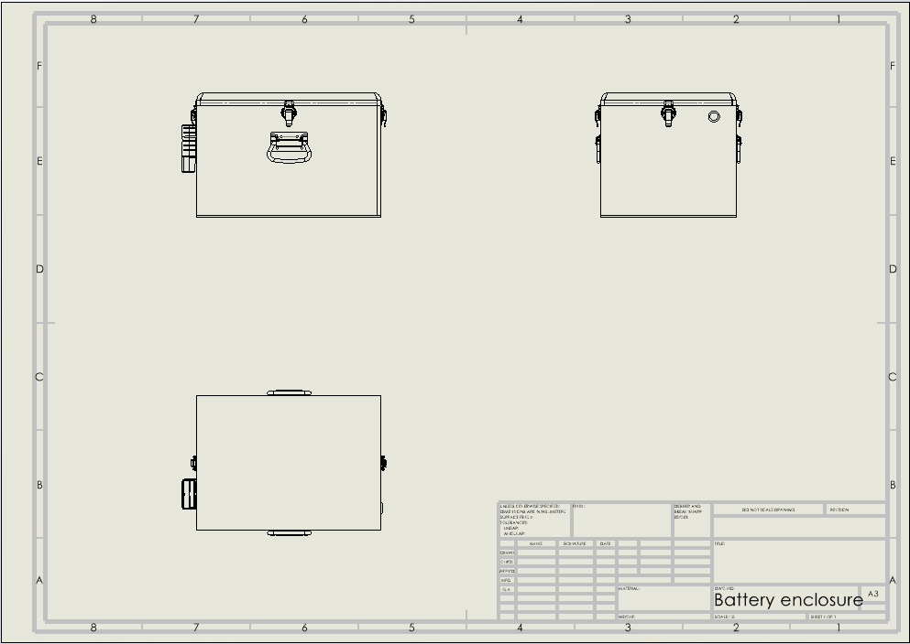
Future works & possible optimizations
Battery container for updated enclosure
Relocating batteries from outer section
of chassis will help weight distribution
and kart performance.

Slide 50
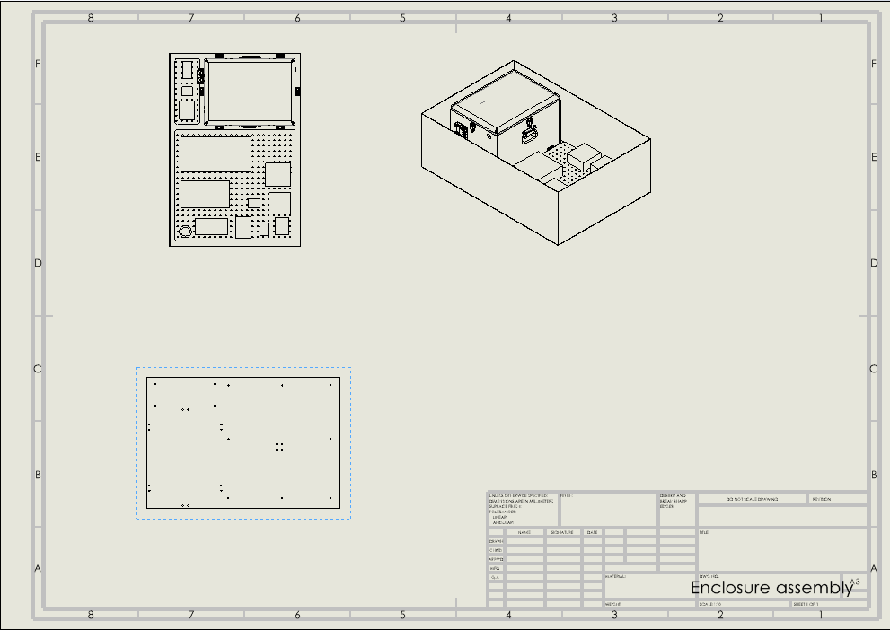
Future works & possible optimizations
Redesigned containment unit
for Voltron electronic and
power components.
Organization of components
will facilitate testing operations
and improve aesthetics.

Slide 51
Questions?

