Slide 1


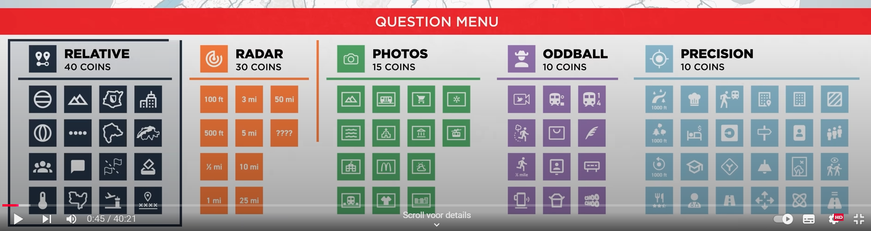
Rubik font

Slide 2


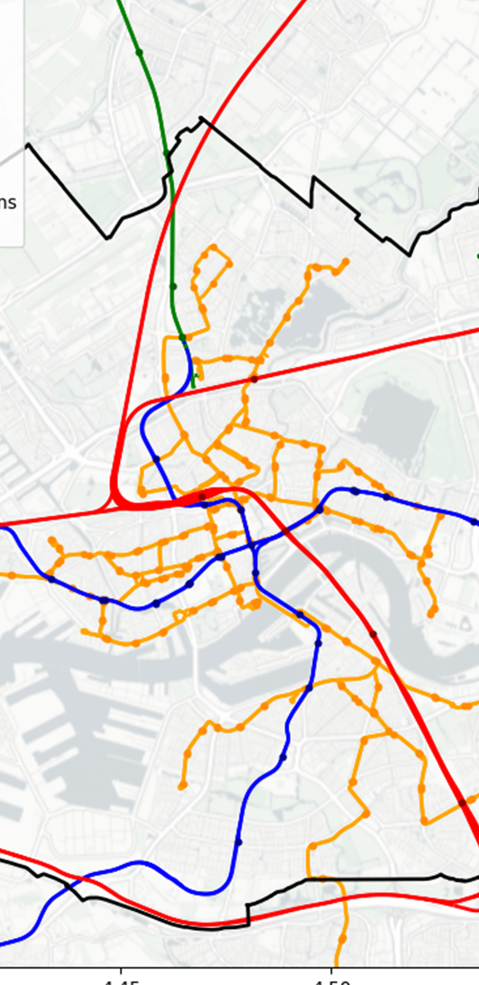



LEADERBOARD
MAPS
QUESTIONS
CURSES
1st
RUBEN
2nd
BEYZA
3rd
KEES
LEADERBOARD
MAP
QUESTIONS
CURSES
LEADERBOARD
MAP
QUESTIONS
CURSES
LEADERBOARD
MAP
QUESTIONS
CURSES
LEADERBOARD
MAP
QUESTIONS
CURSES

