Slide 1

Virtual Reality toolset for Material Science: NOMAD VR tools
Rubén Jesús García-Hernández, Dieter Kranzlmüller
4th International Conference on Augmented Reality, Virtual Reality and Computer Graphics
SALENTO AVR 2017. Ugento (Lecce), Italy. June 13, 2017

Slide 2
Virtual Reality toolset for Material Science: NOMAD VR tools
NOMAD
Chemical systems
Developed VR tools
Supported Hardware
User Study
Future work
GearVR Demo and Questions

Slide 3
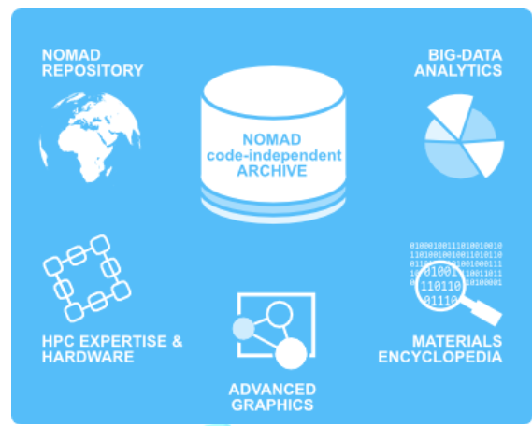
NOMAD
Center of Excellence in Material Science
Includes
Repository
Archive
Encyclopedia
Big Data analytics
Advanced Graphics
Infrastructure

Slide 4
Example datasets
Two example chemical systems were chosen within the NOMAD dataset for this prototype proof of concept
Adsorption of CO₂ on CaO surface
4D dataset, time evolution of electron density
Electron-hole interaction in LiF
6D dataset, due to quantum effects

Slide 5
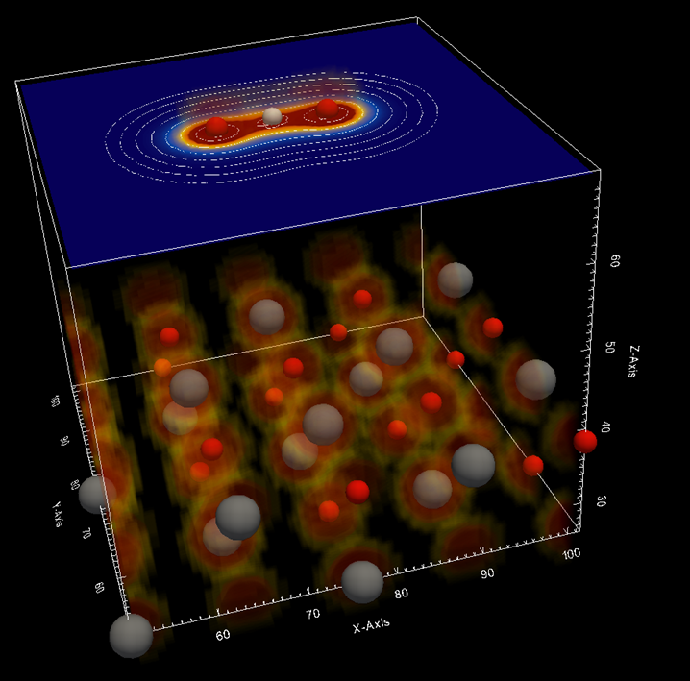
Adsorption of CO₂ on CaO surface
Relevant for carbon dioxide capture, activation and further transformation into other materials useful for industry.

Slide 6
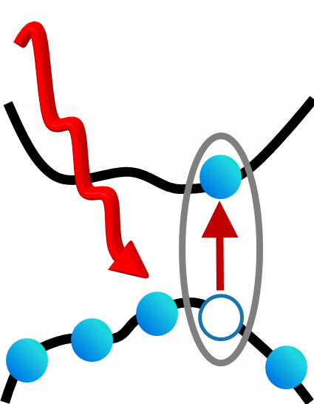
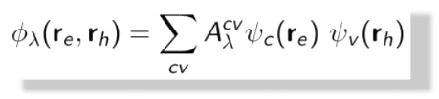
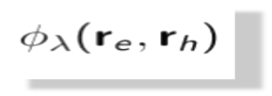
LiF excitons
Excitons: Relevant in opto-electronics, solar cells, lighting devices, photocathalysis, water splitting

Slide 7
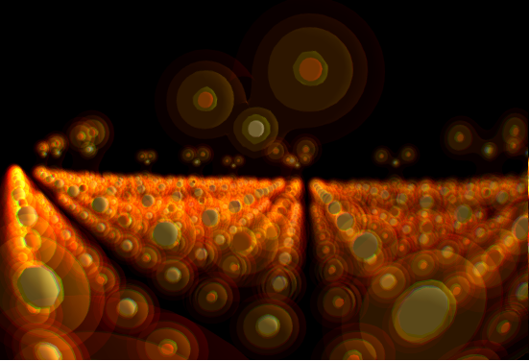
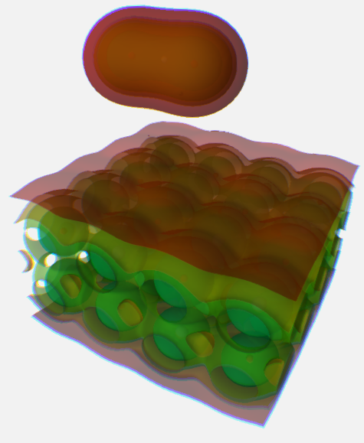
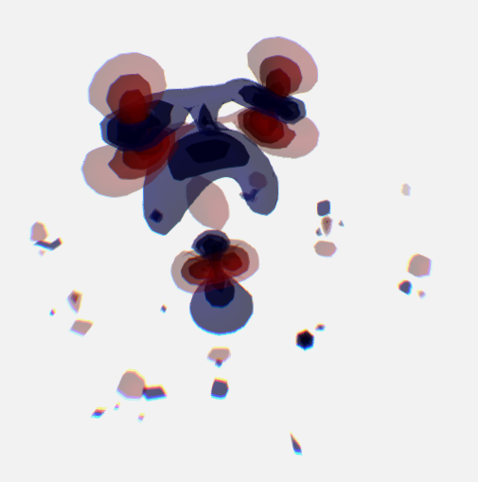
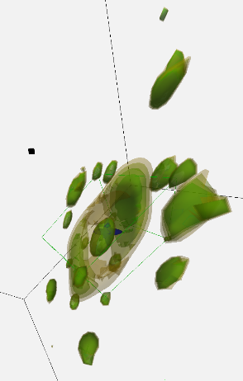
Developed VR tools
Viewers for specific chemical systems
Molecular dynamics simulation (4D dataset)
Exploration of electron-hole interactions (6D)
Running on various VR devices; interaction and rendering tailored for each device

Slide 8
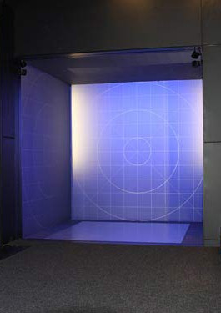
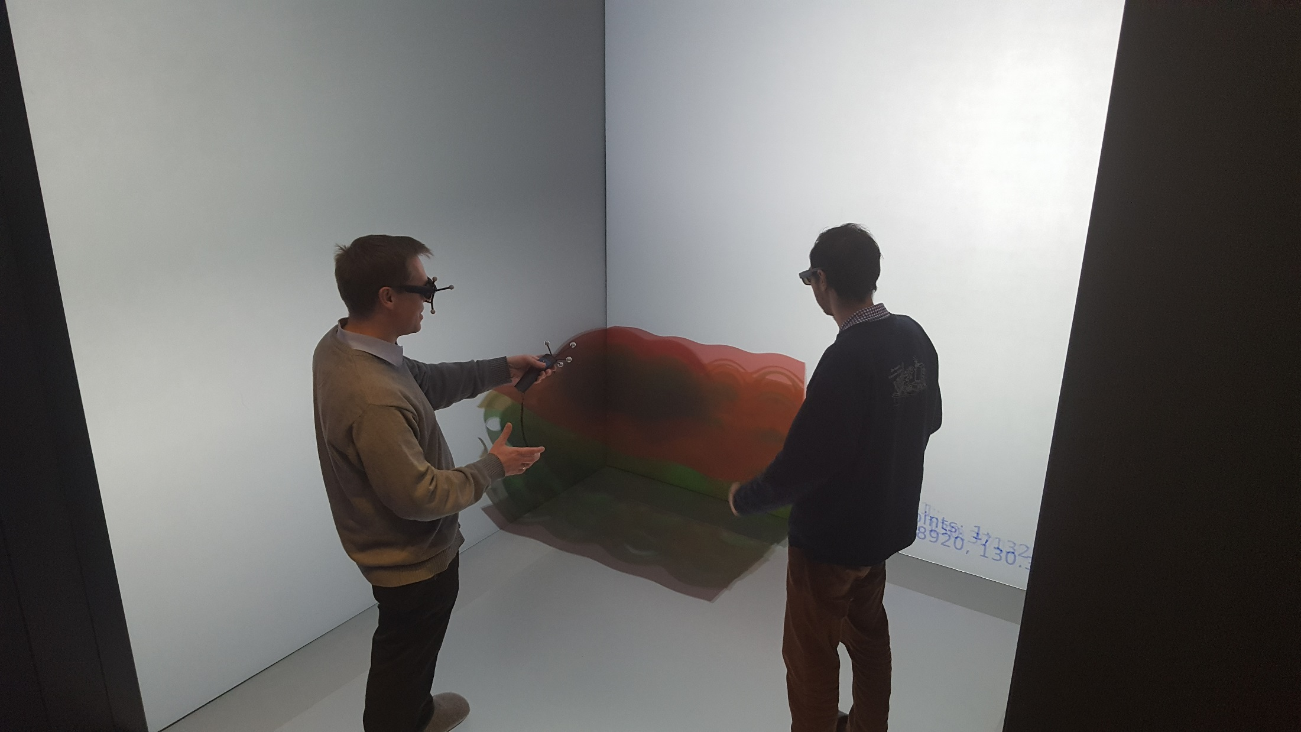
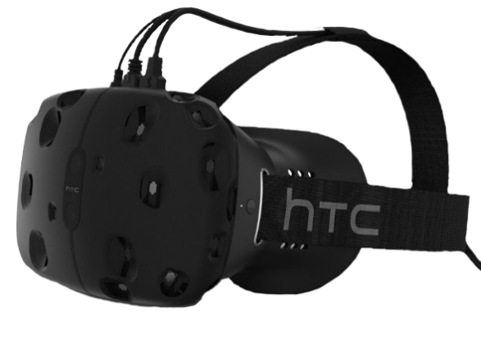
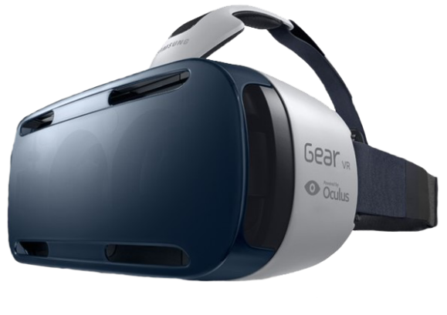
Supported Hardware
LRZ CAVE-like system
HTC Vive
Samsung GearVR

Slide 9
User Study
Informal talks with non-experts
14-item post-questionnaire for experts
15 domain experts
Questions regarding navigation, interaction, data understanding, ease-of-use, students use
4,683±1,997, t=2,65 (2σ), 7-point Likert scale: slight, but significant, preference for the VR system.

Slide 10
Future work
Generalization of the demos and integration in the NOMAD infrastructure
Addition of new functionality and chemical systems
Increase ease of use: More intuitive interface and more extensive documentation
Outreach activities

Slide 11

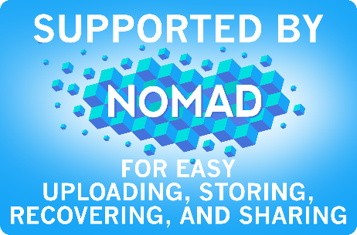
GearVR demo and questions

