Slide 1
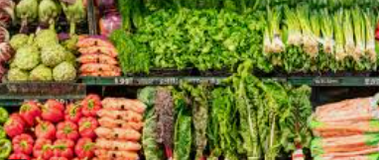
Analysis of Vegetable Prices
By Ruben Juries

Slide 2
Overview
These findings and explanations are based on the Vegetable prices data in csv format found in Kaggle
The data was imported into a notebook using Python for importing, cleaning, analysis and modelling predictions
The vegetable prices explained are relative to the dataset and does not explain vegetable prices from data sources outside of the used dataset

Slide 3
Problem statement:
Dsdaddsd
Adadadadadada
Adadadadadadadadadadadad
Cccccccccc

Slide 4
Hypothesis to test the data:
Dsdaddsd
Adadadadadada
Adadadadadadadadadadadad
Cccccccccc

Slide 5
Findings:
Dsdaddsd
Adadadadadada
Adadadadadadadadadadadad
Cccccccccc

Slide 6
Recommendations:
Dsdaddsd
Adadadadadada
Adadadadadadadadadadadad
Cccccccccc

Slide 7
Trello schedule:

Slide 9
Links to additional resources:
Dsdaddsd
Adadadadadada
Adadadadadadadadadadadad
Cccccccccc
End

Slide 10
Findings:
Dsdaddsd
Adadadadadada
Adadadadadadadadadadadad
Cccccccccc

