Slide 1
Academy Lab Projects – Showcase
Rubén Lombardo Calvo
Creación de una aplicación web de alta disponibilidad y escalabilidad
31/12/2023
Notes:
For Educators: You can use this template to help your students effectively present and communicate their project to a broader audience. Your students can also use this presentation as a portfolio of their work to demonstrate their cloud skills.
The presentation structure is listed below. The total time may vary depending on the activity you want to conduct. For example, you may want your students to provide high-level walkthrough of their final solutions versus deep-dive into why or how they chose certain services and the steps of building their architectures.
Suggested timing for a 15-minute presentation:
Introduction – 30 seconds
Business scenario overview – 1 minute
Solution overview – 5 minutes
Architecture diagram of the solution – 2 minutes
Demo – 5 minutes
Lessons learned – 1.5 minutes

Slide 2
Business scenario overview
Situación:
La Universidad Ejemplo se prepara para el nuevo año escolar. El Departamento de Admisiones recibió reclamos de que su aplicación web para los expedientes de los estudiantes es lenta o no está disponible durante el período de admisiones más alto debido al elevado número de consultas.
Usted es un ingeniero de la nube. Su gerente le pidió que cree una prueba de concepto (POC) para alojar la aplicación web en la nube de AWS. Su gerente desea que diseñe e implemente una nueva arquitectura de hospedaje que mejore la experiencia de los usuarios de la aplicación web. Usted es responsable de construir la infraestructura para alojar la aplicación web de registros de estudiantes en la nube.
Su desafío consiste en planificar, diseñar, crear e implementar la aplicación web en la nube de AWS de forma coherente con las prácticas recomendadas del Marco de AWS Well-Architected. Durante el período de admisiones más alto, la aplicación debe admitir miles de usuarios y ser de alta disponibilidad, ser escalable, tener un balanceo de carga, ser segura y ofrecer un alto rendimiento.
En la imagen siguiente se muestra un ejemplo de la aplicación web para el registros de estudiantes. En el sitio se muestran los expedientes de los estudiantes que solicitaron su admisión en la universidad. Los usuarios pueden ver, añadir, borrar y modificar los registros de los estudiantes.
Notes:
Define the problem or opportunity that you are addressing. Include pictures, figures, and statistics to help the audience better conceptualize the problem or opportunity.
Specify who your users or customers are and what pain points they are experiencing.
For example: “Users complain that the student admissions department website is too slow and isn’t always available.”
Also, list any specific business requirements that you are addressing.
For example: “Improve the experience for users. The web application can be deployed to the AWS Cloud. The application must be highly available, scalable, load balanced, secure, and performant architecture that can support thousands of users.“
Note:
An above-bar overview succinctly defines the problem and opportunity statement. For example: “Customers with media files, such as retail companies, need an easy and cost-effective way to analyze photos and videos of their inventory.”
A below-bar overview is too verbose, technical, or not specific. For example: “The most common media files are .jpg and .mp4. Companies have media files of their inventory.”

Slide 3
Business scenario overview
Requisitos de la solución:
La solución debe cumplir los siguientes requisitos:
Funcional: La solución cumple los requisitos funcionales, como la posibilidad de ver, añadir, eliminar o modificar los expedientes de los estudiantes, sin ningún retraso perceptible.
Balanceo de carga: La solución puede equilibrar adecuadamente el tráfico de usuarios para evitar la sobrecarga o infrautilización de los recursos.
Escalable: La solución está diseñada para adaptarse a la demanda de la aplicación.
Alta disponibilidad: La solución está diseñada para tener un tiempo de inactividad limitado cuando un servidor web deja de estar disponible.
Segura:
La base de datos está protegida y no se puede acceder a ella directamente desde redes públicas.
Solo se puede acceder a los servidores web y a la base de datos a través de los puertos adecuados.
La aplicación web es accesible a través de internet.
Las credenciales de la base de datos no están codificadas en la aplicación web.
Optimización de costos: La solución está diseñada para mantener los costos bajos.
Alto rendimiento: Las operaciones rutinarias (ver, añadir, borrar o modificar registros) se realizan sin un retraso perceptible bajo cargas normales, variables y máximas.
Notes:
Define the problem or opportunity that you are addressing. Include pictures, figures, and statistics to help the audience better conceptualize the problem or opportunity.
Specify who your users or customers are and what pain points they are experiencing.
For example: “Users complain that the student admissions department website is too slow and isn’t always available.”
Also, list any specific business requirements that you are addressing.
For example: “Improve the experience for users. The web application can be deployed to the AWS Cloud. The application must be highly available, scalable, load balanced, secure, and performant architecture that can support thousands of users.“
Note:
An above-bar overview succinctly defines the problem and opportunity statement. For example: “Customers with media files, such as retail companies, need an easy and cost-effective way to analyze photos and videos of their inventory.”
A below-bar overview is too verbose, technical, or not specific. For example: “The most common media files are .jpg and .mp4. Companies have media files of their inventory.”

Slide 4
Resumen de la solución
Descripción de Alto Nivel:
Objetivo: Crear una aplicación web para el registros de estudiantes que sea altamente disponible, escalable, segura, y eficiente en costos.
Plataforma: La solución se alojará en AWS, utilizando varios de sus servicios.
Funcionalidades clave:
Visualizar, añadir, eliminar y modificar los registros de estudiantes.
Capacidad para manejar un alto número de usuarios, especialmente durante los períodos mas altos de admisión y uso de la aplicación.
Notes:
Explain at a high level what you have built.
For example: “I built a web application for a company to host their blog.“
Talk about why you chose certain parts of the solutions and any tradeoffs that you made. Focus on how you designed the solutions and how you applied the AWS Well-Architected Framework as part of the process (AWS Well-Architected Framework: https://docs.aws.amazon.com/wellarchitected/latest/framework/welcome.html).
For example: “I configured load balancers and auto scaling to make the application highly available and reliable.”
Include the use cases that you are addressing. Think about who your users are and how they would want to interact with your solution to solve their problem.
For example: “Users can view, upload, edit, and delete blog posts. Administrators can approve blog posts.”
Talk about the use cases that you addressed as part of the minimum viable product (MVP) that you scoped and built.
Note:
An above-bar description is concise and includes the most important benefits. For example: “The solution allows customers to quickly upload, store, and search large catalogs of images and videos in Amazon S3.”
A below-bar description is too detailed or not specific. For example: “Our solution analyzes media files.”

Slide 5
Resumen de la solución
Consideraciones del diseño:
Arquitectura:
Separación de capas: Servidor web y base de datos separados para una mejor gestión y seguridad.
Balanceo de carga: Distribuir el tráfico para evitar sobrecargas y asegurar una respuesta rápida.
Escalabilidad automática: Ajustar recursos automáticamente para mantener la calidad del servicio ante un uso elevado de estos.
Alta disponibilidad: Diseño que minimiza los tiempos de inactividad, incluso si un servidor web falla.
Seguridad:
Protección de la base de datos contra accesos directos desde redes públicas.
Acceso restringido a servidores web y base de datos solo a través de puertos específicos.
Almacenamiento seguro de credenciales, no codificadas en la aplicación.
Rendimiento:
Operaciones de base de datos optimizadas para garantizar tiempos de respuesta rápidos bajo diferentes cargas de trabajo.
Costo:
Optimización de recursos para mantener bajos los costos operativos.
Tecnología:
Uso de máquinas Ubuntu y JavaScript para la implementación.
Notes:
Explain at a high level what you have built.
For example: “I built a web application for a company to host their blog.“
Talk about why you chose certain parts of the solutions and any tradeoffs that you made. Focus on how you designed the solutions and how you applied the AWS Well-Architected Framework as part of the process (AWS Well-Architected Framework: https://docs.aws.amazon.com/wellarchitected/latest/framework/welcome.html).
For example: “I configured load balancers and auto scaling to make the application highly available and reliable.”
Include the use cases that you are addressing. Think about who your users are and how they would want to interact with your solution to solve their problem.
For example: “Users can view, upload, edit, and delete blog posts. Administrators can approve blog posts.”
Talk about the use cases that you addressed as part of the minimum viable product (MVP) that you scoped and built.
Note:
An above-bar description is concise and includes the most important benefits. For example: “The solution allows customers to quickly upload, store, and search large catalogs of images and videos in Amazon S3.”
A below-bar description is too detailed or not specific. For example: “Our solution analyzes media files.”

Slide 6
Resumen de la solución
Casos de uso:
Periodo de admisiones: Manejo eficiente de un alto volumen de consultas y actualizaciones de registros durante los picos de admisión.
Mantenimiento Rutinario: Capacidad para añadir, eliminar y modificar los registros de estudiantes de manera rápida y segura.
Escalabilidad durante eventos importantes: Rápida adaptación ante un alto uso de la aplicación en fechas determinadas.
Notes:
Explain at a high level what you have built.
For example: “I built a web application for a company to host their blog.“
Talk about why you chose certain parts of the solutions and any tradeoffs that you made. Focus on how you designed the solutions and how you applied the AWS Well-Architected Framework as part of the process (AWS Well-Architected Framework: https://docs.aws.amazon.com/wellarchitected/latest/framework/welcome.html).
For example: “I configured load balancers and auto scaling to make the application highly available and reliable.”
Include the use cases that you are addressing. Think about who your users are and how they would want to interact with your solution to solve their problem.
For example: “Users can view, upload, edit, and delete blog posts. Administrators can approve blog posts.”
Talk about the use cases that you addressed as part of the minimum viable product (MVP) that you scoped and built.
Note:
An above-bar description is concise and includes the most important benefits. For example: “The solution allows customers to quickly upload, store, and search large catalogs of images and videos in Amazon S3.”
A below-bar description is too detailed or not specific. For example: “Our solution analyzes media files.”

Slide 7
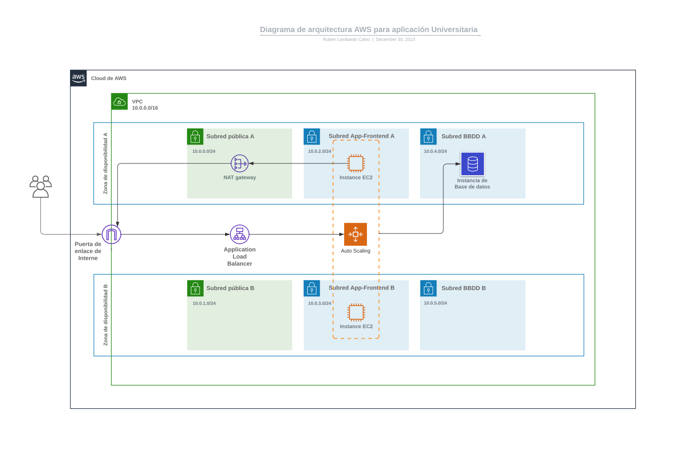
Architecture diagram of the solution
Notes:
Use the following resources to create a diagram of your application architecture:
AWS Architecture Icons at https://aws.amazon.com/architecture/icons. This page includes diagram assets as well as links to drawing and diagramming tools that you can use.
As you walk through the architecture, make sure that you relate back to the business requirements and the AWS Well-Architected Framework (https://docs.aws.amazon.com/wellarchitected/latest/framework/welcome.html).
You can also go more in depth about the design considerations and trade-offs that you made.

Slide 8
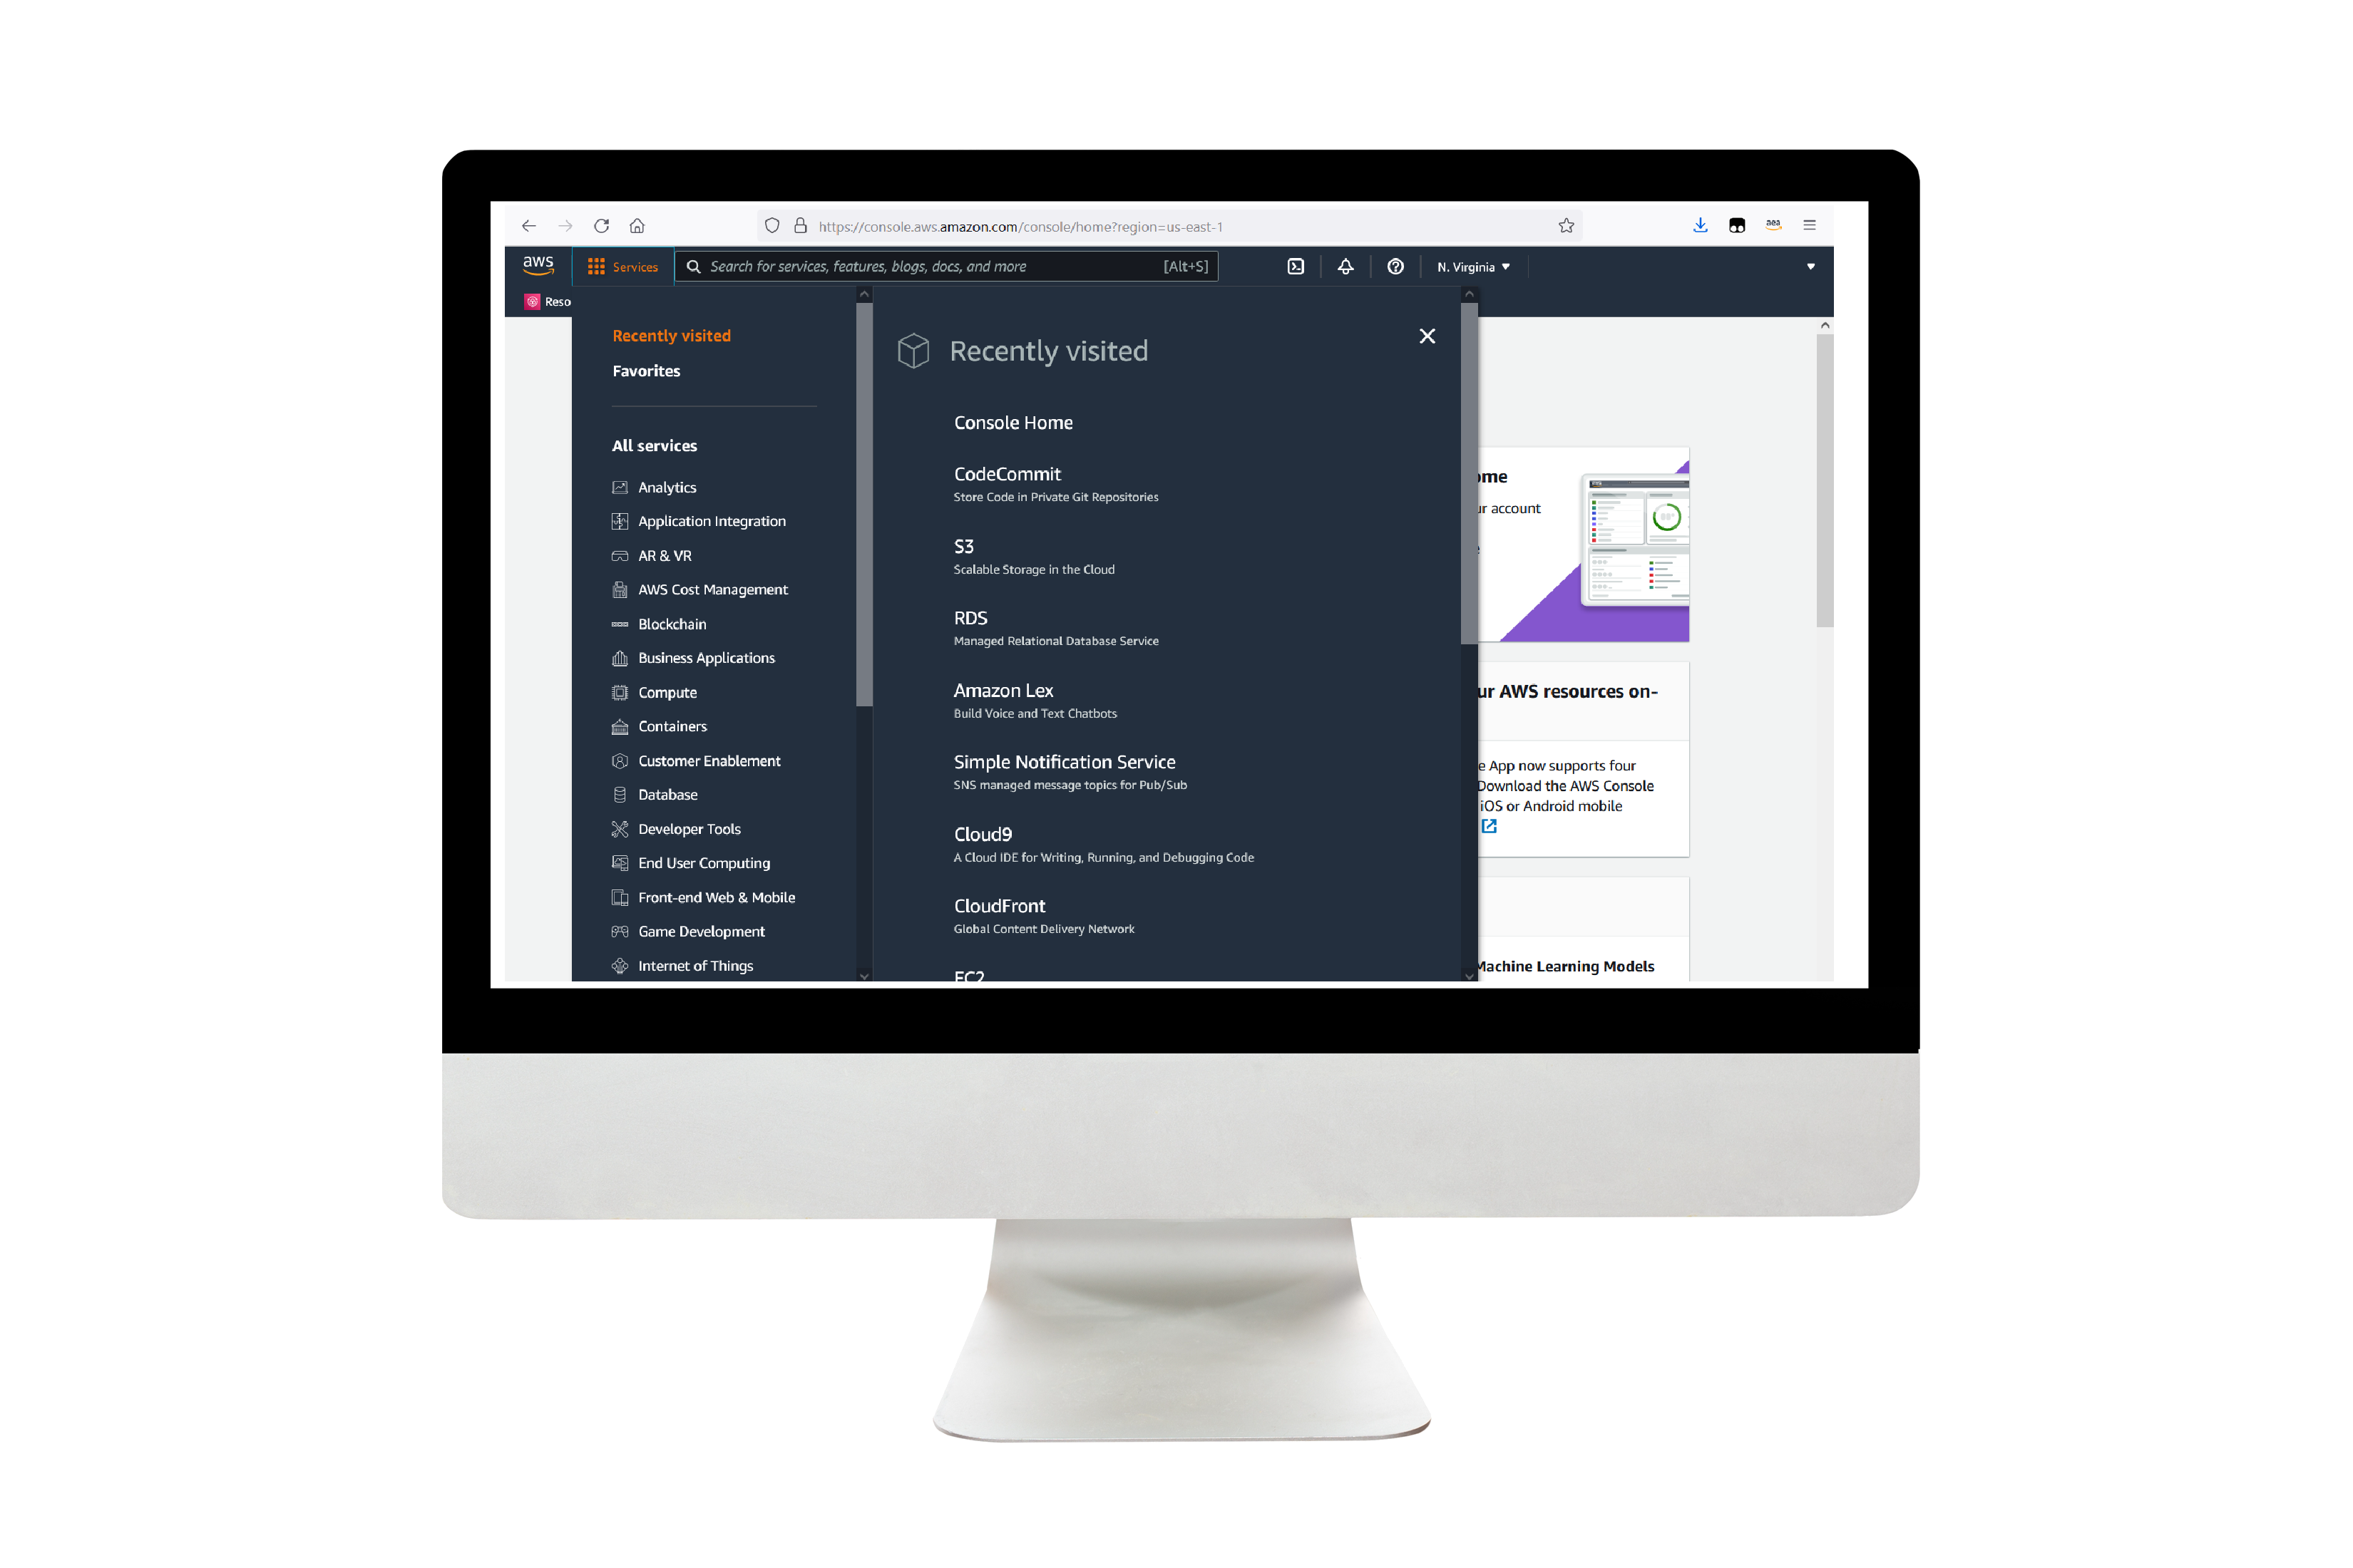
Demo
Imagenes del todo el proceso de diseño de la arquitectura
Fase 1: planificar el diseño y estimar los costos:
Tarea 1: crear un diagrama de la arquitectura:
https://drive.google.com/file/d/1eFJttBTX8kv9e3q7jmjKiu3YCAqCSI5Z/view?usp=drive_link
Tarea 2: desarrollar una estimación de costos:
https://drive.google.com/file/d/1iAH4MAHduIO-NYRrLjCcZhdvA2_MF7CQ/view?usp=drive_link
Fase 2: creación de una aplicación web funcional básica:
Tarea 1: crear una red virtual:
VPC:
https://drive.google.com/file/d/1Zr84o1s3NUz1Y3b9ftc4dEeoFBhkbWwR/view?usp=drive_link
Tabla de rutas públicas:
https://drive.google.com/file/d/1PS7yiLW9GinivM2x8UX0gPgDpko9BfCq/view?usp=drive_link
Internet gateway:
https://drive.google.com/file/d/1sVe57op8divCNsg47lJZ4W85CVJTV5ER/view?usp=drive_link
Notes:
For the demo, guide the audience through the two to three most important benefits of the solution and how it addresses the requirements.
Your demo materials can be screen captures, recordings, a link to your final solution, and/or a link to AWS console.

Slide 9
Demo
Imagenes del todo el proceso de diseño de la arquitectura
Fase 2: creación de una aplicación web funcional básica:
Tarea 2: crear una máquina virtual:
Grupo de seguridad para maquinas virtuales EC2:
https://drive.google.com/file/d/1s-hqZhL46flMVtcsag7562__0gHRPC0m/view?usp=drive_link
Maquina virtual EC2 Monolito:
https://drive.google.com/file/d/1RznRYI6ja4yNcBl6ieNybWVF5qzv-fo-/view?usp=drive_link
Tarea 3: probar la implementación:
https://drive.google.com/file/d/1j9dUoz6wGN6ag9Xvftn0J_b3P9kS4HPf/view?usp=drive_link
Notes:
For the demo, guide the audience through the two to three most important benefits of the solution and how it addresses the requirements.
Your demo materials can be screen captures, recordings, a link to your final solution, and/or a link to AWS console.

Slide 10
Demo
Imagenes del todo el proceso de diseño de la arquitectura
Fase 3: desacoplamiento de los componentes de la aplicación:
Tarea 1: modificar la configuración de la VPC:
Tabla de rutas privada:
https://drive.google.com/file/d/12zPNyLlFmzoE9aV9rBreb7SOJfjzhsjk/view?usp=drive_link
https://drive.google.com/file/d/1d_TH3cV8nGVX9N4gjkJPL1p6i_aLvRHY/view?usp=drive_link
Nat gateway:
https://drive.google.com/file/d/1OtA239SACJg6PlI9iiz28iNht_Gk_zbK/view?usp=drive_link
Tarea 2: creación y configuración de la base de datos de Amazon RDS:
Grupo de seguridad para bases de datos con permisos de acceso configurados solo para EC2 dentro de un grupo de seguridad especifico:
https://drive.google.com/file/d/1jMF62Cb0E_oZiuq4JyHLQ_N6DOwExUcx/view?usp=drive_link
Grupo de subredes para base de datos:
https://drive.google.com/file/d/16TYbDiMqbOD4cHuF6uf2v_PCgQG-4iSH/view?usp=drive_link
Servicio RDS para base de datos:
https://drive.google.com/file/d/1dt8YNRnbJR24y0wBypJ0XKcdVDVEf3h1/view?usp=drive_link
Notes:
For the demo, guide the audience through the two to three most important benefits of the solution and how it addresses the requirements.
Your demo materials can be screen captures, recordings, a link to your final solution, and/or a link to AWS console.

Slide 11
Demo
Imagenes del todo el proceso de diseño de la arquitectura
Fase 3: desacoplamiento de los componentes de la aplicación:
Tarea 3: configuración del entorno de desarrollo:
https://drive.google.com/file/d/1ixkrcH7CUhq9VGMTAHS4Mq0NrAMnx9Qa/view?usp=drive_link
https://drive.google.com/file/d/1_Ah9WhfNs6Ia8j12KqMUYtMTUr4gR2hQ/view?usp=drive_link
https://drive.google.com/file/d/11x3_3twXAVbWBD1wrDrAvvx8RAcoLZqF/view?usp=drive_link
Tarea 4: aprovisionamiento del Secrets Manager:
https://drive.google.com/file/d/16pR1swt27nbYfKyFC0cQhEctc-lNmqoc/view?usp=drive_link
https://drive.google.com/file/d/1j-qerV7ZNCpCDSgF4Q0bYzm697TuhwTP/view?usp=drive_link
Tarea 5: aprovisionamiento de una nueva instancia para el servidor web:
https://drive.google.com/file/d/1jZl9c7RwgVPmAkCiGelGF1yVAdArdQqR/view?usp=drive_link
Tarea 6: migrar la base de datos:
https://drive.google.com/file/d/1v3PchrfeochcNPzWx7VPpm6R_WKHoZhb/view?usp=drive_link
Notes:
For the demo, guide the audience through the two to three most important benefits of the solution and how it addresses the requirements.
Your demo materials can be screen captures, recordings, a link to your final solution, and/or a link to AWS console.

Slide 12
Demo
Imagenes del todo el proceso de diseño de la arquitectura
Fase 4: implementar la alta disponibilidad y escalabilidad:
Tarea 1 / 2: implementación de Amazon EC2 Auto Scaling y Load Balancer:
Launch template para Auto Scaling:
https://drive.google.com/file/d/1s2_WSTQOmLDSqXTVq0hZjFE8omEGfQB6/view?usp=drive_link
Auto scaling group:
https://drive.google.com/file/d/11k69sUGXIfN74KgE1QaIuiTiwV9zNrG3/view?usp=drive_link
Maquinas EC2 generadas por Auto scaling group:
https://drive.google.com/file/d/1aS0_6miBDTD-MMIuFgjILuy073m33vnq/view?usp=drive_link
Target group para balanceador:
https://drive.google.com/file/d/1wNgVHj6cILMivwDiWYYqO5dsV-5_0H1_/view?usp=drive_link
Balanceador de carga:
https://drive.google.com/file/d/1brgbYigtHrJTGVy3c8LjCzGgNbGxn_Rm/view?usp=drive_link
Notes:
For the demo, guide the audience through the two to three most important benefits of the solution and how it addresses the requirements.
Your demo materials can be screen captures, recordings, a link to your final solution, and/or a link to AWS console.

Slide 13
Demo
Imagenes del todo el proceso de diseño de la arquitectura
Fase 4: implementar la alta disponibilidad y escalabilidad:
Tarea 3: acceder a la aplicación:
https://drive.google.com/file/d/1h3mb9CykmHdWo-7Y8pDm_Oo7_uRJxXh3/view?usp=drive_link
Tarea 4: prueba de carga de la aplicación:
Target Tracking Policy
https://drive.google.com/file/d/1UdXAdFgqduvYeG-u4u4Owb_6VG-hRJNM/view?usp=drive_link
Resultado de prueba de carga:
https://drive.google.com/file/d/1w-ErzI02cNP27U_wUH2FZ8sc_Hn5DV4n/view?usp=drive_link
Notes:
For the demo, guide the audience through the two to three most important benefits of the solution and how it addresses the requirements.
Your demo materials can be screen captures, recordings, a link to your final solution, and/or a link to AWS console.

Slide 14
Lecciones aprendidas
Retos que he superado:
Manejo de alta disponibilidad y escalabilidad.
Balanceo de carga y distribución de tráfico.
Seguridad y protección de datos.
Optimización de costos.
Recursos que me han resultado útiles:
Videos de classroom de la asignatura.
Videos de youtube sobre AWS.
Curso AWS de Udemy.
AWS pricing calculator.
Nuevas habilidades que he utilizado:
Diseño de arquitecturas en la Nube.
Seguridad en la Nube.
Explique los próximos pasos: Seguir aprendiendo sobre arquitectura en la nube y practicas DevOps.
Notes:
Describe any challenges that you encountered and how you overcame those challenges.
For example: “I got stuck when I was creating an EC2 instance to host the application. I used the resources that were listed in the instructions to walk myself through the process to create a new EC2, and I was able to complete the task. The links to labs in other courses were very helpful.”
Describe any new skills that you learned from this project.
For example: “I learned how to set up auto scaling correctly so my resources were automatically adjusted and allocated at the lowest possible cost.”
Discuss any future, out-of-scope use cases in the next steps.
For example: “I would like to scale out the web application so that multiple departments can use it.”

Slide 15
Gracias

