Slide 1
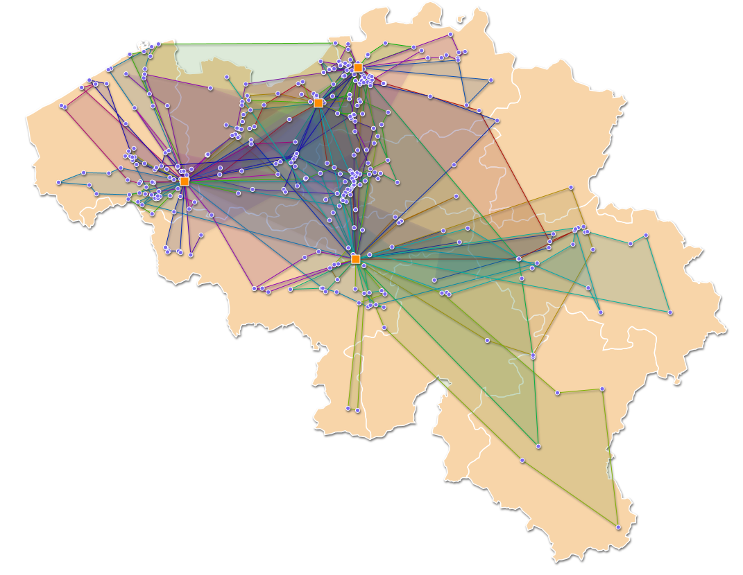
Optimalisatietechnieken Opdracht TVH
Jarne Clarysse
Joran De Wilde
Maarten Vervaeke
Ruben Mechelinck

Slide 2
Constructive Heuristic
Assign requests to best truck (still feasable)
Remaining requests → increase truck working time (infeasable)

Slide 3
Neighbourhood Moves
Hill climbing
3 moves
Move request between trucks
Move a request pair within a truck
Move a depot of a request

Slide 4
Local Search & Simulated Annealing
Inititial solution not feasable ⇒ local search
Each iteration: random move from moves set
Simulated annealing
Reheating with lower acceptance bound
Steeper cooling schedule

Slide 5
Best Results
30 min
Different seeds
Instance | 3 | 4 | 5 | 6 | 7 | 8
Best Result | 1325 | 6825 | 7644 | 8466 | 7985 | 7650

