Slide 1
Capita Selecta Computer Science: Artificial Intelligence
TransPoemer
Sieben Bocklandt & Ruben Broekx

Slide 2
Background

Slide 3
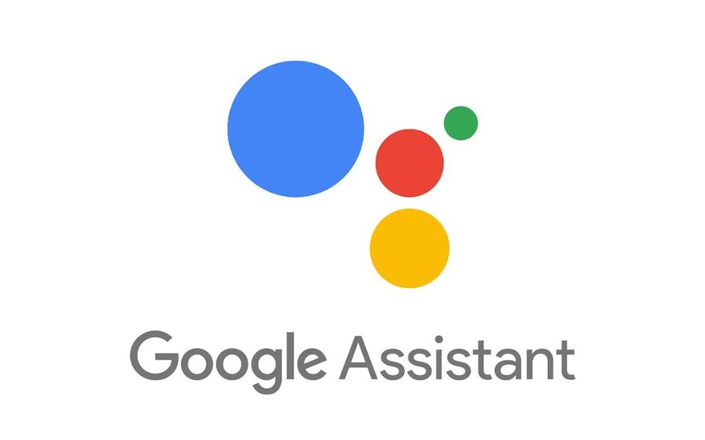
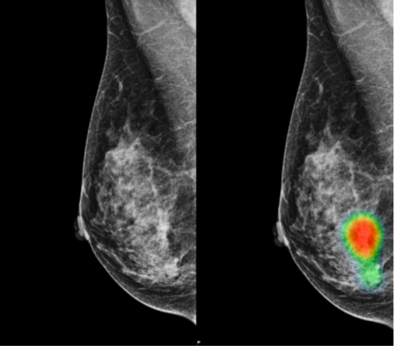

Deep Learning
Deep Learning ⊆ Machine Learning ⊆ Artificial Intelligence

Slide 4
Natural Language Processing
Computer ⬄ natural language
Challenges in NLP:
Speech recognition
Natural language understanding
Natural language generation
…

Slide 5
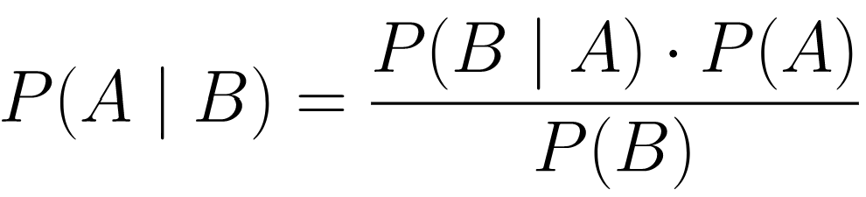
Language Model
Language model = probability distribution
Tokenizing: “this is a sentence” ➔ [23, 13, 4, 178]
P(sentence | language)
generation, translation, summarization, question answering, …
Markov chain:
Based on Bayes’ theorem
Example:
[the, cat] → and
[cat, and] → dog
[and, dog] → and
[dog, and] → cat (loop!)

Slide 6
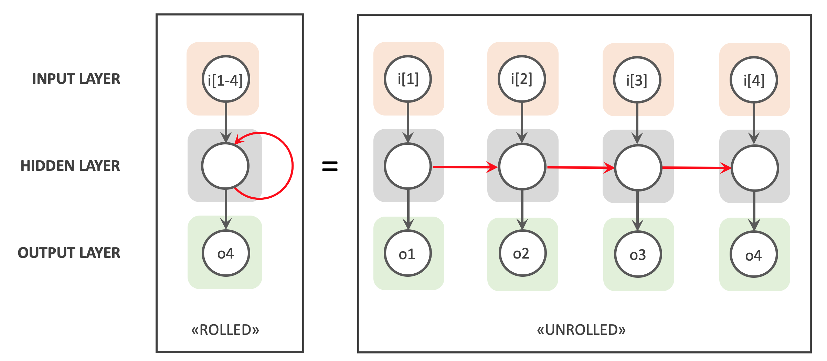
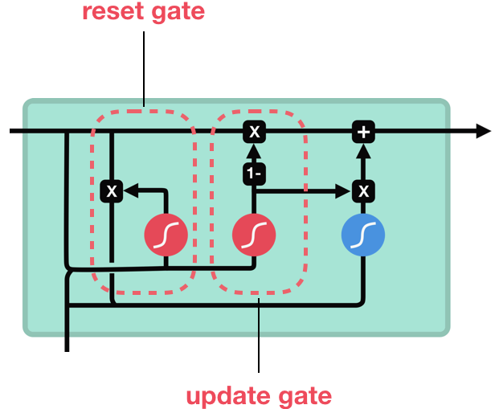
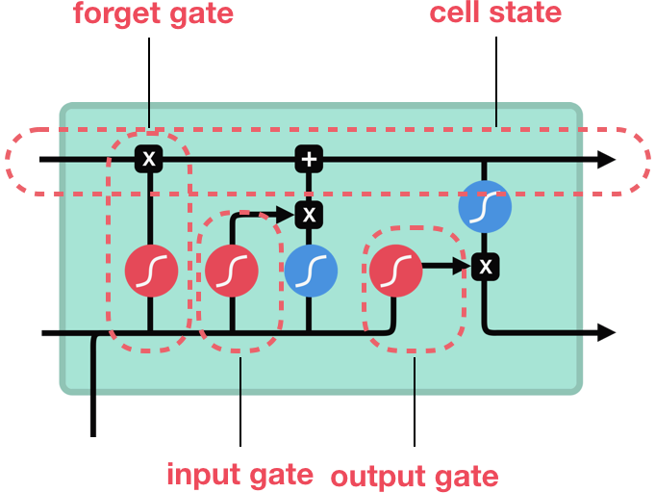
Recurrent Neural Networks
Memory as a continued thread
Current memory + input = output
Advantages:
Preserve context
Variable length inputs
Disadvantages:
Slow to train (not parallelizable)
Do not handle long sequences well
GRU: LSTM:
https://www.bouvet.no/bouvet-deler/explaining-recurrent-neural-networks
https://medium.com/@pierre_guillou/nlp-fastai-lstm-gru-27ce86578c62

Slide 7
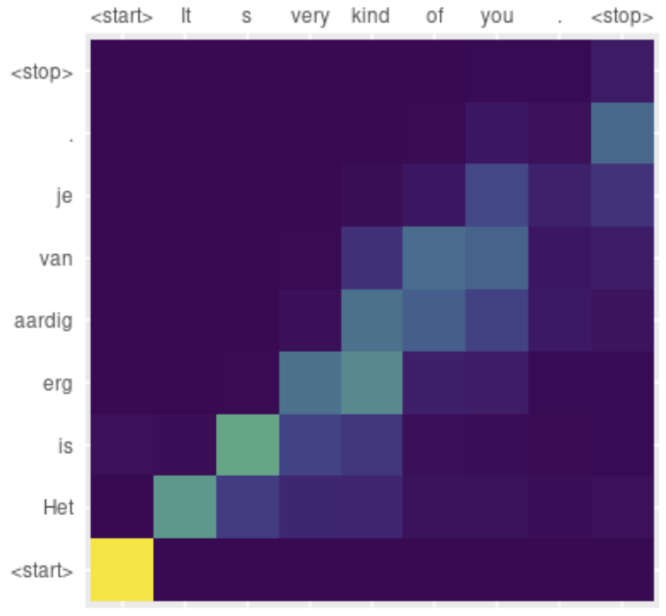
Attention
Translation: “It’s very kind of you.” → “Het is erg aardig van je.” [2, 5, 13, 54, 15, 567, 12] → [4, 9, 42, 543, 25, 17, 5]
Model input:
Sequence to be translated
Translated sequence predicted thus far
Flawed approach: hard to remember early parts!
Attention: decide on which parts of the input to focus on
https://blogs.rstudio.com/tensorflow/posts/2018-07-30-attention-layer/

Slide 8
Transformer
Transformer (2017): Attention Is All You Need [1]
Internal memory and recurrent connections not needed
Advantages:
Fast
Outperform RNNs
Need less memory than RNNs
More interpretable
Limits yet untouched
[1] https://arxiv.org/abs/1706.03762

Slide 9
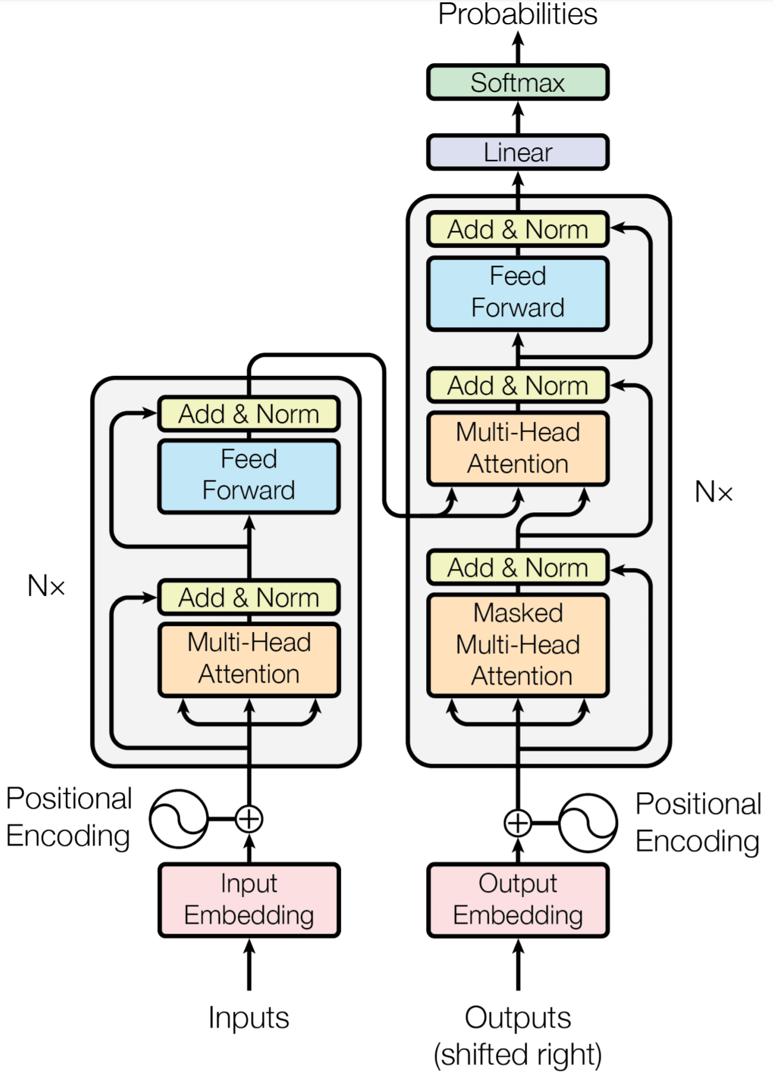
Transformer – Implementation
Implementation
Embeddings
Positional encoding
Encoder
Decoder
Linear layer softmaxed
Weights updated via backpropagation
Multi-head
https://arxiv.org/abs/1706.03762

Slide 10
Project

Slide 11

Task
“Do something creative with a Transformer.”
Twitter generator?
Creating poetry
Poem generator?
Text-to-poem translator!
https://twitter.com/torfsbot?lang=en

Slide 12
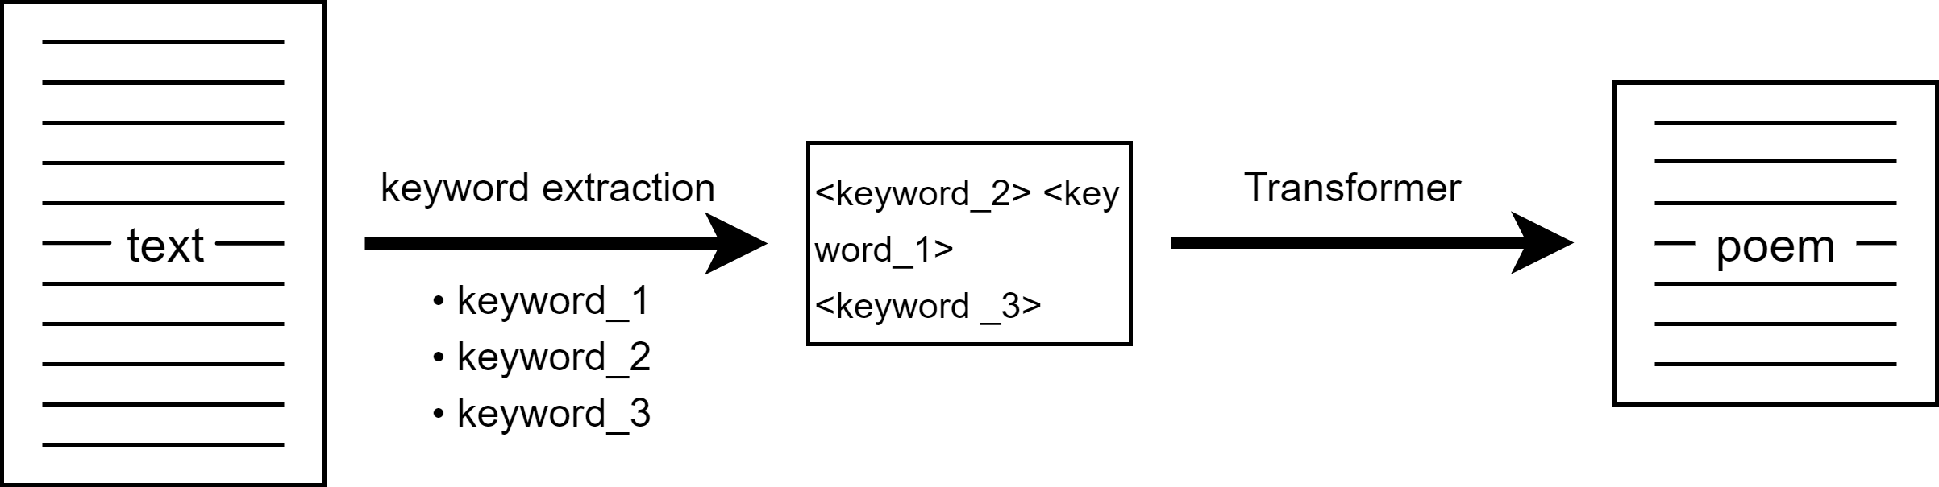
TransPoemer – Architecture
Trained as autoencoder

Slide 13
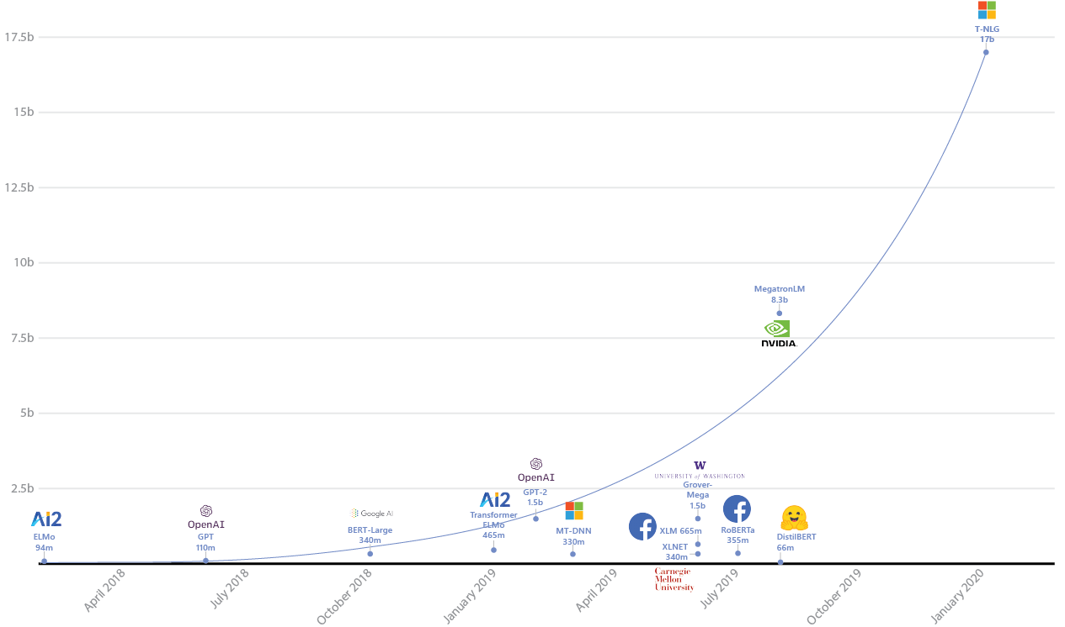
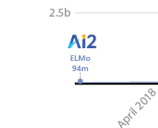
Design Decisions
https://www.microsoft.com/en-us/research/blog/turing-nlg-a-17-billion-parameter-language-model-by-microsoft/
Limericks as poems (AABBA)
Laptop trainable model
Curiosity
2 study point project
Train from scratch
94m
8.7m
0

Slide 14
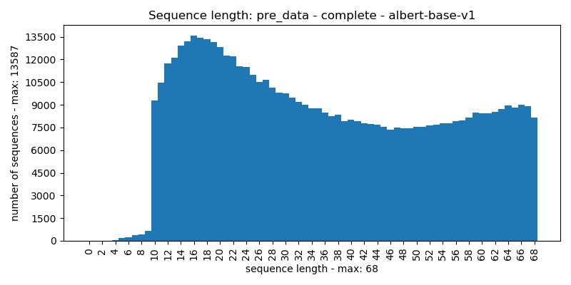
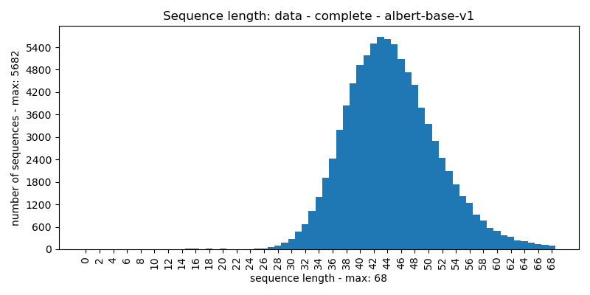
Data
Datasets:
Pre-training: quotes [1] (~ 500 000)
Fine-tuning: limericks [2] (~ 90 000)
Tokenizer:
Word-tokenization?
HuggingFace’s AlbertTokenizer [3]
20 000 most frequently used tokens
Input-size: 68 (70)
(~ 600 000)
[1] https://www.kaggle.com/manann/quotes-500k
[2] https://github.com/sballas8/PoetRNN
[3] https://huggingface.co/transformers/model_doc/albert.html

Slide 15
Keyword Extraction
Natural Language ToolKit (NLTK) [1]
Rapid Automatic Keyword Extraction (RAKE) [2]
TF-IDF
Example:
Input: ‘this is a piece of example text fed into the model that will be used to train the model on’
Keywords: [‘used’, ‘train’, ‘piece’, ‘model’]
Result: ‘piece model used train model’
[1] https://www.nltk.org/
[2] https://pypi.org/project/rake-nltk/

Slide 16


Transformer
pytorch-seq2seq [1]
HuggingFace [2]
PyTorch [3]
Parameters: 8.7 million
Training:
batch-size: 64
Cross entropy loss
Adam optimizer (learning rate = 0.0005)
[1] https://github.com/bentrevett/pytorch-seq2seq
[2] https://huggingface.co/
[3] https://pytorch.org/

Slide 17
Training
Two models: with/without pre-training
Trade-off: originality vs quality
Early stop on validation loss
Training:
Model PF: 5 epochs pre-training, 5 (+1) epochs fine-tuning
Model F: 12 (+1) epochs of training

Slide 18
Evaluation
Metrics:
Cross entropy loss
GLEU score
Minimum of precision and recall
N-grams, N ∈ [1..4]
Quality check on English?
Empirical evaluation
Evaluation
Model PF (with): Loss: 3.537 GLEU: 13.17
Model F (without): Loss: 3.791 GLEU: 14.17

Slide 19
Evaluation – Empirical
English-like gibberish predicted:
Input: comedogenic foods make me break out? acne pimples determined to sprout. greasy pizza and fries send some fat to my thighs and some oil to the tip of my snout.
Keywords: break sprout thighs snout
Model PF: if you break a small metal, you'll sprout from your thighs, and your snout is a big deal. you'll find something drastic, and you'll find something drastic, and you'll see.
Model F: when you break out of your thighs, you can sprout, and your thighs are quite clear. if you're out of your snout, you're a pig, and you'll find yourself a big mistake.

Slide 20
Evaluation – Empirical
Model A has the tendency to loop:
Keywords: someone peeling okay montage cool collage creation
Model PF: someone's peeling, okay, and the montage is cool, collagen, collagen, collagen, collagen, collagen, collagen, collagen, collagen, collage, collage, collage, collage, collage, collage, collage, collage. creation.
Model F: someone's peeling a montrature, okay? it's a montage. it's cool, collagen's creation. it's a popular thrill.

Slide 21
Evaluation – Empirical
1 word as input:
Keywords: rain
Model PF: the "the "old" is a "the """""" "it's a """""" "it's a "no," "it's a "no," "it's a "it"."
Model F: the "the rain" is the sun, and the sun's wet. it's a clear demonstration of rain, and the sun's a good place, and the sun's got a good place to behold.
Model P: the rain is a beautiful thing.
No input:
Keywords: /
Model PF: "i'm a man," said the guy, "i'm a man." "i'm a man," said the guy, "i'm a guy," said the guy. "i'm a guy." "i'm a guy."
Model F: the "the "s" is the "s". "i'm a "s-a-"." "i'm a "s-uh-uh-uh-uh-uh-uh-uh-uh-uh-uh-uh-uh-uh-uh-uh
Model P: the best way to get is to be a good person.

Slide 22
Evaluation – Empirical
First 20 test samples:
Samples with loops: model A: 7, and model B: 0
Both were ‘original’
Keywords used: model A: 97%, and model B: 93%
Both bad at rhyming

Slide 23
Discussion
Poetic gibberish, but no rhymes
Limerick dataset of debatable quality
Valley after pre-training
Limited dataset-size, missing ‘logic’ in predictions
“blabla” said “blabla”
Number of keywords
Translation
Build on pre-trained model

Slide 24
Conclusion
Transformers are laptop trainable, as long as your expectation aren’t too high

Slide 25

Some Cherries
tonsured the crown of the hope that spread is young, and the girls are quite vile. but the girls are a scalding, and they're rather a scalding, and not dead.
i've lost my new girlfriend, and depressing, i deny that my look at the dressing. i worry, hell, i'm a hurry, and i'm gonna get my shotgun and girl.
i know that the prince was a head, and i handle the word that i'd breathe. it's a soul that i'll see, but i'm dead, and i'm not a big deal.

