Slide 2
Deep reinforcement learning for network intrusion detection
department OF information Engineering technology
research group IDLAB
Ruben Peeters 29/06/2022

Slide 3
Goal and use
Goal
Detect cyber attacks by analysing network packets.
Use
Protecting information and systems
Basis for further research

Slide 4
Previous work
Machine Learning SotA
Generalization
Not a lot of research done yet
Outdated datasets
[1,2,3,4]
Notes:
[1] M. Verkerken, L. D’hooge, T. Wauters, B. Volckaert, and F. De Turck, “Towards model generalization for intrusion detection: Unsupervised machine learning techniques,” Journal of Network and Systems Management, vol. 30, no. 1, p. 12, Oct 2021. [Online]. Available: https://doi.org/10.1007/s10922-021-09615-7
[2] M. Rai and H. L. Mandoria, “Network intrusion detection: A comparative study using state-of-the-art machine learning methods,” in 2019 International Conference on Issues and Challenges in Intelligent Computing Techniques (ICICT), vol. 1, Sep. 2019, pp. 1–5. [3] L. Zhiqiang, G. Mohi-Ud-Din, L. Bing, L. Jianchao, Z. Ye, and L. Zhijun, “Modeling network intrusion detection system using feed-forward neural network using unsw-nb15 dataset,” in 2019 IEEE 7th International Conference on Smart Energy Grid Engineering (SEGE), Aug 2019, pp. 299–303. [4] N. Thapa, Z. Liu, D. B. KC, B. Gokaraju, and K. Roy, “Comparison of machine learning and deep learning models for network intrusion detection systems,” Future Internet, vol. 12, no. 10, 2020. [Online]. Available: https://www.mdpi.com/1999-5903/12/10/167

Slide 5
Research questions
Can DRL be used for classifications?
How does it compare to SotA
Identical-dataset performance
Generalization

Slide 6
Available datasets
Overview
How to choose?
Comparison SotA
Generalization

Slide 7
Chosen datasets
Comparison to SotA
NSL-KDD
UNSW-NB15
Generalization
CIC-IDS2017
CIC-DOS2017
CIC-DDOS2019

Slide 8
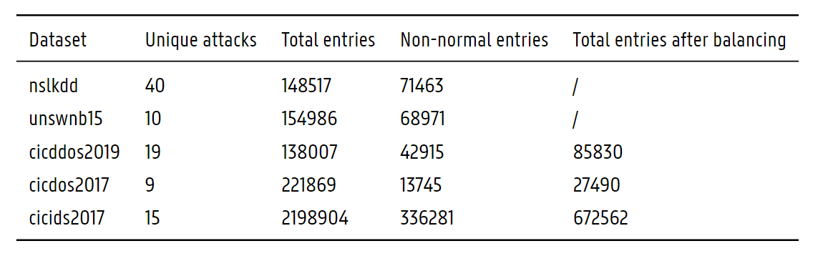
Chosen datasets

Slide 9
Preprocessing
Processed datasets [5]
One-hot encoding
Feature selection [6]
Balancing
Notes:
[5] L. D’Hooge, “clean-ids-collection,” April 2022. [Online]. Available: https://gitlab.ilabt.imec.be/lpdhooge/clean-ids- collection [6] L. D’hooge, M. Verkerken, T. Wauters, B. Volckaert, and F. De Turck, “Hierarchical feature block ranking for data-efficient intrusion detection modeling,” Computer Networks, vol. 201, p. 108613, 2021. [Online]. Available: https://www.sciencedirect.com/science/article/pii/S1389128621005107

Slide 10
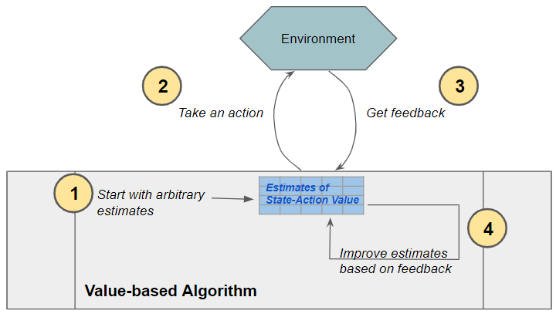
Reinforcement learning
Markov Decision Process
Agent
Environment
State
Action
Reward
[7]
Notes:
[7] K. Doshi, “Reinforcement learning explained visually (part 3): Model-free solutions, step-by-step,” October 2020. [Online]. Available: https://towardsdatascience.com/reinforcement-learning-explained-visually-part-3-model-free-solutions- step-by-step-c4bbb2b72dcf

Slide 11
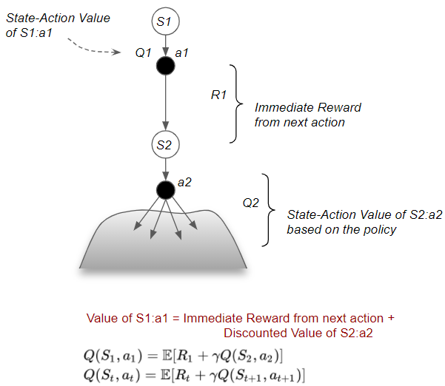
Q-learning
State-action value
Bellman Equation
Expected sum of
future rewards
[7, 8]
Notes:
[8] C. J. C. H. Watkins and P. Dayan, “Q-learning,” Machine Learning, vol. 8, no. 3, pp. 279–292, May 1992. [Online]. Available: https://doi.org/10.1007/BF00992698

Slide 12
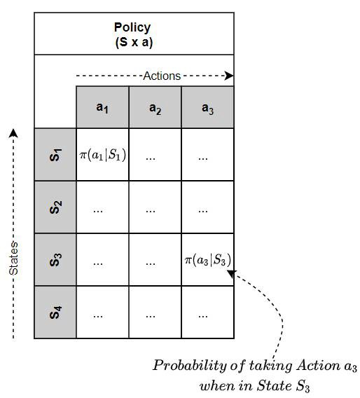
Policy
“How to pick an action”
On-policy vs off-policy
Predicting future rewards
ϵ-greedy
[9]
Notes:
[9] K. Doshi, “Reinforcement learning explained visually (part 1): Intro to Basic Concepts and Terminology,” October 2020. [Online]. Available: https://towardsdatascience.com/reinforcement-learning-made-simple-part-1-intro-to-basic-concepts-and-terminology-1d2a87aa060

Slide 13
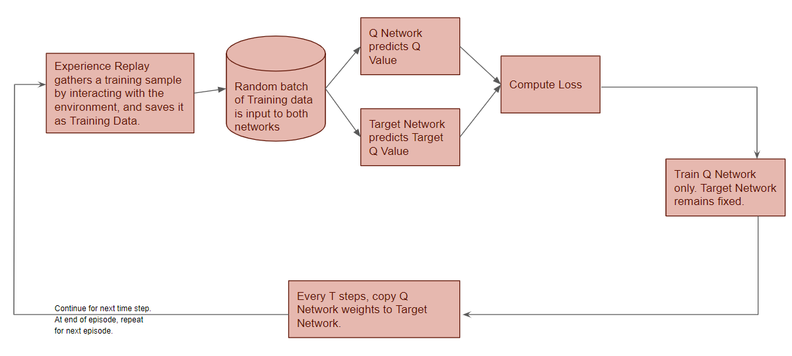
Deep q network
Q-function as neural network
Experience replay
Off-policy
[10, 11]
Notes:
[10] K. Doshi, “Reinforcement Learning Explained Visually (Part 5): Deep Q Networks, step-by-step,” October 2020. [Online]. Available: https://towardsdatascience.com/reinforcement-learning-explained-visually-part-5-deep-q-networks-step-by-step-5a5317197f4b
[11] M. Roderick, J. MacGlashan, and S. Tellex, “Implementing the deep q-network,” CoRR, vol. abs/1711.07478, 2017. [Online]. Available: http://arxiv.org/abs/1711.07478

Slide 14



Double DQn
θ and θ′ weights
Role symmetrically updated
Select and evaluate
Select = pick action a’
Evaluate = calculate Q
[12, 13, 14]
Notes:
First formula, decoupled, is the same as second formula, only the weight is always θ
[12] H. Hasselt, “Double q-learning,” in Advances in Neural Information Processing Systems, J. Lafferty, C. Williams, J. Shawe-Taylor, R. Zemel, and A. Culotta, Eds., vol. 23. Curran Associates, Inc., 2010. [Online]. Available: https://proceedings.neurips.cc/paper/2010/file/091d584fced301b442654dd8c23b3fc9-Paper.pdf [13] M. Sewak, Deep Q Network (DQN), Double DQN, and Dueling DQN. Singapore: Springer Singapore, 2019, pp. 95–108. [Online]. Available: https://doi.org/10.1007/978-981-13-8285-7_8
[14] H. van Hasselt, A. Guez, and D. Silver, “Deep reinforcement learning with double q-learning,” 2015. [Online]. Available: https://arxiv.org/abs/1509.06461

Slide 15
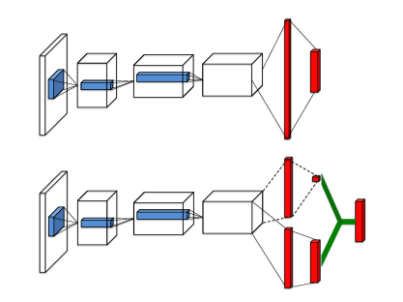
Dueling DQN
Advantage vs value estimate
How advantageous selecting an action is relative to the others at given state
[13]
Notes:
Learning which states are valuable without having to learn the effect of each action for each state.

Slide 16
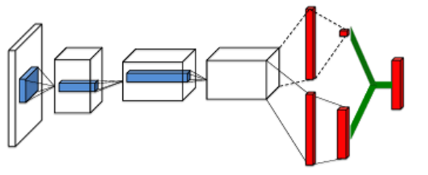
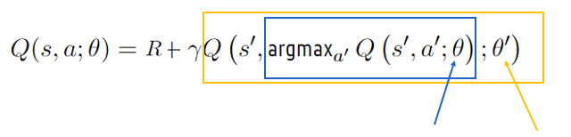
DDDQN
Combination of dueling DQN and double DQN
+

Slide 17
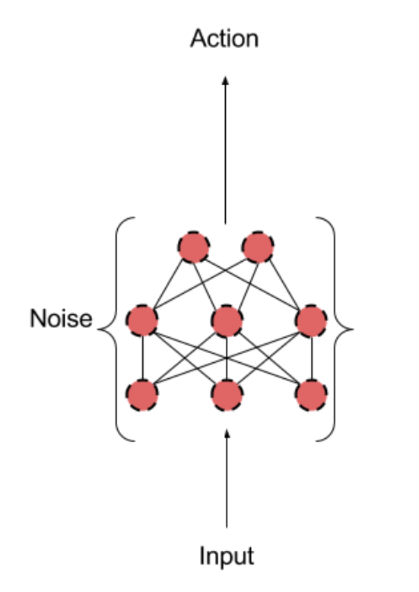
Parameter noise
Gaussian noise applied to the parameters of the policy
Alters decision
Depending on current observations
[15]
Notes:
[15] M. Plappert, R. Houthooft, P. Dhariwal, S. Sidor, R. Y. Chen, X. Chen, T. Asfour, P. Abbeel, and M. Andrychowicz, “Parameter space noise for exploration,” CoRR, vol. abs/1706.01905, 2017. [Online]. Available: http://arxiv.org/abs/1706.01905

Slide 18
Prioritized experience replay
Replay important experiences
Based on temporal-difference (TD) error
How different is the new value from the old value
[16]
Notes:
[16] T. Schaul, J. Quan, I. Antonoglou, and D. Silver, “Prioritized experience replay,” 2015. [Online]. Available: https://arxiv.org/abs/1511.05952

Slide 19
Advantage actor critic
Q-learning [17]
On-policy
For comparison
Notes:
[17] M. Babaeizadeh, I. Frosio, S. Tyree, J. Clemons, and J. Kautz, “GA3C: gpu-based A3C for deep reinforcement learning,” CoRR, vol. abs/1611.06256, 2016. [Online]. Available: http://arxiv.org/abs/1611.06256

Slide 20
Hyperparameter tuning
Manual, grid, Optuna
Done on implementation without normalization layers
All parameters lead to poor results
Used parameters are found in the literature []
No time to re-do tuning on better performing implementation.

Slide 21
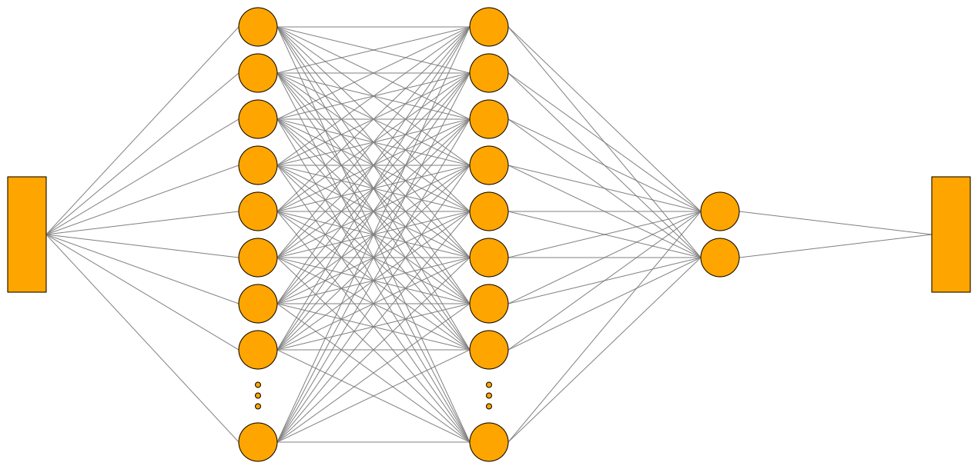
Naive implementation
64
64
2

Slide 22
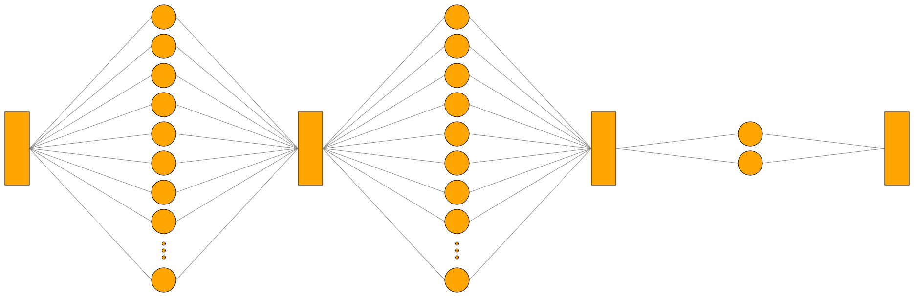
Normalization implementation
128
LN
128
LN
2

Slide 23
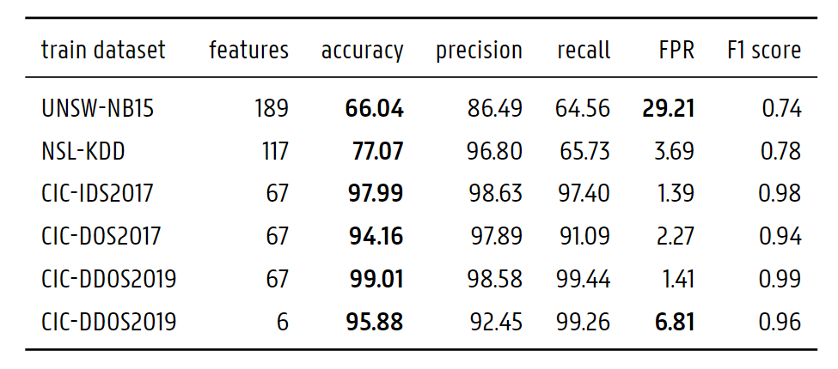
Metrics

Slide 24
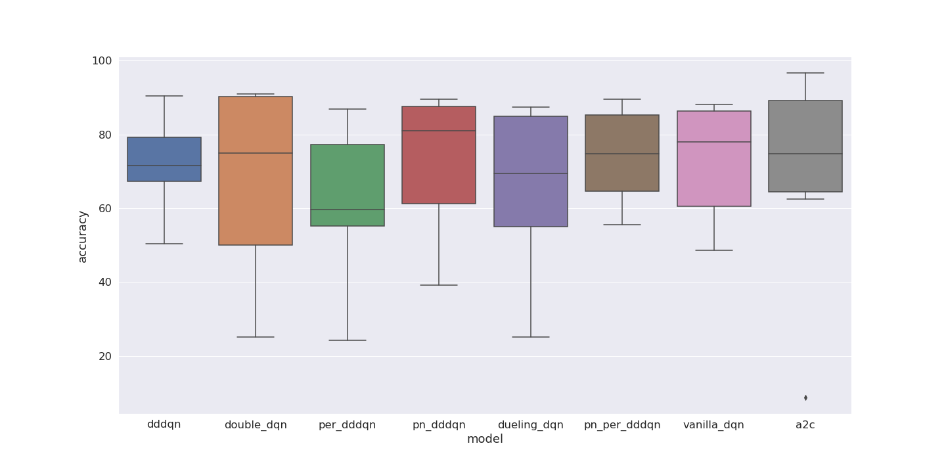
NaIve implementation
Parameter noise helps, DDDQN more consistent

Slide 25
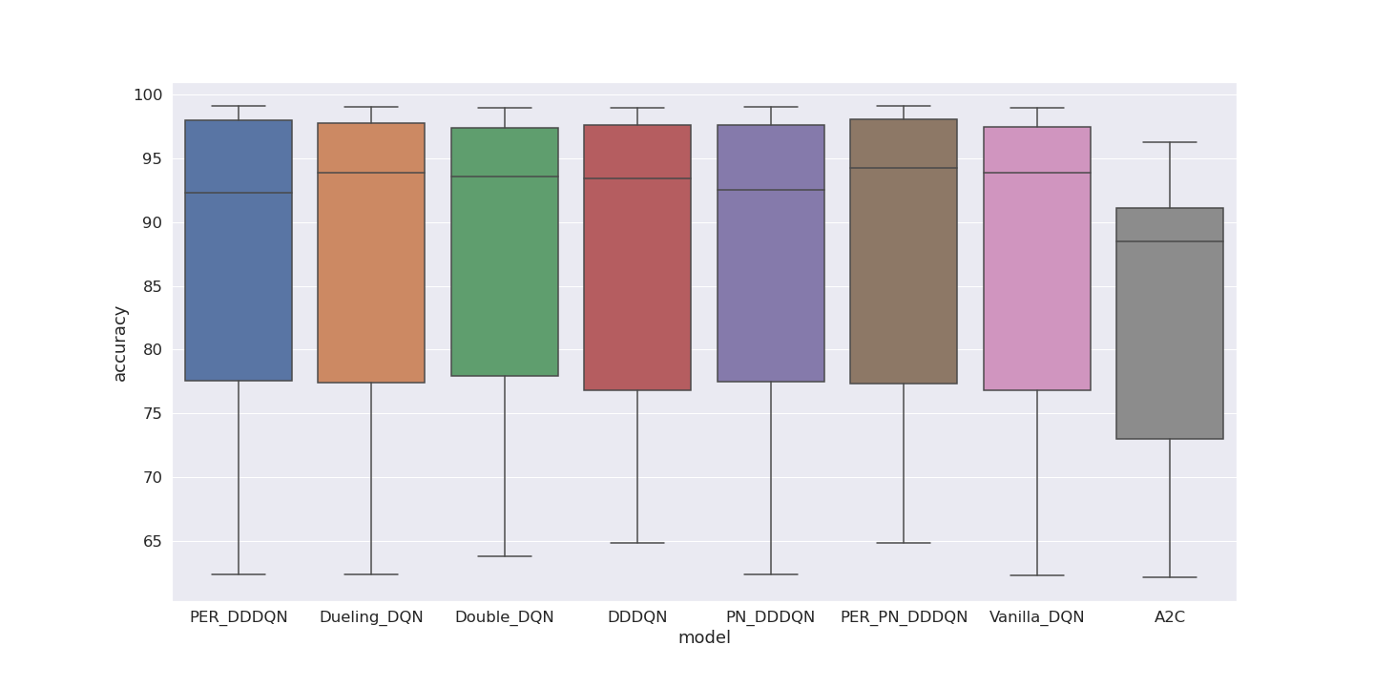
Normalization implementation
Only combination of all upgrades performs superior
A2C worst performer

Slide 26
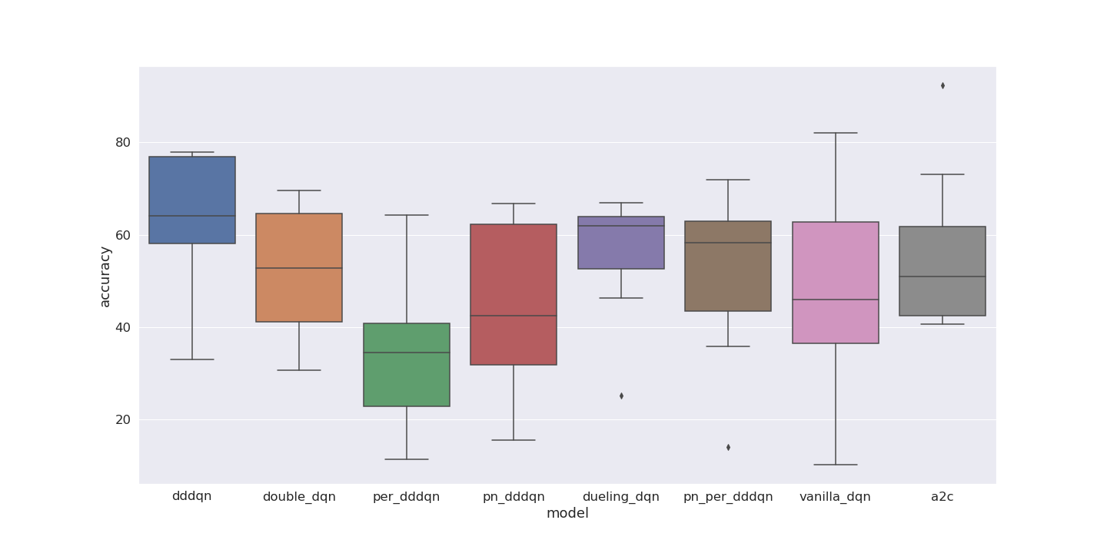
Generalization - Naive
Too inconsistent to draw results

Slide 27
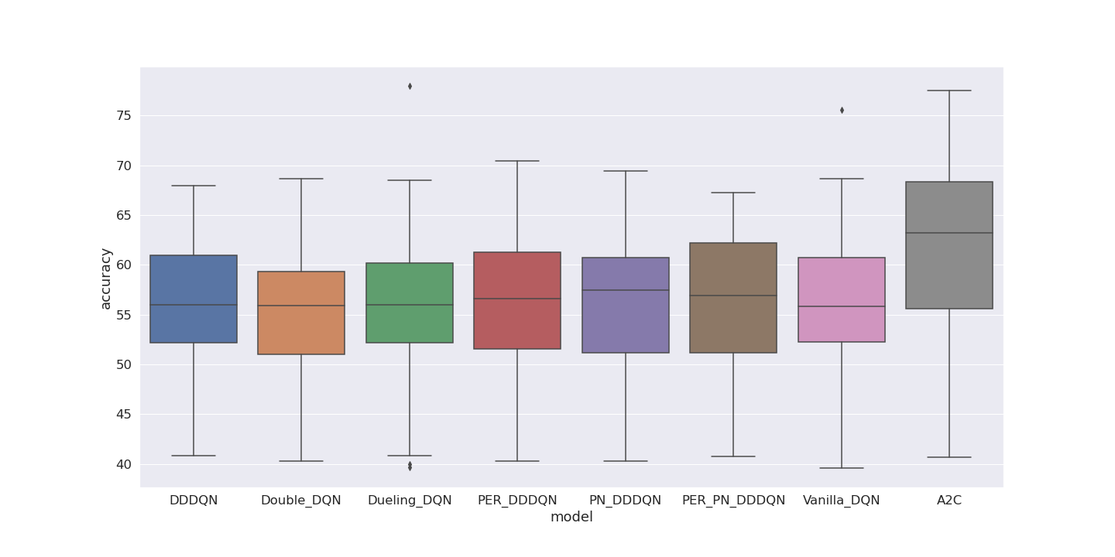
Generalization - normalization
A2C clear winner
All upgrades without PER best, could be overfitted

Slide 28
Chosen datasets

Slide 29
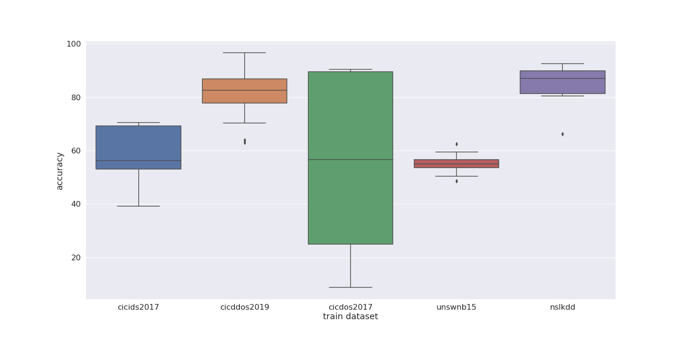
Naïve performance
Very inconsistent
Around 50% for 3 out of 5

Slide 30
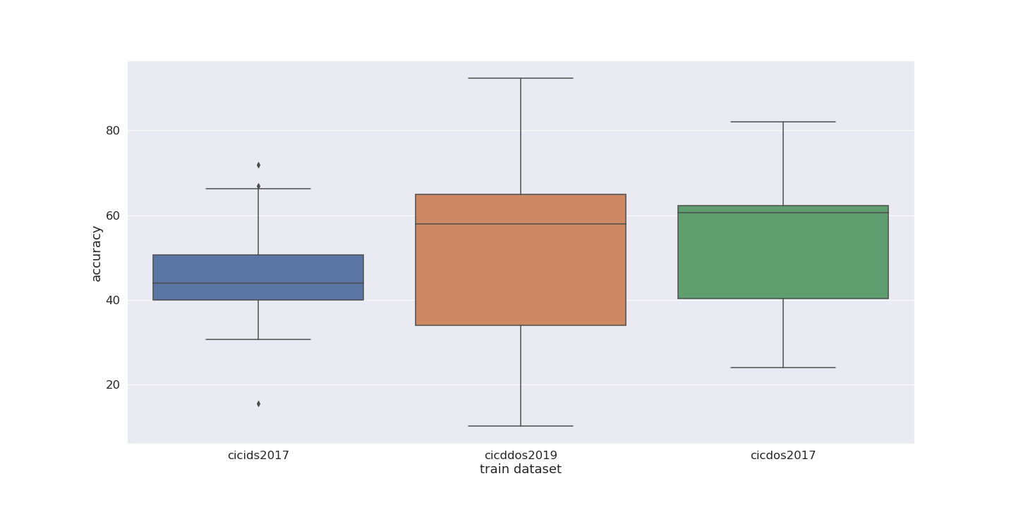
Naïve generalization
All 40-60%

Slide 31
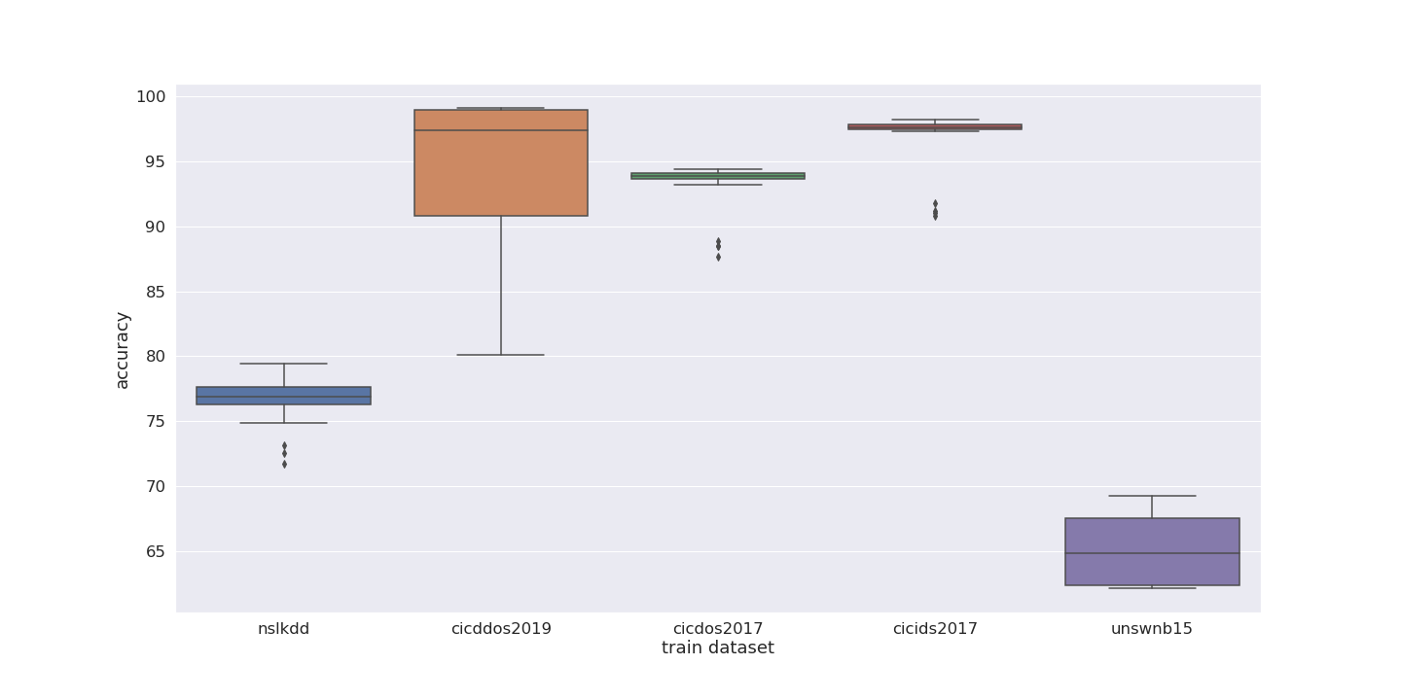
Normalization performance

Slide 32
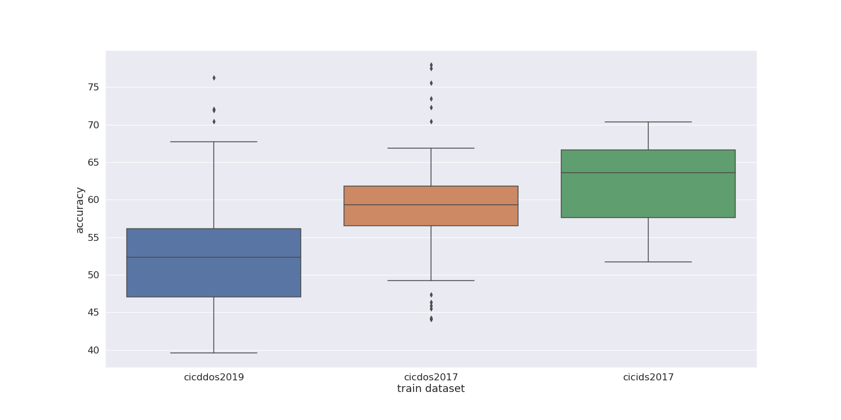
Normalization generalization

Slide 33
Conclusion
DRL can be used for classification.
Worse than SotA, but without extensive tuning.
On-policy performs well for generalization, better than most SotA.
Combination of upgrades leads to greater performance, however singular upgrades do not.
Large amount of sample packets in the dataset shows improved results
Larger amount of unique packets also show improved results.

Slide 34
Future work
Tuned normalization implementation models
Normalization of datasets
Explore other on-policy models for generalization
Different neural networks to represent Q-function
Explore rainbow DQN

Slide 35



Ruben Peeters Master Student Department of Information engineering technology E ruben.peeters@ugent.be M +32 468 01 55 61 www.ugent.be
Universiteit Gent @ugent
@ugent Ghent University

