Slide 1
Accoustic Event Detection
Of Keyboard-keystrokes in Speech
Using the Discrete Wavelet Packet Transform

Slide 2
Approach
Calculate energy vector samples
Average out energy
Apply filter to transformed signal frames
Calculate energy increase
Choose a threshold
(Filter out noise)

Slide 3
Parameters
Frame size
Wavelet (db3, db5, db10, coif5)
Level of wpt decompisition
Incorporate signal into filter

Slide 4
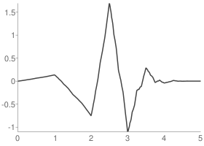
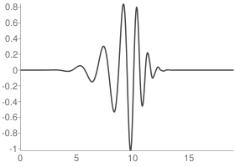
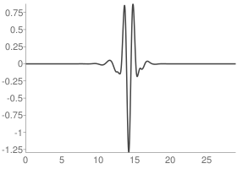
Wavelets
db3
db10
coif5

Slide 5
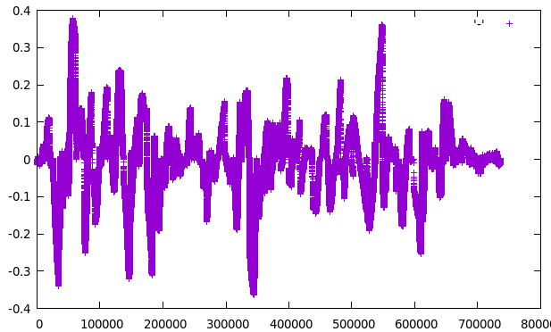
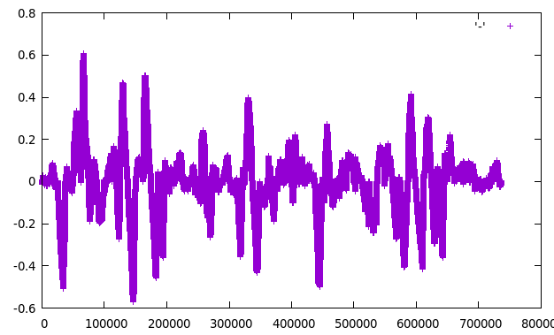
Results
Db5
Level 5
Smoothed
Db5
Level 11
Smoothed

Slide 6
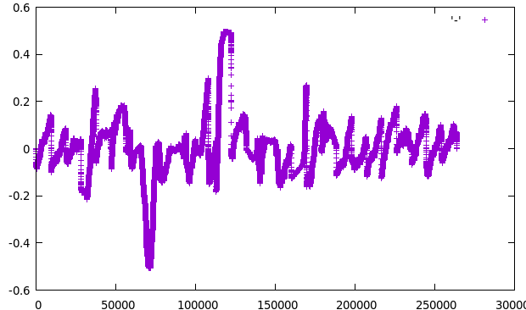
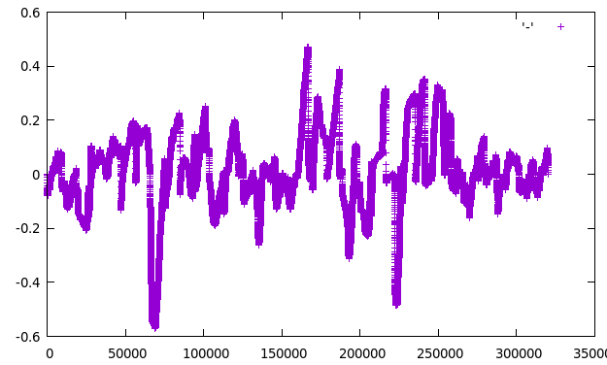
Result(2)
Coif5
Level 5
No smoothing

Slide 7
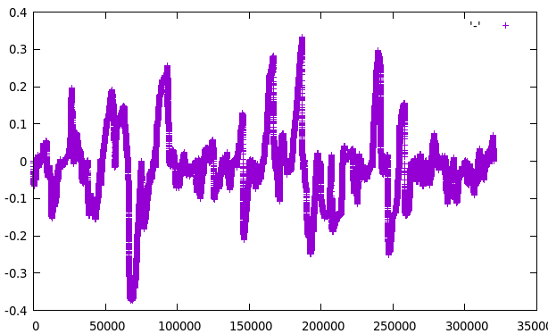
Result(3)
Db3
Level 5
No smoothing

