Slide 1

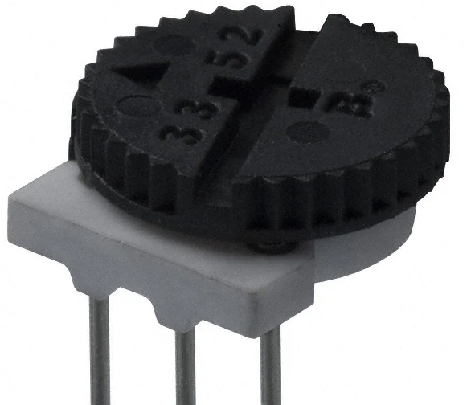
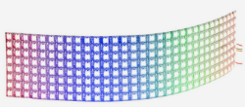
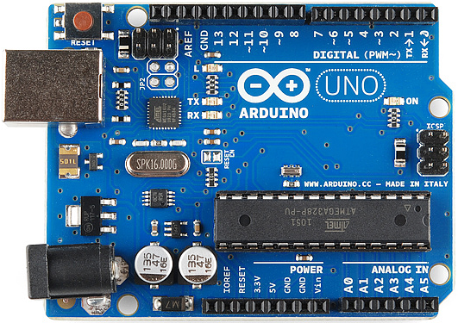
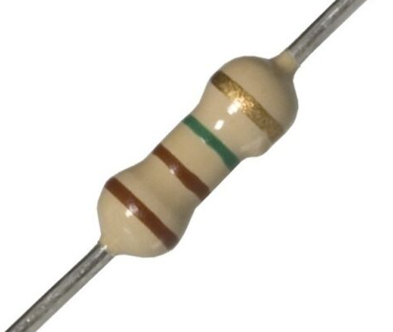
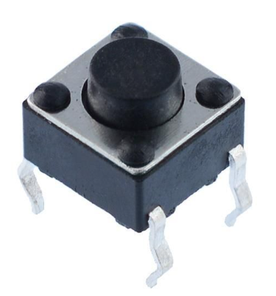
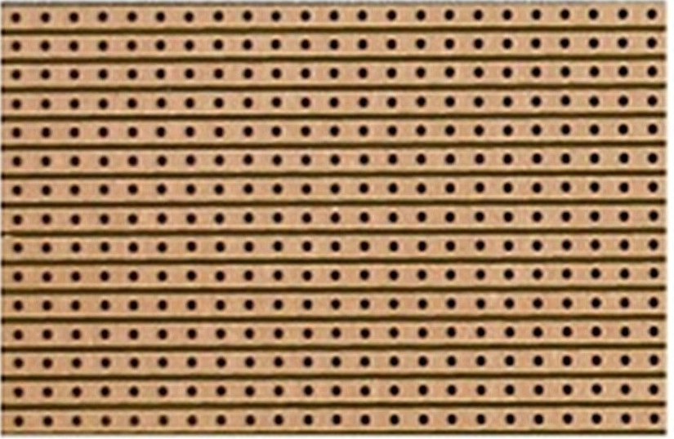
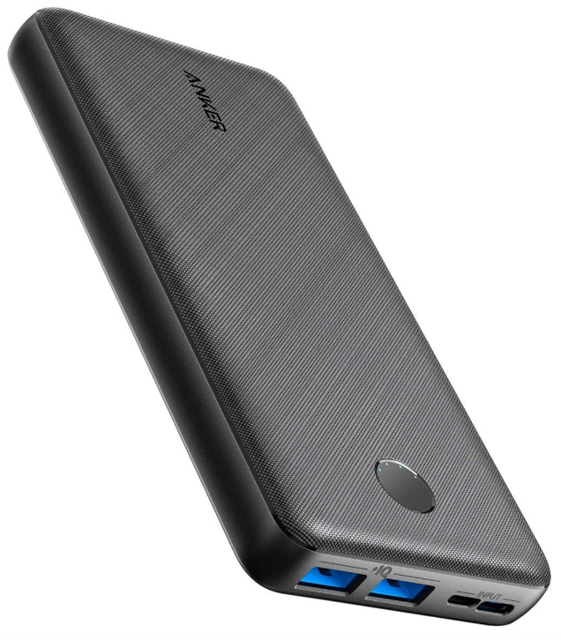

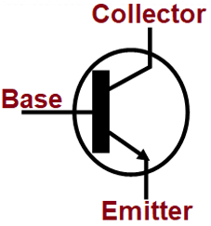
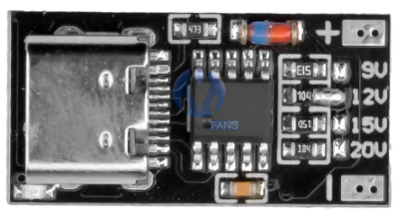
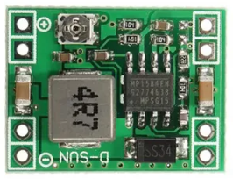
Head Display
Hand Controls
Fuel Display
Input2
Sleeve Cable
Input1
10k pulldown
Input1
Refill/Mode
Input2
Output2
Head Cable
220R
Output1
Drain Speed
Output1
Sleeve Cable
Arduino Cable
Output2
Chest Cable
Head Cable
USB 5v @ 2.1A
2.1A Power Cable
5A Power Cable
C
100w PD PSU
~20000mAh
‘PD Spoof’
20V @ 5A
DC-DC converter
5V @ 5A
1000uF Capacitor
Power Input
Power Distribution

