Slide 1
The fixed-vector bottleneck
…and what removing it does
Sutskever, Vinyals & Le (2014) → Bahdanau, Cho & Bengio (2015)
EE5180 course project · end-term deliverable · TA: Prasenjit Kr Mudi (EE21D057)
Notes:
Mid-term reproduced Table 1 rows 3-4. End-term asks whether the single fixed-length vector is the binding constraint, and we answer it by implementing Bahdanau attention on the same codebase and rerunning the identical grid.

Slide 2
THE BRIEF
What the end-term asks for
Study the bottleneck problem of the fixed-length context vector.
Explain how it motivated Attention, and Attention the Transformer.
Time permitting: the roadmap on to modern LLM-based MT.
Our bar: don't just explain it — remove it and measure what happens.
Implement Bahdanau attention on our own mid-term codebase, behind one flag.
Rerun the identical grid, with the baseline retrained on identical data.
Report the SHAPE of the effect (BLEU vs source length), not just a higher number.
No numeric grading weights were given for this topic; 'study' and 'explain' are the stated bar.
Notes:
The requirement is qualitative. We treat implementing and measuring the fix as the way to demonstrate real understanding, rather than describing attention in prose.

Slide 3
RECAP
Where the mid-term left us
Mid-term result (WMT'14, newstest2014, beam 12) | BLEU | test ppl
Single forward LSTM | 3.89 | 32.888
Single reversed LSTM | 6.60 | 24.504
Reversing the source won on BLEU and perplexity, at every epoch and in every length bucket — the paper's central claim reproduced in direction.
But reversal does not remove the bottleneck; it works AROUND it, by shortening the lag between a source word and the step that needs it.
Both arms still push the whole sentence through one vector before decoding starts.
Absolute BLEU is far below the paper's 26.17 / 30.59 — 500k pairs vs 12M, 2×512 vs 4×1000, one laptop GPU vs 8 GPUs for 10 days.
Notes:
Reversal is a workaround, and that is the hinge of this talk. If the fixed vector is the real constraint, then removing it should make the reversal trick unnecessary — which is a prediction we can test.

Slide 4
THE PROBLEM
The bottleneck, concretely
encoder LSTM ──▶ v ──▶ decoder LSTM ──▶ beam search
▲
2,048 real numbers (2 layers × 512 × h,c)
the paper's is 8,000 (4 × 1000 × h,c)
every decoder step reads the SAME v
The encoder must decide what to keep BEFORE it knows what the decoder will ask for.
A 60-token sentence gets exactly as much room as a 6-token one.
So the prediction: quality should fall as the source gets longer.
Notes:
This is the whole argument in one picture. The vector is fixed-width regardless of sentence length, and it is the only channel between encoder and decoder.

Slide 5
CORPUS
First: we stopped discarding mismatched pairs
Raised in review of the mid-term — and it was right.
WMT'14 pairs dropped | mid-term | end-term
source/target length MISMATCH (ratio > 2.5) | 1,823 | 0
over the length cap (50 → 100 tokens) | 170,275 | 6,752
empty line / exact duplicate (kept as hygiene) | 23,273 | 23,507
→ training pairs (held FIXED) | 500,000 | 500,000
A pair is not bad data because one language says the same thing in fewer words.
Corpus SIZE held fixed at 500k, so only the length distribution moves (mean target 26.1 → 30.8 tokens).
Mid-term pipeline untouched: it still regenerates the submitted corpus exactly.
The baseline is RETRAINED on this data — otherwise the comparison confounds architecture with corpus.
prepare_report.json now records "ratio": 0 — the artefact to check, rather than taking the slide's word for it.
Notes:
We address the objection directly and we make it checkable. Lifting the 50-token cap matters even more here: long sentences are where the fixed vector is supposed to fail, so filtering them would have removed the evidence.

Slide 6
THE FIX
Bahdanau additive attention
e_tj = vᵀ tanh(W_enc h_j + W_dec s_{t-1}) score every source position
a_t = softmax(e_t) pad positions masked out
c_t = Σ_j a_tj h_j the context for step t
s_t = LSTM([E y_{t-1} ; c_t], s_{t-1}) context enters the recurrence
The encoder keeps one annotation h_j PER SOURCE POSITION, instead of only its final state.
At t = 0 the query s_{t-1} IS the baseline's sentence vector — attention starts from the bottleneck and is then allowed to look back.
W_enc h_j is precomputed once per sentence, not once per step; that is what keeps it affordable.
Notes:
Note the query is s_{t-1}, the state before the step — that ordering is the paper's, and we have a test asserting teacher-forced training and step-by-step decoding agree to 1e-6, because an off-by-one here would silently make training optimise a model that decoding does not implement.

Slide 7
CONTROLS
One flag is the only difference
attention: bahdanau
HELD IDENTICAL: corpus, vocabulary, seed, batch order, length bucketing; plain SGD 0.7 with no momentum; the halving schedule; summed-NLL ÷ batch size with clip at 5; U(−0.08, 0.08) init — including on the attention parameters; beam search and both BLEU conventions.
Both arms read ONE config file. There is no second config to drift out of sync.
Declared deviation | Why
tanh readout, not the paper's maxout | All three of Bahdanau's terms kept (U_o s + V_o E y + C_o c); tanh bounds the output so SGD 0.7 / clip 5 transfer untouched. An unbounded readout needs its own tuning — then a BLEU gap could be an optimisation artefact.
unidirectional encoder (paper: BiRNN) | Adding bidirectionality alongside attention would confound the two. Separate flag, unused in reported runs.
context into layer 1 + readout, not every layer | Bahdanau's decoder is single-layer, so any multi-layer placement deviates; this one measured no worse.
Notes:
The experimental control is the point of this slide. If the arms differed in optimiser or corpus we could not attribute a BLEU gap to the architecture.

Slide 8
COST
What attention costs us
1.18×
+3.6%
10.5 h
slower per epoch
(measured, make benchmark)
parameters
57.6M → 59.9M
both WMT arms
on one M1 Pro GPU
The context enters the recurrence, so timesteps can no longer be one fused LSTM call — the decoder loop is ~3× slower in isolation.
But the decoder is a small share of a training step: the 32k-word softmax dominates. So it dilutes to 1.18× end to end.
The small parameter delta matters for the argument — the arms' BLEU gap cannot be waved away as extra capacity.
Measured with the same instrument as the mid-term's throughput table, at the end-term's batch and length distribution.
Notes:
We measured rather than assumed. A microbenchmark first suggested 1.38x; the real pipeline with packing and bucketing came in at 1.18x. We also measured and rejected a cheaper non-input-feeding variant: it needed a single 2.8 GB allocation and drove the machine into swap.

Slide 9
CORRECTNESS
Before any result: did we break the mid-term?
make baseline-regression → hypotheses byte-identical on all 3,003 sentences, both directions
Attention meant changing the encoder and beam search — the code that produced the submitted mid-term. So we re-decode the submitted checkpoints and diff against the committed hypotheses. Decoding is deterministic, so the diff must be EMPTY — much sharper than "BLEU still rounds to 6.60".
52 gates total: 23 from the mid-term, unchanged and still green, plus 29 new.
Alignments sum to 1 and are EXACTLY 0 on padding (the source is always padded).
Teacher-forced training and step-by-step decoding agree to 1e-6.
MPS and CPU agree on loss and every gradient to 1e-3 — attention adds new Metal kernels.
Notes:
The byte-exact gate is the one we are proudest of. It converts 'we think the refactor was safe' into a checkable fact.

Slide 10
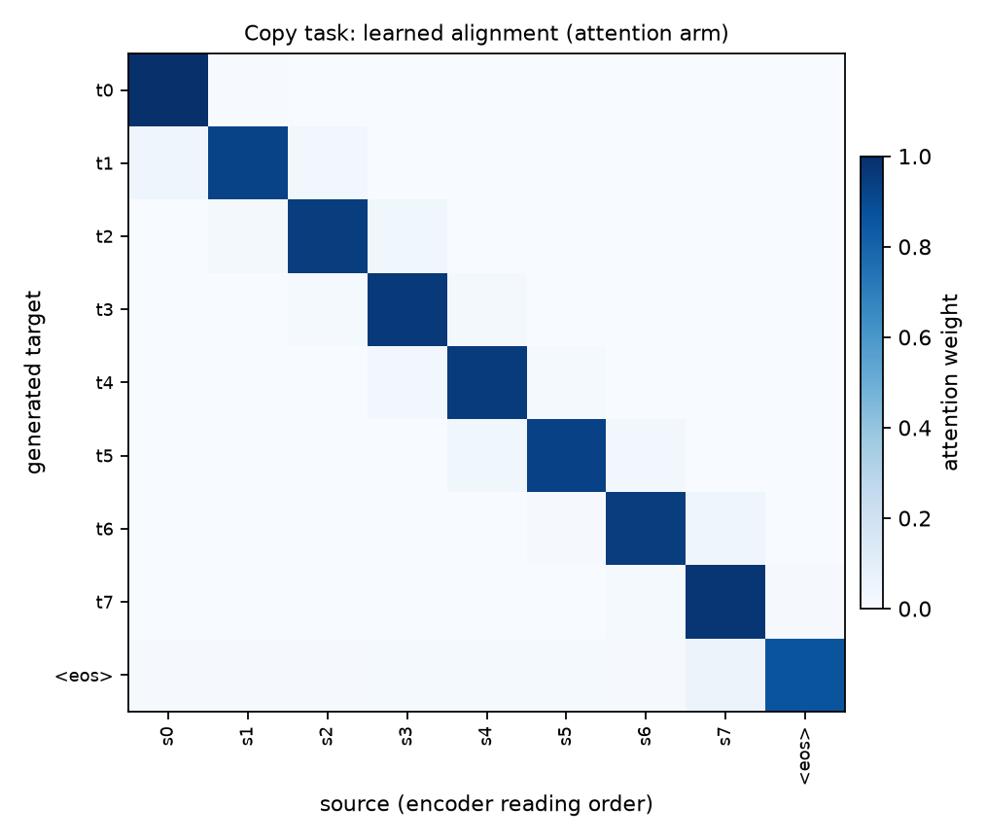
SANITY CHECK
The bottleneck in miniature
Target = source, over random tokens. Nothing is memorisable, so emitting position t REQUIRES reading source position t.
4.88
0.00
28.60
fixed vector
loss / sequence
+ attention
loss / sequence
chance
The fixed vector cannot solve a task that is purely about reading the right source position.
Attention solves it and learns the exact diagonal.
One minute, no corpus — run before committing a night to WMT.
Adam, not the paper's SGD: a controlled demonstration, not a reported reproduction. Stated rather than buried.
Notes:
This is the cleanest possible statement of the bottleneck: a task with no language-model confound where the fixed-vector model simply cannot compete.

Slide 11
RESULTS
WMT'14 En→Fr — the paper's own newstest2014
Arm (beam 12) | BLEU (tok) | BLEU (detok) | test ppl
reversed, fixed vector | 6.36 | 4.62 | 24.067
reversed, + attention | 18.49 | 14.99 | 10.690
Reversed: fixed vector 6.36 → attention 18.49 (+12.13 BLEU).
500k pairs vs the paper's 12M; 2×512 vs 4×1000. Absolute BLEU is NOT comparable to Table 1.
Notes:
We claim the direction and shape of the effect, never the absolute BLEU.

Slide 12
RESULTS
Multi30k — 3 seeds, the full 2×2 grid
Arm (beam 12) | BLEU (tok) | BLEU (detok) | test ppl
forward, fixed vector | 2.61 | 2.26 | 15.103
forward, + attention | 23.90 | 23.17 | 6.282
reversed, fixed vector | 15.35 | 14.96 | 9.014
reversed, + attention | 27.99 | 27.16 | 5.677
Forward: fixed vector 2.61 → attention 23.90 (+21.29 BLEU).
Reversed: fixed vector 15.35 → attention 27.99 (+12.64 BLEU).
The REVERSAL GAP is +12.74 without attention and +4.09 with it — attention absorbs the paper's trick.
29k image captions, 2×256 — not the paper's corpus or test set, but the only tier where we can afford error bars.
Notes:
We claim the direction and shape of the effect, never the absolute BLEU.

Slide 13
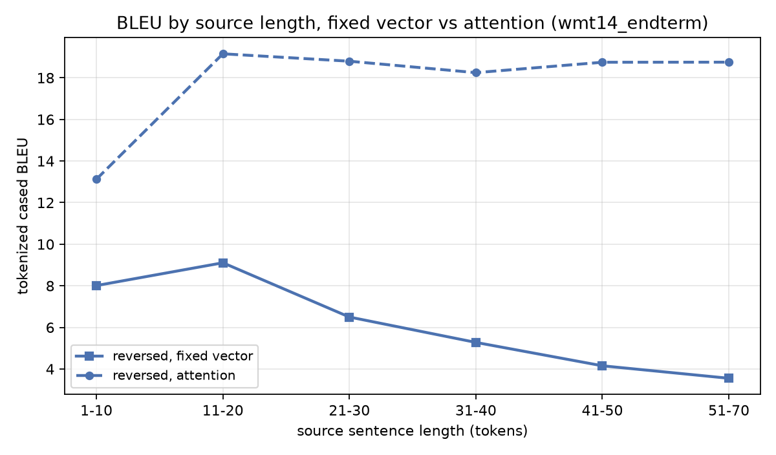
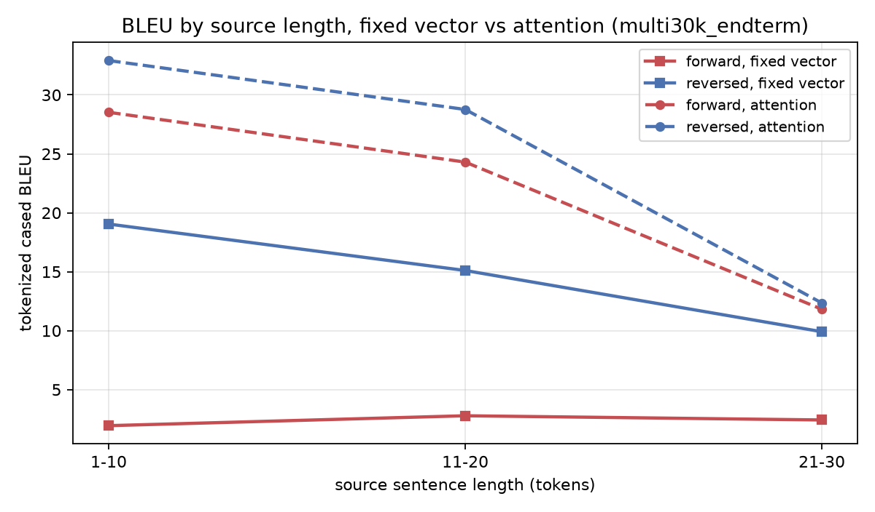
THE RESULT
The actual claim: the SHAPE of the curve
Not "attention scores higher" — a better model would do that. The claim is that a FIXED-WIDTH vector degrades as sentences grow, and attention does not.
Notes:
If the fixed-vector curve falls across the length buckets and the attention curve stays flat, the fixed-length vector was the binding constraint. If both fall equally, something else is — and we would say so.

Slide 14
THE NULL RESULT
Where the curve does NOT show it — and why
Same code, same flag, same grid. On Multi30k the length curve does not evidence the bottleneck. Reporting that is the point: the claim is about long sources, and Multi30k has none.
tier | longest bucket | sentences in it | attention's gain | verdict
Multi30k (captions) | 21-30 | 52 | 13.87 at 1-10 → 2.43 at 21-30 | does NOT widen
WMT'14 (news) | 51-70 | 80 | 5.11 at 1-10 → 15.20 at 51-70 | widens with length
Multi30k is image captions: its longest bucket is 21-30 tokens and holds 52 of 1,000 sentences. There is nothing past 30 tokens to bottleneck.
So its arm-level gain is real, but it is NOT explained by source length — a 13-token caption fits in 2,048 numbers either way.
WMT'14 reaches 70 tokens, which is the only tier here where a fixed vector is actually under pressure — and there the gain widens monotonically.
Multi30k still earns its place: 3 seeds and all four cells, so it carries the error bars and the reversal × attention interaction that WMT's single run cannot.
The generator states this verdict itself from the bucket data, rather than leaving a conditional for the reader to resolve favourably.
Notes:
This is the slide to use if asked whether we only reported the tier that agreed with us. We ran the same grid on both, and the cheap tier disagrees on the length claim for a reason we can state: it has no long sentences. The honest reading is that Multi30k tests the plumbing and the seed variance, WMT tests the bottleneck.

Slide 15
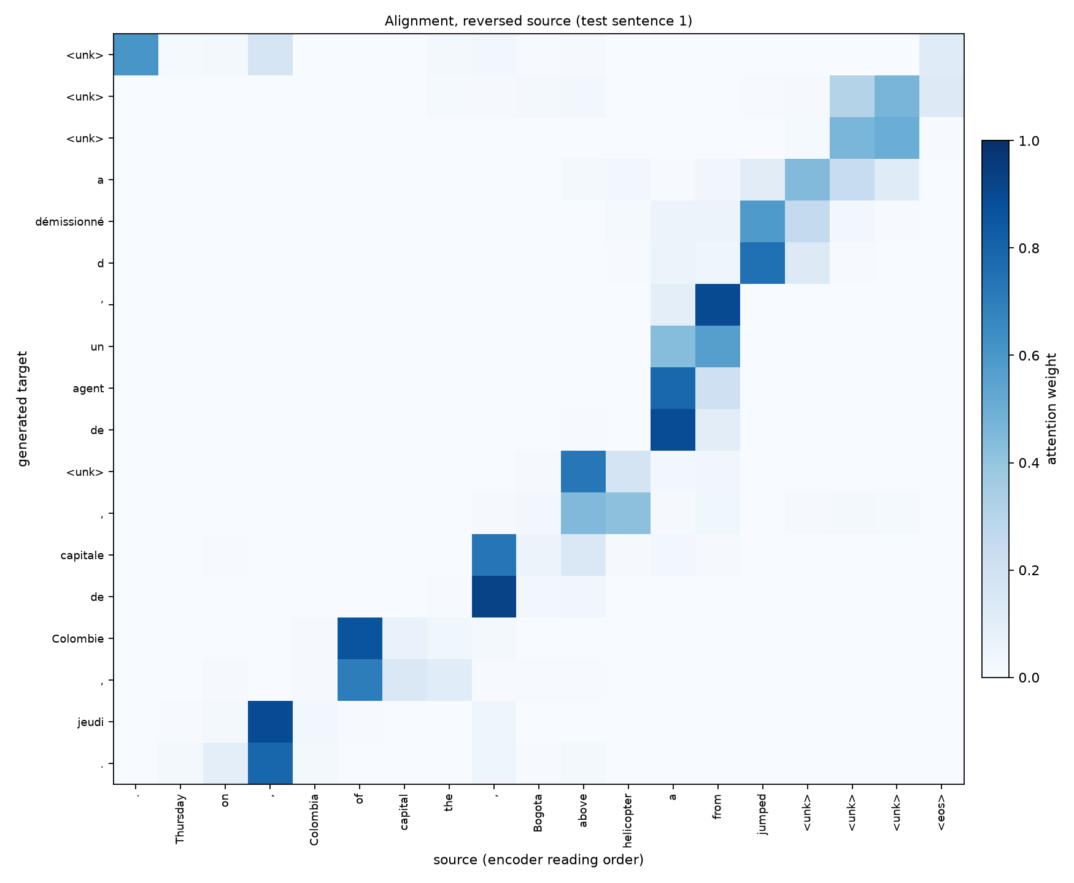
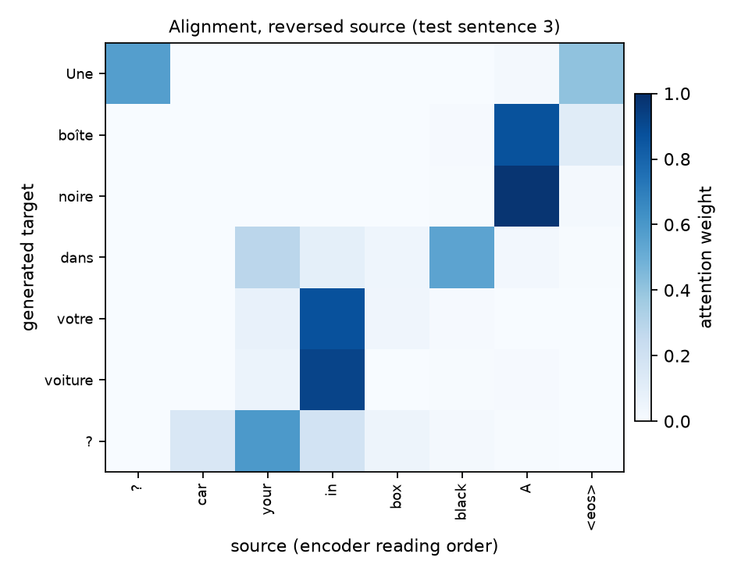
EVIDENCE
What the model actually reads
Alignments over the model's OWN output. Source axis is in ENCODER reading order — for a reversed model that is right-to-left, so a faithful alignment is an ANTI-diagonal.
Notes:
We label the axis in encoder order rather than un-reversing it to make a prettier picture — the weights index the order the encoder read.

Slide 16
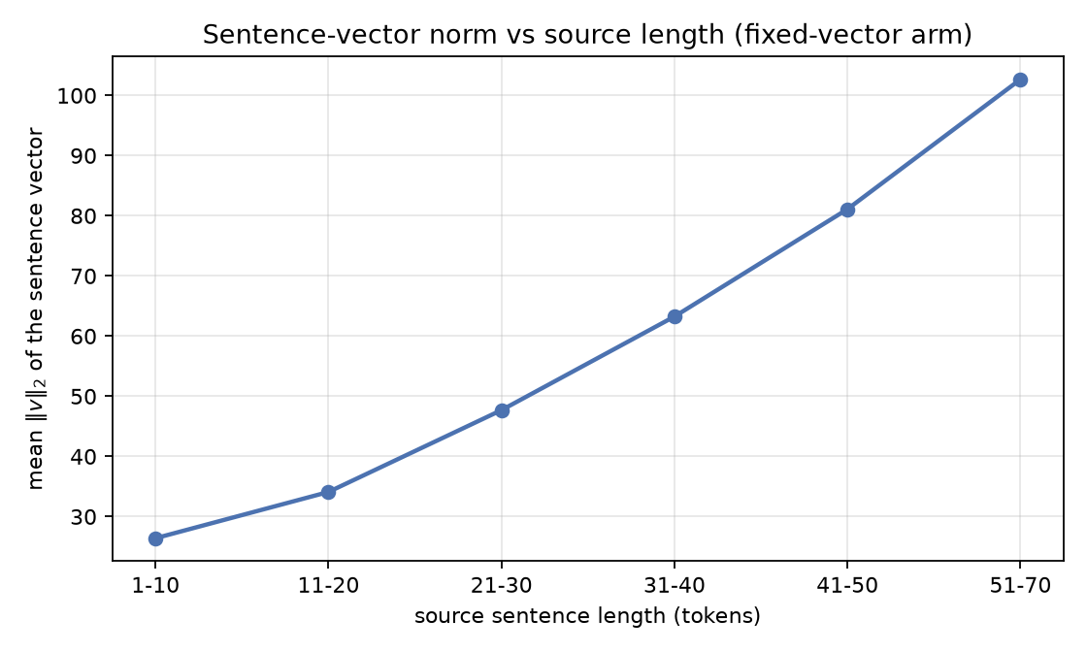
PROBES
The bottleneck without BLEU
source length | n | fixed vector | + attention | ratio
1-10 | 405 | 20.43 | 13.27 | 0.650
11-20 | 954 | 17.79 | 9.57 | 0.538
21-30 | 832 | 21.66 | 9.95 | 0.459
31-40 | 535 | 27.96 | 11.27 | 0.403
41-50 | 194 | 32.97 | 11.60 | 0.352
51-70 | 80 | 39.16 | 12.67 | 0.324
Per-token perplexity — the model's own likelihood. No beam search, no brevity penalty, no n-gram matching. A ratio that FALLS across the buckets means attention helps more on long sentences.
Notes:
BLEU is a beam-mediated n-gram view. Perplexity by source length takes the decoding machinery out of the picture entirely, so it is the cleaner test of the same claim.

Slide 17
THE LINE
Attention → Transformer
fixed vector → attention, → attention only, → decoder-only LLMs
Sutskever 2014 recurrence kept recurrence removed
(our mid-term) Bahdanau 2015 Vaswani 2017
(this report)
Attention gives a CONSTANT-LENGTH path between any source position and any target step. The recurrence's path grows with distance — which is exactly why the paper had to reverse the source.
So why keep the recurrence? Its last job was context-dependent representations — and attention can do that too, by attending to itself.
Removing it buys what an LSTM never can: timesteps stop being sequentially dependent. We PAID that cost and measured it — our attention decoder is ~3× slower precisely because the context enters the recurrence and forces a per-step loop.
Three gaps had to close first: positional encodings (a set has no order), multiple heads (one distribution expresses one alignment), and the scaled DOT-PRODUCT score — our additive energy needs a (B,T,S,A) tensor, 2.8 GB in one allocation at our batch, which we measured driving this machine into swap. QKᵀ/√d needs two matmuls.
We do not claim to have tested the Transformer step — the self-attention run stayed out of scope. The runs here support the first arrow.
Notes:
Each step removes a constraint the previous one worked around. The move from additive to dot-product attention is not cosmetic: it is what makes all-pairs attention affordable, and we have the memory measurement to show why.

Slide 18
HONESTY
What we claim, and what we do not
We do NOT claim comparable BLEU. 500k pairs vs 12M, 2×512 vs 4×1000, 32k/32k vocab vs 160k/80k, one laptop GPU vs 8 GPUs for 10 days.
We DO claim the direction and the shape: whether the fixed-vector arm degrades with source length and the attention arm does not; whether the reversal gap shrinks.
The comparison is controlled: one flag apart, +3.6% parameters, baseline retrained on identical data.
The mid-term is untouched — its hypotheses re-decode byte-identically.
Negative results are reported. The mid-term's beam trend did not reproduce and we said so.
No pair is dropped for a source/target length mismatch; prepare_report.json records "ratio": 0.
Notes:
Closing on what the evidence does and does not support is the point of the project, not a disclaimer.

