Slide 1
Reproducing Table 1
Sequence to Sequence Learning with Neural Networks
Sutskever, Vinyals & Le — Google — NeurIPS 2014 — arXiv:1409.3215
EE5180 course project · mid-term deliverable · TA: Prasenjit Kr Mudi (EE21D057)
Notes:
We reproduce Table 1 rows 3 and 4 — single forward vs single reversed LSTM — at reduced scale, and are explicit throughout that absolute BLEU is not comparable to the paper's.

Slide 2
THE BRIEF
What the mid-term asks for
Table 1 row | Paper, cased BLEU on ntst14
Single forward LSTM, beam 12 | 26.17
Single reversed LSTM, beam 12 | 30.59
Why these two rows: they differ in exactly one thing — the direction the encoder reads the source — so together they isolate the paper's central empirical claim.
Reproduce 1–2 rows of Table 1 and demonstrate understanding of the method.
End-term: study the fixed-vector bottleneck and how it motivated Attention → Transformer.
Notes:
Rows 3 and 4 are also the cheapest scientifically meaningful pair — no ensembling required.

Slide 3
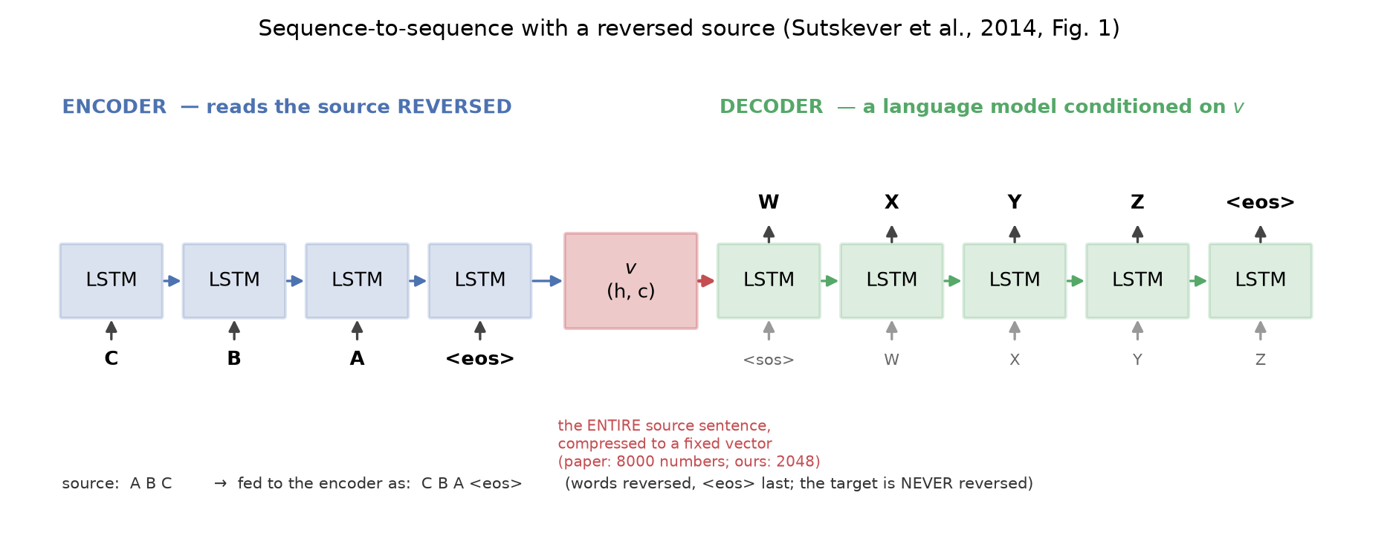
HOW IT WORKS
The method
Encoder LSTM reads the source and ends in a state (h, c). That state — and nothing else — conditions a separate decoder LSTM, a language model over the target. Trained by maximising log p(T | S); decoded by beam search.
Paper: 4 layers x 1000 cells = 8000 numbers per sentence. Ours: 2 x 512 = 2048.

Slide 4
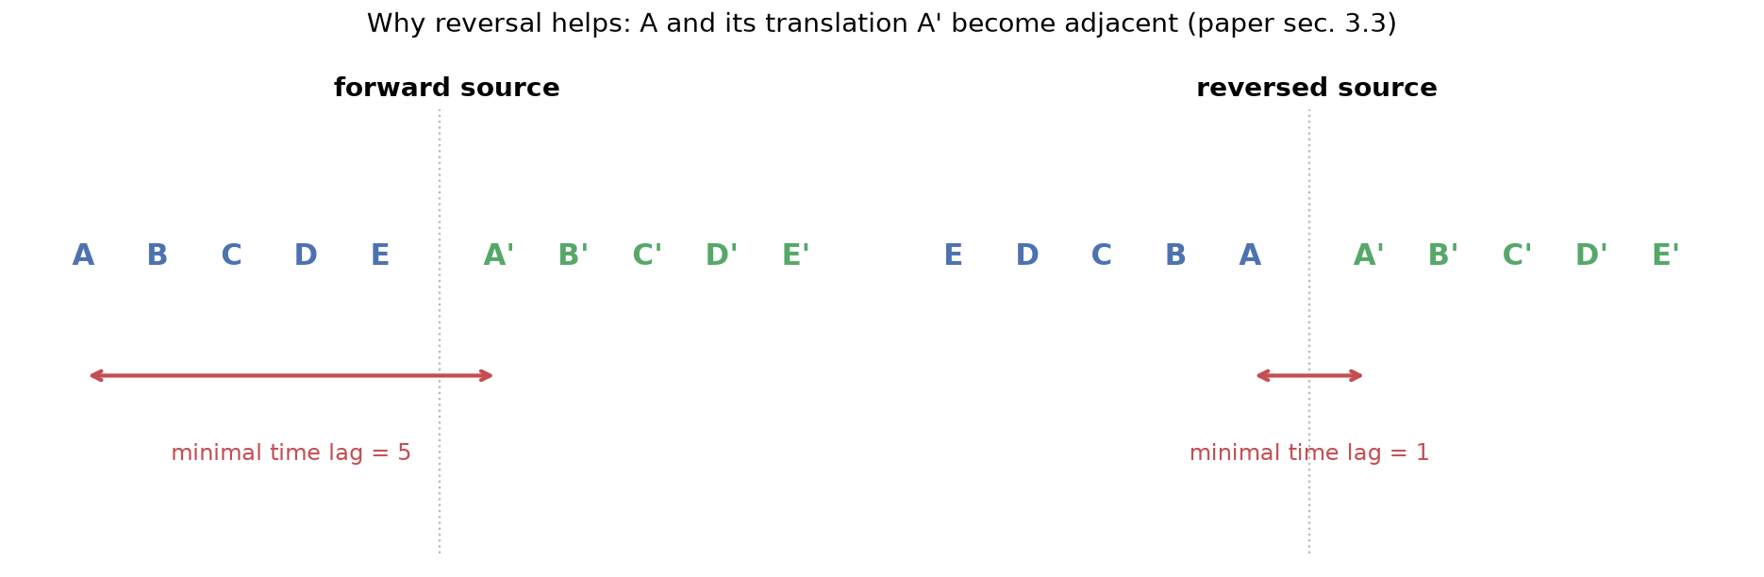
THE CLAIM UNDER TEST
Why reversing the source should help
Reversal leaves the average distance between corresponding words unchanged, but collapses the minimal time lag from the sentence length to one step — so backpropagation has a short path to establish the source→target correspondence early.
The target is never reversed.
Notes:
Paper sec. 3.3: perplexity 5.8 -> 4.7, BLEU 25.9 -> 30.6. This is the paper's key technical contribution.

Slide 5
THE HONEST CAVEAT
Our BLEU is not comparable to the paper's
12M → 0.5M
384M → 58M
8 GPUs, 10 days
→ 1 laptop GPU, 5 h
training sentence pairs
parameters
compute
So we claim reproduction of the direction, ordering and shape of the effects — never of the absolute numbers. Every table we show repeats this.
Held exactly as in the paper: separate enc/dec LSTMs · U(−0.08, 0.08) init · plain SGD lr 0.7 with halving · batch 128, loss ÷ batch size so clip@5 means what the paper says · length bucketing · beam search with hypotheses leaving the beam on <EOS>

Slide 6
SETUP
Data and evaluation
Training: News-Commentary v9 + Europarl v7 En–Fr — both constituent corpora of the official WMT'14 training set; 1,087,880 pairs survive cleaning, we sample 500,000
Test: newstest2014, full 3003-sentence version — the paper's own ntst14, fetched via sacreBLEU
Dev: newstest2013. Vocabulary 32k / 32k, OOV → UNK (5.8% OOV on the English test side)
Two BLEU numbers, always both: tokenized cased BLEU (the multi-bleu.pl equivalent the paper used) and standard sacreBLEU on detokenized output
A bug worth flagging. News-Commentary v9 contains ~2,900 bare carriage returns inside lines — a different count in English than in French. Python's default newline handling splits on them and silently misaligns the parallel corpus. Our reader splits on \n only; two regression tests pin it.

Slide 7
RESULT
Table 1 rows 3 and 4, reproduced
WMT'14 runs still training — regenerate with `make results-wmt && node scripts/make_slides.js`.
Scale gap applies: 0.5M pairs vs 12M, 2x512 vs 4x1000, 32k/32k vocab vs 160k/80k. Compare within our column, not against the paper's.

Slide 8
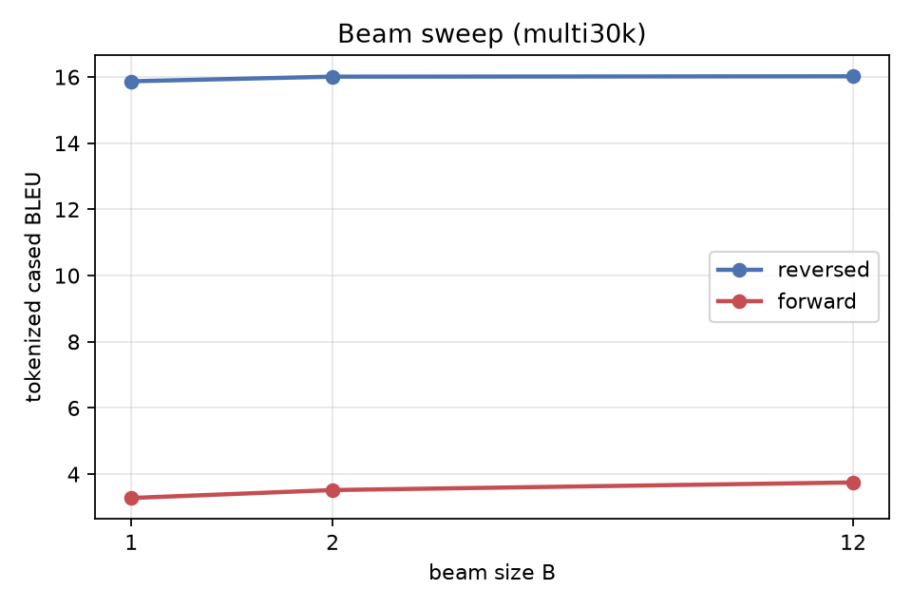
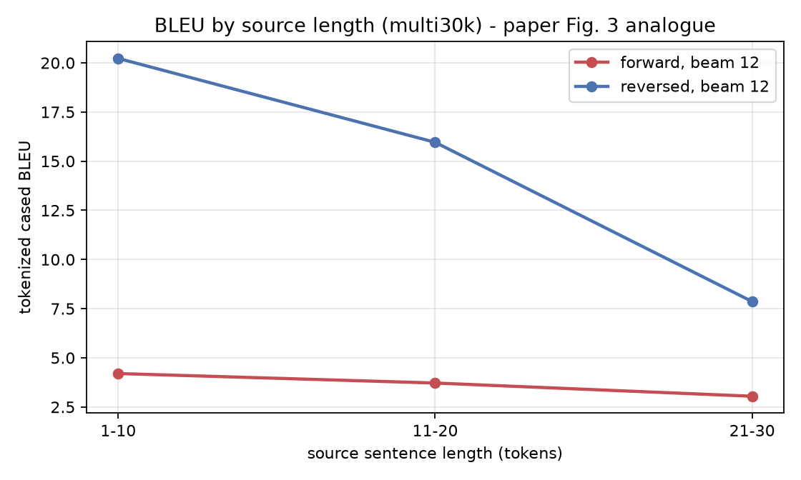
THE OTHER TABLE 1 TRENDS
Beam size and sentence length
Beam 2 recovers 93% of the gain from beam 1 to beam 12 — reproducing the paper's observation that "a beam of size 2 provides most of the benefits of beam search".
Shown on Multi30k while the WMT runs finish.

Slide 9
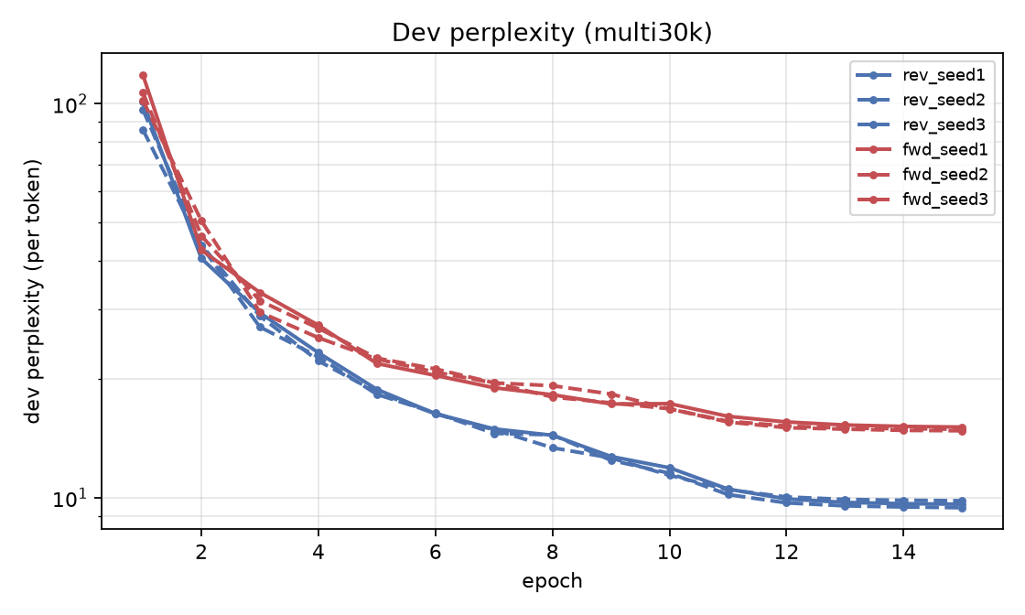
SUPPORTING EVIDENCE — MULTI30K En→Fr
A seed-controlled replication
29k pairs, same language direction — trains in minutes, so we can afford three seeds per arm.
Not a Table 1 reproduction: different corpus, domain and test set. It shows the effect survives where we can control for seed noise.
Reversal moves BLEU 3.75 → 16.02 and test perplexity 14.35 → 8.93 at beam 12.
The effect is proportionally larger than the paper's — with only 29k pairs the forward model never learns a reliable correspondence, so it emits fluent French that does not track the source.
Reversed (blue) sits below forward (red) at every epoch, in all 3 seeds.

Slide 10
ENGINEERING
Getting it right before spending compute
Correctness gates (pytest, ~12 s)
Two findings worth keeping
beam search at B=1 is exactly greedy decoding
a wider beam never returns a lower-scoring hypothesis
reversing the input by hand and setting the flag cancel out
padding does not change the encoder's sentence vector
scoring the references against themselves gives BLEU 100
MPS and CPU agree on loss and gradients to 1e-3
Corpus misalignment
~2,900 in-line carriage returns in News-Commentary v9, unequal across languages — would have trained on mismatched pairs, silently.
Decoding 9× too slow on GPU
Beam search is latency-bound: 317 ms/sentence on MPS vs 34 ms on CPU. Training stays on GPU; decoding moved to CPU.
PyTorch's Metal LSTM has a history of silently wrong numbers — finding that after an overnight run costs a day.

Slide 11
VERDICT
What this establishes — and what it does not
Reproduced
Not attempted
Reversing the source improves both BLEU and perplexity by a clear margin, under an otherwise identical setup.
A beam of 2 captures most of the benefit of a beam of 12.
The ordering of Table 1 rows 3 and 4 holds at our scale.
Absolute BLEU anywhere near 26–31.
The 5-model ensemble rows of Table 1.
The 1000-best SMT rescoring of Table 2.
These need the paper's data and compute. We say so, rather than presenting a smaller number as if it were comparable.

Slide 12
WHERE THE END-TERM GOES
Everything passes through one fixed vector
A twelve-word sentence and a fifty-word sentence are compressed into the same 2048 numbers before a single target word is emitted. That is the bottleneck. In our runs on Multi30k, reversed-model BLEU falls from 20.2 on 1-10-token sources to 7.9 on 21-30 — the paper, at full scale, reported no such degradation.
1
Quantify
2
Fix
3
Trace
BLEU and perplexity by source-length bucket; probe encoder-state saturation.
Implement Bahdanau attention on this same codebase; rerun the identical grid.
From attention to the Transformer, and on to modern LLM-based MT.
The fix will be demonstrated, not merely argued.

