Slide 1

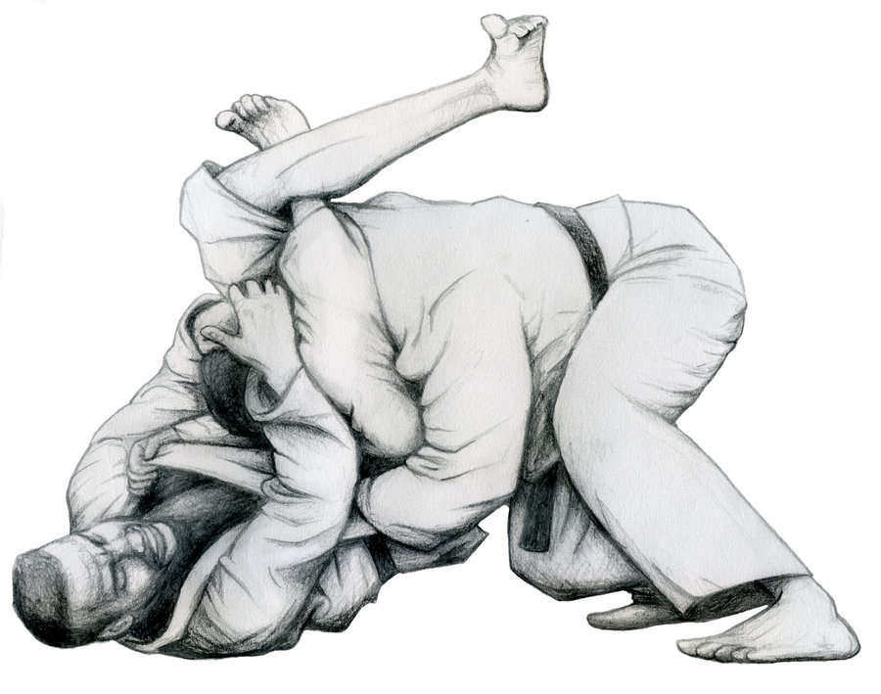
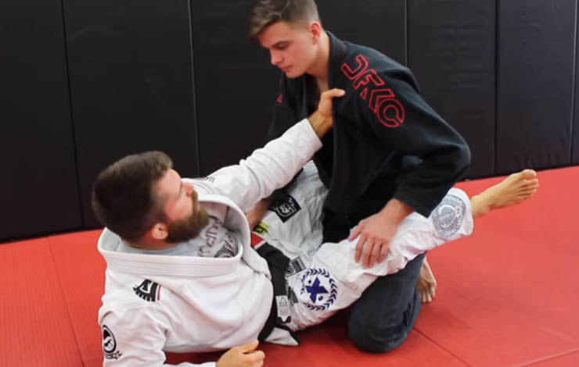
My notebook
Name, position or type
Add Note
Friends
Account
Triangle
I can set up the triangle when my opponent tries to pass my guard or I can force one arm out of the guard whilst pulling one arm in. It’s very important to hold my opponent’s head down throughout the execution of the technique.
Position: Guard
Type: Submission
Taps: 42
Scissor-sweep
When performing a scissor-sweep, it’s very important to pull the opponent down using the lapels. This way, the weight of the opponent is divided and the base is broken.
Position: Guard
Type: Sweep
Sweeps: 18

