Slide 1
Localization using Extended Kalman Filter and a LRF
Autonomous Systems
Rúben Miguel Oliveira Tadeia
December 05, 2017
Group 7
Rúben Tadeia, Nº 75268 Manuel Moura, Nº 75756
Pedro Falcão, Nº 77063
Davi Mello, Nº 89126
Supervisors
Prof. Rodrigo Ventura
Prof. Oscar Lima
Notes:
Good afternoon to everyone present, my name Rúben Tadeia and I will tell you about our Autonomous Systems project, whose title is Localization using Extended Kalman Filter and a Laser Range Finder.

Slide 2
Outline
2
Part I - Introduction
Concept
Part II - Implementation
Methods and Algorithms
Part III - Results
Experimental Results
Part IV - Discussion
Conclusions and Future Work
Notes:
I will start by introducing you to the theme and problem under study and then the methods used and results obtained to achieve the proposed objectives. And finally these results will be discussed, presenting the conclusions.

Slide 3
Part I - Introduction
1. Concept

Slide 4
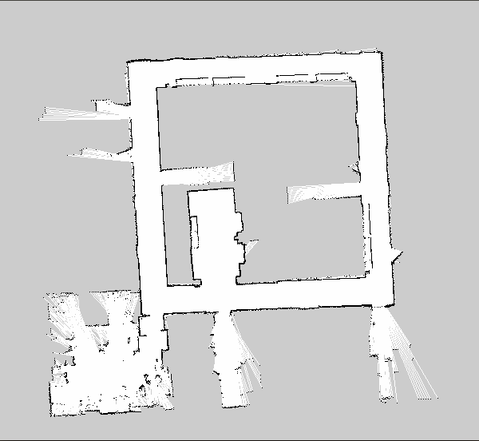
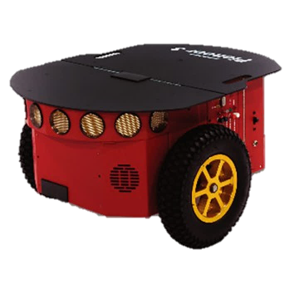


1. Concept
3
We want to Localize our robot
Introduction
Implementation
Results
Could not localize
Could localize
FEEDBACK
Discussion

Slide 5
Part II – Implementation
Methods and Algorithms

Slide 6
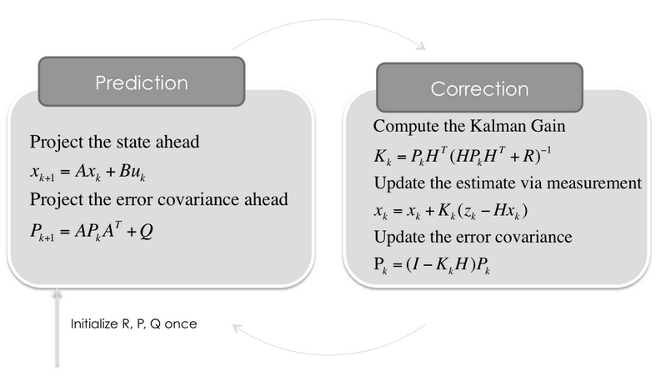
Methods and Algorithms
4
Prediction of training performance based on intensity/regularity:
Introduction
INPUT
Parameters
Applying
the
EKF
OUTPUT
Robot Localization
Implementation
Results
Discussion

Slide 7
Methods and Algorithms
4
Prediction of training performance based on intensity/regularity:
Introduction
INPUT
Parameters
Applying
the
EKF
OUTPUT
Robot Localization
Implementation
Results
ROS Packages
Odometry
LRF
EKF
Laser
+
Gmapping
Velocities instead of positions
Distance to objects
EKF CTVR – Constant turn rate and velocity model
Discussion

Slide 8
Methods and Algorithms
4
Prediction of training performance based on intensity/regularity:
Introduction
INPUT
Parameters
Applying
the
EKF
OUTPUT
Robot Localization
Implementation
Results
ROS Packages
Odometry
LRF
EKF
Laser
+
Gmapping
Velocities instead of positions
Distance to objects
EKF CTVR – Constant turn rate and velocity model
Discussion

Slide 9
Methods and Algorithms
4
Prediction of training performance based on intensity/regularity:
Introduction
INPUT
Parameters
Applying
the
EKF
OUTPUT
Robot Localization
Implementation
Results
ROS Packages
Odometry
LRF
EKF
Laser
+
Gmapping
Velocities instead of positions
Distance to objects
EKF CTVR – Constant turn rate and velocity model
Discussion

Slide 10
Methods and Algorithms
4
Prediction of training performance based on intensity/regularity:
Introduction
INPUT
Parameters
Applying
the
EKF
OUTPUT
Robot Localization
Implementation
Results
ROS Packages
Odometry
LRF
EKF
Laser
+
Gmapping
Velocities instead of positions
Distance to objects
EKF CTVR – Constant turn rate and velocity model
Discussion

Slide 11
Methods and Algorithms
4
Prediction of training performance based on intensity/regularity:
Introduction
INPUT
Parameters
Applying
the
EKF
OUTPUT
Robot Localization
Implementation
Results
Our Error
We have an error
From the order of millimeters
Discussion

Slide 12
Methods and Algorithms
4
Prediction of training performance based on intensity/regularity:
Introduction
INPUT
Parameters
Applying
the
EKF
OUTPUT
Robot Localization
Implementation
Results
Localization
Sucess
Discussion

Slide 13
Part III – Results
1. Experimental Results

Slide 14
Experimental Results
5
We were able to :
Introduction
INPUT
Odometry
LRF
+
EKF
OUTPUT
Robot Localization
Implementation
Giving the velocities
Knowing:
Results
Distances to objects
Pose estimation
Discussion

Slide 15
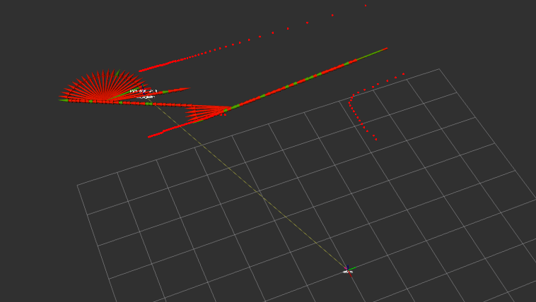
Experimental Results
6
Introduction
Implementation
Results
Test in simulation
Discussion

Slide 16
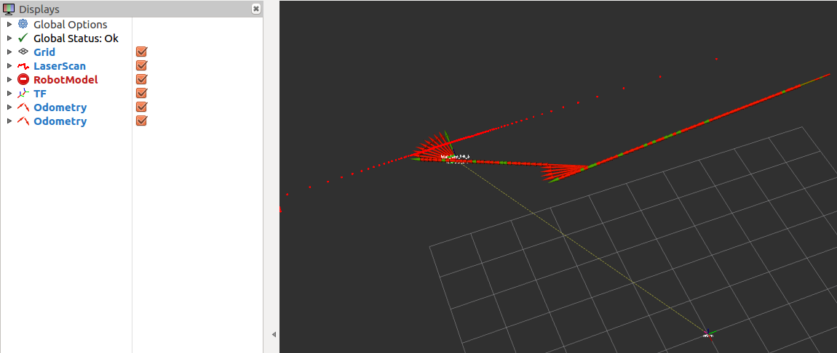
Experimental Results
7
Introduction
Implementation
Results
Test in the fifth floor
Discussion

Slide 17
Part IV - Discussion
1. Conclusions and Future Work

Slide 18
Conclusions and Future Work
8
A. Conclusions:
EKF algorithm is implemented in order to achieve the most accurate localization of a mobile robot with four wheels
First, it is necessary to linearize the kinematic model of the robot to perform the prediction step of the EKF
To perform the matching step, it is necessary to extract the line parameters from the global map
In the end our code and work revealed worthy
Introduction
Implementation
Results
B. Future Work:
Implement a solution for the kidnapping problem
Continue testing the robustness of the algorithm
Discussion

Slide 19
Thank you for your attention

