Slide 1



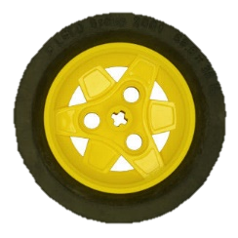

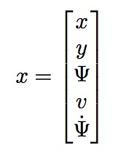
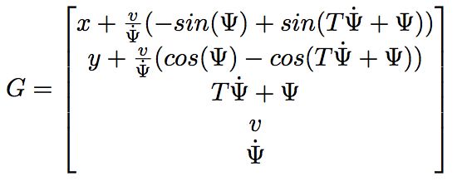

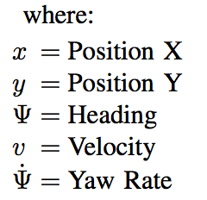
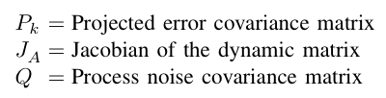



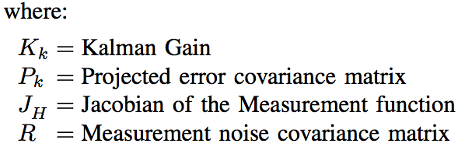
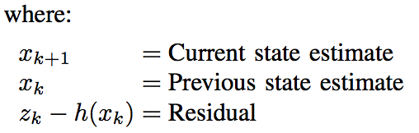

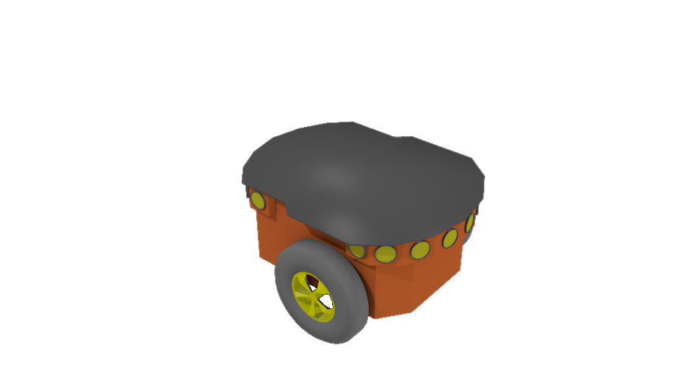

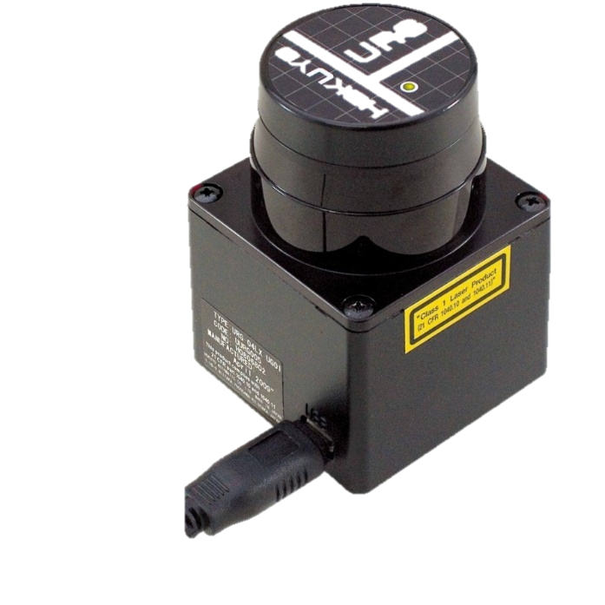
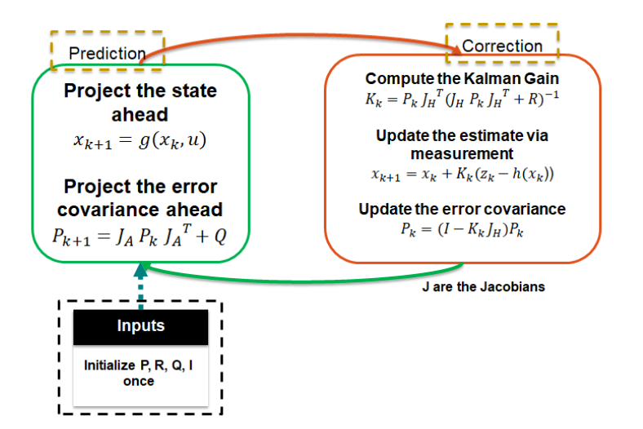

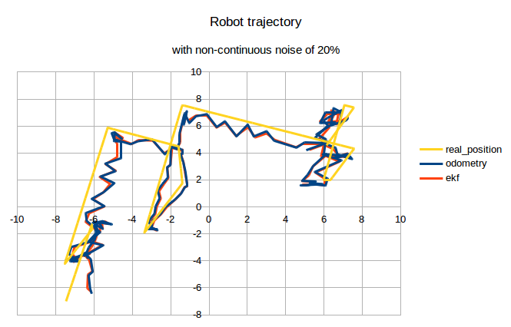
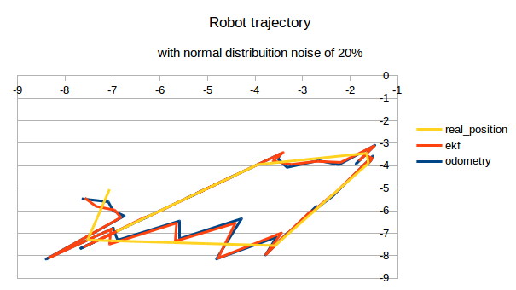


Sistemas Autónomos / Autonomous Systems
PROJECT [L2] – Localization of a Pioneer P3-DX using LRF and EKF
Rúben Tadeia, nº 75268, ruben.tadeia@tecnico.ulisboa.pt
Manuel Moura, nº 75756, manuel.moura@tecnico.ulisboa.pt
Pedro Falcão, nº 77063, pedrofalcao@tecnico.ulisboa.pt
Davi Mello, nº 89196 , davimello@tecnico.ulisboa.pt
MEEC
Instituto Superior Técnico, Universidade de Lisboa
Introduction
The localization problem is a recurring issue in every day's life. Whether they are smart-phones, our computers or even mobile robots all of them have a method of self-localization, usually by triangulation (GPS).
To accomplish this task we used the Extended Kalman Filter (EKF) with the help of a Laser Range Finder that scans the environment and allows us to acquire a map.
The Extended Kalman Filter provides optimal estimates for non-linear systems and is composed by 2 steps the Prediction Step and the Update Step. The EKF helps us find the pose of the robot The EKF helps us find the main objective that is to correct the pose of the robot.
EKF - State Definition
z
Prediction Step (Time update)
Measurement Update
(Correction)
z
z
Methods – Laser Range Finder
Methods – EKF
Obtaining Points of the Global Map by SLAM and Points of the Local Map with the sensor measurements
Get Line Paremeters for both Maps
using Least Squares Method
Compute the matrix of Line Parameters Covariances for EKF
Transform the line parameters of the Global Map into the robot´s coordinates to get the robot´s pose correction
Transform each line of the global map (transformed into the robot´s coordinates)
and of the local map in
Cartesian cordinates to get pairs of lines and determine
Results
which pairs are valid
Conclusions
The algorithm’s efficiency maintaining the information over a long period of time, and filtering the information in order to achieve a satisfactory result
The applicability in non-controllable environments such as streets or open spaces
Applying this work to autonomous vehicles, if we know the position of the vehicle, it can leave the know environment and still keep its trajectory with precision
The possibility of locomotion in unknown environments is confirmed as the result of the algorithm has a very small error in environments with high noise. It is possible to return to the initial position if we don´t have external actions that move the robot.
Acknowledgments:
We would like to thank to our supervisor of this project, Professors Oscar Lima and Rodrigo Ventura for the valuable guidance and advice. Their willingness to motivate us contributed tremendously to our project.
© 2018 Autonomous Systems / DEEC / IST

