Slide 1

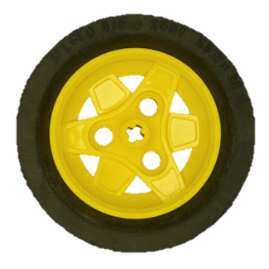
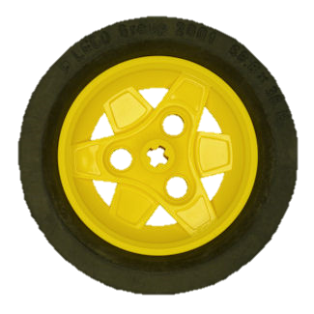
Introduction
The localization problem is a recurring issue in every day's life. Whether they are smart-phones, our computers or even mobile robots all of them have a method of self-localization, usually by triangulation (GPS).
To accomplish this task we used the Extended Kalman Filter (EKF) with the help
of a Laser Range Finder that scans the environment and allows us to acquire a map.
The Extended Kalman Filter provides optimal estimates for non-linear systems and is composed by 2 steps the
Prediction Step and the Update Step.
The EKF helps us find the pose of the robot The EKF helps us find the main objective that is to correct the pose of the robot

