Slide 1
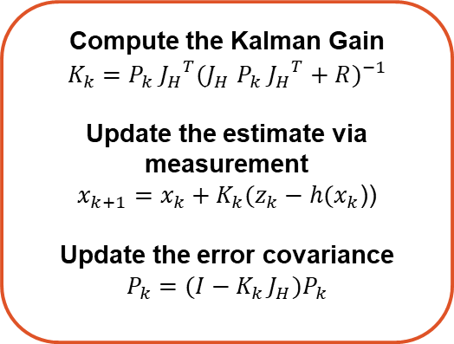
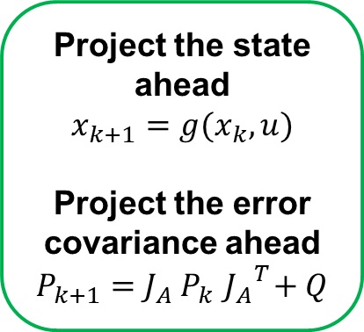
Prediction
Correction
Compute the Kalman Gain
$$K_{k}=P_{k} {J_{H}}^{T}{(J_{H} P_{k} {J_{H}}^{T}+R)}^{−1}$$
Update the estimate via measurement
$x_{k+1}=x_{k}+K_{k}(z_{k}−h(x_{k}$))
Update the error covariance
$$P_{k}=(I−K_{k }J_{H})P_{k}$$
Project the state ahead
$$x_{k+1}=g(x_{k},u)$$
Project the error covariance ahead
$$P_{k+1}=J_{A} P_{k}{ J_{A}}^{T}+Q$$
J are the Jacobians
Inputs
Initialize P, R, Q, I
once

