Slide 1
Risk-Constrained Kelly Gambling
Optimization and Algorithms Project Presentation
Diogo Silva
Luís Alves
Rúben Tadeia
Pedro Falcão
December 12, 2017
Supervisors
Prof. António Simões

Slide 2
Outline
2
Part I – Implementation in CVX
Kelly Problem
Risk-Constrained Kelly Problem
Our implementation
Results
Part II - A. Experiment
Methods
Results

Slide 3
Part I - Implementation in CVX
1. Kelly Problem
2. Risk-Constrained Kelly Problem
3. Our implementation
4. Results

Slide 4
1. Kelly problem
3
Implementation in CVX
We consider the classic Kelly gambling problem with general distributions of outcomes.
John Kelly proposed a systematic way to allocate a total wealth across a number of bets so as to maximize the long term growth rate when the gamble is repeated [1].
1. Kelly problem
2. Risk-Constrained Kelly Problem
3. Our implementation
4. Results

Slide 5

1. Kelly problem
4
Implementation in CVX
With this strategy – Kelly optimal bets – there is a risk of the wealth dropping substantially from its original value before increasing.
The wealth growth is given by
with t equal to 1,2,… with I.I.D. returns.
1. Kelly problem
2. Risk-Constrained Kelly Problem
3. Our implementation
$$w_{t}=\left(r_{1}^{T}b\right)…(r_{t−1}b)$$
4. Results

Slide 6
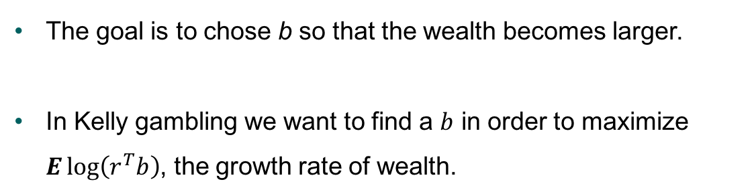
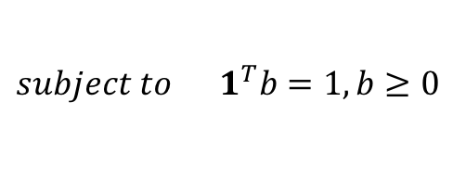
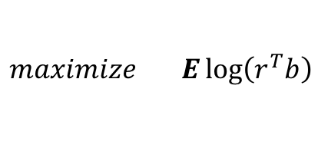
1. Kelly problem
5
Implementation in CVX
The goal is to chose b so that the wealth becomes larger.
In Kelly gambling we want to find a $b$ in order to maximize $E\log\left(r^{T}b\right)$, the growth rate of wealth.
1. Kelly problem
2. Risk-Constrained Kelly Problem
$$maximize E\log\left(r^{T}b\right)$$
3. Our implementation
$$subject to 1^{T}b=1, b≥0$$
The solution of $b$ optimal values is called Kelly Optimal bets.
4. Results

Slide 7
Part I - Implementation in CVX
1. Kelly Problem
2. Risk-Constrained Kelly Problem
3. Our implementation
4. Results

Slide 8
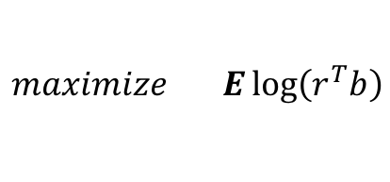
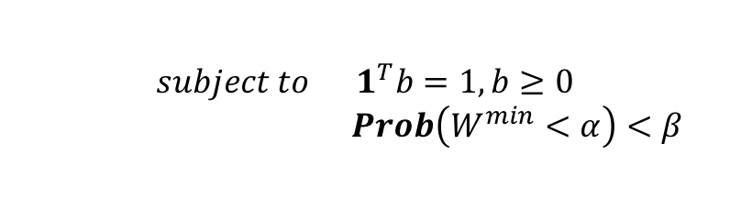
2. Risk-Constrained Kelly Problem
6
Implementation in CVX
In Risk-Contrained Kelly we add a drawdown risk contraint:
1. Kelly problem
$$maximize E\log\left(r^{T}b\right)$$
$$subject to 1^{T}b=1, b≥0$$
$Prob\left(W^{min}<α\right)<β$
2. Risk-Constrained Kelly Problem
The new contraint limits the probability of a drop in wealth to value ⍺ to be no more than β.
3. Our implementation
4. Results

Slide 9
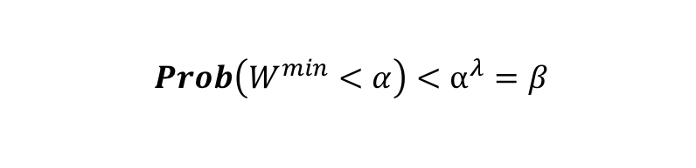
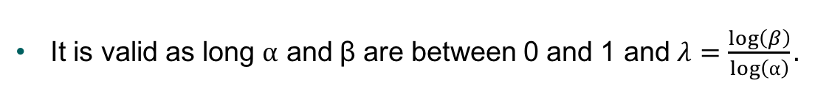
2. Risk-Constrained Kelly Problem
7
Implementation in CVX
A bound of the drawdown risk is developed to make the problem easly solvable in CVX.
1. Kelly problem
$$Prob\left(W^{min}<α\right)<⍺^{λ}=β$$
2. Risk-Constrained Kelly Problem
It is valid as long ⍺ and β are between 0 and 1 and $λ=\frac{\log\left(β\right)}{\log\left(⍺\right)}.$
3. Our implementation
4. Results

Slide 10
2. Risk-Constrained Kelly Problem
8
Implementation in CVX
The parameter λ is the risk aversion parameter.
A higher value means the problem only considers risk-free bets while a low value limits the ratio of variance to the mean growth.
1. Kelly problem
2. Risk-Constrained Kelly Problem
3. Our implementation
4. Results

Slide 11
Part I - Implementation in CVX
1. Kelly Problem
2. Risk-Constrained Kelly Problem
3. Our implementation
4. Results

Slide 12
3. Our implementation
9
Implementation in CVX
The Kelly gambling problem is a convex optimization problem since the objective is concave and the contraints are convex.
We inserted the function to maximize and the contraints directly on CVX.
1. Kelly problem
2. Risk-Constrained Kelly Problem
3. Our implementation
4. Results

Slide 13
3. Our implementation
10
Implementation in CVX
We created wealth trajectories for both Kelly and the Risk-Constrained Kelly and also a random betting situation.
In our testing environment we created 1000 trajectories and displayed 10 of them next.
The risk aversion parameter used took into account that ⍺ = 0.9 and β = 0.05 resulting in λ of around 28.
1. Kelly problem
2. Risk-Constrained Kelly Problem
3. Our implementation
4. Results

Slide 14
Part I - Implementation in CVX
1. Kelly Problem
2. Risk-Constrained Kelly Problem
3. Our implementation
4. Results

Slide 15
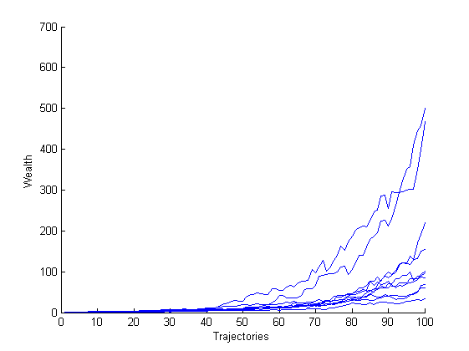
4. Results
11
Implementation in CVX
Wealth trajectories for the Kelly optimal bet.
1. Kelly problem
2. Risk-Constrained Kelly Problem
3. Our implementation
4. Results

Slide 16
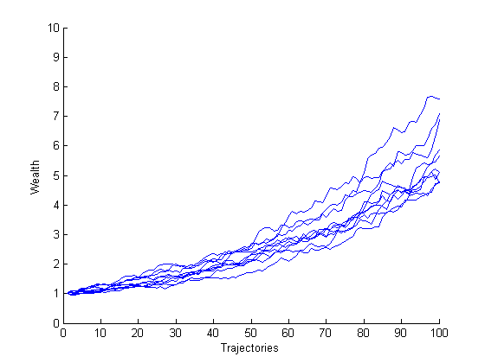
4. Results
12
Implementation in CVX
Wealth trajectories for the Risk-Constrained Kelly optimal bet.
1. Kelly problem
2. Risk-Constrained Kelly Problem
3. Our implementation
4. Results

Slide 17
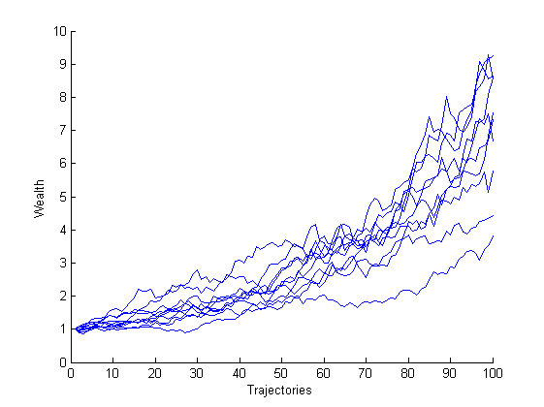
4. Results
13
Implementation in CVX
Wealth trajectories for a random bet.
1. Kelly problem
2. Risk-Constrained Kelly Problem
3. Our implementation
4. Results

Slide 18
4. Results
14
Implementation in CVX
We can conclude that:
The Risk-Contrained Kelly with the selected parameters represent a conservative approach for betting;
Solving an optimization problem translates in a better final result given the contraints.
1. Kelly problem
2. Risk-Constrained Kelly Problem
3. Our implementation
4. Results

Slide 19
Thank you for your attention

Slide 20
Risk-Constrained Kelly Gambling
Optimization and Algorithms Project Presentation
Diogo Silva
Luís Alves
Rúben Tadeia
Pedro Falcão
December 12, 2017
Supervisors
Prof. António Simões

