Slide 1
Risk-Constrained Kelly Gambling
Optimization and Algorithms Project Presentation
Diogo Silva
Luís Alves
Rúben Tadeia
Pedro Falcão
December 12, 2017
Supervisors
Prof. António Simões

Slide 2
Outline
2
Part I – Implementation in CVX
Kelly Problem
Risk-Constrained Kelly Problem
Our implementation
Results
Part II – The Optimal Strategy
Problem Formulation
Our implementation
Results

Slide 3
Part I - Implementation in CVX
1. Kelly Problem
2. Risk-Constrained Kelly Problem
3. Our implementation
4. Results

Slide 4
1. Kelly problem
3
Implementation in CVX
We consider the classic Kelly gambling problem with general distributions of outcomes.
John Kelly proposed a systematic way to allocate a total wealth across a number of bets so as to maximize the long term growth rate when the gamble is repeated [1].
1. Kelly problem
2. Risk-Constrained Kelly Problem
3. Our implementation
4. Results

Slide 5

1. Kelly problem
4
Implementation in CVX
With this strategy – Kelly optimal bets – there is a risk of the wealth dropping substantially from its original value before increasing.
The wealth growth is given by
with t equal to 1,2,… with I.I.D. returns.
1. Kelly problem
2. Risk-Constrained Kelly Problem
3. Our implementation
$$w_{t}=\left(r_{1}^{T}b\right)…(r_{t−1}b)$$
4. Results

Slide 6
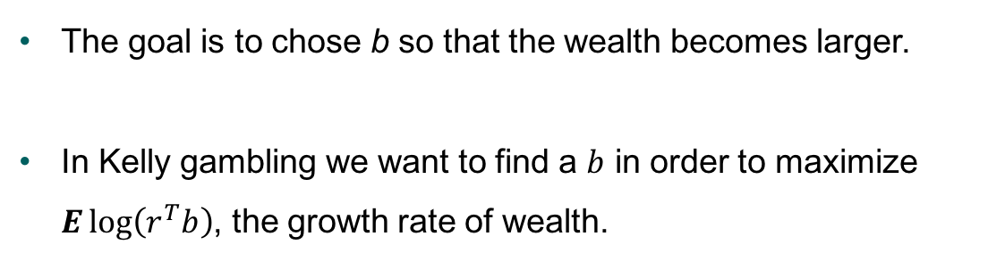
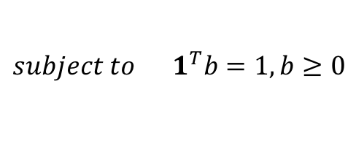
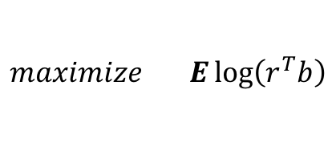
1. Kelly problem
5
Implementation in CVX
The goal is to chose b so that the wealth becomes larger.
In Kelly gambling we want to find a $b$ in order to maximize $E\log\left(r^{T}b\right)$, the growth rate of wealth.
1. Kelly problem
2. Risk-Constrained Kelly Problem
$$maximize E\log\left(r^{T}b\right)$$
3. Our implementation
$$subject to 1^{T}b=1, b≥0$$
The solution of $b$ optimal values is called Kelly Optimal bets.
4. Results

Slide 7
Part I - Implementation in CVX
1. Kelly Problem
2. Risk-Constrained Kelly Problem
3. Our implementation
4. Results

Slide 8
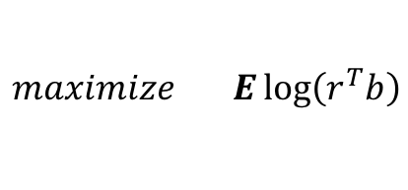
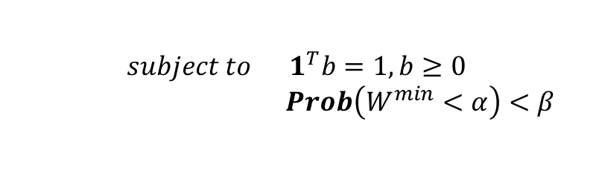
2. Risk-Constrained Kelly Problem
6
Implementation in CVX
In Risk-Contrained Kelly we add a drawdown risk contraint:
1. Kelly problem
$$maximize E\log\left(r^{T}b\right)$$
$$subject to 1^{T}b=1, b≥0$$
$Prob\left(W^{min}<α\right)<β$
2. Risk-Constrained Kelly Problem
The new contraint limits the probability of a drop in wealth to value ⍺ to be no more than β.
3. Our implementation
4. Results

Slide 9
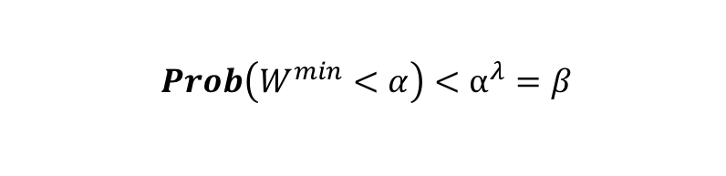
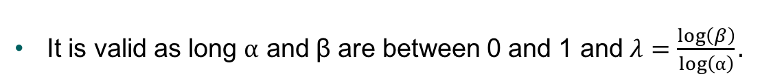
2. Risk-Constrained Kelly Problem
7
Implementation in CVX
A bound of the drawdown risk is developed to make the problem easly solvable in CVX.
1. Kelly problem
$$Prob\left(W^{min}<α\right)<⍺^{λ}=β$$
2. Risk-Constrained Kelly Problem
It is valid as long ⍺ and β are between 0 and 1 and $λ=\frac{\log\left(β\right)}{\log\left(⍺\right)}.$
3. Our implementation
4. Results

Slide 10
2. Risk-Constrained Kelly Problem
8
Implementation in CVX
The parameter λ is the risk aversion parameter.
A higher value means the problem only considers risk-free bets while a low value limits the ratio of variance to the mean growth.
1. Kelly problem
2. Risk-Constrained Kelly Problem
3. Our implementation
4. Results

Slide 11
Part I - Implementation in CVX
1. Kelly Problem
2. Risk-Constrained Kelly Problem
3. Our implementation
4. Results

Slide 12
3. Our implementation
9
Implementation in CVX
The Kelly gambling problem is a convex optimization problem since the objective is concave and the contraints are convex.
We inserted the function to maximize and the contraints directly on CVX.
1. Kelly problem
2. Risk-Constrained Kelly Problem
3. Our implementation
4. Results

Slide 13
3. Our implementation
10
Implementation in CVX
We created wealth trajectories for both Kelly and the Risk-Constrained Kelly and also a random betting situation.
In our testing environment we created 1000 trajectories and displayed 10 of them next.
The risk aversion parameter used took into account that ⍺ = 0.9 and β = 0.05 resulting in λ of around 28.
1. Kelly problem
2. Risk-Constrained Kelly Problem
3. Our implementation
4. Results

Slide 14
Part I - Implementation in CVX
1. Kelly Problem
2. Risk-Constrained Kelly Problem
3. Our implementation
4. Results

Slide 15
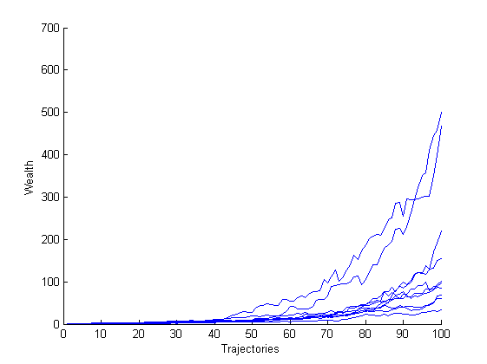
4. Results
11
Implementation in CVX
Wealth trajectories for the Kelly optimal bet.
1. Kelly problem
2. Risk-Constrained Kelly Problem
3. Our implementation
4. Results

Slide 16
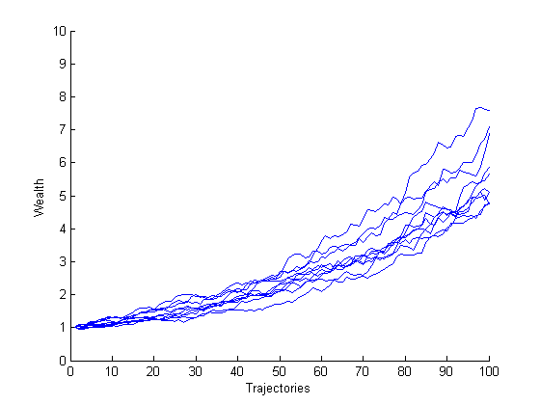
4. Results
12
Implementation in CVX
Wealth trajectories for the Risk-Constrained Kelly optimal bet.
1. Kelly problem
2. Risk-Constrained Kelly Problem
3. Our implementation
4. Results

Slide 17
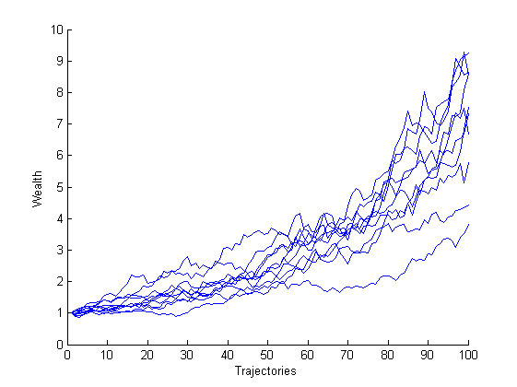
4. Results
13
Implementation in CVX
Wealth trajectories for a random bet.
1. Kelly problem
2. Risk-Constrained Kelly Problem
3. Our implementation
4. Results

Slide 18
4. Results
14
Implementation in CVX
We can conclude that:
The Risk-Contrained Kelly with the selected parameters represent a conservative approach for betting;
Solving an optimization problem translates in a better final result given the contraints.
1. Kelly problem
2. Risk-Constrained Kelly Problem
3. Our implementation
4. Results

Slide 19
Part II – The Optimal Strategy
1. Problem Formulation
2. Our implementation
3. Results

Slide 20


1. Problem Formulation
15
Only one bet;
We cannot evaluate the performance of the optimal strategy;
No
CVX ?
The Optimal Strategy
1. Problem Formulation
2. Our implementation
3. Results
Still using Kelly gambling;

Slide 21





1. Problem Formulation
16
We have L hypothesis for vector
Consider no drawdown λ = 0
The Optimal Strategy
$$π_{i}$$
$$π_{1}$$
$$π_{2}$$
1. Problem Formulation
1
2. Our implementation
$$π_{L}$$
3. Results

Slide 22
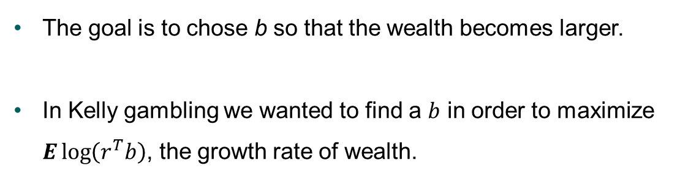

1. Problem Formulation
17
The goal is to chose b so that the wealth becomes larger.
In Kelly gambling we wanted to find a $b$ in order to maximize $E\log\left(r^{T}b\right)$, the growth rate of wealth.
The Optimal Strategy
1. Problem Formulation
2. Our implementation
$$maximize π_{i}\log\left(r^{T}b\right)$$
$$subject to 1^{T}b=1, b≥0$$
3. Results
The solution of $b$ optimal values cannot depend on $π_{i}$.

Slide 23





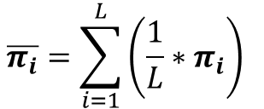
1. Problem Formulation
18
We came up with 2 solutions
The Optimal Strategy
1. Problem Formulation
Since we bet just one…
2. Our implementation
$$…r ϵ R_{+}$$
The First one:
3. Results
$$maximize \overline{π_{i}}∗\log\left(r^{T}b\right)$$
$$\overline{π_{i}}=\sum_{i=1}^{L}{\left(\frac{1}{L}∗π_{i}\right) }$$
$$b$$
$$subject to 1^{T}b=1, b≥0$$
$$1^{T}π_{i}=1,π_{i}≥0$$

Slide 24
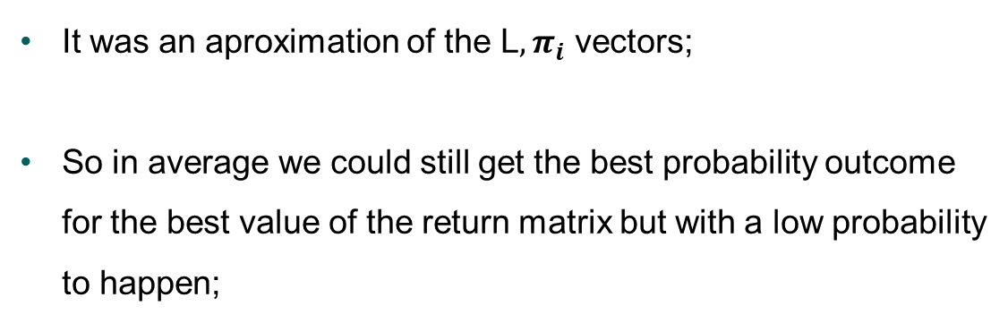
1. Problem Formulation
19
The Optimal Strategy
It was an aproximation of the L${, π}_{i}$ vectors;
So in average we could still get the best probability outcome for the best value of the return matrix but with a low probability to happen;
1. Problem Formulation
2. Our implementation
3. Results

Slide 25


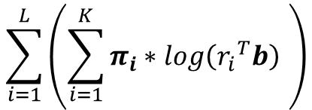





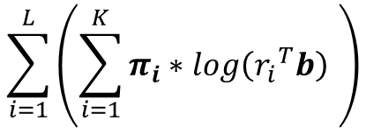


1. Problem Formulation
20
The Second one:
$$\sum_{i=1}^{L}{\left(\sum_{i=1}^{K}{π_{i}∗log\left({r_{i}}^{T}b\right) }\right)}$$
The Optimal Strategy
$$\sum_{i=1}^{L}{\left(\sum_{i=1}^{K}{π_{i}∗log\left({r_{i}}^{T}b\right) }\right)}$$
$$maximize$$
$$b$$
1. Problem Formulation
$$subject to 1^{T}b=1, b≥0$$
$$1^{T}π_{i}=1,π_{i}≥0$$
2. Our implementation
$$…$$
3. Results
$$π_{L}$$
$$π_{1}$$
$$π_{2}$$

Slide 26
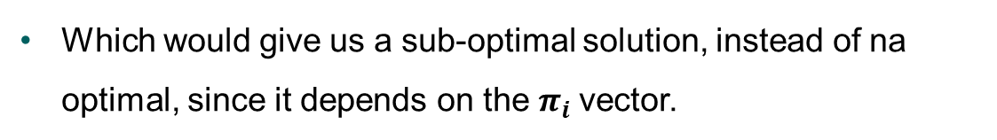

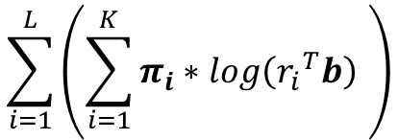



1. Problem Formulation
21
Wrapping up our final formulation of the problem is:
The Optimal Strategy
$$\sum_{i=1}^{L}{\left(\sum_{i=1}^{K}{π_{i}∗log\left({r_{i}}^{T}b\right) }\right)}$$
$$maximize$$
1. Problem Formulation
$$b$$
2. Our implementation
$$subject to 1^{T}b=1, b≥0$$
$$1^{T}π_{i}=1,π_{i}≥0$$
3. Results
Which would give us a sub-optimal solution, instead of na optimal, since it depends on the $π_{i}$vector.

Slide 27
Part II – The Optimal Strategy
1. Problem Formulation
2. Our implementation
3. Results

Slide 28
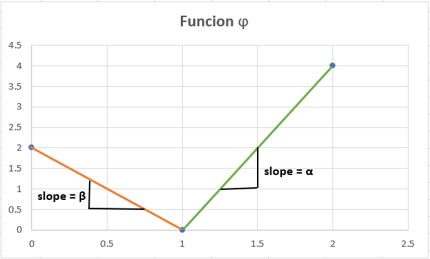
2. Our Implementation
22
$$maximize Elog\left(r^{T}b\right)−\sum_{K=1}^{N−1}{∅_{K}(b_{K})}$$
The Optimal Strategy
1. Problem Formulation
$$subject to \sum{b}=1 , b≥0$$
2. Our implementation
How to compute Ø ???
3. Results

Slide 29
2. Our Implementation
23
The Optimal Strategy
$$Ø_{k left}= β∗x+b_{left}$$
$$b_{left }?b_{right}?$$
1. Problem Formulation
$$Ø_{k right}= β∗x+b_{right}$$
2. Our implementation
$$Ø_{k}=0$$
$$b_{left}=−β∗b_{ref} ; b_{right}=−α∗b_{ref}$$
3. Results

Slide 30
2. Our Implementation
24
The Optimal Strategy
$$φ_{k}=\frac{φ_{k left}+abs(φ_{k left})}{2}+\frac{φ_{k right}+abs(φ_{k right})}{2}$$
1. Problem Formulation
2. Our implementation
3. Results

Slide 31
Part II – The Optimal Strategy
1. Problem Formulation
2. Our implementation
3. Results

Slide 32
3. Results
25
beta | alpha | b_ref | b | f
-0,009086676 | 0,002219772 | 0,031523 | 5,58E-10 | 1.436064870445068e-05
-0,012612436 | 0,003127419 | 0,037992 | 0,039044 | 6.324034386243374e-11
-0,002627492 | 0,001638187 | 1,03E-11 | 3,14E-10 | 6.223819422760464e-05
-0,006249097 | 0,009005711 | 0,067072 | 0,102199 | 1.817214165423828e-04
-0,004256923 | 0,008158623 | 0,043498 | 1,14E-09 | 2.343735076042130e-05
-0,005698702 | 0,007799906 | 5,36E-11 | 3,07E-10 | 2.963348504180051e-04
-0,007459977 | 0,001753795 | 0,024038 | 0,114074 | 2.447182242156811e-05
-0,006763373 | 0,001359863 | 0,024854 | 8,61E-10 | 1.786662147664591e-05
-0,016471701 | 0,004391443 | 0,035969 | 8,07E-10 | 8.883297361319504e-06
-0,008377609 | 0,000356627 | 7,34E-12 | 3,09E-10 | 1.354902526360758e-05
-0,012423276 | 0,003644971 | 0,031356 | 7,27E-10 | 2.418683101891456e-05
-0,019288206 | 0,001941571 | 0,072681 | 0,336566 | 6.690839346358344e-04
-0,0159011 | 0,008429447 | 5,83E-12 | 2,66E-10 | 3.202524502259855e-04
-0,002488317 | 0,003819346 | 1,47E-11 | 2,77E-10 | 1.451050013226316e-04
-0,000513339 | 0,002265991 | 5,23E-12 | 2,33E-10 | 8.608977823962039e-05
-0,013267218 | 0,009010134 | 3,92E-11 | 8,52E-10 | 3.423139654905364e-04
-0,01533912 | 0,005798302 | 0,055178 | 0,024953 | 2.636181542563345e-04
-0,015928254 | 0,008838222 | 0,035647 | 0,083646 | 2.072753161244550e-05
-0,008436608 | 0,007668449 | 0,067195 | 0,299518 | 2.463742926625958e-04
0 | 0 | 0,472997 | 4,51E-10 | 0
The Optimal Strategy
1. Problem Formulation
2. Our implementation
3. Results

Slide 33
Thank you for your attention

Slide 34
Risk-Constrained Kelly Gambling
Optimization and Algorithms Project Presentation
Diogo Silva
Luís Alves
Rúben Tadeia
Pedro Falcão
December 12, 2017
Supervisors
Prof. António Simões

