Slide 1
Risk-Constrained Kelly Gambling
Optimization and Algorithms Project Presentation
Diogo Silva
Luís Alves
Rúben Tadeia
Pedro Falcão
December 12, 2017
Supervisors
Prof. António Simões

Slide 2
Outline
2
Part I – Implementation in CVX
Kelly Problem
Risk-Constrained Kelly Problem
Our implementation
Results
Part II – The Optimal Strategy
Problem Formulation
Our implementation
Results

Slide 3
Part I - Implementation in CVX
1. Kelly Problem
2. Risk-Constrained Kelly Problem
3. Our implementation
4. Results

Slide 4
1. Kelly problem
3
Implementation in CVX
We consider the classic Kelly gambling problem with general distributions of outcomes.
John Kelly proposed a systematic way to allocate a total wealth across a number of bets so as to maximize the long term growth rate when the gamble is repeated [1].
1. Kelly problem
2. Risk-Constrained Kelly Problem
3. Our implementation
4. Results

Slide 5

1. Kelly problem
4
Implementation in CVX
With this strategy – Kelly optimal bets – there is a risk of the wealth dropping substantially from its original value before increasing.
The wealth growth is given by
with t equal to 1,2,… with I.I.D. returns.
1. Kelly problem
2. Risk-Constrained Kelly Problem
3. Our implementation
$$w_{t}=\left(r_{1}^{T}b\right)…(r_{t−1}b)$$
4. Results

Slide 6
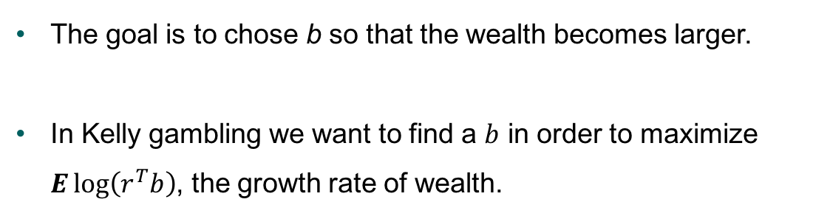
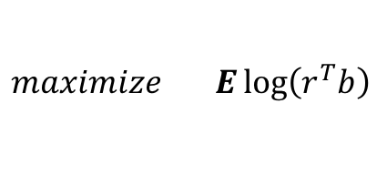
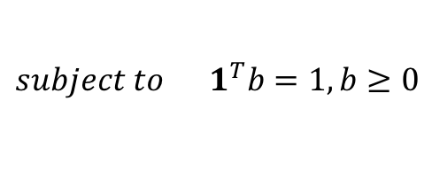
1. Kelly problem
5
Implementation in CVX
The goal is to chose b so that the wealth becomes larger.
In Kelly gambling we want to find a $b$ in order to maximize $E\log\left(r^{T}b\right)$, the growth rate of wealth.
1. Kelly problem
2. Risk-Constrained Kelly Problem
$$maximize E\log\left(r^{T}b\right)$$
3. Our implementation
$$subject to 1^{T}b=1, b≥0$$
The solution of $b$ optimal values is called Kelly Optimal bets.
4. Results

Slide 7
Part I - Implementation in CVX
1. Kelly Problem
2. Risk-Constrained Kelly Problem
3. Our implementation
4. Results

Slide 8
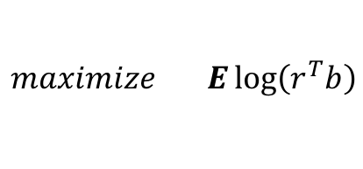
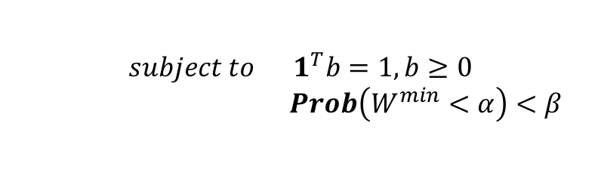
2. Risk-Constrained Kelly Problem
6
Implementation in CVX
In Risk-Contrained Kelly we add a drawdown risk contraint:
1. Kelly problem
$$maximize E\log\left(r^{T}b\right)$$
$$subject to 1^{T}b=1, b≥0$$
$Prob\left(W^{min}<α\right)<β$
2. Risk-Constrained Kelly Problem
The new contraint limits the probability of a drop in wealth to value ⍺ to be no more than β.
3. Our implementation
4. Results

Slide 9
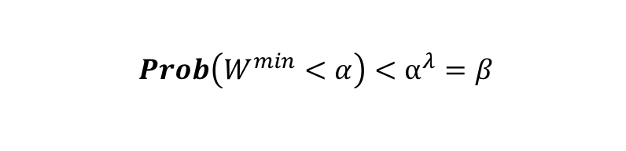
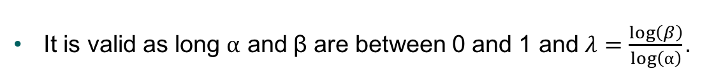
2. Risk-Constrained Kelly Problem
7
Implementation in CVX
A bound of the drawdown risk is developed to make the problem easly solvable in CVX.
1. Kelly problem
$$Prob\left(W^{min}<α\right)<⍺^{λ}=β$$
2. Risk-Constrained Kelly Problem
It is valid as long ⍺ and β are between 0 and 1 and $λ=\frac{\log\left(β\right)}{\log\left(⍺\right)}.$
3. Our implementation
4. Results

Slide 10
2. Risk-Constrained Kelly Problem
8
Implementation in CVX
The parameter λ is the risk aversion parameter.
A higher value means the problem only considers risk-free bets while a low value limits the ratio of variance to the mean growth.
1. Kelly problem
2. Risk-Constrained Kelly Problem
3. Our implementation
4. Results

Slide 11
Part I - Implementation in CVX
1. Kelly Problem
2. Risk-Constrained Kelly Problem
3. Our implementation
4. Results

Slide 12
3. Our implementation
9
Implementation in CVX
The Kelly gambling problem is a convex optimization problem since the objective is concave and the contraints are convex.
We inserted the function to maximize and the contraints directly on CVX.
1. Kelly problem
2. Risk-Constrained Kelly Problem
3. Our implementation
4. Results

Slide 13

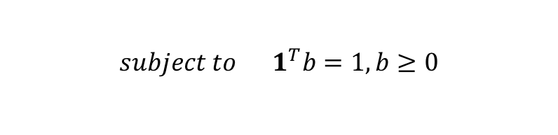

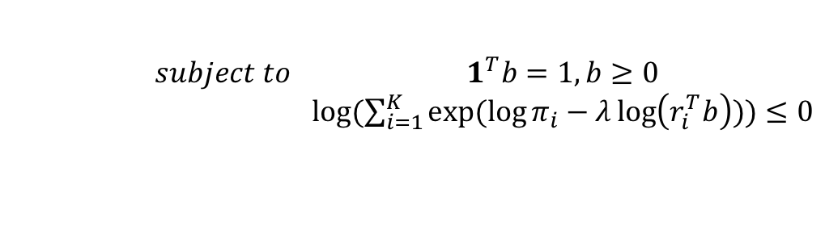
3. Our implementation
9
Implementation in CVX
For the Kelly problem we used
$$maximize \sum_{i=1}^{K}{π_{i}}\log\left(r^{T}b\right)$$
1. Kelly problem
$$subject to 1^{T}b=1, b≥0$$
2. Risk-Constrained Kelly Problem
And for the Risk-constrained Kelly problem we used
3. Our implementation
$$maximize \sum_{i=1}^{K}{π_{i}}\log\left(r^{T}b\right)$$
$$subject to 1^{T}b=1, b≥0$$
$log⁡(\sum_{i=1}^{K}{exp⁡(\log{π_{i}}−λ\log\left(r_{i}^{T}b\right)))}≤0$
4. Results

Slide 14
Part I - Implementation in CVX
1. Kelly Problem
2. Risk-Constrained Kelly Problem
3. Our implementation
4. Results

Slide 15
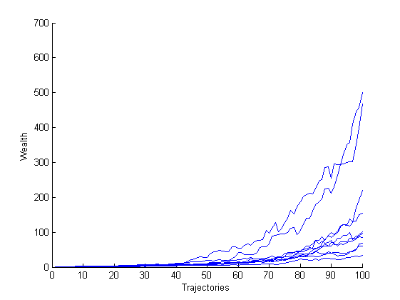
4. Results
11
Implementation in CVX
Wealth trajectories for the Kelly optimal bet.
1. Kelly problem
2. Risk-Constrained Kelly Problem
3. Our implementation
4. Results

Slide 16
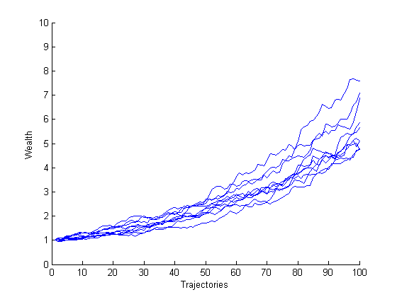
4. Results
12
Implementation in CVX
Wealth trajectories for the Risk-Constrained Kelly optimal bet.
1. Kelly problem
2. Risk-Constrained Kelly Problem
3. Our implementation
4. Results

Slide 17
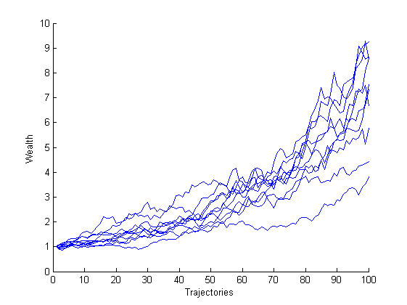
4. Results
13
Implementation in CVX
Wealth trajectories for a random bet.
1. Kelly problem
2. Risk-Constrained Kelly Problem
3. Our implementation
4. Results

Slide 18
4. Results
14
Implementation in CVX
We can conclude that:
The Risk-Contrained Kelly with the selected parameters represent a conservative approach for betting;
Solving an optimization problem translates in a better final result given the contraints.
1. Kelly problem
2. Risk-Constrained Kelly Problem
3. Our implementation
4. Results

Slide 19
Part II – The Optimal Strategy
1. Problem Formulation
2. Our implementation
3. Results

Slide 20


1. Problem Formulation
15
Only one bet;
We cannot evaluate the performance of the optimal strategy;
No
CVX ?
The Optimal Strategy
1. Problem Formulation
2. Our implementation
3. Results
Still using Kelly gambling;

Slide 21





1. Problem Formulation
16
We have L hypothesis for vector
Consider no drawdown λ = 0
The Optimal Strategy
$$π_{i}$$
$$π_{1}$$
$$π_{2}$$
1. Problem Formulation
1
2. Our implementation
$$π_{L}$$
3. Results

Slide 22
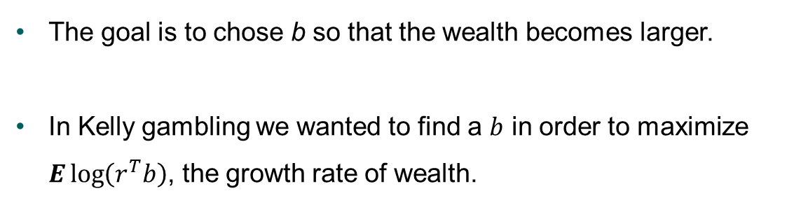

1. Problem Formulation
17
The goal is to chose b so that the wealth becomes larger.
In Kelly gambling we wanted to find a $b$ in order to maximize $E\log\left(r^{T}b\right)$, the growth rate of wealth.
The Optimal Strategy
1. Problem Formulation
2. Our implementation
$$maximize π_{i}\log\left(r^{T}b\right)$$
$$subject to 1^{T}b=1, b≥0$$
3. Results
The solution of $b$ optimal values cannot depend on $π_{i}$.

Slide 23

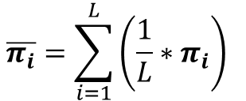




1. Problem Formulation
18
We came up with 2 solutions
The Optimal Strategy
1. Problem Formulation
Since we bet just one…
2. Our implementation
$$…r ϵ R_{+}$$
The First one:
3. Results
$$maximize \overline{π_{i}}∗\log\left(r^{T}b\right)$$
$$\overline{π_{i}}=\sum_{i=1}^{L}{\left(\frac{1}{L}∗π_{i}\right) }$$
$$b$$
$$subject to 1^{T}b=1, b≥0$$
$$1^{T}π_{i}=1,π_{i}≥0$$

Slide 24
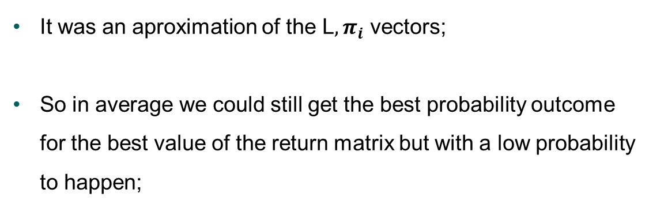
1. Problem Formulation
19
The Optimal Strategy
It was an aproximation of the L${, π}_{i}$ vectors;
So in average we could still get the best probability outcome for the best value of the return matrix but with a low probability to happen;
1. Problem Formulation
2. Our implementation
3. Results

Slide 25





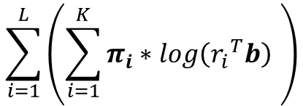
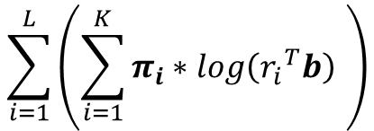




1. Problem Formulation
20
The Second one:
$$\sum_{i=1}^{L}{\left(\sum_{i=1}^{K}{π_{i}∗log\left({r_{i}}^{T}b\right) }\right)}$$
The Optimal Strategy
$$\sum_{i=1}^{L}{\left(\sum_{i=1}^{K}{π_{i}∗log\left({r_{i}}^{T}b\right) }\right)}$$
$$maximize$$
$$b$$
1. Problem Formulation
$$subject to 1^{T}b=1, b≥0$$
$$1^{T}π_{i}=1,π_{i}≥0$$
2. Our implementation
$$…$$
3. Results
$$π_{L}$$
$$π_{1}$$
$$π_{2}$$

Slide 26




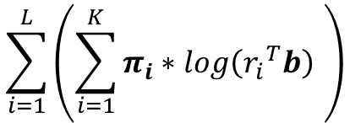
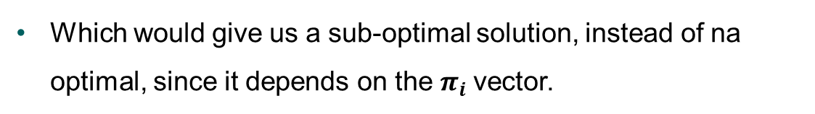
1. Problem Formulation
21
Wrapping up our final formulation of the problem is:
The Optimal Strategy
$$\sum_{i=1}^{L}{\left(\sum_{i=1}^{K}{π_{i}∗log\left({r_{i}}^{T}b\right) }\right)}$$
$$maximize$$
1. Problem Formulation
$$b$$
2. Our implementation
$$subject to 1^{T}b=1, b≥0$$
$$1^{T}π_{i}=1,π_{i}≥0$$
3. Results
Which would give us a sub-optimal solution, instead of na optimal, since it depends on the $π_{i}$vector.

Slide 27
Part II – The Optimal Strategy
1. Problem Formulation
2. Our implementation
3. Results

Slide 28
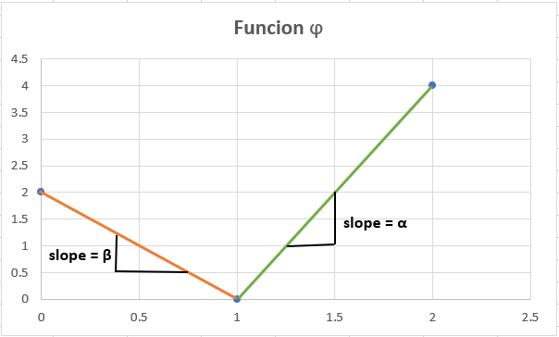
2. Our Implementation
22
$$maximize Elog\left(r^{T}b\right)−\sum_{K=1}^{N−1}{∅_{K}(b_{K})}$$
The Optimal Strategy
1. Problem Formulation
$$subject to \sum{b}=1 , b≥0$$
2. Our implementation
How to compute Ø ???
3. Results

Slide 29
2. Our Implementation
23
The Optimal Strategy
$$Ø_{k left}= β∗x+b_{left}$$
$$b_{left }?b_{right}?$$
1. Problem Formulation
$$Ø_{k right}= β∗x+b_{right}$$
2. Our implementation
$$Ø_{k}=0$$
$$b_{left}=−β∗b_{ref} ; b_{right}=−α∗b_{ref}$$
3. Results

Slide 30
2. Our Implementation
24
The Optimal Strategy
$$φ_{k}=\frac{φ_{k left}+abs(φ_{k left})}{2}+\frac{φ_{k right}+abs(φ_{k right})}{2}$$
1. Problem Formulation
2. Our implementation
3. Results

Slide 31
Part II – The Optimal Strategy
1. Problem Formulation
2. Our implementation
3. Results

Slide 32
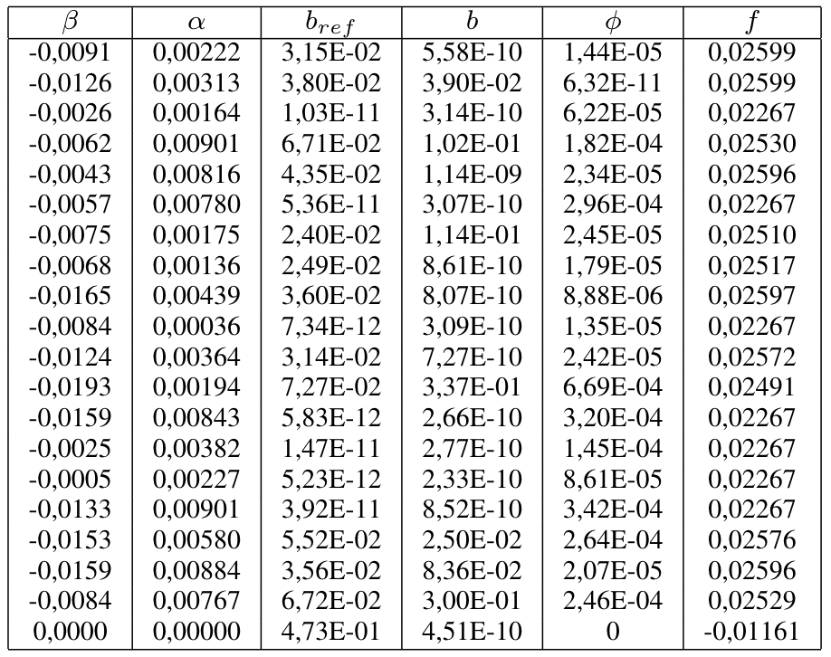
3. Results
25
The Optimal Strategy
1. Problem Formulation
2. Our implementation
3. Results

Slide 33
Thank you for your attention

Slide 34
Risk-Constrained Kelly Gambling
Optimization and Algorithms Project Presentation
Diogo Silva
Luís Alves
Rúben Tadeia
Pedro Falcão
December 12, 2017
Supervisors
Prof. António Simões

