Slide 1
Forecasting Suspicious Activity Reports for 2022

Slide 2
Project Goal
Forecast using an ARIMA model
The goal of this project is to forecast Suspicious Activity Reports for each month of Year 2022. To accomplish this goal, we will build an ARIMA model in python. An ARIMA model uses the following three components to create a forecast:
“AR” –auto regression: create an equation based on past data points
“I” –integration or differencing: accounting for overall “trend” in the data
“MA” –moving average: create an equation of error or noise based on past data points

Slide 3
Data Source
The data for this project was taken directly from the Financial Crimes Enforcement Network (FinCen). The suspicious activity report data was collected for years 2014 to 2021 and aggregated at the state/county level.
Data Source:
https://www.fincen.gov/reports/sar-stats

Slide 4
Background
What are Suspicous Activity Reports?
Suspicious Activity Reports (SARs) are reports that every Financial Institution, Money Service Business (MSB), Casino and similar entities must file with the government for every potential incident of money laundering and/or violation of the Bank Secrecy Act (BSA) and/or Patriot Act. These reports are filed with the Financial Crimes Enforcement Network (FinCen) which is under the supervision of the Department of the Treasury. SARs help aid law enforcement and government agencies in the prosecution of illicit activity.

Slide 5
Suspicious Activity Reports
The Importance of Suspicious Activity Reports
The filing of Suspicious Activity Reports by a financial institution’s Anti-Money Laundering (AML) program are of upmost importance as financial institutions are heavily regulated and audited by several government agencies.
A non-compliant AML program can lead to large fines and penalties as well as a loss in reputational risk for the financial institution in question.

Slide 6
Predicting and Forecasting
The Predicting and Forecasting of Suspicious Activity Reports.
Some of the ways Financial Institutions have incorporated technology into there AML programs is in predicting what segments of there customer populations are likely to violate the BSA Act; as well as forecasting the number of SARs they will likely file within a given time frame. This is to ensure that resources are allocated correctly in areas where investigations may be needed the most.

Slide 7
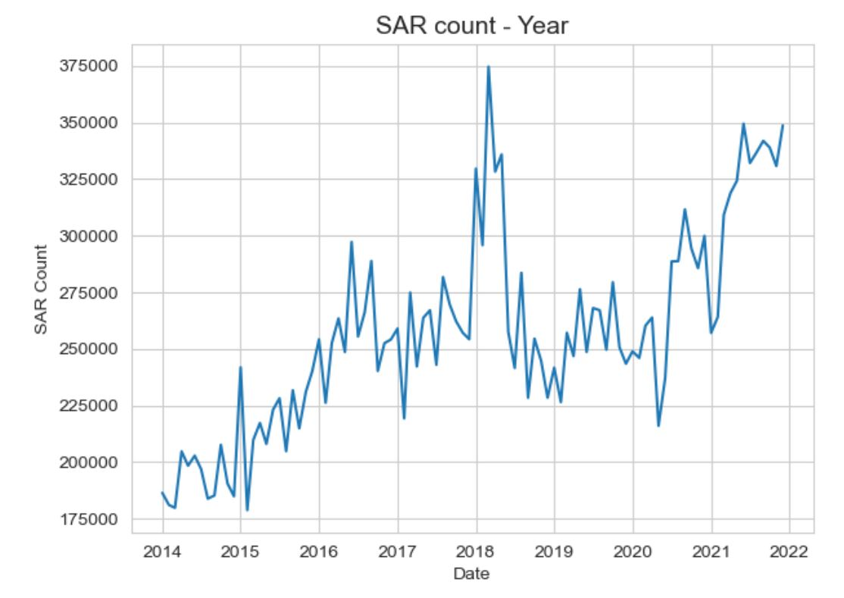
SAR Count by Year
The spike in activity for year 2018 was likely related to the price of bitcoin and the increase in business activity for cryptocurrency exchanges and related fintech businesses.

Slide 8
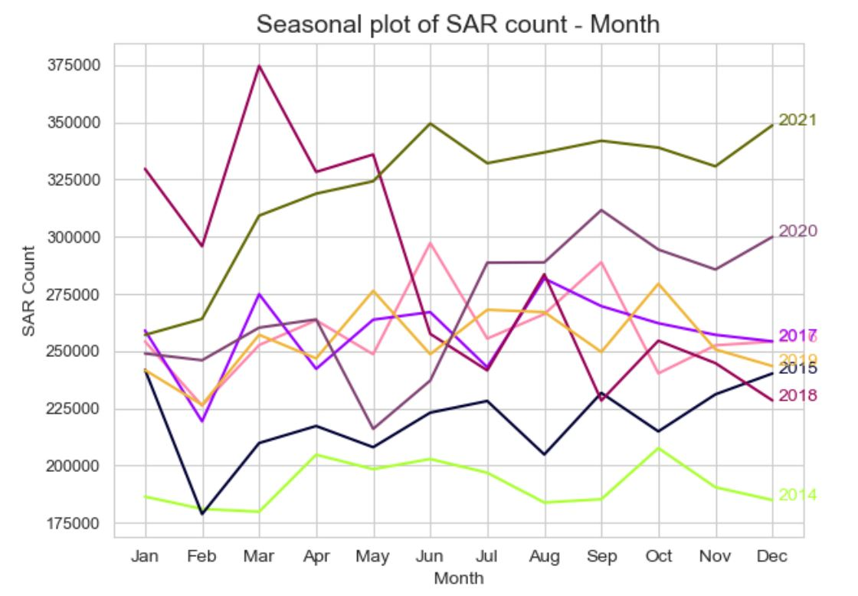
SAR Count by Month (Seasonal)

Slide 9
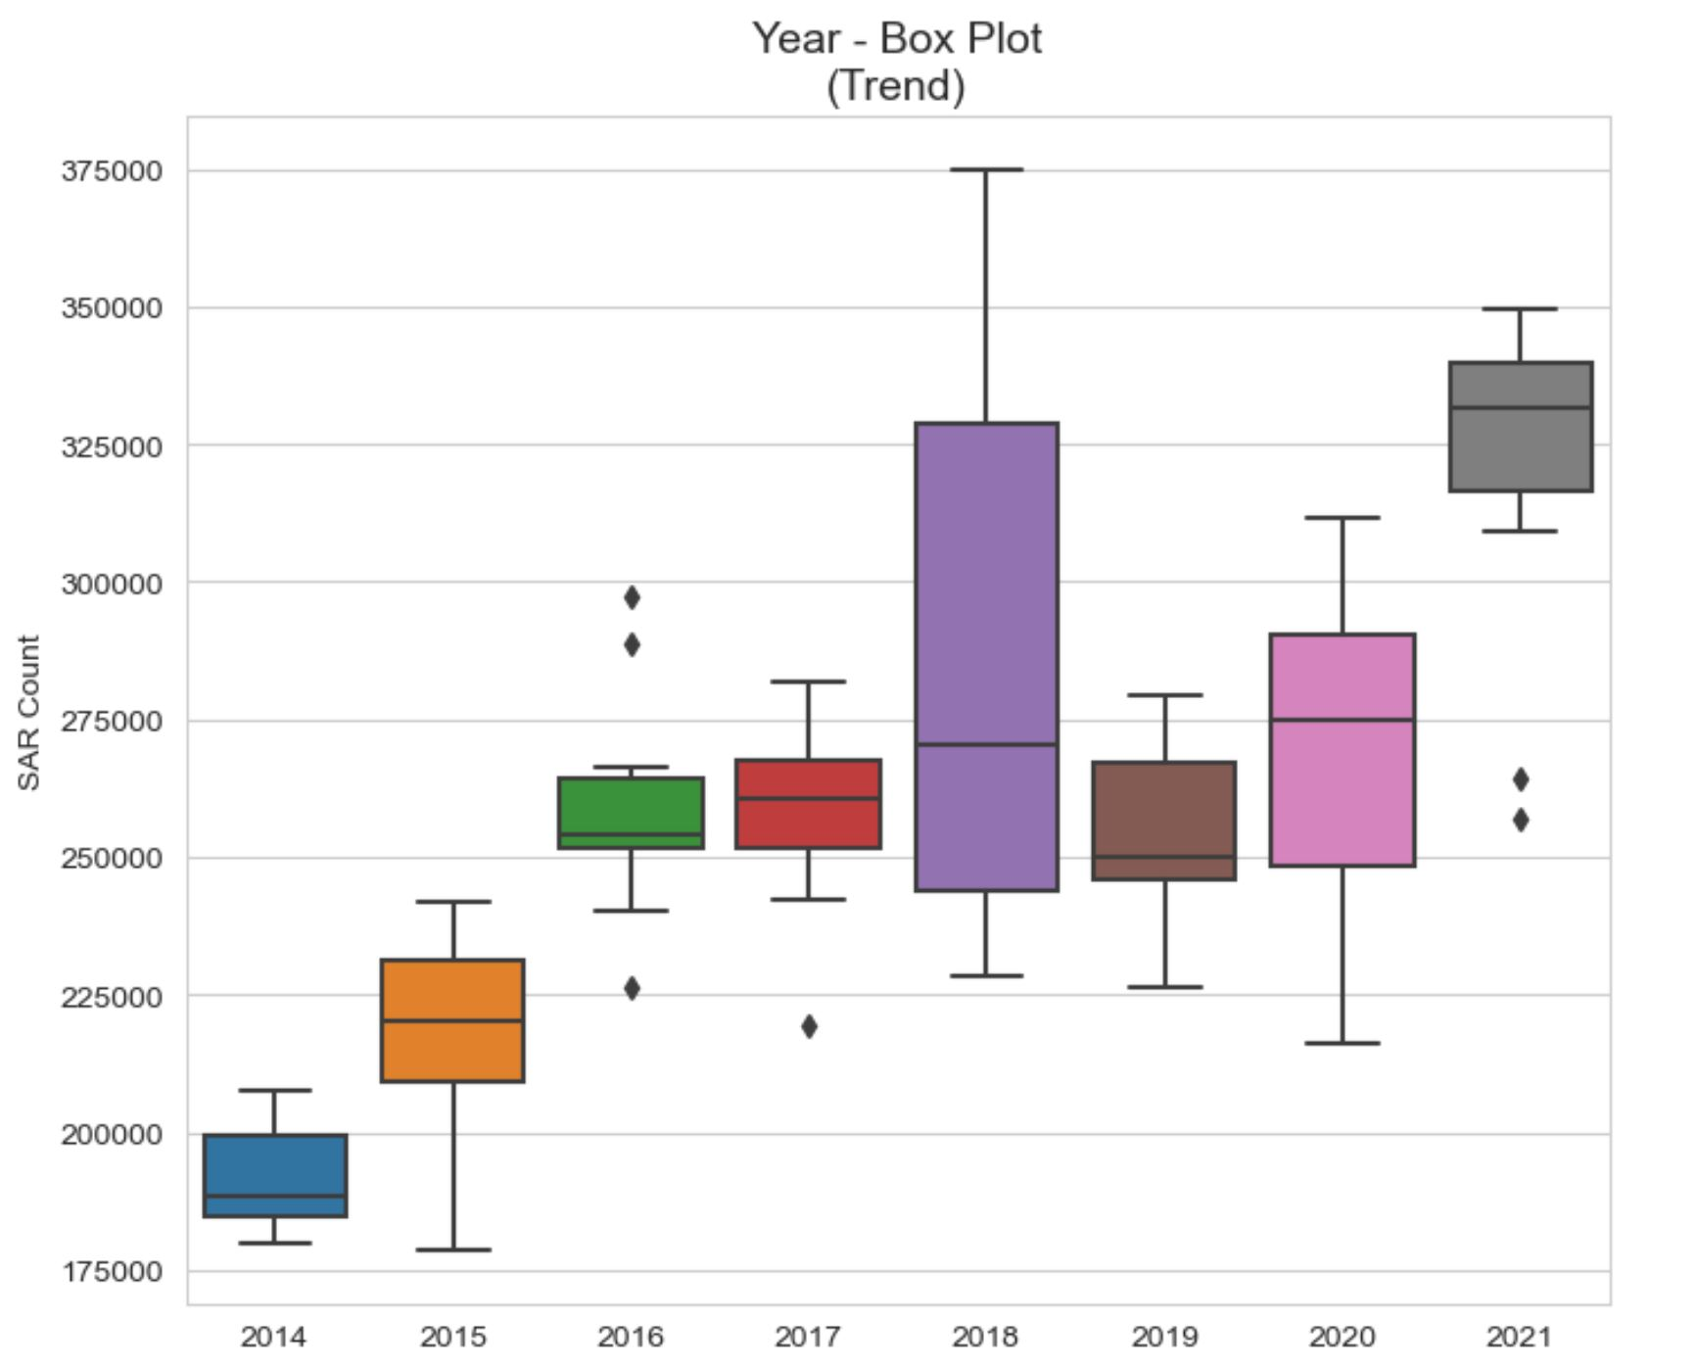
SAR Count by Year (Trend)

Slide 10
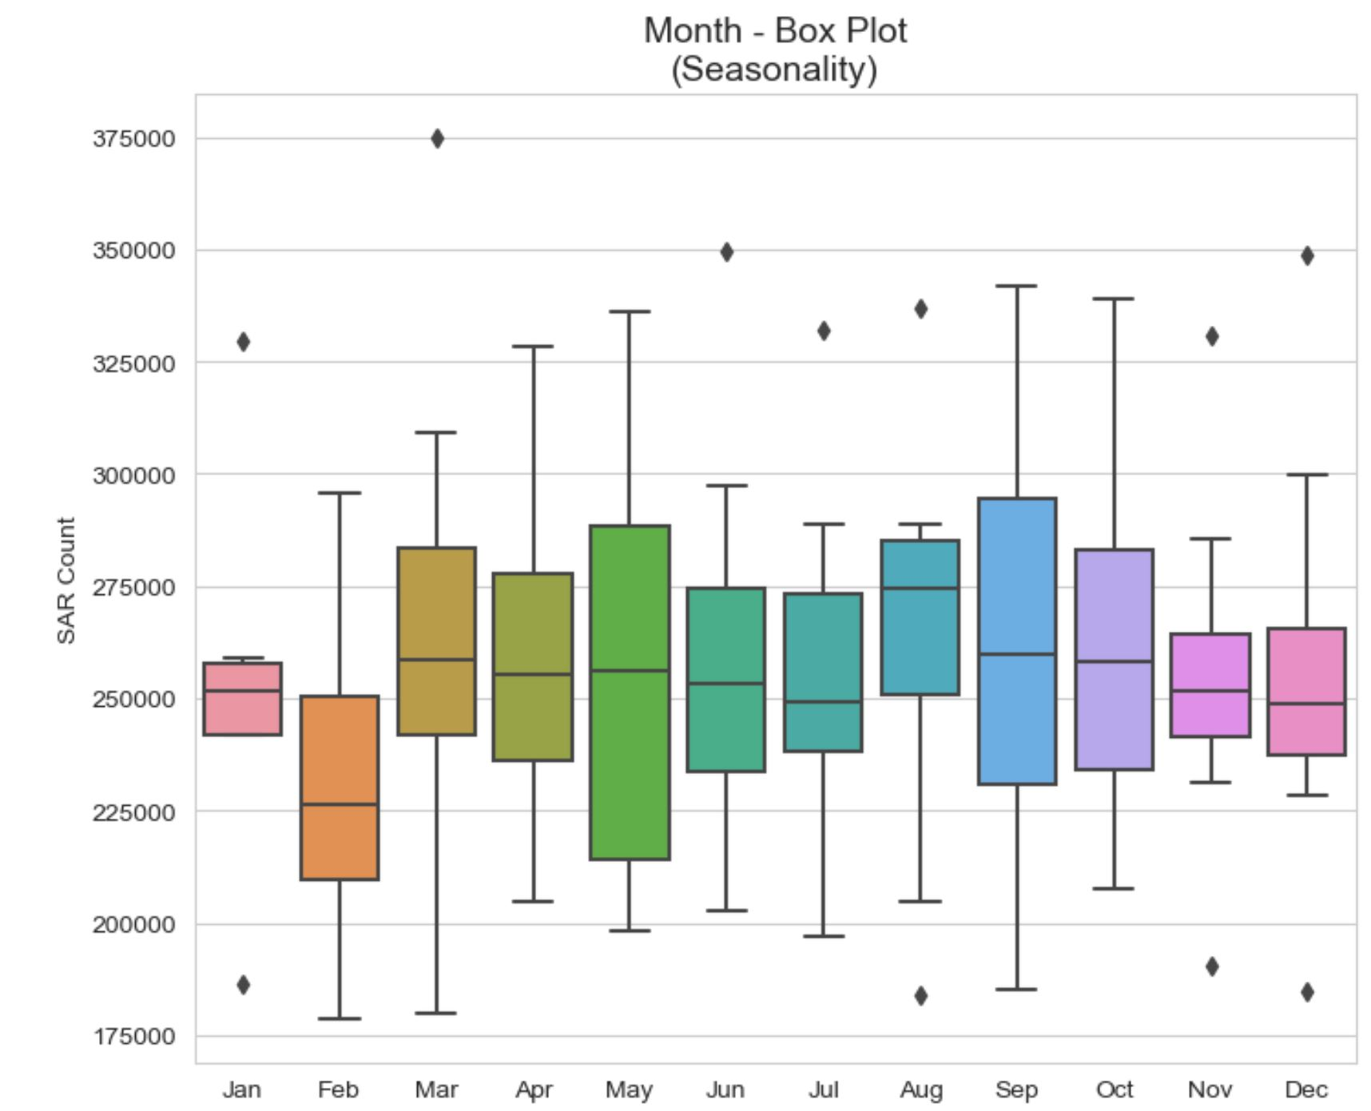
SAR Count by Month (Seasonality)

Slide 11
Additive Decomposition
The time series object is broken down into three components:
Trend
Seasonality
Residuals
Trend is the long-term movement of a time series.
Seasonality is the presence of variations that occur at a specific regular intervals less than a year i.e., weekly, monthly, quarterly.
Residuals are the remainder component after removing the Trend and Seasonality from the time series object.
The following two slides will display the time series object (SAR Count) and the three components within the times series object (Trend, Seasonality and Residuals).

Slide 12
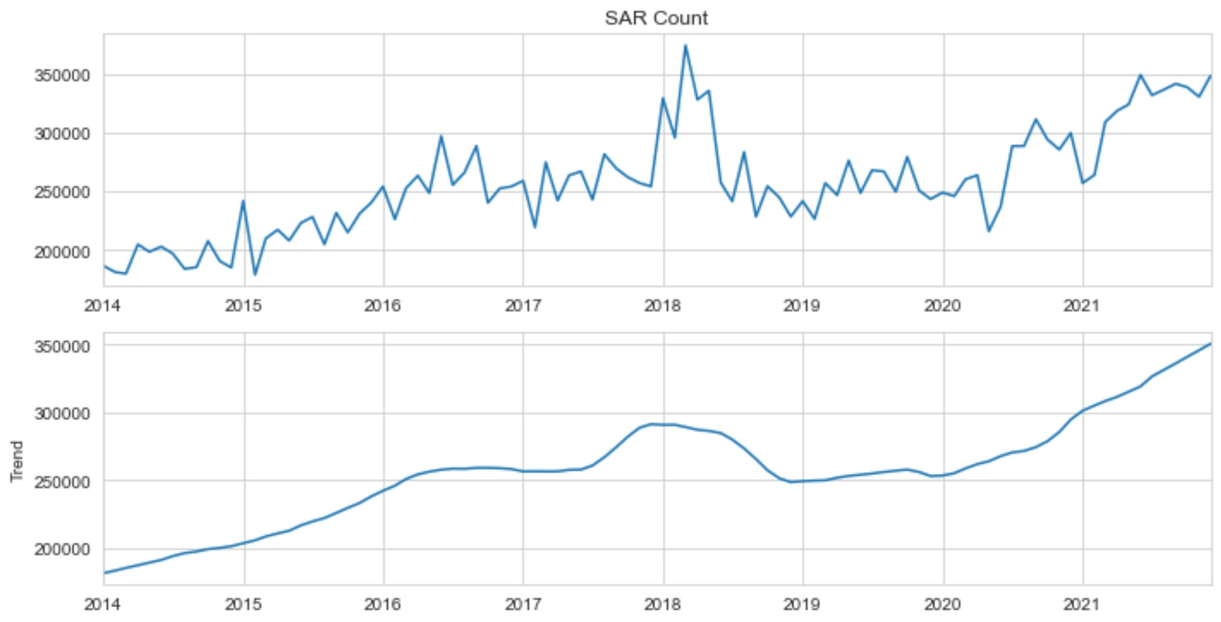
The Additive Decomposition Part 1

Slide 13
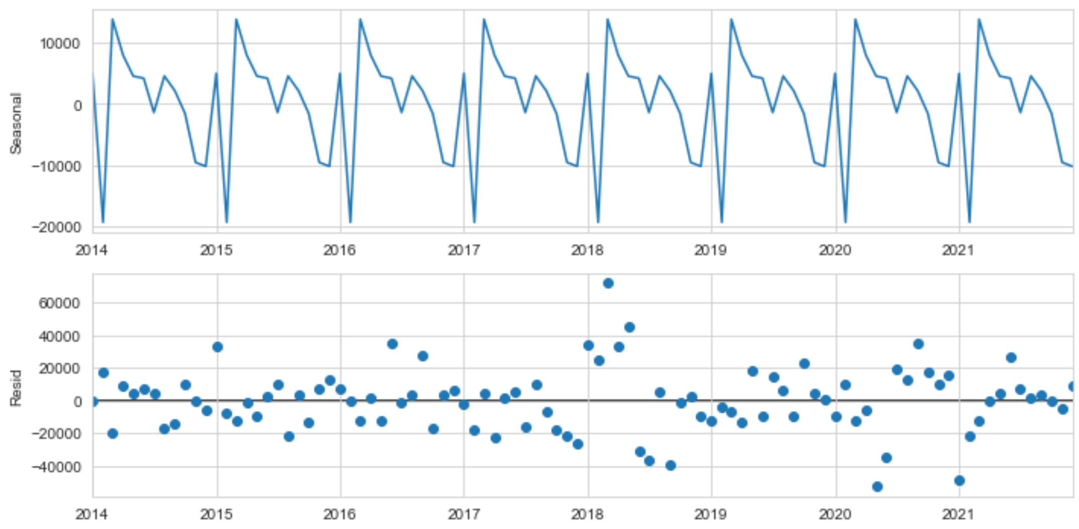
The Additive Decomposition Part 2

Slide 14
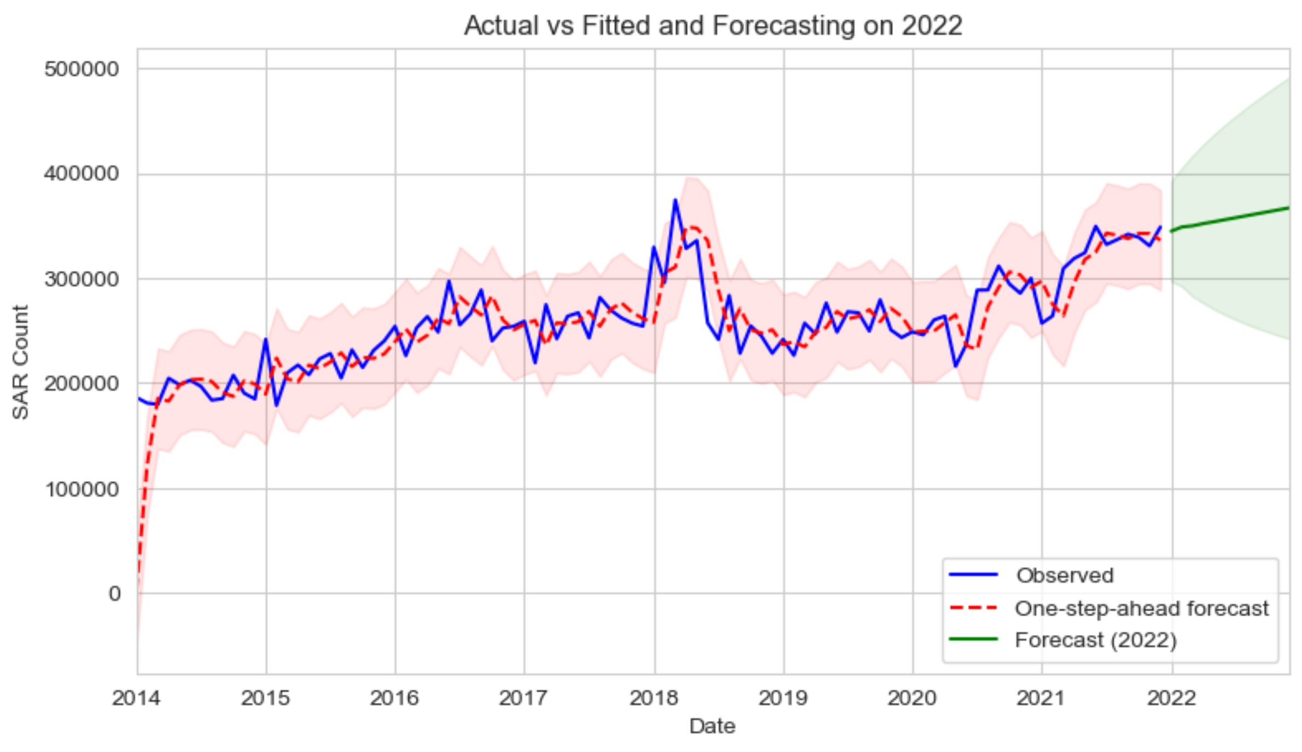
ARIMA Model –Forecast for Year 2022

Slide 15
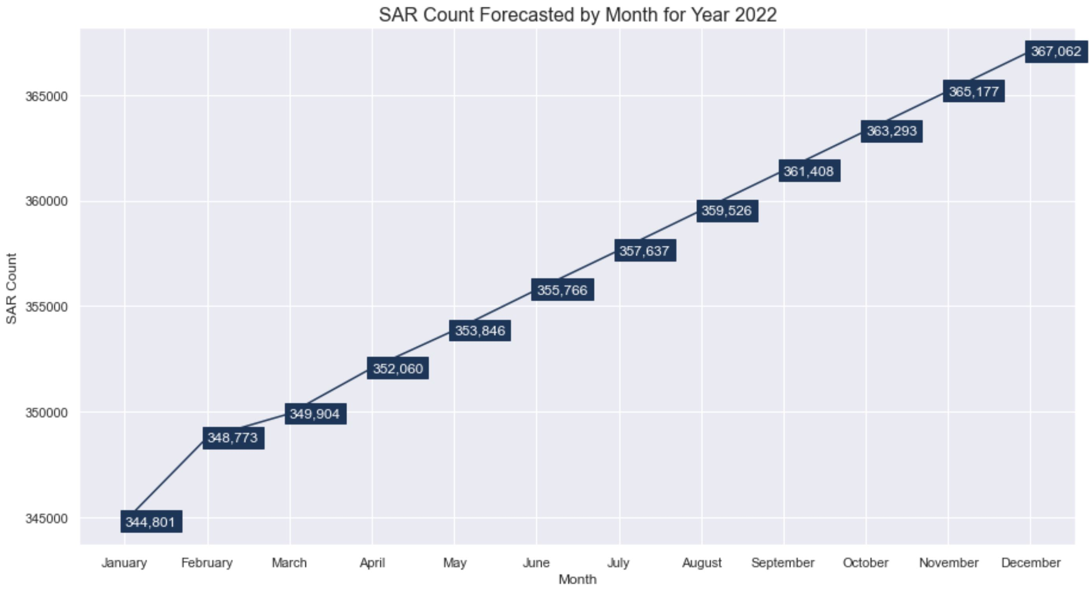
2022 Forecasted SAR Count by Month

