Slide 1
Placing a finger on wifi fingerprinting.
Predicting Wi-Fi Location through Wireless Access Points.

Slide 2
Background
Unlike outdoor positioning, which uses GPS satellites, finding the indoor geolocation with a cell phone is a challenge due to poor or no access to satellite signals. An active area of research to address this problem revolves around the use of signals from Wireless Access Points (WAPs) in a building.
The approach covered in this project known as “Wi-Fi fingerprinting” uses a training set of exact positions in a building and the corresponding signal strength from all WAPs in the vicinity. In this way, a “Wi-fi fingerprint” of WAP signal strength is produced for each position in the building. One challenge to this approach is that the received signal strength can vary based on the phone brand and model, and the position of the phone when in usage. This project will try to predict the Wi-Fi location of individuals via cell phones through Wireless Access Points.

Slide 3
Business Objectives
Investigate the feasibility of using "Wi-Fi fingerprinting" to determine a person's location in indoor spaces.
Build and recommend a working model that produces the best performance metrics for dependable results. This will be attempted without deleting any data that may unnaturally skew the results.

Slide 4
Outline
The Data
Data Modeling
Model Evaluation
Recommendations

Slide 5
The Data
The dataset contained 19937 observations and 529 features.
There were no NA’s among the dataset and no data was deleted.
Features 1 – 520 pertain to the identified Wireless Access Points
The 19937 observations pertain to the recorded Wi-Fi signals recorded primarily from the cellphones of the building’s patrons.
The values in the dataset i.e. Wi-Fi signals range from -104 dbm (extremely poor) to 0 dbm.
To accurately assess the data, a unique identifier was created. Feature LOCATIONID was created by consolidating the following features: BUILDINGID, FLOOR and SPACEID.

Slide 6
Data Modeling I
LOCATIONID was the direct variable we predicted for.
The train/test split was 75/25.
The chosen algorithms to build the models include: KNN, Random Forest and c5.0
Each algorithm was trained on the training data using a 10-fold cross validation.
Model Tuning was performed on the training data for each chosen algorithm.
Due to the size of the dataset, we devised a strategy to separate the dataset by Building number (#0,#1,#2) and then sample out 2,000 observations from each Building number dataset.

Slide 7
Data Modeling II
Due to the size of the dataset, we devised a strategy to separate the dataset by Building number (#0,#1,#2) and then sample out 2,000 observations from each Building number dataset.
In modeling our data this way, we derived 9 separate performance metrics, 3 algorithms for each Building (#0,#1,#2).
We could have chosen to train the algorithms on one specific building and then applied the best performing algorithm to the test sets of the other buildings, but we decided against this for two reasons.
(1) We don’t know the specific locations of the other Wireless Access Points in the other buildings. The exact location of the Wireless Access Points could differ from building to building.

Slide 8
Data Modeling III
(2) We don’t know the internal structure of the other buildings. We did not want to assume that all three buildings are built the same as the others.
A drawback with Wi-Fi coverage is that, depending on the internal structure of the building, there may be “black spots” present. There may be weak or no signals in these “black spots”. This will affect results and how accurately we can meet our business objectives.

Slide 9
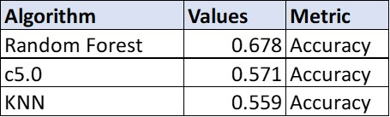
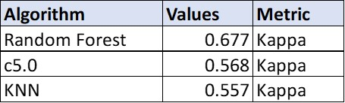
Model Evaluation
Since we derived 9 separate performance metrics, one for each algorithm and each building; we decided to calculate the weighted average of each algorithm for the entire dataset (all buildings). The following slide displays this in a bar chart.
The tables below show that after taking the weighted average of each algorithm, the Random Forest algorithm had the best performing metrics.

Slide 10
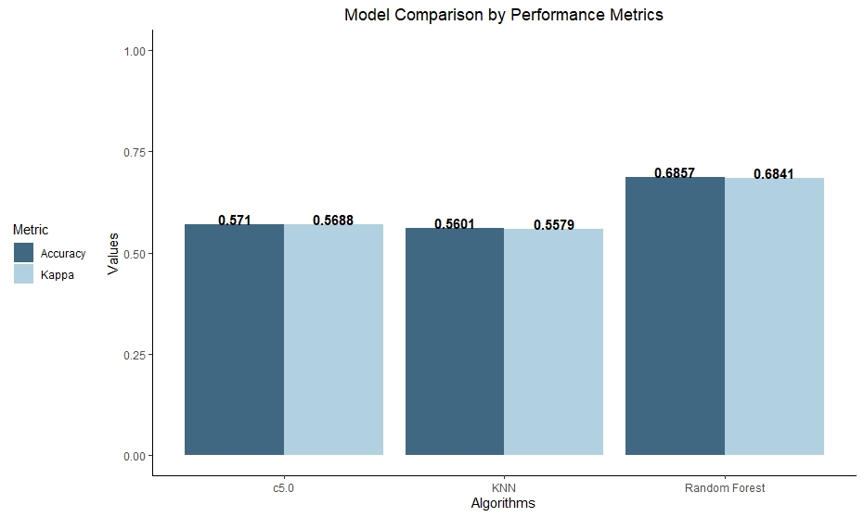
Model Evaluation II

Slide 11
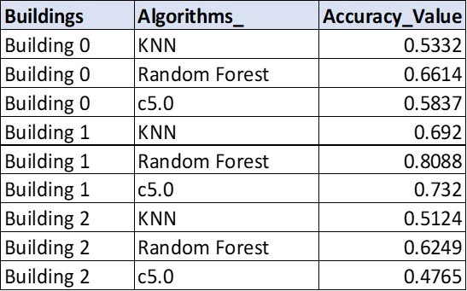
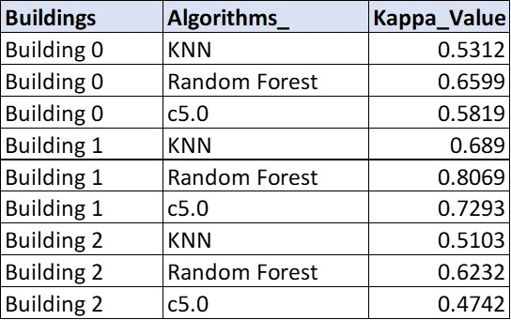
Model Evaluation III
The tables below show the performance metrics by building. The next slides illustrate the information below in a grouped bar chart.

Slide 12
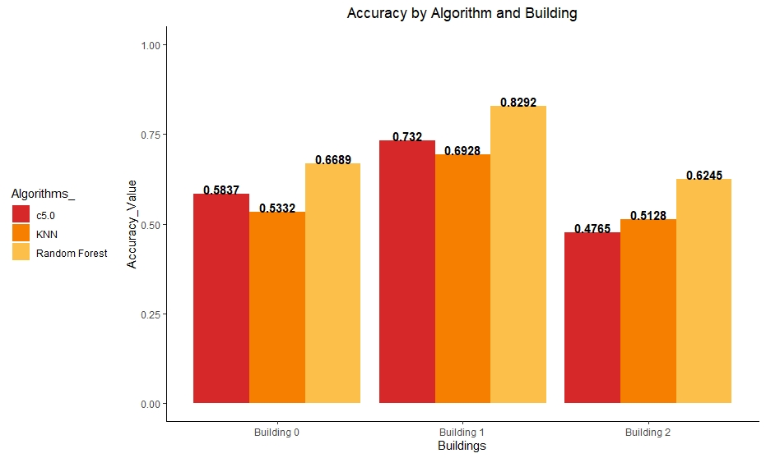
Model Evaluation IV

Slide 13

Model Evaluation V

Slide 14
Conclusions
We were able to develop a model that can predict Wi-Fi location via an individual’s cell phone. With that said, we do realize we could have likely created a more accurate model by eliminating the Wireless Access Points that had zero signal. As discussed earlier, we understand that “black spots” (areas within a building with zero WAP signal) do exist. We do feel we accomplished our business objectives with this project.
Another highlight of our project, was our ability to show the differences in the performance metrics by building. The internal structures of the building have a likely influence on this.
Overall, we feel our current analysis is a good foundation for future analysis as more pertinent data becomes available.

