Slide 1
EduSound Metrics
A distributed acoustic monitoring system for classrooms
Proof-of-concept demonstration · May 2026
Presented to international colleagues in education

Slide 2
Why classroom noise matters
Sound shapes attention, well-being and learning every single minute
Learning
Health
Inclusion
Background noise above approximately 55 dB measurably reduces reading comprehension and working memory, especially in younger students and language learners working in a second language.
Teachers suffer the highest rate of voice disorders of any profession. Sustained classroom noise also raises stress, fatigue and the cognitive load required to stay focused, for both staff and students.
Students with hearing aids, autism spectrum profiles, or attention difficulties are disproportionately affected by noisy environments. A quieter, more predictable room is a more inclusive room.

Slide 3
What this project does
A simple loop: measure, visualise, reflect, act
Several tiny microphones in each classroom continuously measure sound levels in decibels, sampling every few seconds and aggregating into per-minute and per-hour statistics that are kept for the whole school year.Each microphone gives instant, ambient visual feedback to students through a coloured LED, so the room can self-regulate without the teacher having to be the noise police.All readings stream to a single web dashboard that any teacher can open from any device in or outside of the school, protected by a password.Historical data allows the school to compare rooms, days, lessons and entire academic years to inform decisions about acoustics, schedules and pedagogy.The whole stack is open source, runs on a free public MQTT broker, and exposes itself through a free HTTPS tunnel — no school IT changes are required.

Slide 4
Two architectures we evaluated
One big central microphone, or a swarm of small ones — and why we chose the swarm
Option A · One central microphone
Option B · Six distributed mini-microphones
Chosen
Classroom
Classroom (one room, six listening points)
Simpler to install: a single device, a single power point.Captures one viewpoint of the room — usually the centre or the teacher's desk.A single point of failure: if it fails, the room goes dark.Tends to over-weight the loudest local source (the closest table).Cheaper per room, but the cost-per-coverage is actually worse.
Real spatial coverage — picks up where the students actually sit, not only at the teacher's desk.Median across mics filters out a single noisy table without losing real signal.Graceful degradation: if one mic dies, the room still reports a value.Same total cost ballpark — six ESP32 boards beat one industrial sensor.Enables future work: heatmaps, identifying loud spots inside the same room.

Slide 5
How it works end-to-end
From the classroom to the cloud, in a few hops
Classroom mics
Public MQTT broker
Backend
Web dashboard
Public HTTPS
ESP32-S3 + I2S
broker.hivemq.com
Node.js + SQLite
Next.js + WebSocket
Cloudflare Tunnel
Why this stack matters
Microphones reach the broker through ordinary outbound Wi-Fi, exactly as a student tablet would. Data never enters the school network as a server — there are no inbound ports, no firewall changes, no extra credentials to manage. The whole loop survives if a router restarts, and the public URL means a head teacher can open the live dashboard from their phone at home.

Slide 6
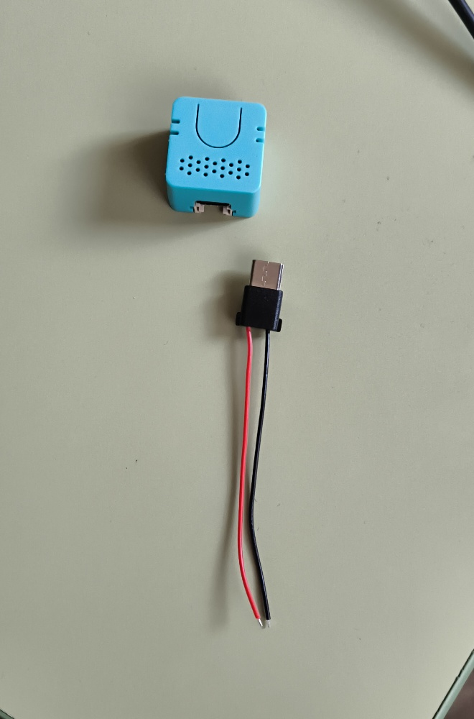
The hardware — small, cheap, classroom-friendly
Each listening point is the size of a matchbox
M5Stack ATOM Echo S3R
ESP32-S3 microcontroller, MEMS microphone over I2S, RGB LED
Around 20 USD per listening point — six per classroom is still within reach of a teacher's pocket budget.USB-C powered through a step-down PCB; a single 24 V line feeds an entire room of mics from one ceiling box.Wi-Fi enabled and configured once via PlatformIO; afterwards each device just appears in the dashboard.Firmware applies median filtering and per-microphone calibration so the readings stay stable across units.All firmware code, board files and the dashboard live in one open source repository.
A single ATOM Echo node with its USB-C pigtail.

Slide 7
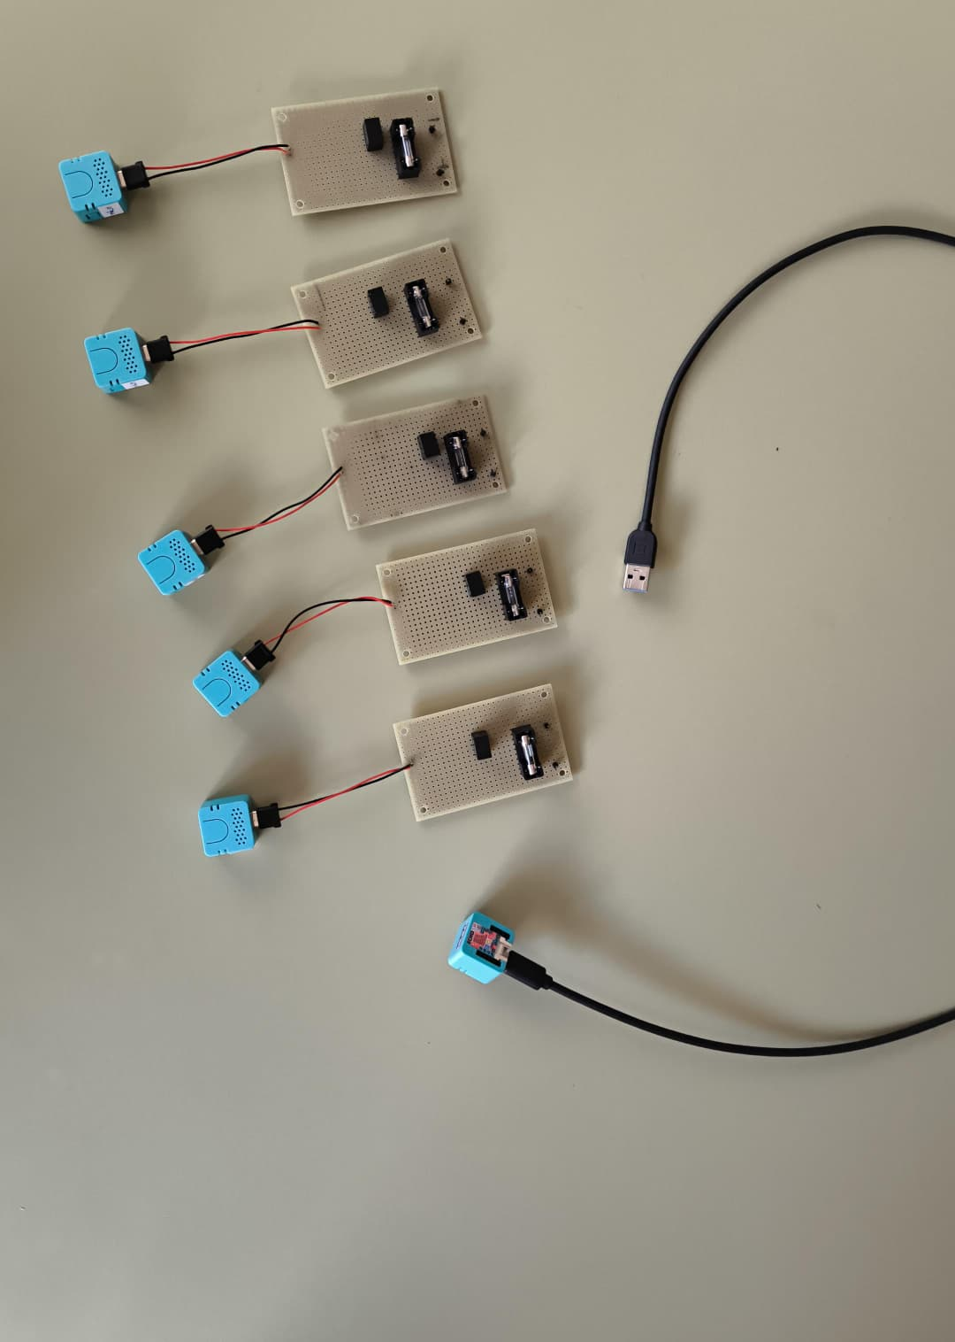
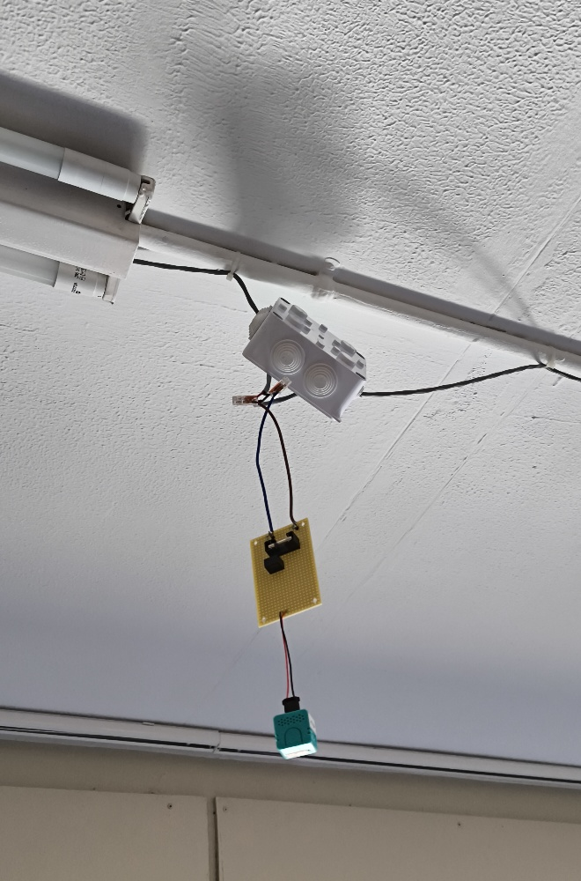
Building the network of listening points
Custom step-down PCB, single 24 V bus, mounted on the classroom ceiling
Engineering decisions
Single 24 V power bus down the ceiling line.Local TSR 1-2450 step-down per node, fused.WAGO splices, no soldering needed in the room.Replaceable USB-C pigtail to each ATOM.Everything documented as repeatable schematics.
Five complete listening nodes ready to install — PCB + ATOM Echo + USB-C pigtail.
One node mounted on the classroom ceiling, fed by the 24 V bus.

Slide 8
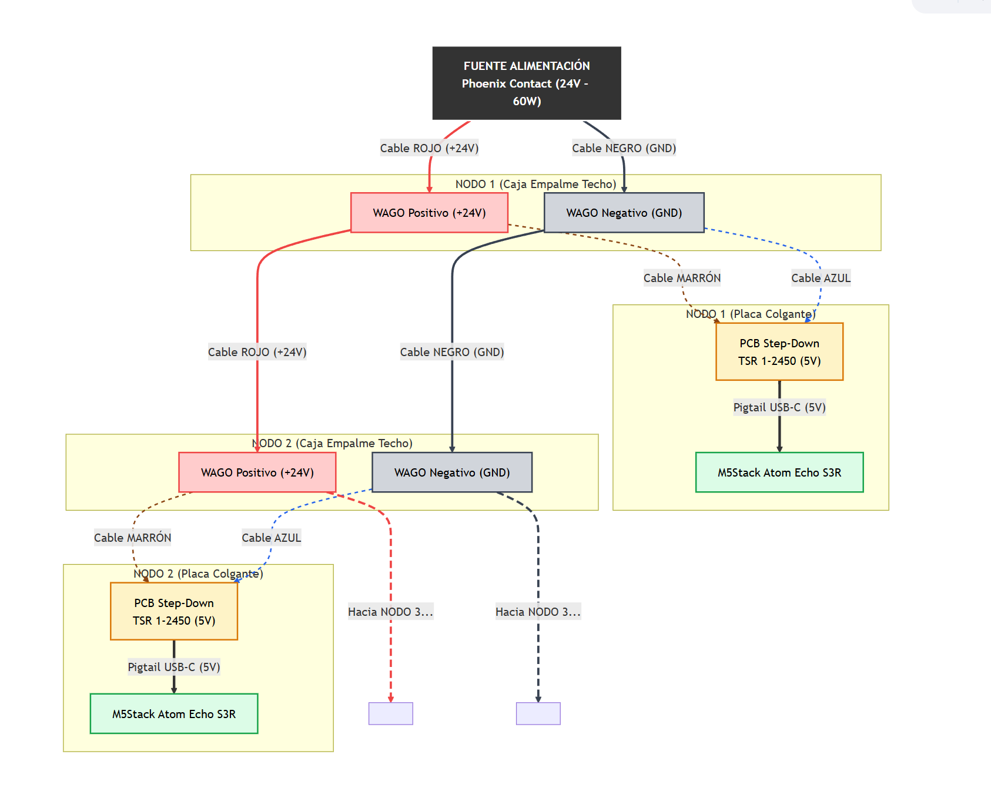
From wall socket to ceiling microphone
A repeatable wiring scheme keeps every classroom identical
Why this scheme
A single low-voltage 24 V line is daisy-chained from one ceiling box to the next. Every classroom uses the same junction-box layout, so an electrician familiar with one room can wire any other room in the school without reading new documentation.
Power distribution: 230 V → 24 V supply → ceiling junction boxes → step-down PCBs → microphones.

Slide 9
Real-time feedback students can read at a glance
The LED is an ambient classroom signal — no teacher voice required
< 50 dB
50 – 70 dB
> 70 dB
Calm
Working
Too loud
Reading, individual work, focused listening.
Group work, lively discussion, normal class buzz.
Time to pause, breathe, reset the room.

Slide 10
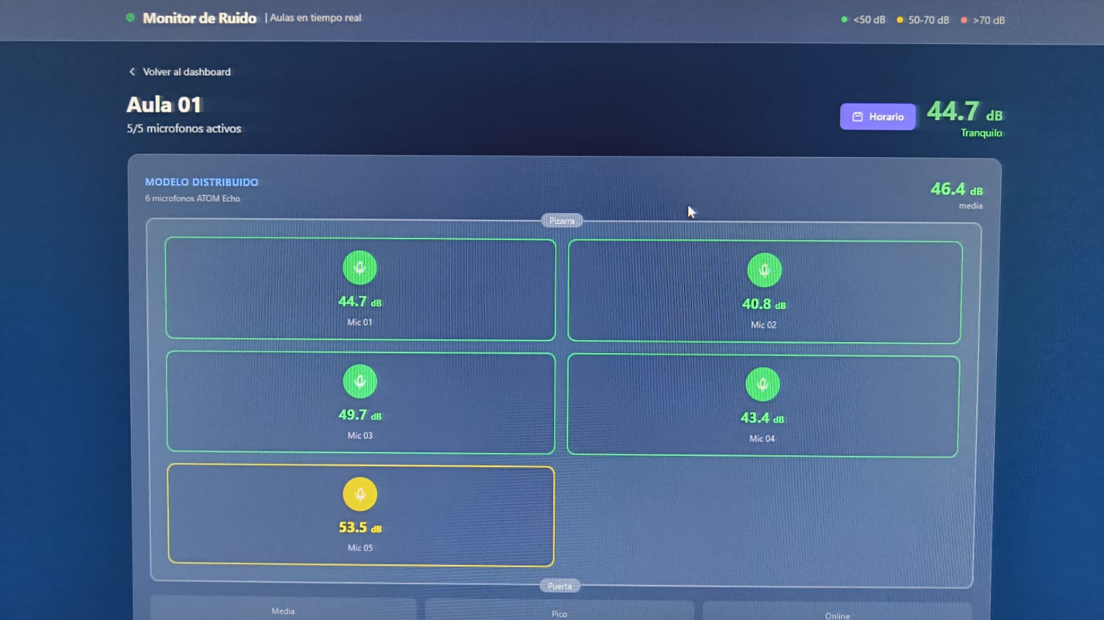
The dashboard — live view of every microphone
One classroom shown here with five active listening points
What you see
The room average in large numerals.Each individual mic with its own value.Colour coding matches the LED traffic light.Status header shows how many mics are active.Updates in real time through WebSockets.
Live view of Aula 01 — five mics reporting 39 – 53 dB, room average 44.7 dB.

Slide 11
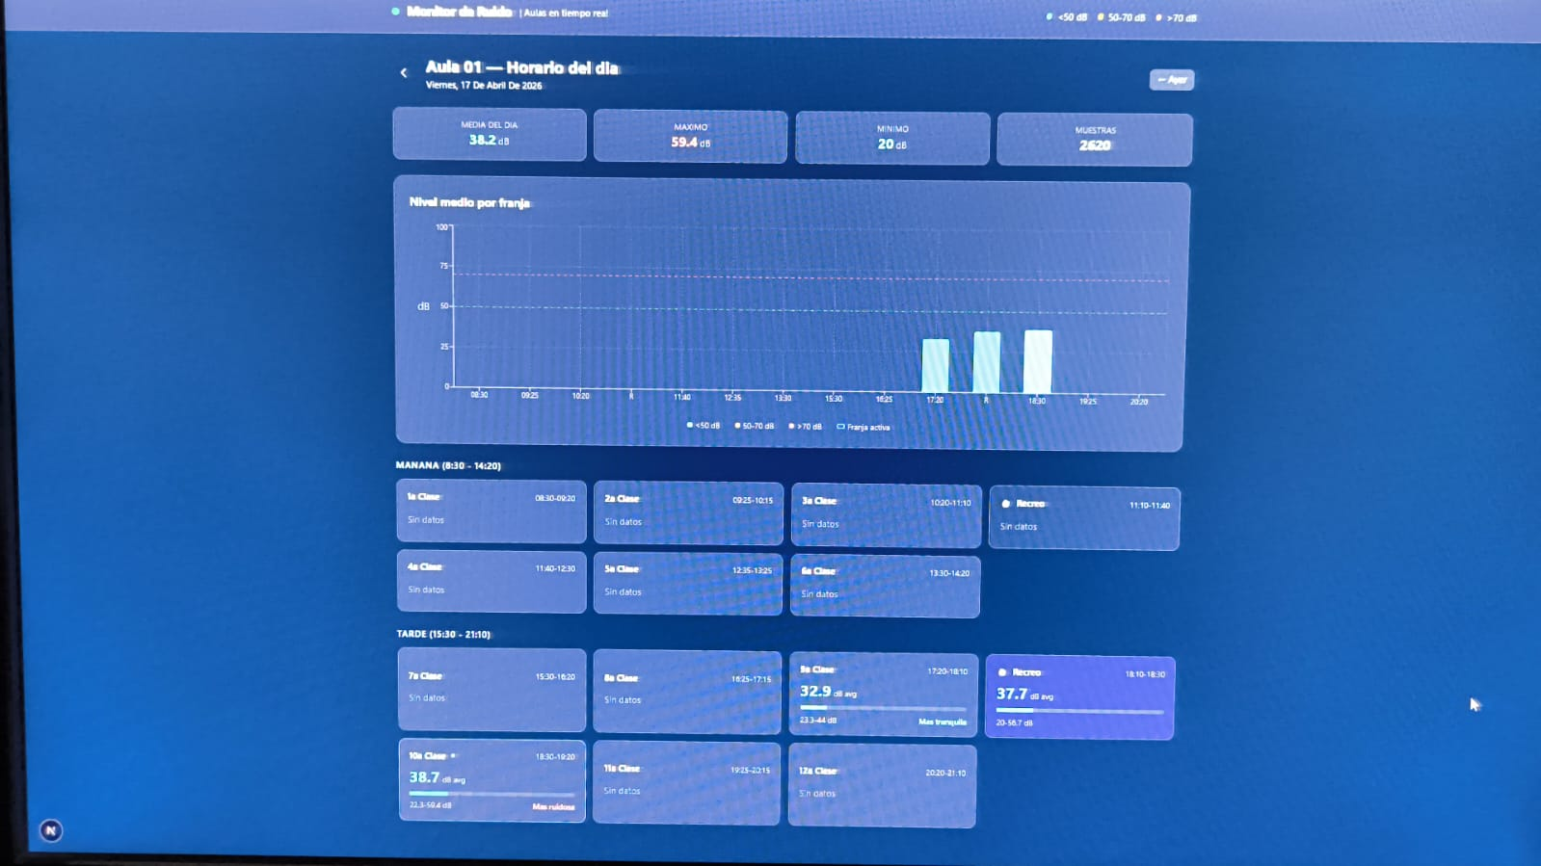
The dashboard — historical view
Day-by-day patterns, per timetable slot, with stable long-term storage
Under the hood
Raw 5-second samples for 14 days.Per-minute rollups for 6 months.Per-hour rollups kept forever.Queries switch granularity automatically.Histograms align with the school timetable.
Daily view: average per timetable slot, with min and max bars for each lesson period.

Slide 12
Educational angle 1 — Awareness and shared agreements
Shifting the question from "who is shouting" to "what does our room sound like right now"
Classroom rituals it makes possible
Why it works
Class and teacher agree on a target dB level for individual reading time, and the LED becomes the impartial referee.End-of-lesson reflection: the room looks back at the curve from the day and discusses whether it matched the activity.Substitute teachers can see at a glance what the room is supposed to sound like for each lesson type.Conflict de-escalation: the LED, not the teacher, signals "too loud" — the class regulates the class.Allows quiet students to ask for a quieter environment without singling out a peer.
Children regulate behavior more effectively when feedback is immediate, visible and impersonal. Moving the signal from the teacher's voice to an ambient LED removes the room from a power struggle and into shared norms.

Slide 13
Educational angle 2 — Turning the data into school decisions
Objective measurements replace opinions in conversations about the learning environment
Identify acoustically problematic rooms
Evaluate physical interventions
Compare every room across the same week. The dashboard surfaces which spaces sit chronically above target levels, regardless of which group occupies them.
Measure before and after adding acoustic panels, soft furniture, carpets, or curtains. Decisions stop being aesthetic preferences and become measurable outcomes.
Inform timetable and grouping choices
Detect anomalies, early
Find the loudest slots of the week. Sometimes the answer is not behavior — it is two demanding subjects scheduled back-to-back, or a class size that no longer fits the room.
A sudden change in baseline noise often correlates with a broken ventilation unit, a new corridor activity, or a class going through a hard week. Patterns are easier to spot than incidents.

Slide 14
Educational angle 3 — Data literacy with data students care about
The dataset is their own classroom, so the questions become personal
Which time of the day is loudest in our room, and why? Compare what we expected with what really happened.Does our class get noisier on Fridays? Does the room next door follow the same pattern?Did the new seating arrangement actually change anything, or did it just feel like it?Plot the curve before and after we changed the carpet, the blinds, or the way we line up to leave.Hypothesise, test, plot, and share findings with the school council — using the same data that the school management sees.
Every chart on the dashboard is also a JSON endpoint — older students can pull the data into Excel, Google Sheets, Python, R or Scratch.

Slide 15
Privacy by design
Measure the room, not the people in it
What is collected
What is never collected
A single decibel number, sampled every few seconds.Minimum, maximum and average per minute and per hour.An anonymous room identifier chosen by the school.
No audio recordings — voices never leave the device.No speech-to-text, no keyword detection, no transcription.No personal identifiers, no faces, no names.No location data beyond the room label the school chooses.
This makes the system compatible with GDPR, FERPA-style policies and the kind of conversations schools actually want to have with families about technology in the classroom.

Slide 16
What this proof of concept has shown
A swarm of mini-microphones can monitor a real classroom continuously and stably for weeks.Off-the-shelf parts and open software are enough — no specialised acoustic hardware is required.A coloured LED, driven directly from the device, is enough to change behavior in the room.Long-term storage with rollups keeps queries fast and history meaningful across a whole school year.The same system can be used as a teaching tool, a behavior tool, and a school-management instrument.
EduSound Metrics · Thank you · Questions welcome

