Slide 1
EduSound
Metrics
Listening to classrooms, not to people.
Proof-of-concept demonstration · May 2026

Slide 2
Why classroom noise matters
Sound shapes attention, well-being and learning — silently.
55 dB
60 %
2×
Threshold above which comprehension drops
of teachers report voice strain at work
louder rooms hit students with hearing aids hardest

Slide 3
What EduSound Metrics does
One simple loop, repeated all day, every day.
MEASURE
SHOW
COMPARE
DECIDE
01
02
03
04
Six tiny mics per room, every few seconds.
An LED in the room, a dashboard on any device.
Across rooms, across days, across the year.
Evidence for teachers and school leadership.

Slide 4
Two architectures, one choice
One central mic vs. a swarm of tiny ones.
A
CHOSEN
B
One central mic
Six distributed mini-mics
+ Simple install
+ Real spatial coverage
+ One viewpoint of the room
+ Median filters out one loud table
− Single point of failure
- Lower dynamic sensitivity range.
− Skewed by closest table
- Highly complex installation and prone to failure.

Slide 5
How it works
From the ceiling of the classroom to a phone anywhere in the world.
Mics
MQTT
Backend
Dashboard
Public URL
ESP32-S3
broker.hivemq.com
Node.js + SQLite
Next.js
Cloudflare Tunnel
No school IT changes
No open ports
Works from any phone

Slide 6
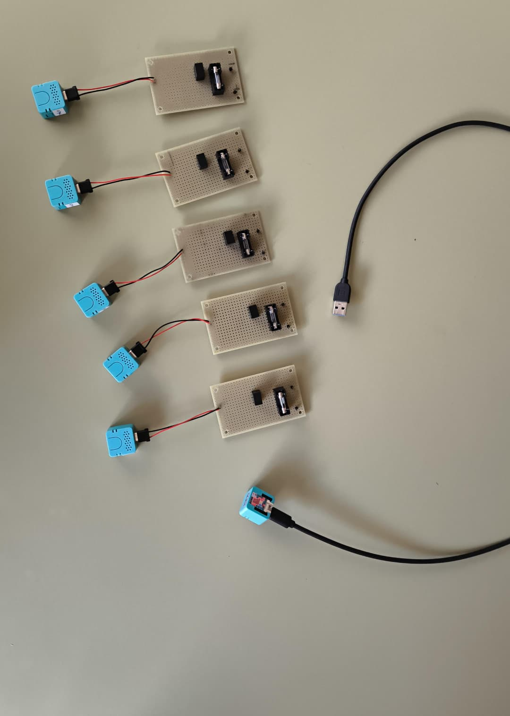
The listening node
Each node = step-down PCB (fuse + TSR) + soldered USB-C pigtail + M5Stack ATOM Echo S3R.
2 comp.
soldered on the PCB (fuse + TSR 1-2450)
6
nodes per classroom (mesh)
1 bus
Five complete listening nodes — each ATOM Echo wired to its own step-down PCB through a soldered pigtail.
single 24 V line per room

Slide 7
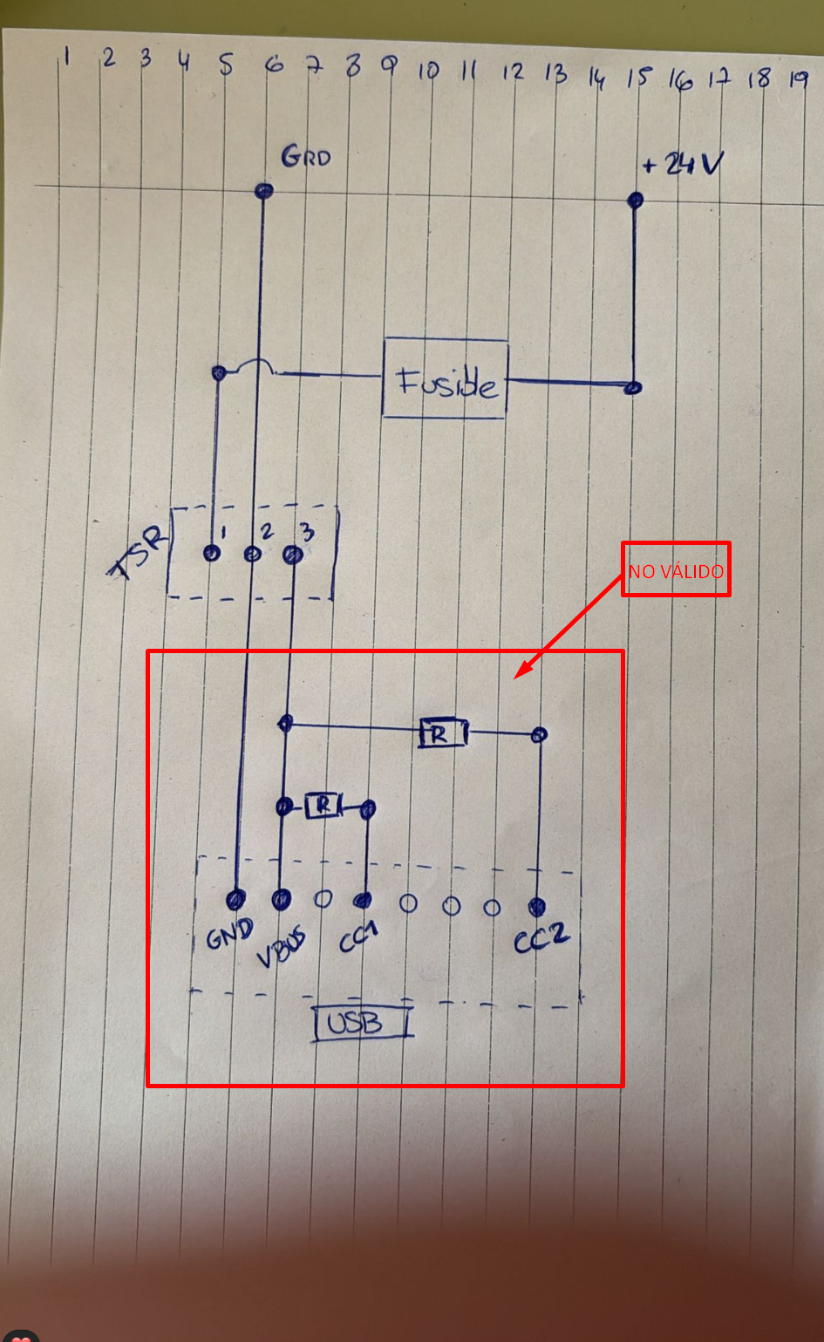
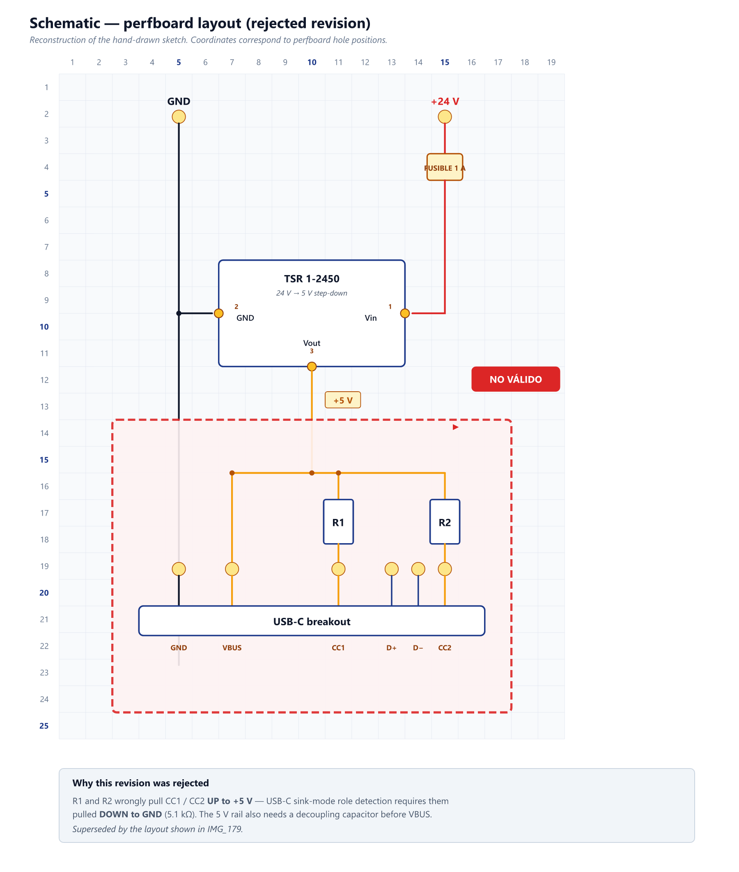
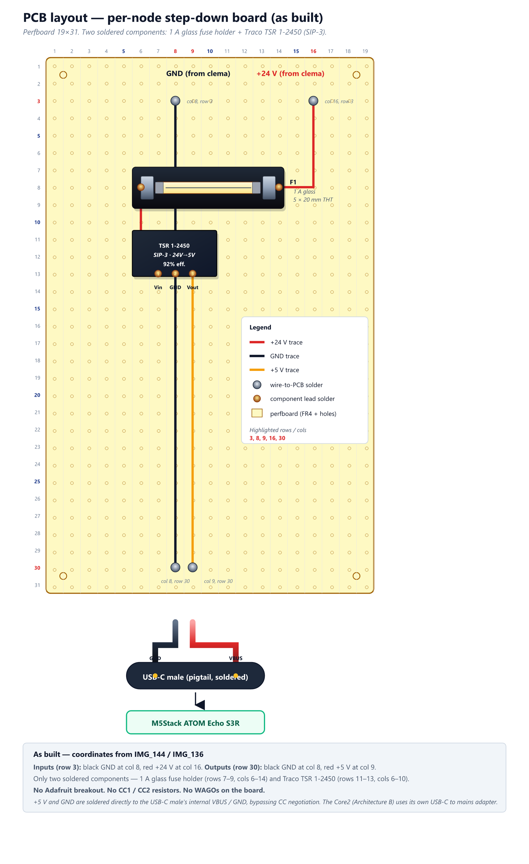
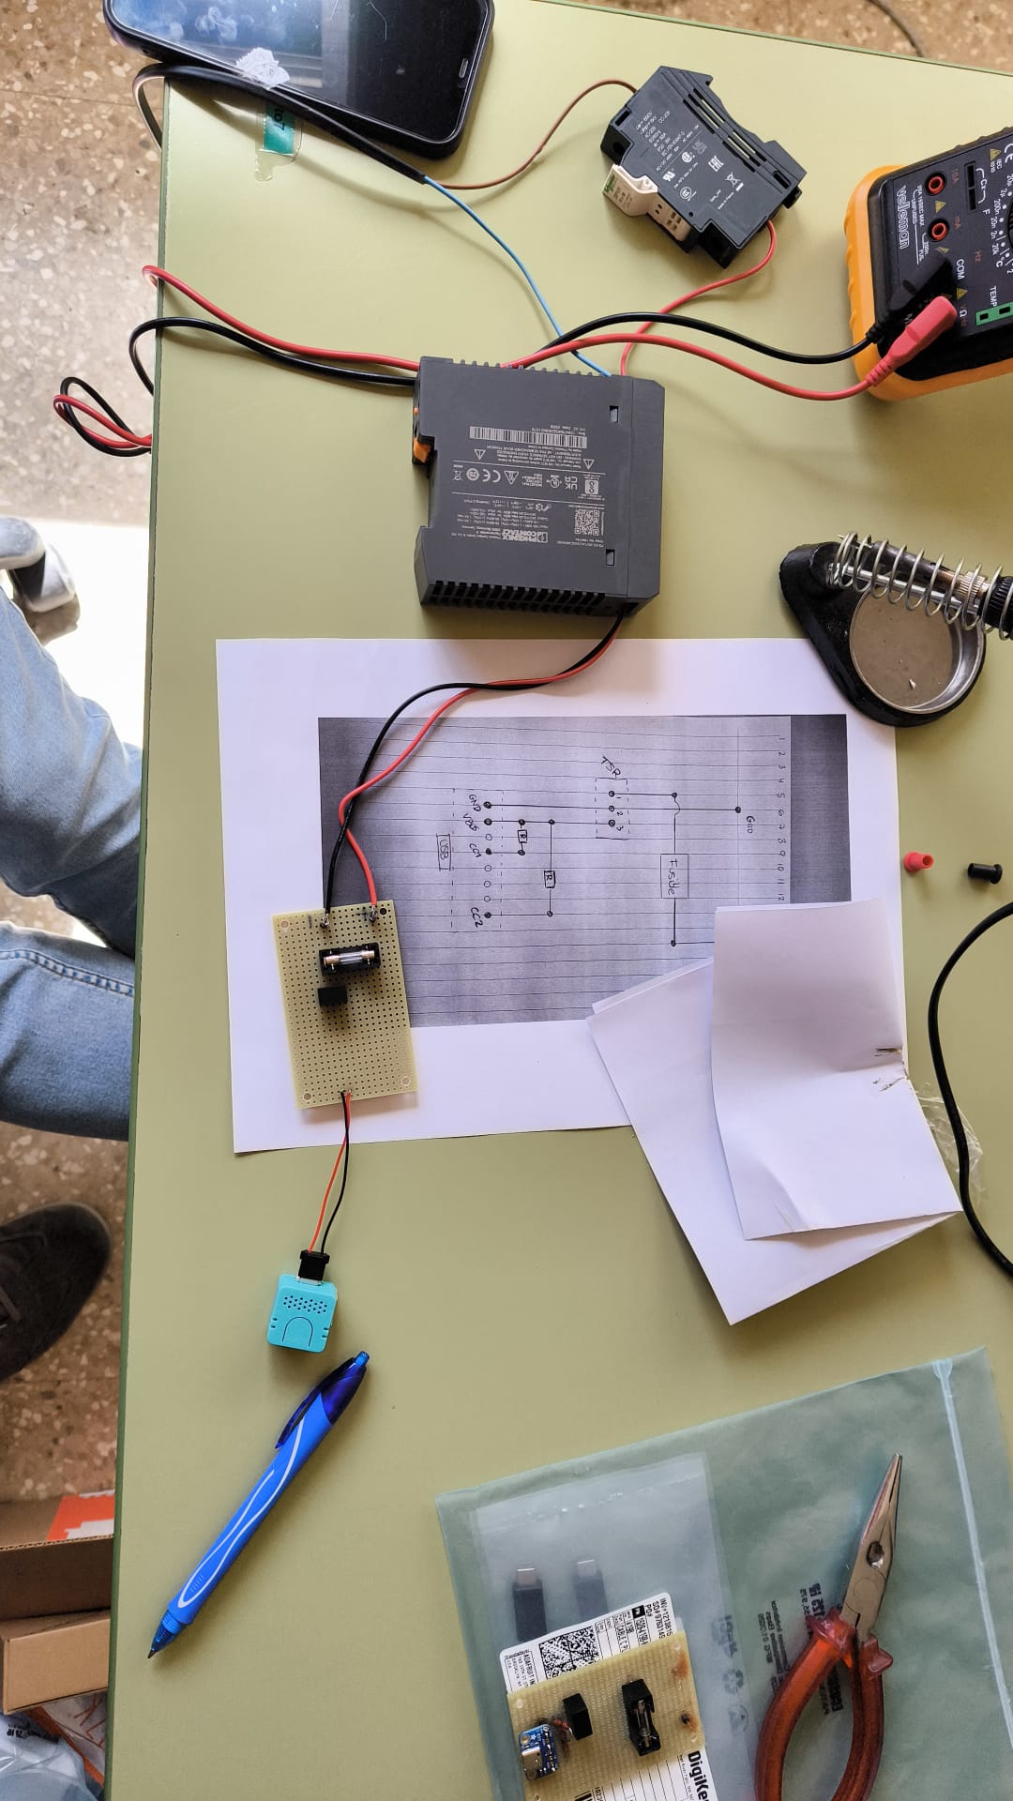
From sketch to circuit
Three steps from a pencil drawing to a board on the ceiling.
01
Sketch
02
Review
03
Diagram
04
Build
Pencil on graph paper — first attempt at the perfboard layout.
First digital pass with an Adafruit USB-C breakout — CC pull-ups spotted as wrong. Discarded.
Corrected as-built schematic on 19×31 perfboard — only a 1 A fuse and a Traco TSR 1-2450, all soldered.
Real board from IMG_144 — fuse + TSR soldered, 24 V wires up, USB-C pigtail down.

Slide 8
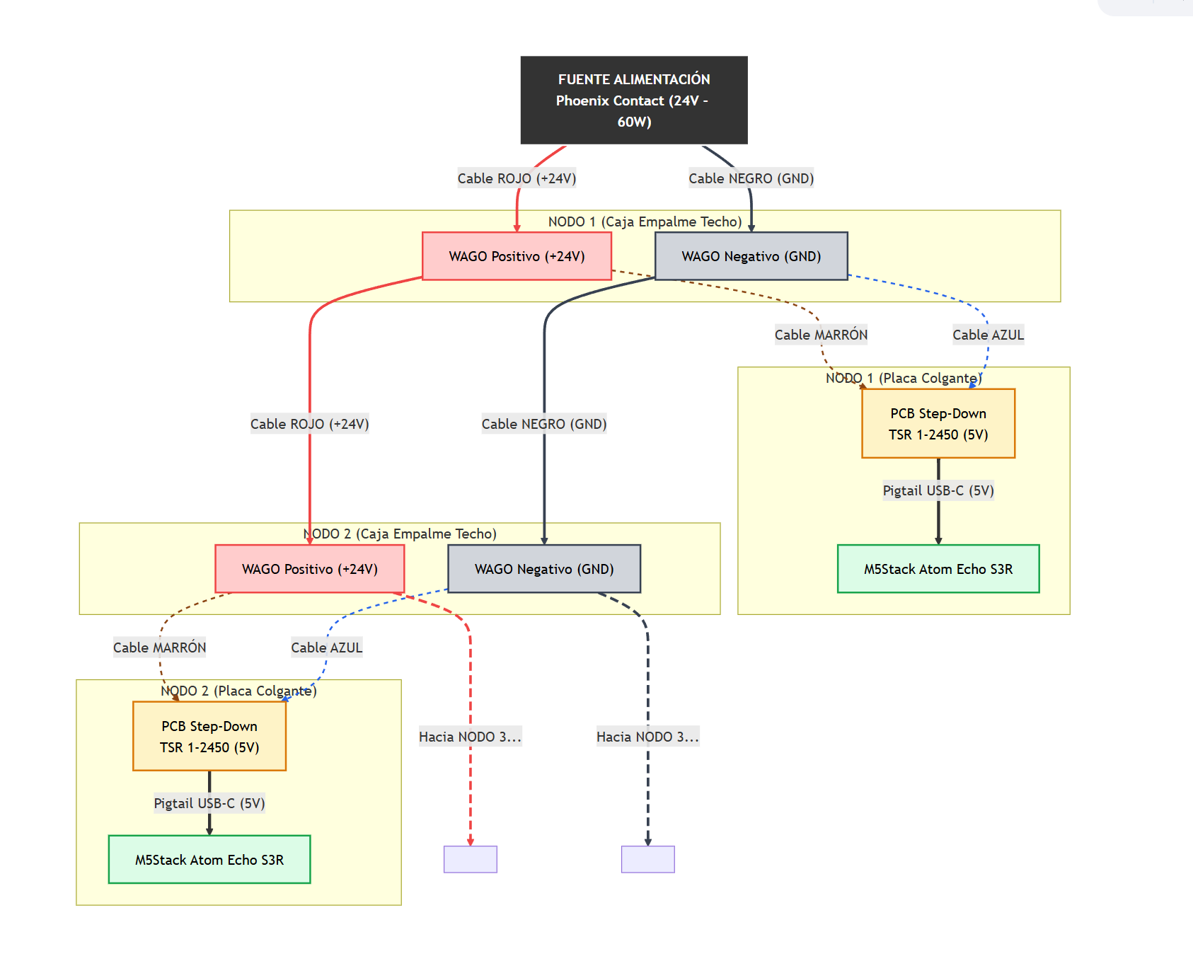
From wall socket to ceiling mic
A repeatable wiring scheme — every classroom is identical.
24 V
supply
5 V
per node
USB-C
to ATOM Echo

Slide 9
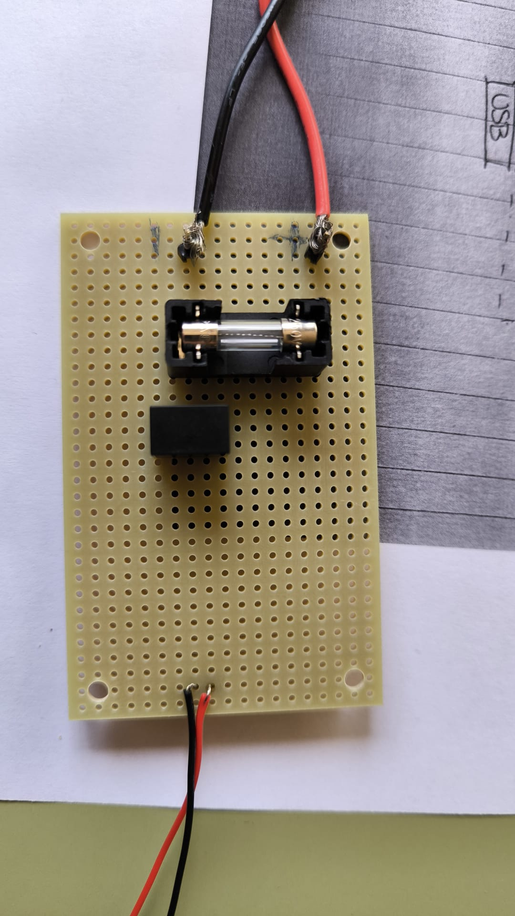
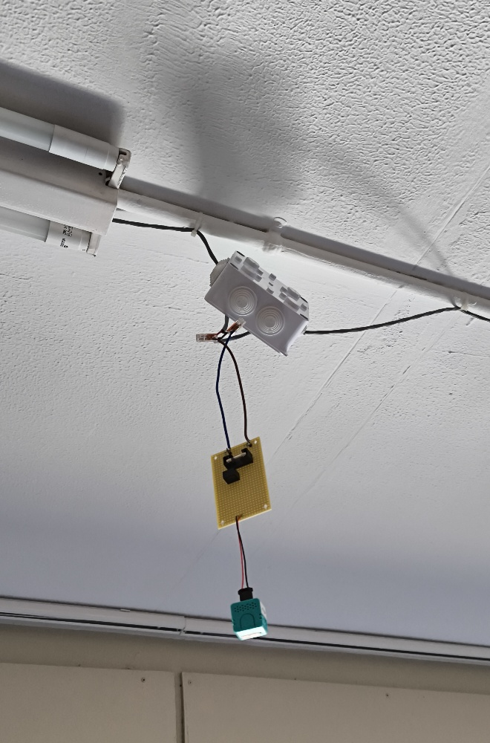
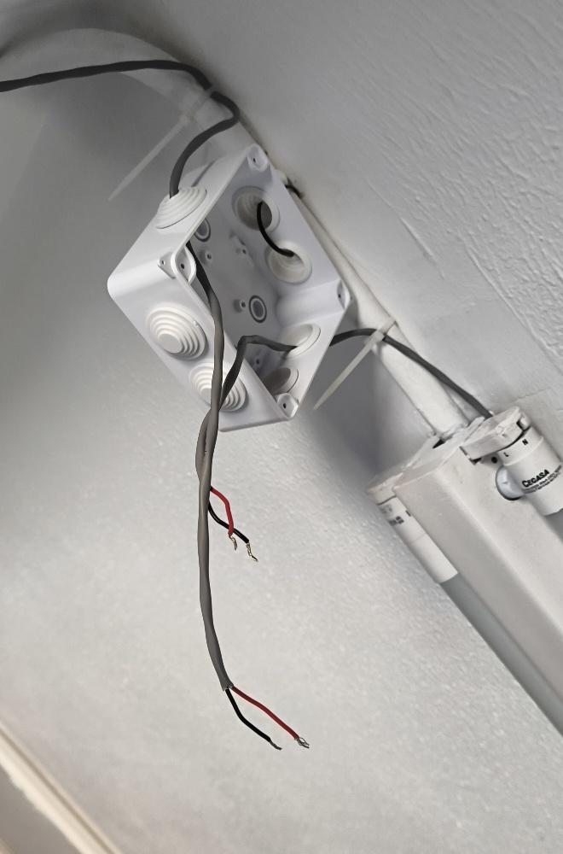
Built and installed
Custom step-down PCB, single 24 V bus, mounted on the ceiling.
Per-node PCB (close-up).
Mounted on the ceiling.
Ceiling junction box with 24 V terminal block.

Slide 10
The room speaks for itself
Each mic glows. The class regulates the class.
< 50 dB
50–70 dB
> 70 dB
CALM
WORKING
TOO LOUD
No teacher voice required.

Slide 11
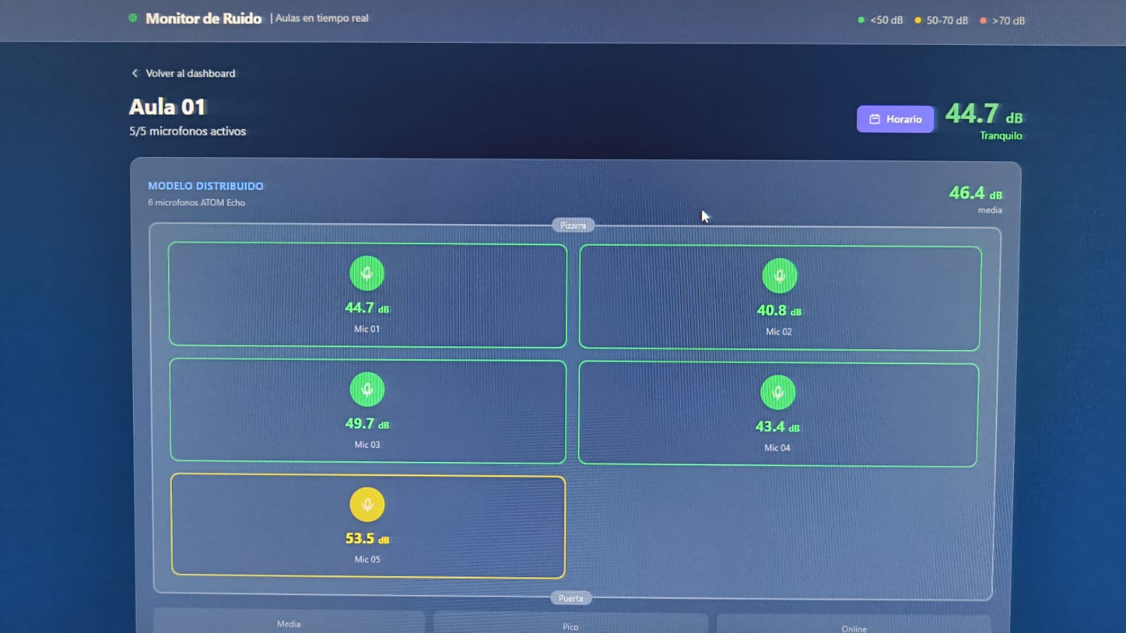
Live view
One classroom, five active mics, real time.
44.7 dB
Room average
5 / 5
Active mics
<1 s
Update latency

Slide 12
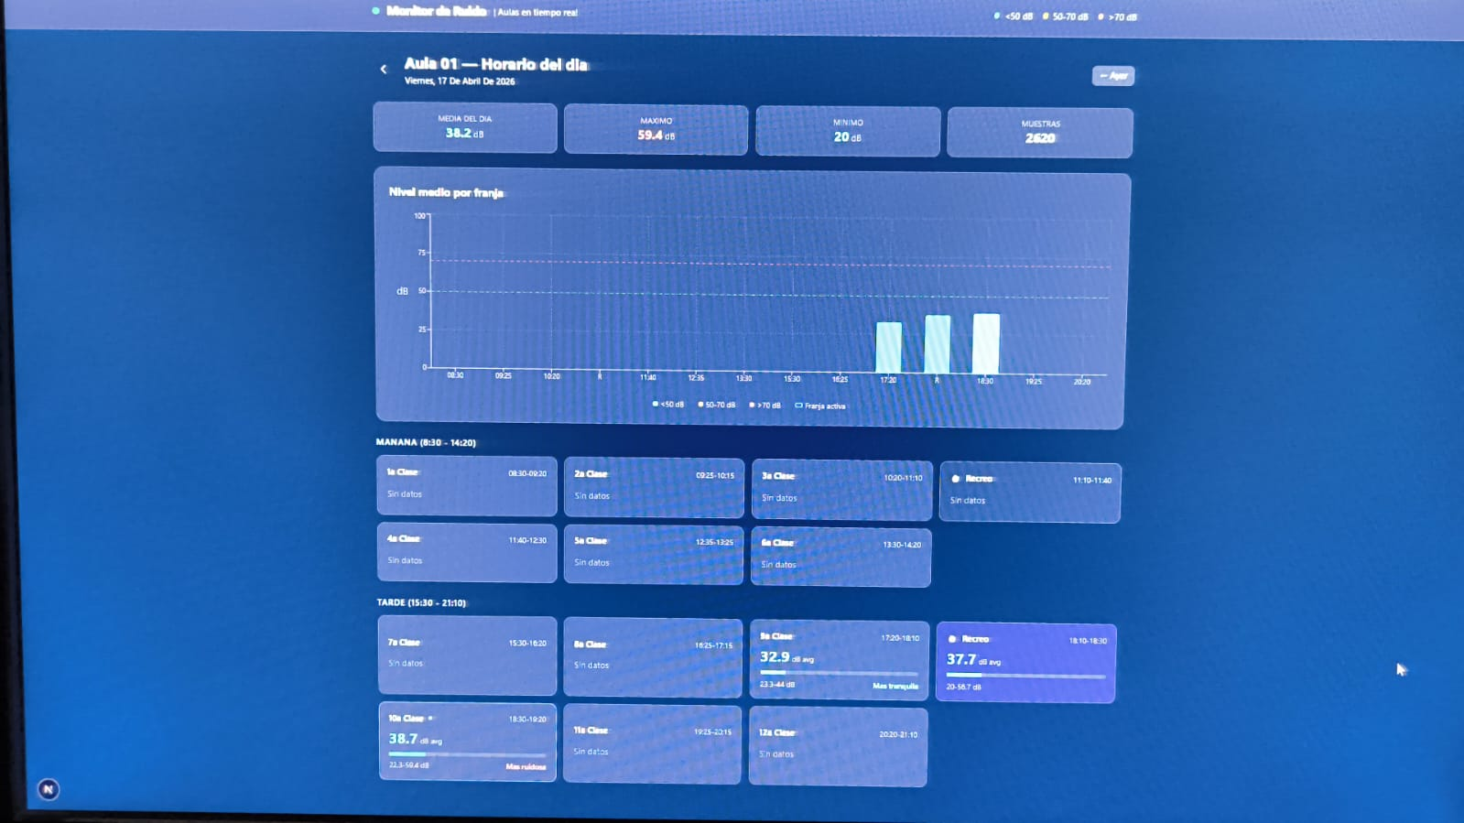
History — by lesson, by day
Slots align with the school timetable.
14 d
raw 5-s samples
6 mo
per-minute rollup
∞
per-hour rollup

Slide 13
Awareness, not authority
The LED becomes the impartial referee.
“The class regulates the class.”
From “who is shouting?” to “what does our room sound like right now?”
Agree a target
Reflect together
De-escalate
Class & teacher set a dB goal for each activity.
End of lesson, the curve becomes a conversation.
The LED, not the teacher, says “too loud”.

Slide 14
From data to decisions
Objective measurements replace opinions.
Spot problem rooms
Test interventions
01
02
Find rooms that are loud regardless of who occupies them.
Measure before & after acoustic panels, carpets, blinds.
Reshape the timetable
Catch anomalies early
03
04
Identify the loudest slots — sometimes it's scheduling, not behavior.
A sudden baseline shift often signals a broken HVAC unit.

Slide 15
Their data, their questions
Data literacy with a dataset students actually care about.
?
When is our room loudest — and why?
?
Do Fridays sound different from Mondays?
?
Did the new seating plan really change anything?
?
Is the room next door noisier than ours?
Every chart is also a JSON endpoint — export to Excel, Sheets, Python, R or Scratch.

Slide 16
Privacy by design
Measure the room, not the people in it.
YES
NEVER
✓ dB level (every few seconds)
✗ Audio recording
✗ Speech / transcription
✓ min / max / avg per minute
✗ Names, faces, identifiers
✓ Anonymous room label
✗ Location data

Slide 17
What the data is already telling us
21 days of continuous monitoring in one classroom — 7 microphones, 24/7.
21 days
42k samples
14.6 dB
of continuous recording, no dropouts
captured in one school day, 7 mics
instantaneous spread across mics in the same room — the distributed model earns its keep
47 dB
25 dB
0 %
loudest lesson average (5th period, just after lunch)
quietest moment of the day — the break, when the room is empty
of the day above 70 dB — the room never tipped into red

Slide 18
What this PoC has shown
Stable
Off-the-shelf
Behavioral
weeks of continuous monitoring
ESP32 + open software is enough
the LED changes the room
Year-long
Versatile
Open
rollups keep history meaningful
teach, regulate, manage
MIT-licensed, replicable
EduSound Metrics · Thank you

