Slide 1
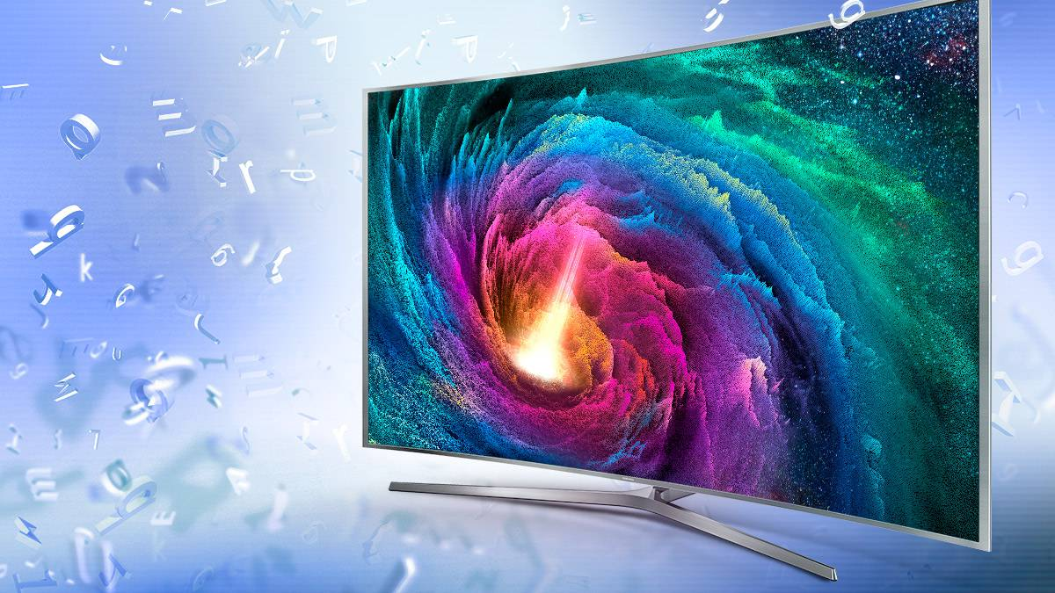
Television

Slide 2
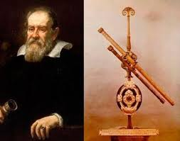
History
The concept of television (distance vision) can be traced back to Galileo Galilei and his telescope

Slide 3
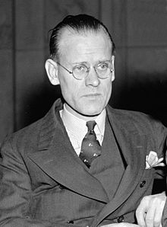
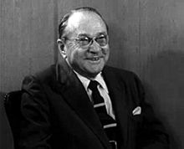
Creators of television
Philo Taylor Farnsworth
Vladímir Zvorykin

Slide 4
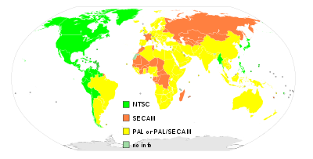
Distribution of TV systems in the world.

Slide 5
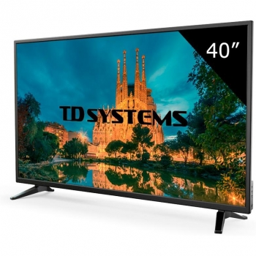
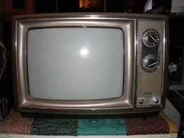
High definition television
Is one of the formats that, together with digital television (DTV), are characterized by broadcasting television signals in a digital quality superior to traditional analog color television systems.

Slide 6
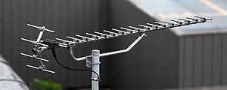
Terrestrial television
Programming is broadcast by television stations, sometimes called "channels", as stations are licensed by their governments to broadcast only over assigned channels in the television band.

Slide 7

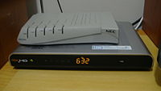
Cable television
Cable television is a system of broadcasting television programming to paying subscribers via radio frequency (RF) signals transmitted through coaxial cables or light pulses through fiber-optic cables.

Slide 8
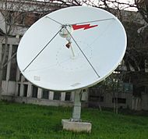
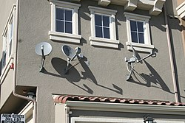
Satellite television
Satellite television is a system of supplying television programming using broadcast signals relayed from communication satellites.

Slide 9
Internet television
Internet television (Internet TV) (or online television) is the digital distribution of television content via the Internet as opposed to traditional systems like terrestrial, cable, and satellite, although the Internet itself is received by terrestrial, cable, or satellite methods. Internet television is a general term that covers the delivery of television shows, and other video content, over the Internet by video streaming technology, typically by major traditional television broadcasters.

Slide 10
