Slide 2
Insert logo of your partners here
CHILDREN ABDUCTION
RUBENIA BORGE
NICARAGUA
UNIVERSIDAD NACIONAL DE INGENIERIA
#
MANAGUA

Slide 3
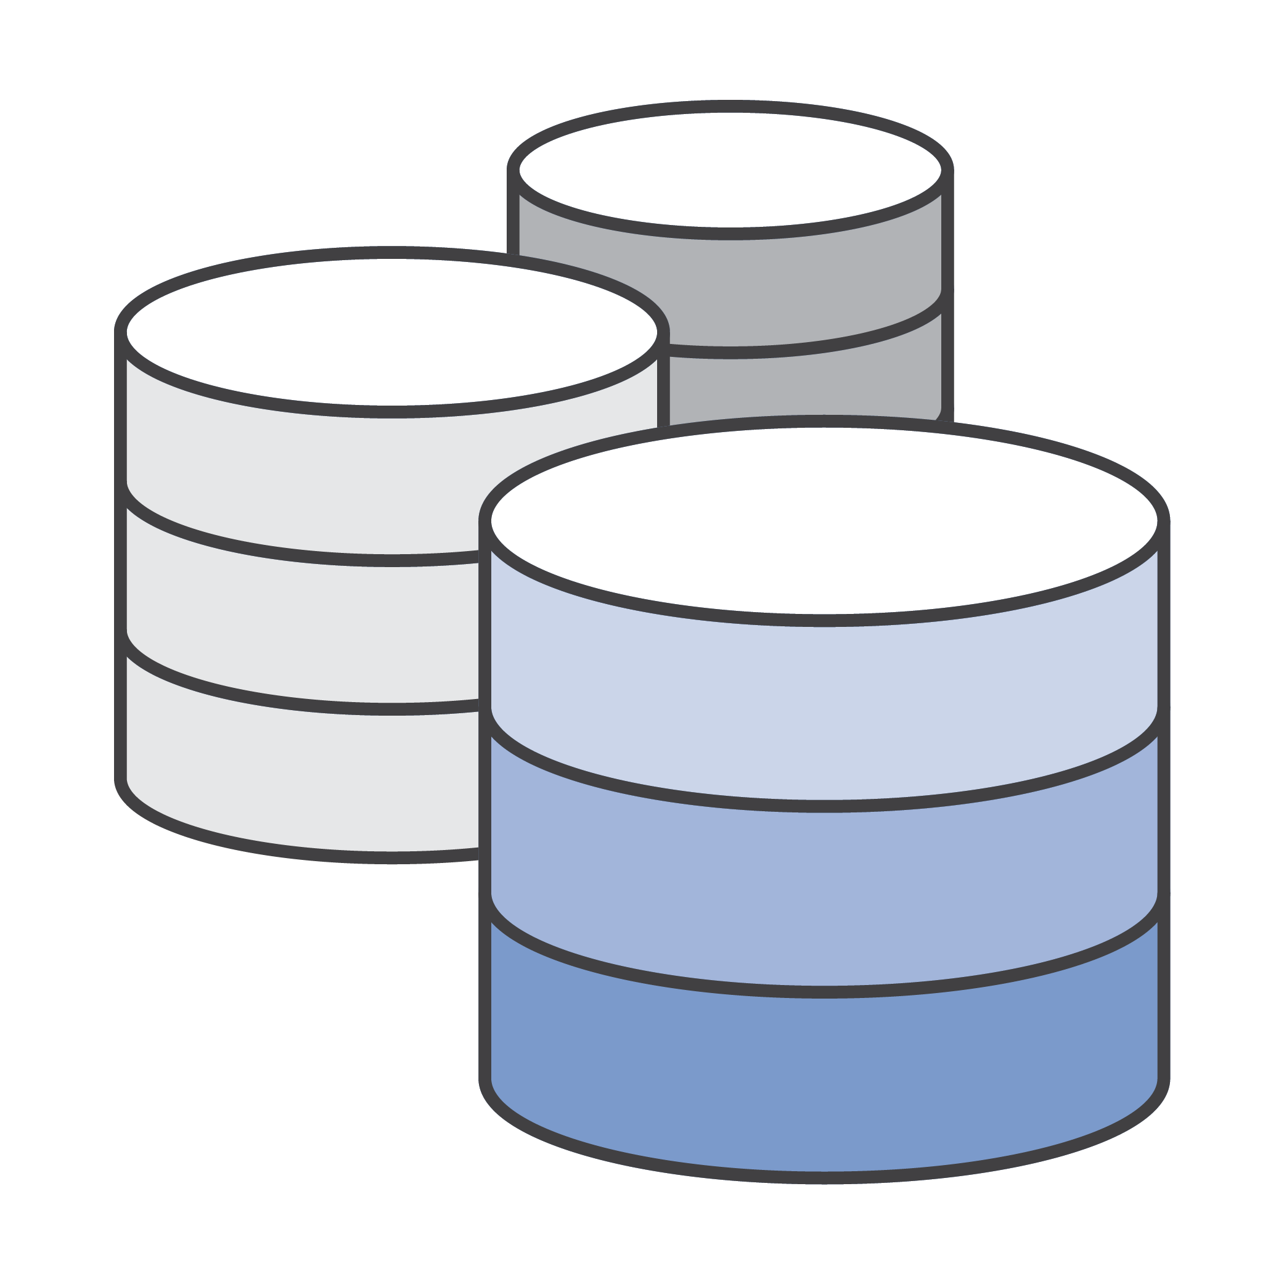
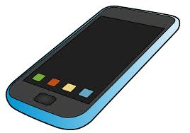
RUBENIA BORGE
BREAKING THE WALL OF CHILDREN ABDUCTION
Problem Definition
Proposed tool to aid in the solution
Criminals around the area
Store parent data
Store children data
Store support network data
Store criminal’s data
Store danger zones
Report missing children
Organize search for kids
Notify findings, tips, and updates
Share relevant information
Children Abduction
Databases
Apps
Benefits of the tool
Communication in real time.
Media files sharing (sound, video, images).
Allows international collaboration (if needed).
Increases speed of updating information.
Facilitates collaboration between different stakeholders.
Technology advances can provide security in information shared.
Race against time to protect children

Slide 4
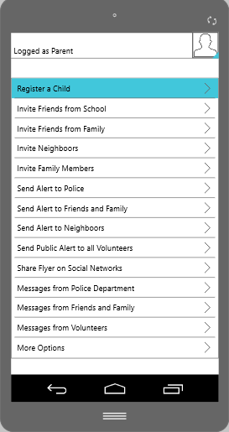
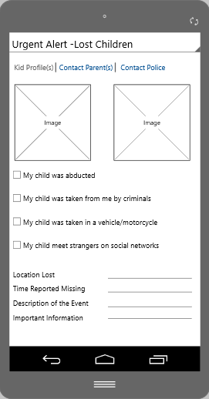
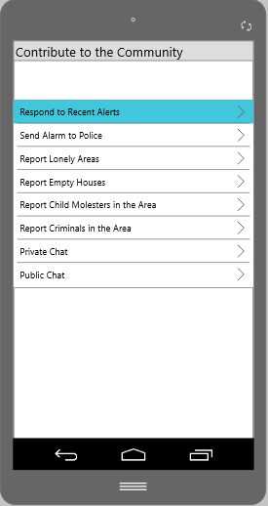
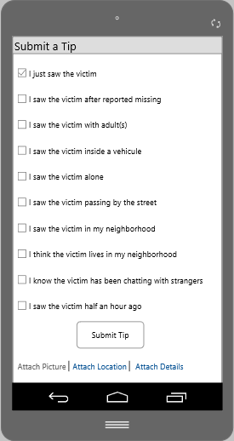
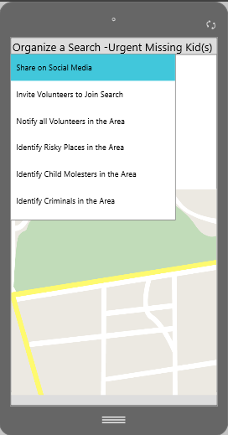
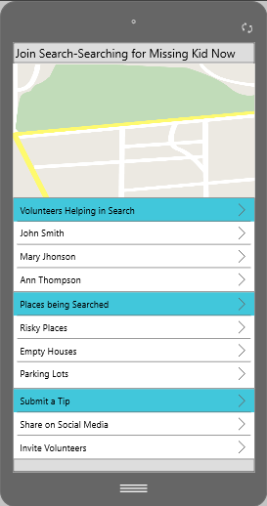
RUBENIA BORGE
BREAKING THE WALL OF CHILDREN ABDUCTION
App functionality

Slide 5
QUESTIONS?

