Slide 1
Missing Children App
Rubenia Borge
Managua, Nicaragua
Notes:
Hello! ☺ I am Rubenia Borge. And, I will present my app idea to Falling Walls Lab Nicaragua.
The purpose of this app is to help parents create and develop a network of support including family members, friends, authorities, and volunteers, that will collaborate with them immediately when they send alerts reporting a missing children.
Experts suggest that a gap of three hours when searching for a kid can make the difference between rescuing the victim or losing him/her forever.
Sadly, experience supports that after 48 hours have passed, finding a missing person becomes a lot harder.

Slide 2

A parent’s worst nightmare
An app to help parents to be prepared on how to start the search and act fast during the search
Pictures downloaded from: www.google.com
Notes:
There are no words to express the sadness and pain that parents of missing children experience. It is normal for them to lose control under such a scary situation. One important aspect in which technology can help is the storage of relevant information, and sharing it when needed in a secure and fast way. And, that’s the reasoning behind this app.

Slide 3










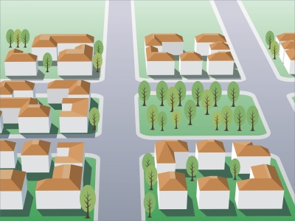
Parent(s) Functionality
Notes:
The purpose of the app is to allow parents to build a network that is committed to preserve children’s safety and offers help and support when searching for a lost kid. The app will enhance the efficiency of the communication between the parent and the helping community.
It will be used to report the a missing child, share important details for the search, and collaborate in the search right immediately after the child is reported missing.

Slide 4
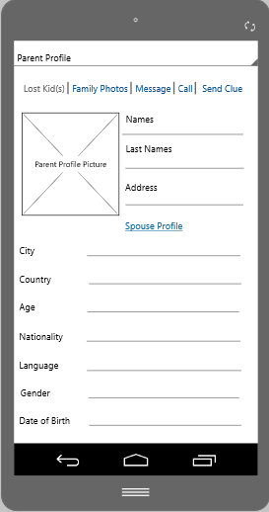
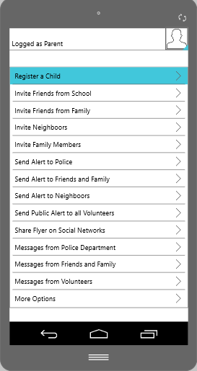
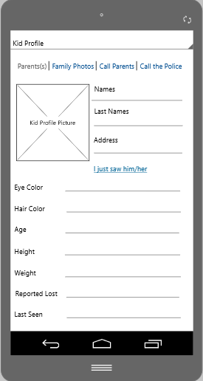
Parent(s) Functionality
Notes:
The app allows to plan ahead, and store securely on their phone, all the information needed in case that the worst happens.
Important functions are: create a parent profile and store plenty of contact information to facilitate communication with the whole community, create children profiles, and send invitations to join to family members, friends from school and work, neighbors, and volunteers. The invitations are sent to build the parent’s support network that could be needed in the future. Other features are: sending and receiving messages from the whole community, and making public posts about missing children on social networks.

Slide 5
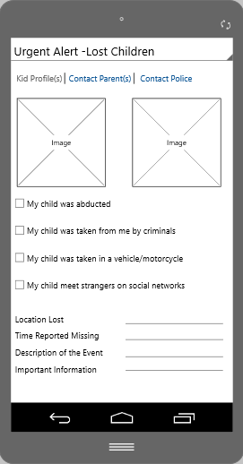
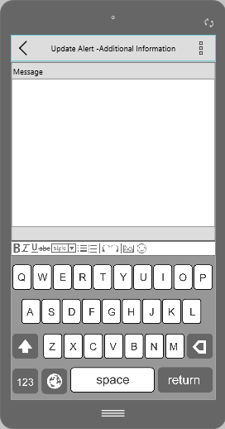
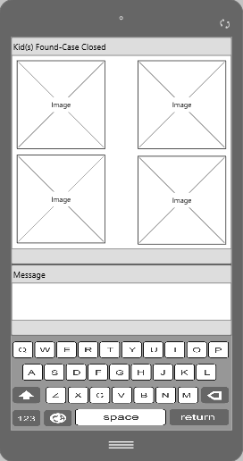
Parent(s) Functionality
Notes:
The most important assistance parents need in case of a missing kid is to start the search immediately and get as much help as possible, as quickly as possible. For that, the app includes the options to report a lost kid to authorities and support community in real time, send constant updates with details that can help to improve the search, and/or close the case notifying the whole community if a child is found.

Slide 6

Support Network Functionality
Notes:
The app helps volunteers to reach parents and help them.

Slide 7
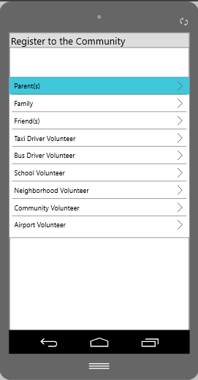
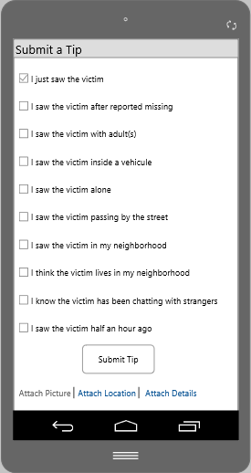
Support Network
Notes:
As many supporters as possible are needed. It is important that parents, family members, taxi and bus drivers, teachers and school volunteers, work and social volunteers, airport staff, and everybody in the community do its best to help.
The goal is to have lots of people being vigilant so that kidnappers can be found before it is too late, or kids are hurt.
The more people know about a missing kid, the more people can send tips to notify with exact details when and where the victim was seen, who was accompanying the victim, if the victim had been in contact with strangers, real time notifications in case the victim is located, and the possibility to share pictures to confirm the victim’s identity.

Slide 8
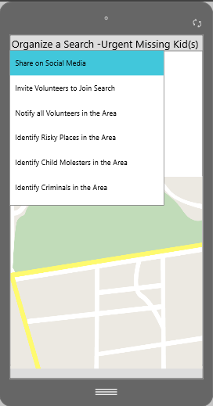
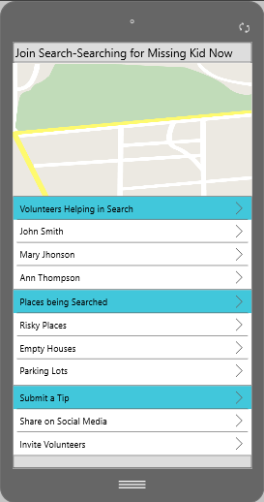
Support Network
Notes:
The app helps to organize a search, and allows volunteers to join an ongoing search. It facilitates spreading the word on social media about the search, inviting volunteers to join, sending notifications and updates to all volunteers, notifying risky places, and informing about criminals and child molesters reported in the area.

Slide 9
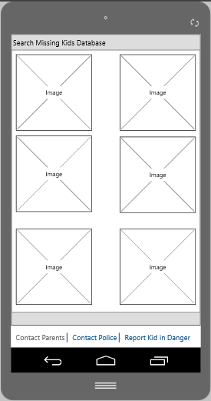
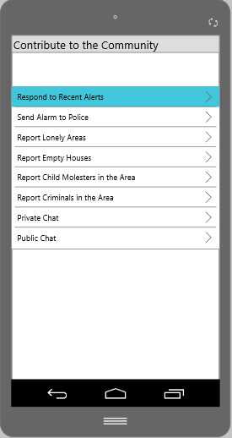
Support Network
Notes:
The app facilitates a way to provide ongoing support for cases not yet solved, and to report risks that may endanger children in the community. For example, searching through the Missing Kids database to submit a tip even when alerts were not made public, and also to report kids that could be in danger even if they were not yet registered in the database.

Slide 10
Thank you for your attention.
Notes:
This app prototype is an example on how Mobile technologies and social networks can help to accelerate the process of searching for a missing kid, and save precious time that could make a crucial difference in saving a victim.
Thank you very much for your attention! ☺

