Slide 1

MavHangOut
Isqa Electronic commerce
Professor: dr. sajda qureshi
Alexander Fuchsberger, Anil Paugani CA Hoang, Rubenia Borge

Slide 2
Agenda
Introduction
Problem/Opportunity
Relevant Research Findings
E-commerce Solution Needed
MavHangOut Business Plan
Conclusion
Questions and Answers

Slide 3
Introduction
Team
Electronic Commerce Course
MavHangOut Business Plan

Slide 4
Problem/opportunity
UNO has 14,162 students
ca. 295 available organizations for students
busy schedules during class time
Information available in different places:
DailyMav
MavSync
Maverick Weekly
Finding information takes too much time
Information is presented in general list with minimum filters and classification
No mobile support
Students want to communicate, engage, network, and make friends

Slide 5
Ecommerce solution
Ubiquity
Global reach
Universal Standards
Richness
Interactivity
Information Density
Personalization/Customization
Social Technology
Notes:
The scope of this project is the UNO community since target customers are UNO students. However the benefits of e-commerce can be leveraged in the following way:
Ubiquity: MavHangOut will be available everywhere for UNO students whether they are at work, home, or elsewhere via mobile devices, anytime.
Global reach: In this case, the mobile app is not intended to reach across national boundaries around the Earth, but it certainly can.
Universal Standards: MavHangOut will use latest web standards.
Richness: The possibility of MavHangOut to display video, audio, and text messages.
Interactivity: The mobile app will work through interaction with UNO students.
Information Density: MavHangOut will reduce information costs and will raise the quality of the information.
Personalization/Customization: MavHangOut will allow personalized messages delivered to individuals as well as groups.
Social Technology: MavHangOut will take advantage of content generation and social networks.

Slide 6
Relevant Research Findings
Literature Review
Social learning environment
User’s preferences and marketing trends in E-commerce
Key factors to implement successful apps
Focus Groups
UNO students use of available tools
Desire for a more beneficial and convenient tool
Not aware of all available organizations/events
Interviews
MavSync
No mobile support
General lists
No customization and personalization
Surveys
Desire of customization and personalization
Use and desire of a mobile app

Slide 7
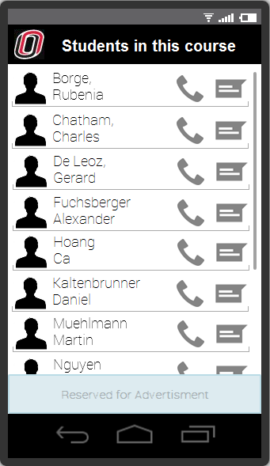
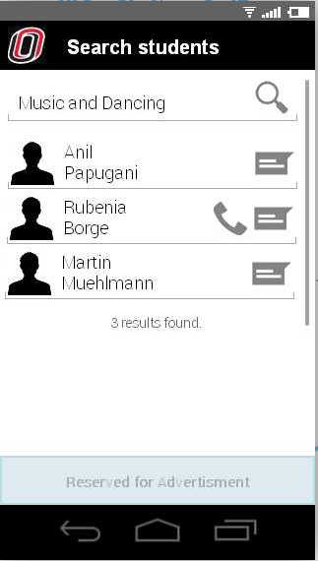
Literature Review – Social Learning
A social learning environment can be created through conversations among participants. By sharing stories, ideas, and experiences among the members of the social system, members are encouraged to learn from each other. Incorporating entertainment and education promotes educational contents (Papa et al., 2001).
Communication exchange and entertainment activities attract audience’s attention, influence audiences’ knowledge, attitude, social and behavior change (Papa et al., 2001).
Organized activities help students to have better friendship and lower loneliness. Activities involvement are opportunities for students to engage with the community and better develop their social skills (Bohnert, Aikins, & Ediline, 2007).

Slide 8
Literature Review – Users’ Preferences
“Accessibility, real-time, variety, exclusivity” (Heinonen, 2011)
Users want convenience, they want to do the minimal effort to attain something or to make a purchase. Mobile devices are convenient for quick access to information, and purchase of products anytime and anywhere. Convenience, ubiquity, localization, and personalization improve customer experience, increase customer satisfaction and customer relations (Jill, 2007).
Contextual Marketing finds who they are, where they are located, what they do. Actively understand customers and deliver a message at the appropriate time and place. This creates customer satisfaction (Xumieng & Mojtaba, 2004).
Free smartphone app supported by advertisings is preferable over a paid app with no advertisings. (Marketing Charts, 2012, supported through our survey).

Slide 9
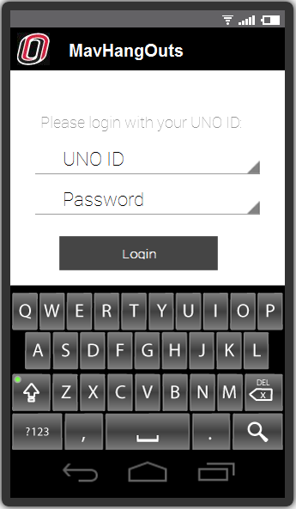
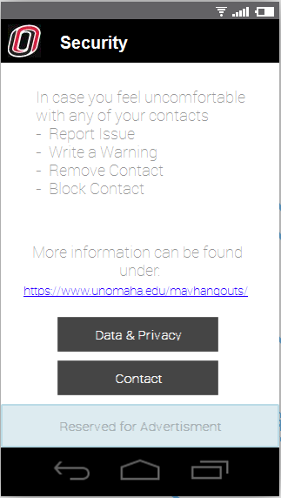
Literature Review – Successful Apps
Adapted to users, relevance for users increase the use of the app. Also, location specific information, customizable, portable. Adaptability to collect and analyze input data (Donovan, Benedicks, & Kan 2012).
Secure log in procedure and user support increase the app success (Judith & Michael, 2004).

Slide 10

Business Plan
Value Proposition
Revenue Model
Competitive Environment
Competitive Advantage
Market Strategy
Organizational Development
Management Team

Slide 11
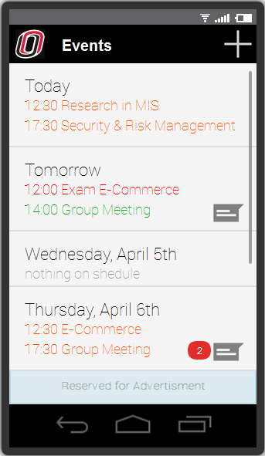
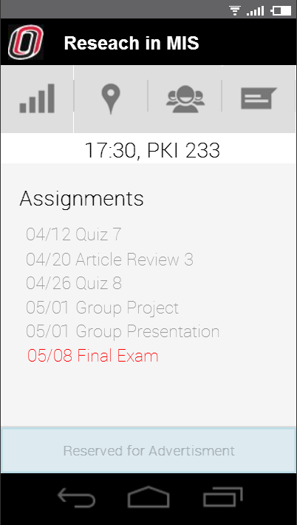
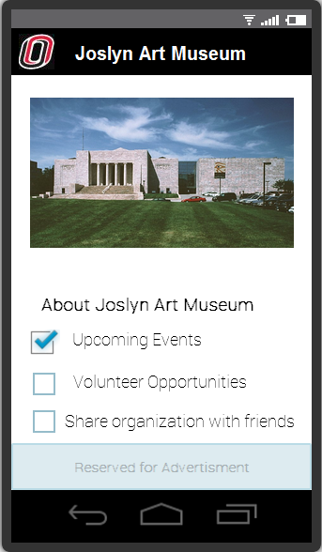
Value Proposition
“The events you want, the people you want, at the time you want”
MavHangOut is a mobile application which offers convenience for students.
Personalization is an important component of MavHangOut..
Another important feature that builds the value proposition of MavHangOut is customization.

Slide 12
Market Opportunity
Statistics
95% of UNO students have smartphones
90% of the students willing to use MavHangOut (according to survey results)
Market range
potential market range of 12,746 users
Estimated effective market range: 10,900 users (after fist year)
Potential interest of 3rd parties:
Local business & organizations
Advertisers
Other Universities

Slide 13
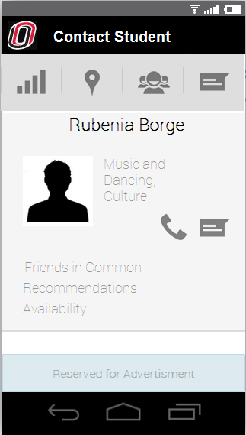
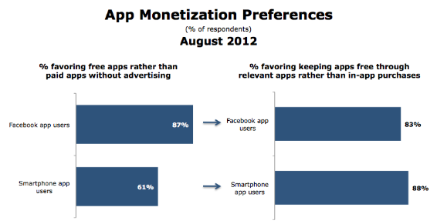
Revenue Model
We will have an advertisement-based model.
Figure 3: App monetization preferences. (Marketingcharts.com, 2012)

Slide 14
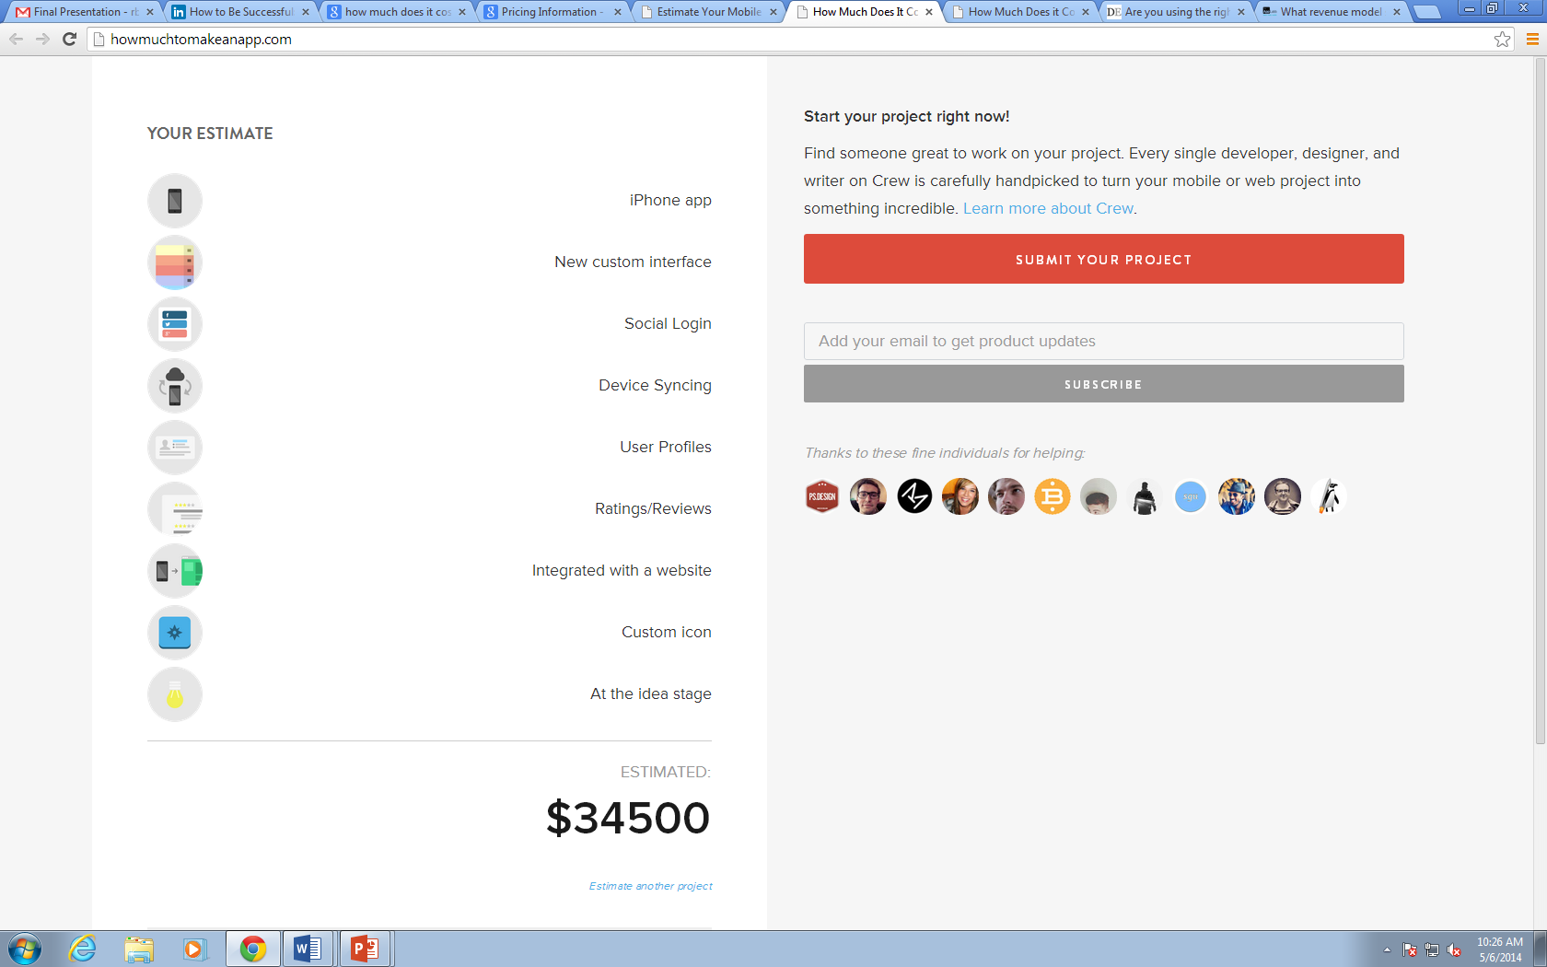
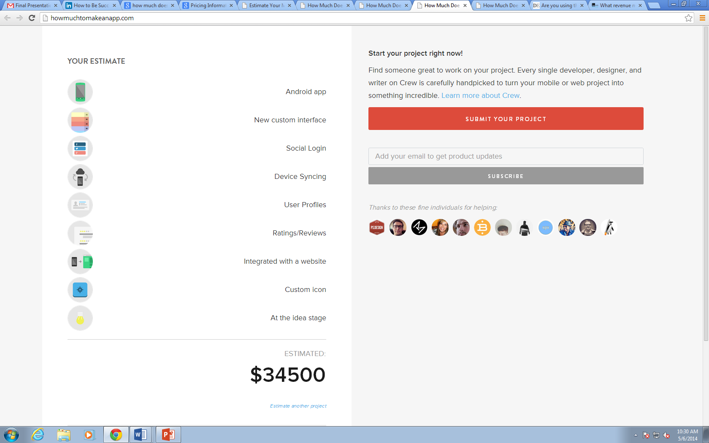
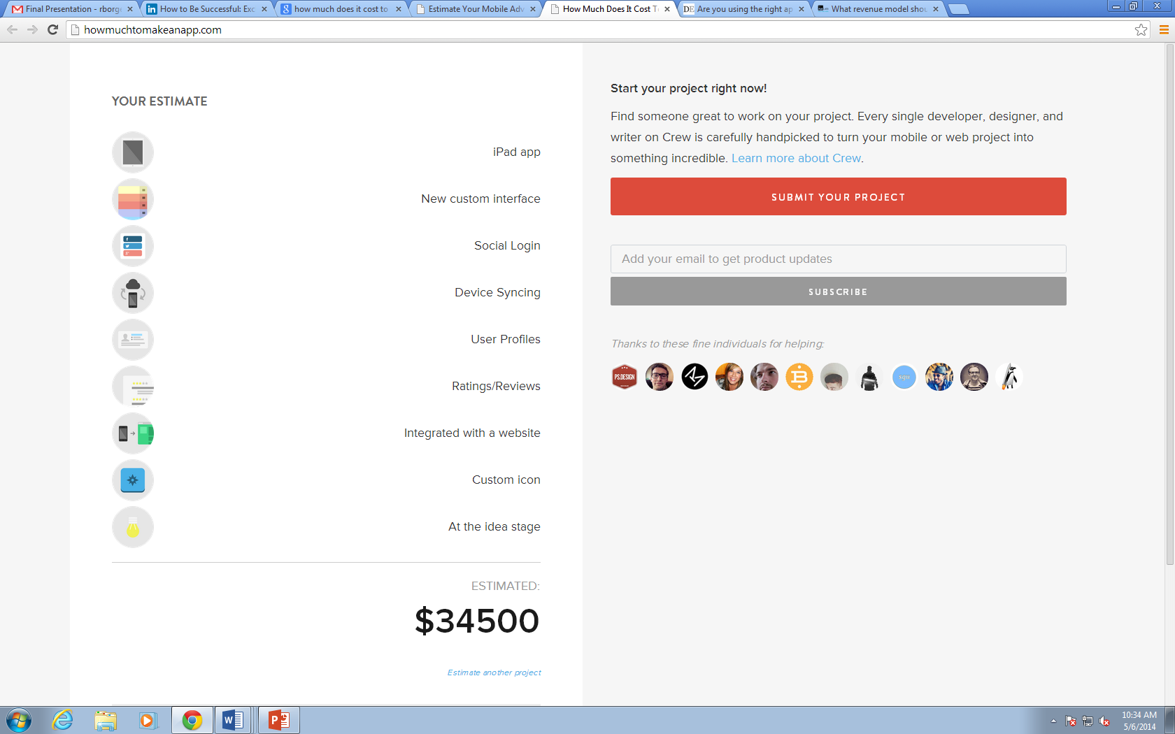
Cost Estimations –iPhone, Android, iPad

Slide 15
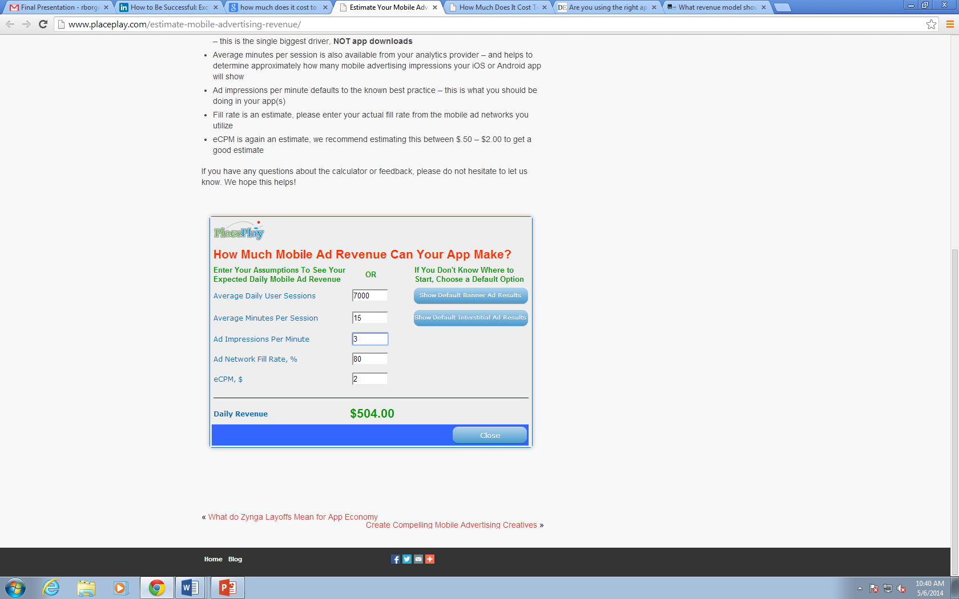
Ad Revenue Estimation
Annual Income: $180,000
 | Estimated Costs
 | 2015 | 2016 | 2017
Annual Income | 180000 | 180000 | 180000
Initial Costs
Development | 103500
Marketing | 50000
Operational Costs | 50000 | 60000 | 70000
 | -23500 | 120000 | 110000

Slide 16
Competitive Environment
Substitution services for event scheduling:
Email
Facebook
Doodle
Calls & SMS
Calendar apps (e.g. Google)
traditional calendars (physical)
Direct Competitors:
DailyMav
Maverick Weekly
MavSync
Community Engagement Center.
Substitution services for collaboration:
Email
Dropbox
SkyDrive
Google Drive
Apple Cloud
Notes:
MavSync is another tool that serves as an online community to connect students to organizations, departments, events and many other opportunities around campus

Slide 17
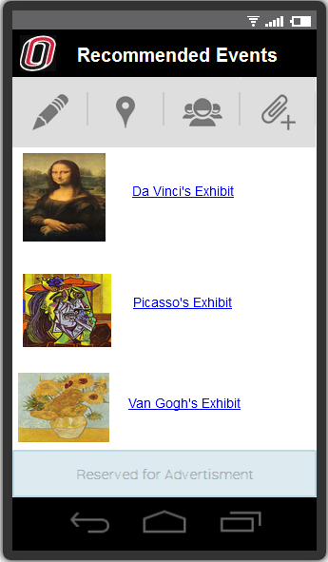
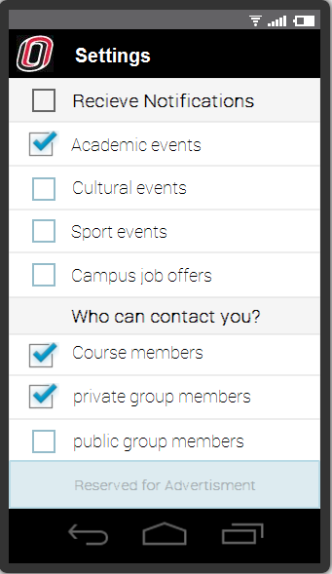
Competitive Advantage
DailyMav, MavSync, Maverick Weekly or Community Engagement Center are:
Not broadly known or used (market entrance opportunity)
Inconvenient and difficult to search for specific information
lack of personalization options
We provide a solution that
Summarizes, filters and personalizes relevant information from various sources
Is simple, convenient and practical to use

Slide 18
Market Strategy
MavHangOut will be introduced to students, UNO partner organizations and local businesses at different UNO events
Omaha World Heralds will also be reached out, along with potential local radio stations
The app will be introduced over all the internal communication channels of UNO

Slide 19
Organizational Development
Start-up company
Project Manager: Keep track of deadlines, relate the work done by all team members, update project goals, and provide a seamless flow for the project. Generate reports, summarize results, maintain the project objectives, and address team member’s needs.
Business Analyst: Professional that understands industry and customers and provide insights to improve the product.
Application Developer: Software developer, professional with knowledge and experience in mobile applications.
Tester: Information technology professional that understands the scope of the project and provides suggestions for improving the tool being developed.

Slide 20
Management Team
Our Management team includes:
Project Manager: Ca Hoang
Business Analyst: Rubenia Borge
Application Developer: Alexander Fuchsberger
Tester: Anil Papugani

Slide 21
Conclusion
Mobile apps are efficient and convenient to use. Results from the survey tells us that users expect great experiences in convenience and usability using MavHangOut mobile app. We are going to make great effort throughout every stage of the design and development process to adhere to it. Appearance and design was also given high importance. An application with great performance and integrity but poor appearance and design is not going to click with customers. Although students were quite satisfied with university website, students prefer a mobile app that is fast and convenient, which offers students better experiences in connecting with peers or friends.

Slide 22
Recommendations
To make the business plan successful, there are a few things which should be done. First of all, students should be aware of the importance of participating in social, on-campus activities. UNO can start encouraging students to balance studying and seek to join activities outside of the classroom.
Secondly, communication should be open for all stakeholders from students, faculties, organizational representatives, etc. It is very important to include the stakeholders in the development plan of MavHangOut and address stakeholders’ concerns or feedback seriously.
One year after the release of the app, an evaluation on MavHangOut should be conducted to measure students’ satisfaction.

Slide 23
References
Montgomery, S. (2014). Welcome to Maverick Weekly! http://www.unomaha.edu/news/maverick-weekly/2014/01/welcome-to-the-weekly.php
Orgsync. (2014). Community Home. https://orgsync.com/home
Papa, M. J., Singhal, A., Law, S., Pant, S., Sood, S., Rogers, E. M., & Shefner-Rogers, C. L. (December 01, 2000). Entertainment-education and social change: an analysis of parasocial interaction, social learning, collective efficacy, and paradoxical communication. Journal of Communication, 50, 4, 31-55. http://onlinelibrary.wiley.com.leo.lib.unomaha.edu/doi/10.1111/j.1460- 2466.2000.tb02862.x/pdf
The Power of Place, the Power of Partnership. (2014). http://www.unomaha.edu/community-engagement-center/
Xueming, L., & Mojtaba, S. (March 07, 2004). Contextual Marketing and Customer- Orientation Strategy for E-Commerce: An Empirical Analysis. International Journal of Electronic Commerce, 8, 2, 95-118. http://web.b.ebscohost.com.leo.lib.unomaha.edu/ehost/pdfviewer/pdfviewer?sid=b9d 984da-7a2d- 4c63-b040-07068cabe090%40sessionmgr114&vid=2&hid=113

Slide 24
References
Application Developer Alliance. (2012). Estimate Your Mobile Advertising Revenue. http://devsbuild.it/resources/type/serviceproduct/estimate-your-mobile-advertising-revenue
Bohnert, A. M., Aikins, J. W., & Edidin, J. (January 01, 2007). The Role of Organized Activities in Facilitating Social Adaptation across the Transition to College. Journal of Adolescent Research, 22, 2, 189-208. http://jar.sagepub.com.leo.lib.unomaha.edu/content/22/2/189.full.pdf+html
DailyMav. (2014). Daily Deals on the Best in Omaha. http://dailymav.getsocio.com/deals
Donovan, M., Benedicks, R., & Kang, P. (November 01, 2012). Insight into performance improvement in action: Inspiration from mobile apps. Performance Improvement, 51, 10, 5-11. http://web.b.ebscohost.com.leo.lib.unomaha.edu/ehost/detail?sid=72f0d584-db7a- 43b0-b537- 16fe6c502603%40sessionmgr111&vid=1&hid=117&bdata=JnNpdGU9ZWhvc3QtbGl2Z Q%3d%3d#db=bth&AN=83583702

Slide 25
References
Heinonen, K. (2011). Consumer activity in social media: Managerial approaches to consumers' social media behavior. Journal of Consumer Behaviour, 10(6), 356-364. doi:10.1002/cb.376 http://web.b.ebscohost.com.leo.lib.unomaha.edu/ehost/pdfviewer/pdfviewer?sid=4d93f25 6-5da1-4ff9-b4f2-ff3571709edf%40sessionmgr110&vid=2&hid=113
Jil, W.-J. K. (October 01, 2007). Effects of Consumer-Perceived Convenience on Shopping Intention in Mobile Commerce: An Empirical study. International Journal of E-Business Research, 3, 4, 3348. http://search.proquest.com.leo.lib.unomaha.edu/docview/222324323?accountid=14692
Lawrence, A. (2012). Five Customer Tips for Entrepreneur. Forbes. http://www.forbes.com/sites/alexlawrence/2012/11/01/five-customer-retention-tips-for-entrepreneurs/
Marketing Charts. (2012). App Users Prefer Theme Free, Interactive Ad-Supported. http://www.marketingcharts.com/wp/online/app-users-prefer-them-free-interactive-ad-supported-23004/

Slide 26
References
Judith, G., & Michael, J. S. (June 06, 2004). Success Factors and Impacts of Mobile Business Applications: Results from a Mobile e-Procurement Study. International Journal of Electronic Commerce, 8, 3, 19-41 http://web.b.ebscohost.com.leo.lib.unomaha.edu/ehost/pdfviewer/pdfviewer?sid=b59fb563-8791-43fd-a4c6-1e2d5d02f494%40sessionmgr111&vid=2&hid=113
Laudon, Kenneth C, and Carol Guercio.Traver. E-commerce: Business, Technology, Society. Boston, Mass.: Pearson, 2014.Print
Robyn Long, Centennial Fellow, Community Engagement Center. Personal interview. April 24th 2014.

Slide 27
Thank you!

