Slide 1



KaggleX- Showcase Template
Notes:
Recommending picking out he most interesting and important parts from your documentation.

Slide 2
Exploratory Data Analysis in Python
Rubenia Borge

Slide 3
Exploratory Data Analysis

Slide 4
Background
Computer Science PhD student
I have been working on data mining and data modeling during my PhD.

Slide 5
Project Definition
I present a project in Exploratory Data Analysis for a classification dataset.
During my practice as a Kaggle BIPOC mentee I also studied Neural Networks so I will talk about that experience, too.
I learned to explore, process and visualize data for analysis. I also gained experience with the data science libraries, NumPy, Matplotlib, and in these months I got to practice more Python, Keras, and TensorFlow.

Slide 6
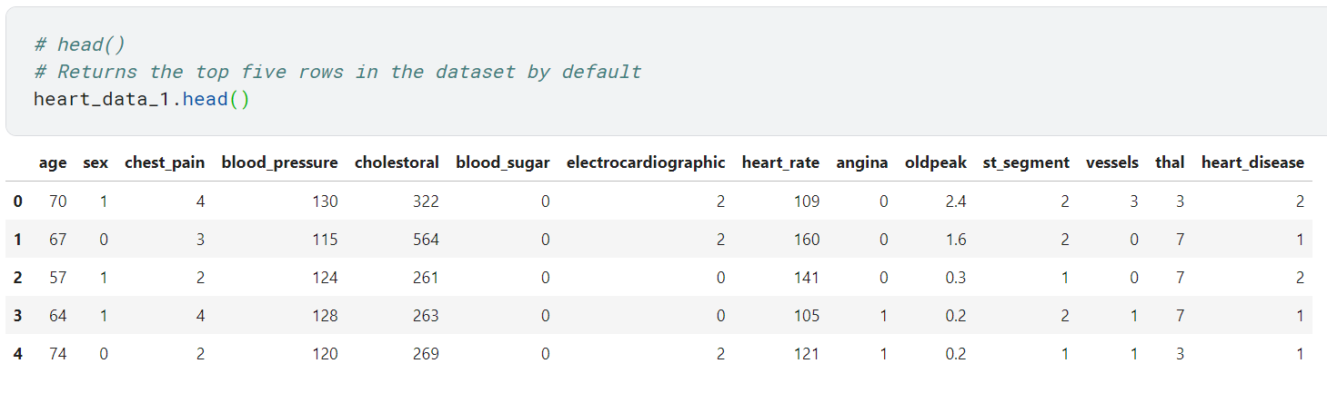
View Data Values

Slide 7
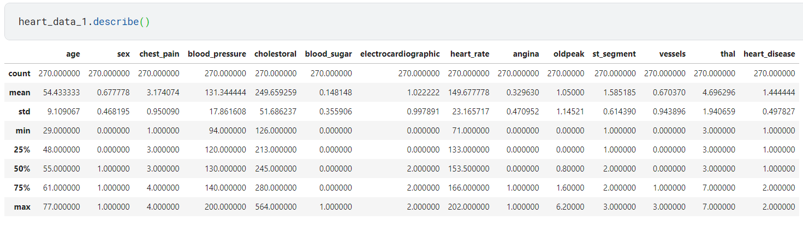
Descriptive Summary of Data

Slide 8
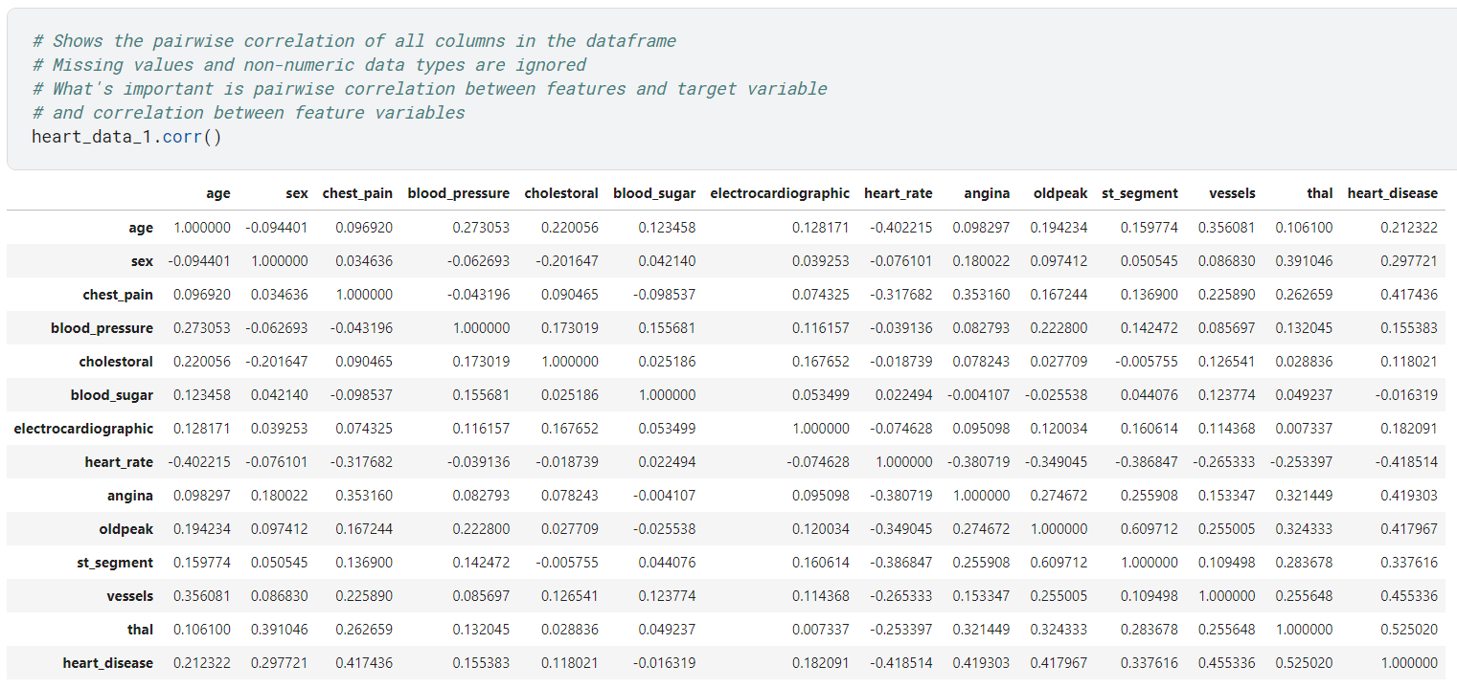
Pairwise Correlation in Data

Slide 9
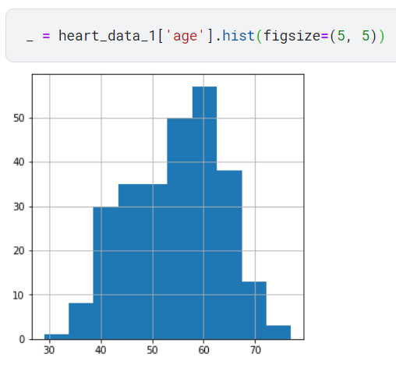
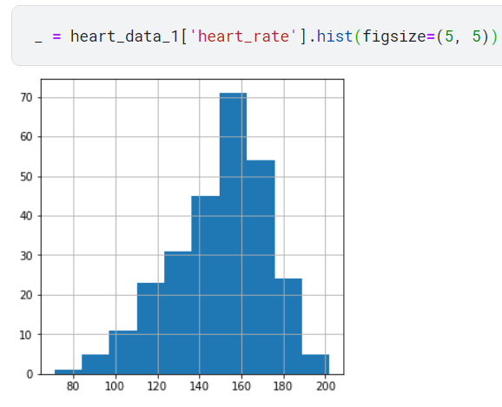
Distribution of Numerical Data

Slide 10
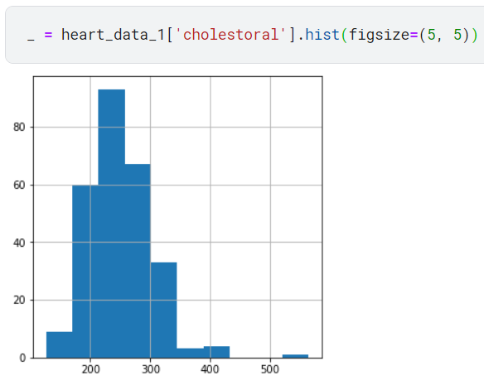
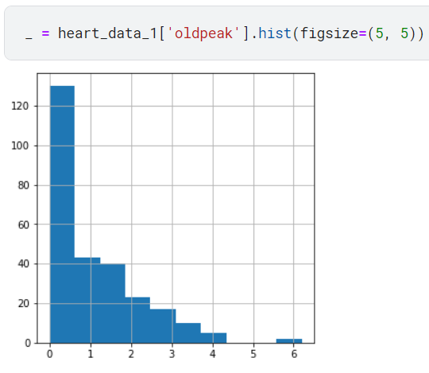
Distribution of Numerical Data

Slide 11
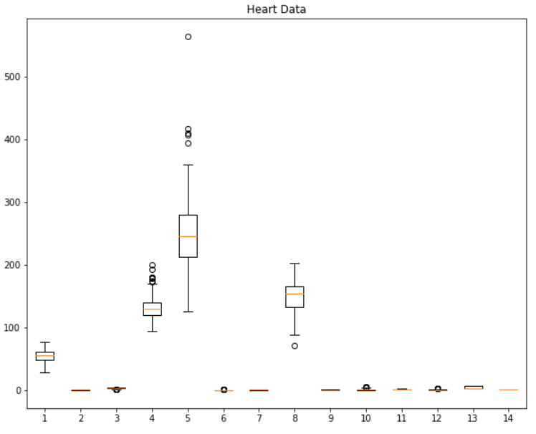
Boxplot

Slide 12
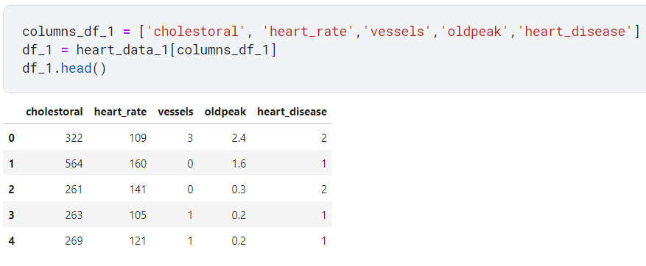
Smaller Dataset

Slide 13
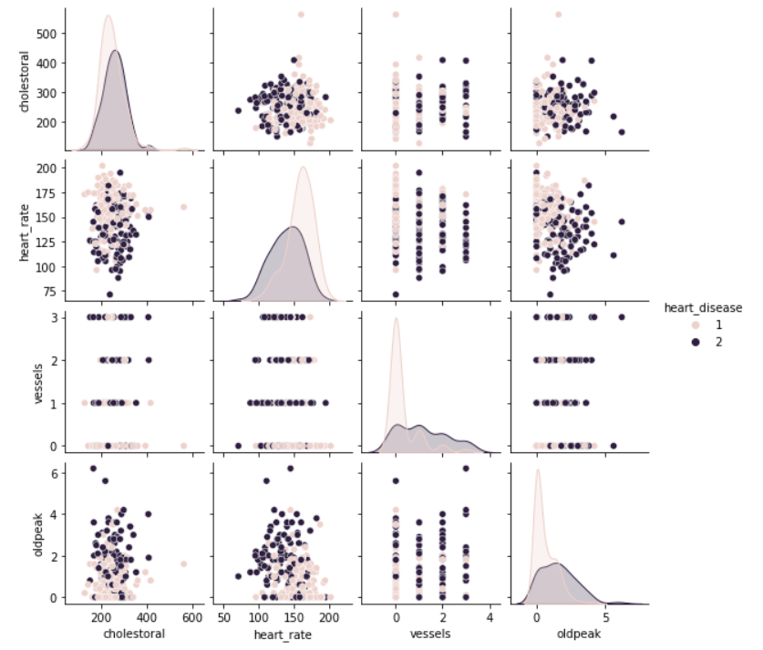
Pairwise Correlation

Slide 14
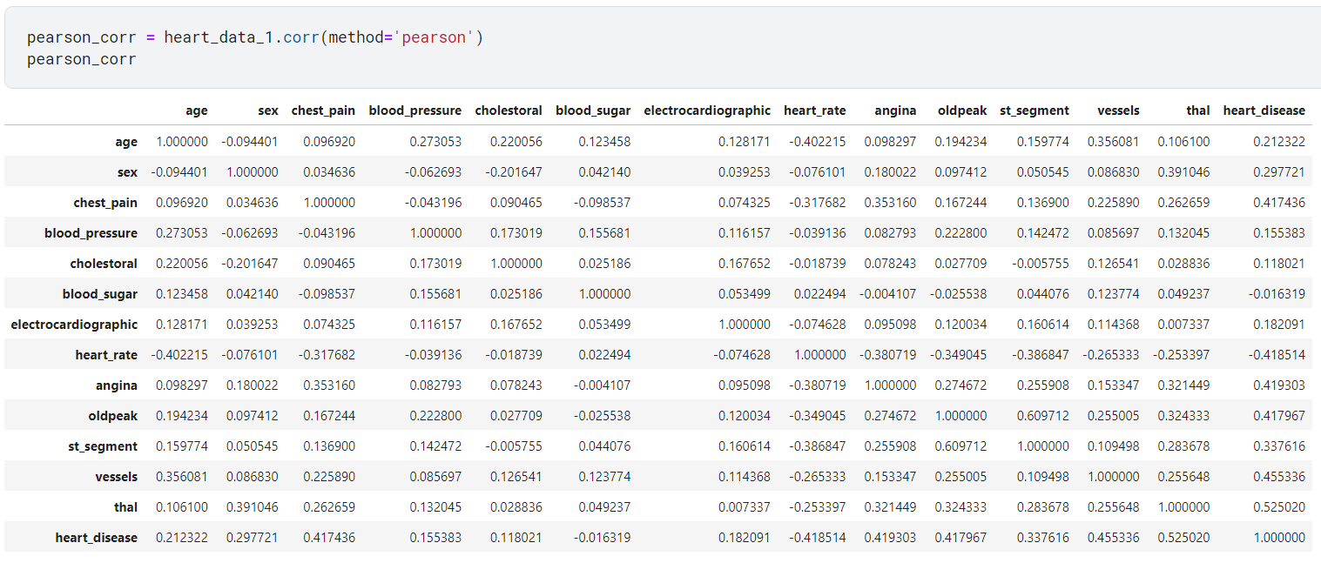
Pearson Correlation

Slide 15
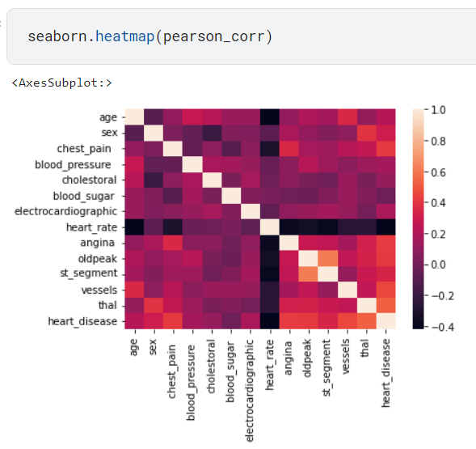
Pearson Correlation

Slide 16
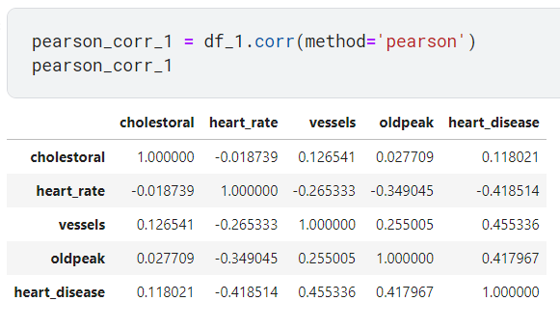
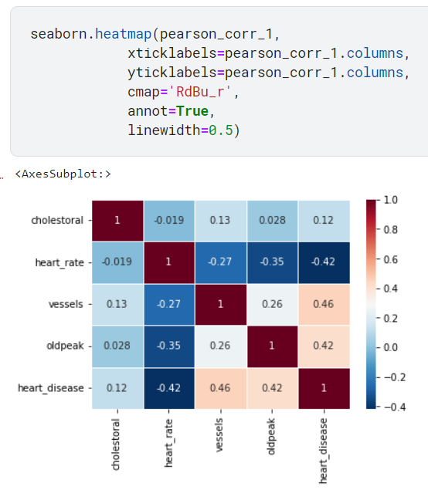
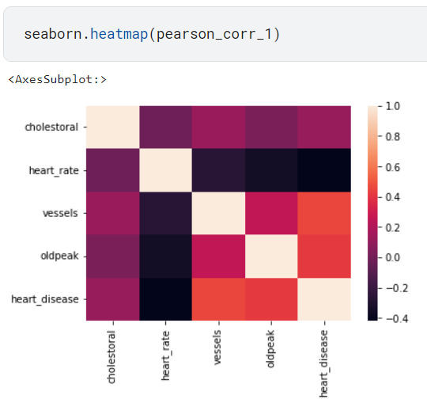
Pearson Correlation

Slide 17
Introduction to Artificial Neural Networks

Slide 18
The Perceptron Algorithm
PERCEPTRON
Input Vector
Weights Vector
Weighted Sum
Activation Function
Output

Slide 19
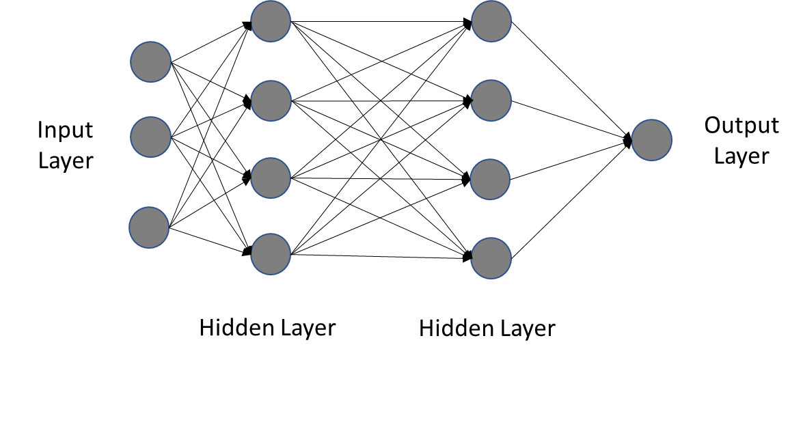
Artificial Neural Networks
Input Layer
Output Layer
Hidden Layer
Hidden Layer

Slide 20
Code

Slide 21
Links to Code and Dataset
Dataset
https://archive.ics.uci.edu/ml/datasets/heart+disease
Exploratory Data Analysis
https://github.com/Rubenia-Borge/kaggle_practice/blob/main/exploratory-analysis-heart-data.ipynb
The Perceptron Algorithm
https://github.com/Rubenia-Borge/kaggle_practice/blob/main/perceptron-algorithm.ipynb

